Slide 1
STA 311 Statistical Computing & Data Management
Instructor: Cheng Peng, Ph.D.
Department of Mathematics
West Chester University
West Chester, PA 19383
Office: 25 University Avenue, RM 111
Phone: 610.436.2369
Email: cpeng@wcupa.edu

Slide 2
Topics
Review: Input Styles, OPTIONS, LENGTH, FORMAT/INFORMAT, etc.
SET statement – Reading existing SAS data sets
Reading in other format data generated from other applications- WIZARD
Reading in data from other applications – PROC INPORT.
Export SAS data set to a CSV file

Slide 3
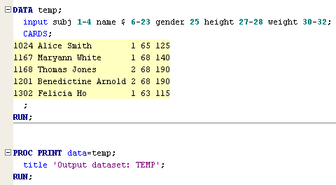
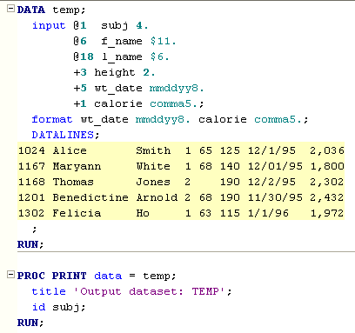
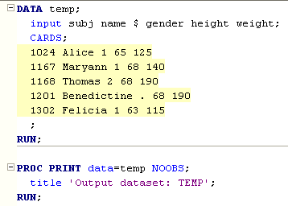
Three Basic Input Styles: Examples
Formatted Input
Column input
List Input

Slide 4
Formats and Informats of SAS Variables
Informats is used to tell SAS how to read a variable whereas Formats is used to tell SAS how to display or write values of a variable.
Informats is basically used when you read or import data from either an external file (Text/Excel/CSV) or read in sample data which was created using CARDS/DATALINES statement. It is also used when you create a new variable in a dataset.
Formats can be used in both Data Steps and PROC Steps whereas Informat can be used only in Data Steps.

Slide 5
Setting the Length of a Variable
The default length for character and numeric variables is 8 bytes in SAS.
SAS uses exactly one byte for one character! This means that if the value of a character variable has more than 8 characters, SAS only keeps the first 8 characters (including the white space if any) and truncate the rest.
However, for a numeric variable SAS variable, 8 bytes can store a number with up to 16 digits. In other words, the default length of numeric variable is 16 digits.
It is important to note that the minimum length of a numeric is 3 bytes. It does not mean it cannot store a numeric value lower than 3 digits. It can store values of 1 or 2 digits.
The maximum length of any character value in SAS is 32,767 bytes!

Slide 6
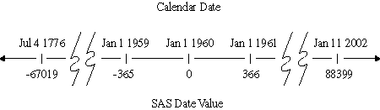
A First Glance of SAS Dates: Value and Formats
A SAS date is stored as a numerical value - 1/1/1960 00:00:00 as ZERO
A SAS Date has different formats, so does SAS time!

Slide 7
Summary: SAS Data Sets
SAS Data Set - a binary formatted representation of the input data set stored in such a way that future SAS programs do not need to input the data in again.
Temporary SAS Data Sets - created and remain in working memory for the SAS session, but disappear when the SAS session ends. Fine for small to moderate size, simple input programs.
Permanent SAS Data Sets - created in one SAS session but stored on disk for later reuse. Convenient for large or complex input data sets that may require multiple analysis steps. Reduces time and computer resources.
LIBNAME statement - identifies to the SAS program where the previously created SAS data set is located.

Slide 8
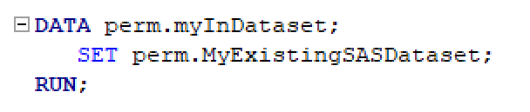
Reading in Existing SAS Data Sets
Reading a single existing SAS data set using SET Statement
A Comparison between INPUT and SET
SET reads an observation from an existing SAS data set.
INPUT reads raw data from an external file (with INFILE statement) or from in-stream data lines (with DATALINES) in order to create SAS variables and observations.

Slide 9
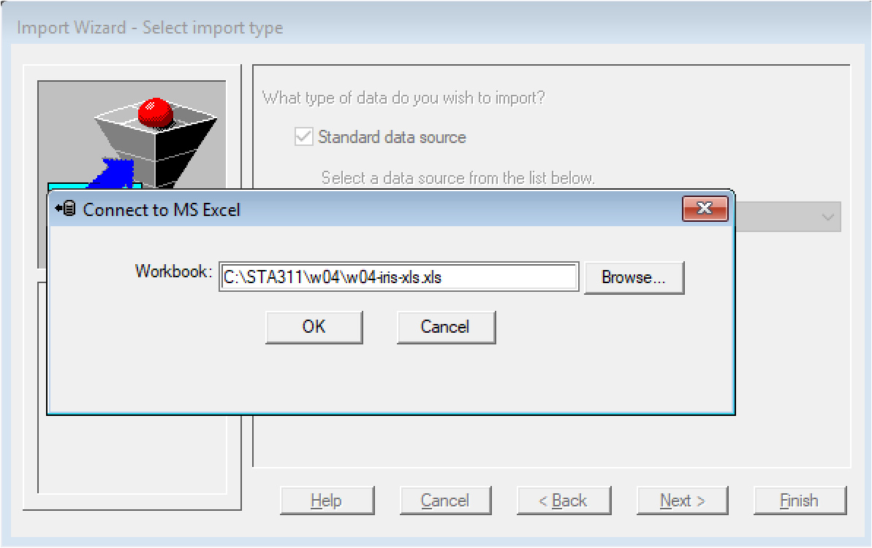
Create SAS Data Sets from Other Applications: Locating the xls File

Slide 10
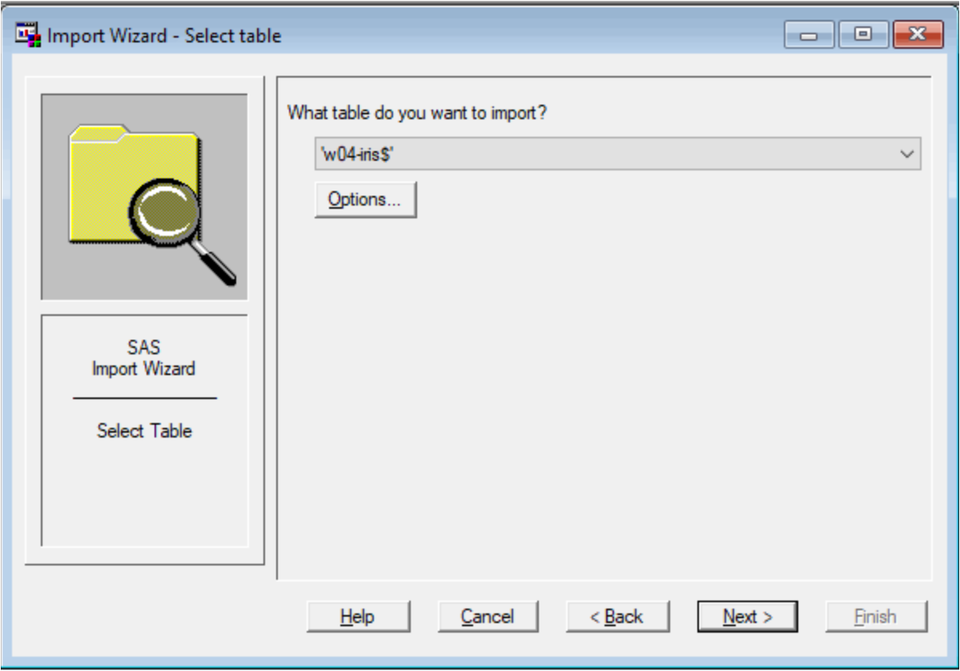
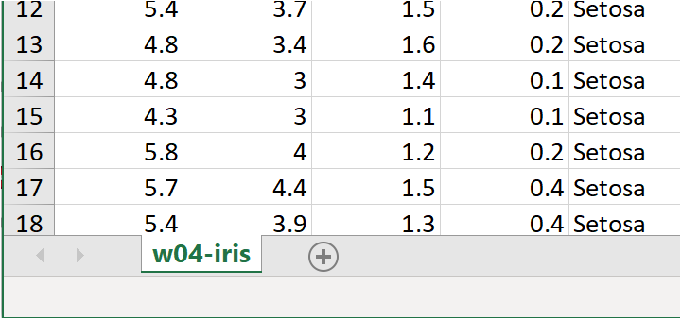
Create SAS Data Sets from Other Applications: Specifying tab in xls File

Slide 11
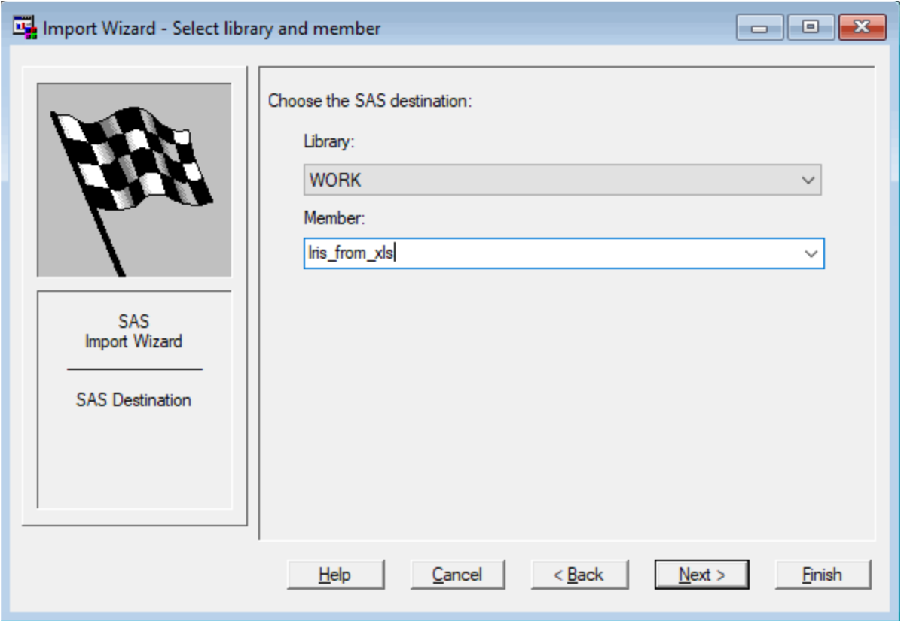
Create SAS Data Sets from Other Applications: Save SAS Data Set
Name the
sas data set
Click next to generate an SAS code
that duplicates this manual process

Slide 12
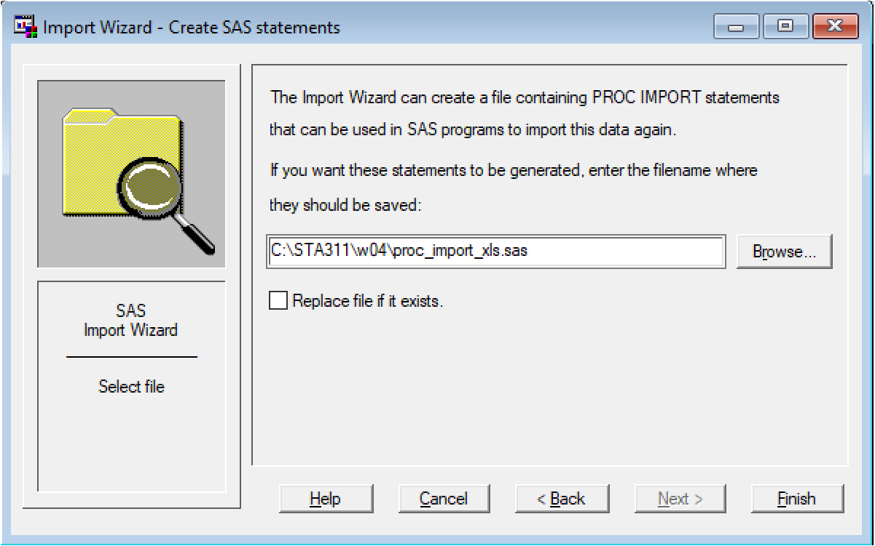
Create SAS Data Sets from Other Applications: Save SAS Data Set
The physical location to
save the SAS code.
Click Finish to generate
both SAS code and SAS data set

Slide 13
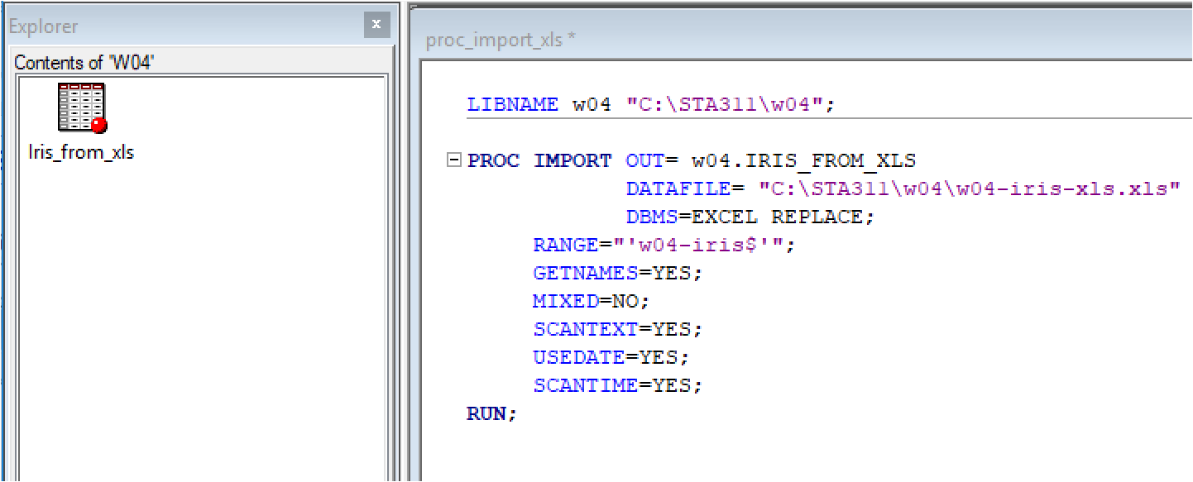
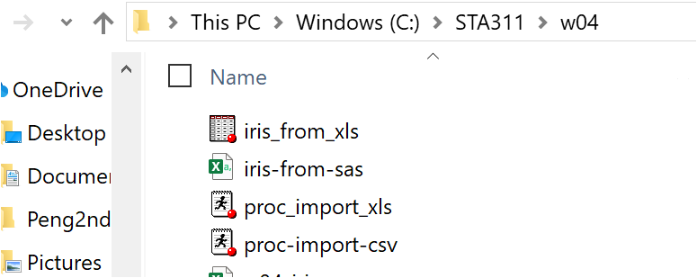
Create SAS Data Sets from Other Applications: Save SAS Data Set

Slide 14
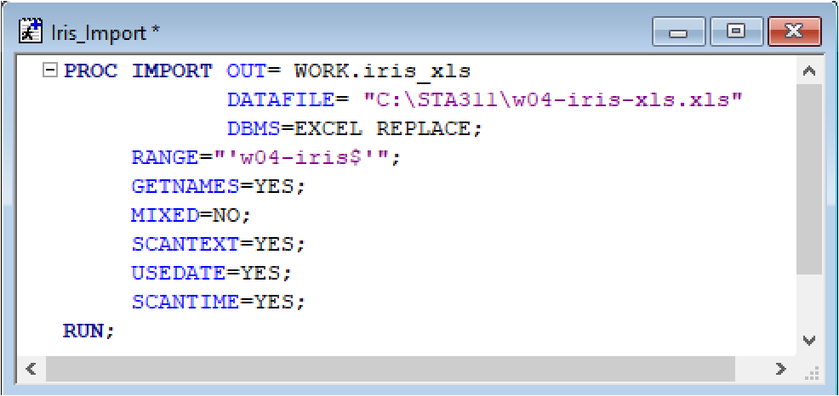
SAS Generated PROC IMPORT Code

Slide 15
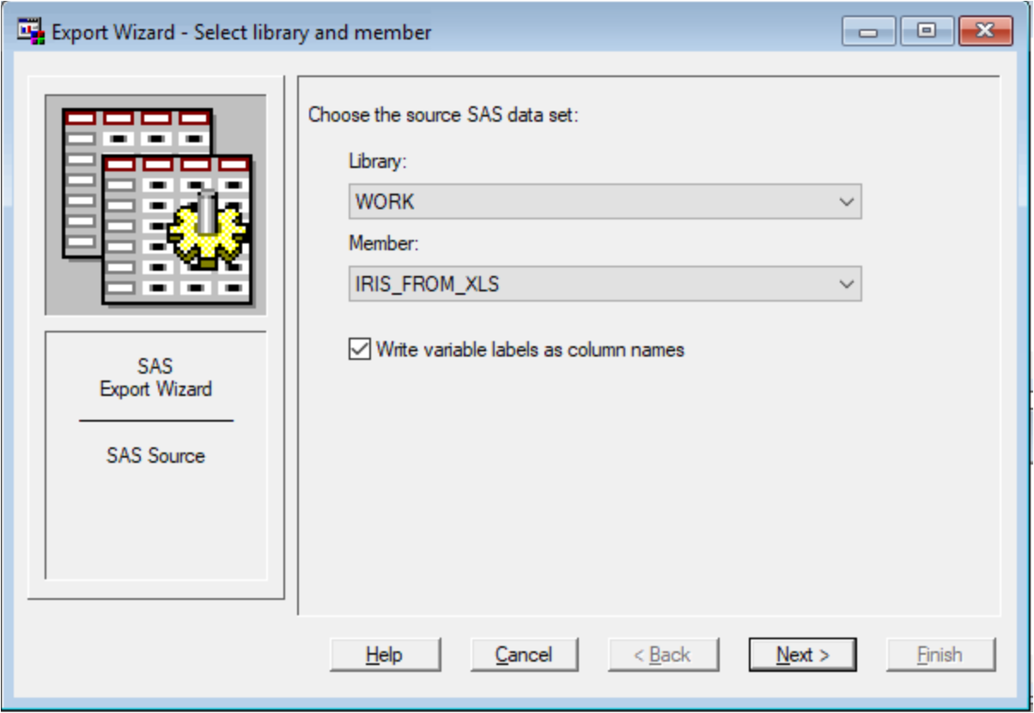
Export SAS Data in CSV File

Slide 16
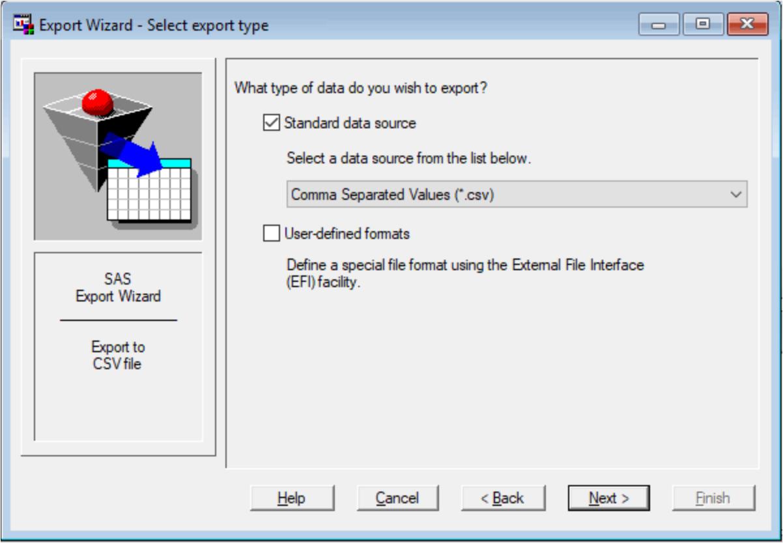
Export SAS Data in CSV File

Slide 17
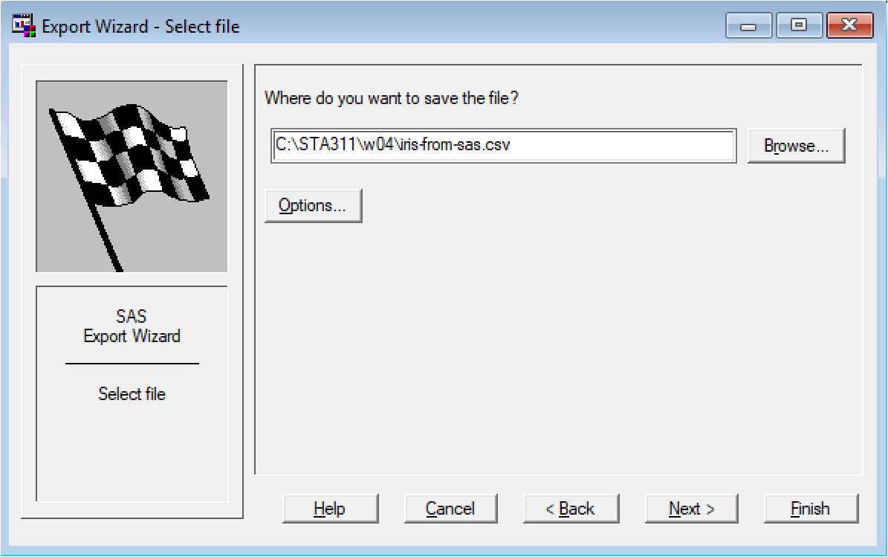
Export SAS Data in CSV File
Click Finish to generate the csv file
Click Finish to generate
the SAS code PROC EXPORT

Slide 18
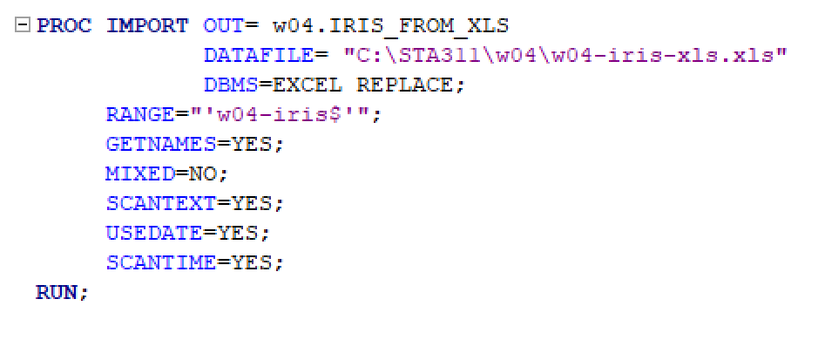
SAS Generated PROC EXPORT

Slide 19
Input Wizard v.s. PROC IMPORT/EXPORT
If you occasionally load a few data files, there is no difference between input Wizard and PROC IMPORT/EXPORT.
However,
If you work in a data-rich environment in industries such as financial services, healthcare, medicine, transportation, pharmaceutical companies, and some government sectors, you may have to deal with hundreds or thousands of files or streaming data sources. The input/output wizard approach is not a feasible choice. Using PROC IMPORT/EXPORT can automate your manual work!

Slide 20
A Piece of Advice on Output Data
You may not have control over the format of input data. But you have the full control over the output data formats.
Unless you are asked to output data in a specific format, you should always export your SAS data set in CSV format.

