Slide 1
STA 311 Statistical Computing and Data Management
Instructor: Cheng Peng, Ph.D.
Department of Mathematics
West Chester University
West Chester, PA 19383
Office: 25 University Avenue, RM 111
Phone: 610-435-2369
Email: cheng.peng@maine.edu

Slide 2
Computing Univariate Statistics
Review of Descriptive Statistics
PROC MEANS
PROC FREQ
PROC UNIVARIATE

Slide 3
Computing Univariate Statistics
What we have learned from Introduction to Statistics
Basic Concepts of Statistics
Summarizing Data
Probability
Confidence Intervals
Hypothesis Testing - Means & Proportions

Slide 4
Basic Statistics
Continuous Variables
Measures of Central Tendency
Median
Mean
Graphs
Histograms
Scatter Plots
Measures of Dispersion
Interquartile Range (IQR)
Variance
Standard Deviation (SD)
Two Continuous Variables
Correlation
Regression

Slide 5
Basic Statistics
Categorical Variables
Descriptive Statistics
Counts
Proportions
Graphs
Bar charts
Pie charts

Slide 6
Basic Statistics SAS PROCs
SAS procedures MEANS, UNIVARITE and FREQ produce much more than what are covered in Introductory Statistics
1. Continuous variable
mean, variance, standard deviation, median, mode, upper quartile, lower quartile, percentiles, skewness, kurtosis, number of missing observations.
2. Classification variable
Frequency in each category, relative frequency.

Slide 7
Several Options of Descriptive Statistics
N Number of observations with non-missing values
Sum Wgts Sum of weights = N unless a weighted analysis is requested
Mean Arithmetic average
Sum Total of all values
Std Dev Sample standard deviation
Variance Sample variance
CV Coefficient of variation =
(standard deviation divided by mean) times 100
Std Mean Standard error of the mean =
standard deviation/(square root of N)

Slide 8
Sum of Squares
USS Uncorrected sum of squares =
sum of the squared values of the observations
CSS Corrected sum of squares =
sum of the squares of the differences between the observations and their mean.
Num ≠ 0 the number of observations not equal to zero.
Num > 0 the number of observations greater than zero.

Slide 9
Skewness
The skewness is a measure of the tendency of the deviations from the mean to be larger in one direction than in the other. The sample skewness is calculated as:
Negative values of μ₃ indicate skewness to the right.
Positive values of μ₃ indicate skewness to the left.
The normal and t distributions have zero skewness.

Slide 10
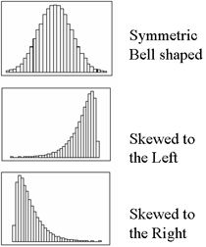
Skewness

Slide 11
Test Statistics
T: Mean=0 t-test statistic for testing whether the population average is zero.
This is often used for paired t-tests in which one examines whether the difference between two measurements on the same experimental unit is different from zero.
Pr > |T| P-value for a two-tailed t-test of whether the population average is zero.
Low P-values provide evidence that the population mean is not zero.

Slide 12
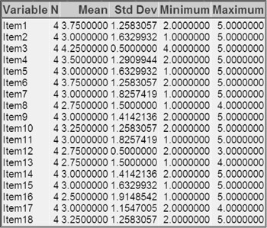
PROC MEANS Syntax
The MEANS procedure provides descriptive statistics such as the mean, minimum, and maximum provide useful information about numeric data.
Procedure Syntax
PROC MEANS <DATA=SAS-data-set>
<statistic-keyword(s)> <option(s)>;
RUN;
Where
SAS-data-set is the name of the data set to be used
statistic-keyword(s) specify the statistics to compute
option(s) control the content, analysis, and appearance
Example
proc means data=perm.survey;
run;

Slide 13
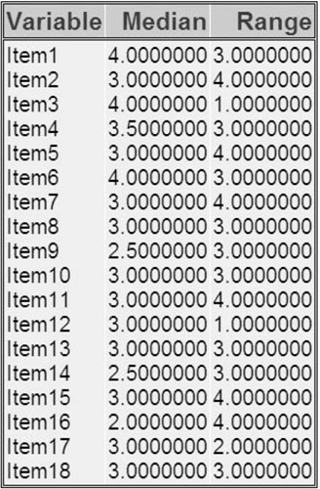
PROC MEANS Example
Selecting Statistics
Consider that you want to see the median and range of Perm. Survey numeric values, add the MEDIAN and RANGE keywords as options.
Example
proc means data=perm.survey median range;
run;
The following keywords can be used with PROC
MEANS to compute statistics:
Keyword | Description
MAX | Maximum value
MEAN | Average
MODE | Value that occurs most frequently
MIN | Minimum value
VAR | Variance

Slide 14
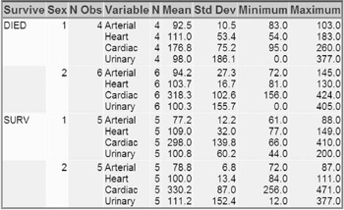
PROC MEANS: CLASS Statement
Group Processing Using the CLASS Statement
To produce separate analyses of grouped observations, add a CLASS statement to the MEANS procedure. General form, CLASS statement:
CLASS variable(s);
where variable(s) specifies category variables
for group processing.
CLASS variables can be either character or
numeric, but they should contain a limited
number of discrete values that represent
meaningful groupings.
Example
proc means data = clinic.heart maxdec=1;
var arterial heart cardiac urinary;
class survive sex;
run;

Slide 15
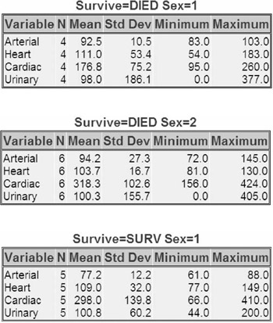
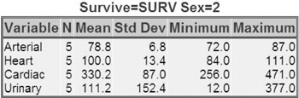
PROC MEANS: BY Statement
When using the BY statement, you must SORT the data by the variable to be used in the BY statement!
proc sort data=clinic.heart out=work.heartsort;
by survive sex;
run;
proc means data= work.heartsort
maxdec=1;
var arterial heart cardiac
urinary;
by survive sex;
run;

Slide 16


PROC MEANS: OUTPUT Statement
Specifying the STATISTIC= Option
You can specify which statistics to produce in the output data set. To do so, you must specify the statistic and then list all of the variables. The variables must be listed in the same order as in the VAR statement. You can specify more than one statistic in the OUTPUT statement.
PROC MEANS in SAS LIST WINDOW
proc means data=clinic.diabetes;
class sex;
var age height weight;
output out=work.sum_gender
mean=AvgAge AvgHeight AvgWeight
min=MinAge MinHeight MinWeight;
run;
To see the contents of the output data set,
submit the following PROC PRINT step.
PROC MEANS OUTPUT TO SAS DATASET

Slide 17
PROC FREQ: Basics
The FREQ procedure is a descriptive procedure as well as a statistical procedure. It produces one-way and n-way frequency tables.
You can use the FREQ procedure to create cross-tabulation tables that summarize data for two or more categorical variables by showing the number of observations for each combination of variable values.
General form, basic FREQ procedure:
PROC FREQ <DATA=SAS-data-set>;
RUN;
By default, PROC FREQ creates a one-way table with the frequency, percent, cumulative frequency, and cumulative percent of every value of all variables in a data set.

Slide 18
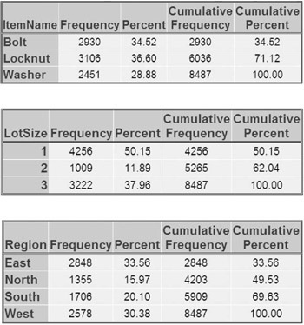
PROC FREQ: Example- Frequency Table
For example, the following FREQ procedure creates a frequency table for each variable in the data set Parts. Widgets. All the unique values are shown for ItemName, LotSize, and Region.
proc freq data=parts.widgets;
run;
To create a frequency table for a specific variable, use TABLE statement,
proc freq data=parts.widgets;
TABLE Region;
run;

Slide 19
PROC FREQ: Cross-tabulation Syntax
Creating Two-Way Tables
It is often helpful to crosstabulate frequencies with the values of other variables. For example, census data is typically crosstabulated with a variable that represents geographical regions.
Syntax
TABLES variable-1 *variable-2 <* ... variable-n>;
variable-1 specifies table rows and variable-2 specifies table columns.
When crosstabulations are specified, PROC FREQ produces tables with cells that contain
column cell frequency
cell percentage of total frequency
cell percentage of row frequency
cell percentage of frequency.
We will revisit this two-way table later this semester with examples!

Slide 20
PROC UNIVARIATE: Syntax
PROC UNIVARIATE produces descriptive statistics on continuous variables just like proc means, but many more of them, and also can produce some univariate plots.
Useful in so many ways
-Instant(near-instant) analysis of large data sets
-Can manipulate variables for relational comparison
-Can provide hard-proof for QA flags
-Can view in SAS or easily output to Excel (Word, PDF)
-Easily Isolate outliers

Slide 21
PROC UNIVARIATE: Syntax
PROC UNIVARIATE DATA= SASdataset
PLOTS
FREQ
NORMAL
PCTLDEF= value
MU0= value value ... ;
BY var-1 ... var-n;
CLASS var-1 ... var-n;
VAR variables;
FREQ variable;
HISTOGRAM < variable(s) >;
PROBPLOT < variable(s) >;
QQPLOT < variable(s) > ;
OUTPUT OUT= SASdataset keyword= names...;
RUN;

Slide 22
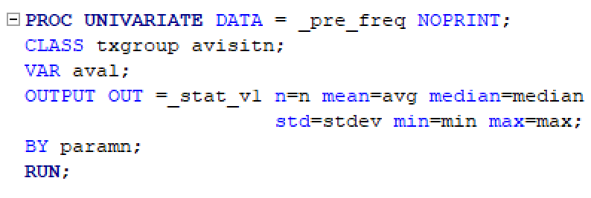
PROC UNIVARIATE: Example
Below is a basic example of a PROC UNIVARIATE outputting to a new dataset _STAT_V1. Note that the data had been previously sorted by PARAMN,TXGROUP and AVISITN.

