Slide 1
Relational databases & SQL
Cheng Peng

Slide 2
Brief Topics
DBMS and define its components.
DBMS architecture and its levels.
Database models and schemas.
Relational database operations on a relation.
Database query language.

Slide 3
Understand a DBMS and define its components
Database – a collection of logically coherent data tables.
DBMS – Database Management System
defines, creates, and maintains a database.
allows users-controlled access to data in the database.
has 5 components: Hardware, Software, Data, Users, Procedures

Slide 4
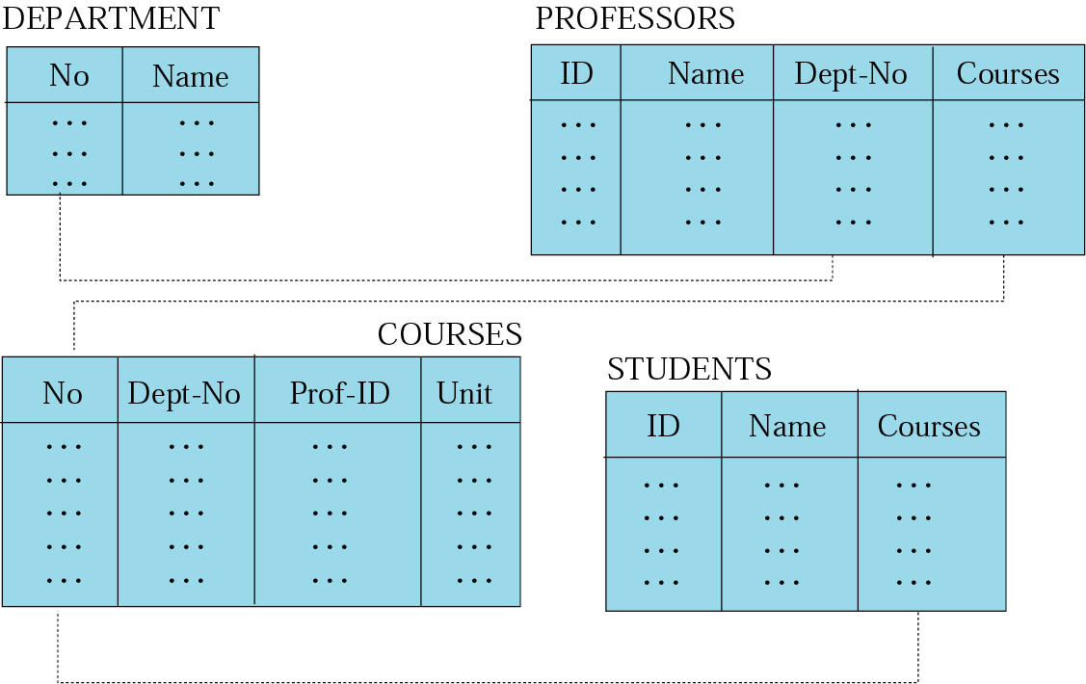
relational model
Data are organized in two-dimensional tables called relations.
The tables are related to each other.
The most popular model.

Slide 5
Relational database: schemas
A database schema - the “blueprint” of a database
o describes the relation to other tables or other data models.
o does not actually contain data.
A data instance - sample of data from a database at a
single moment in time.
o contains all the properties described in schema.
o is just a snapshot at a given moment.
o changes over time, unlike database schemas.

Slide 6
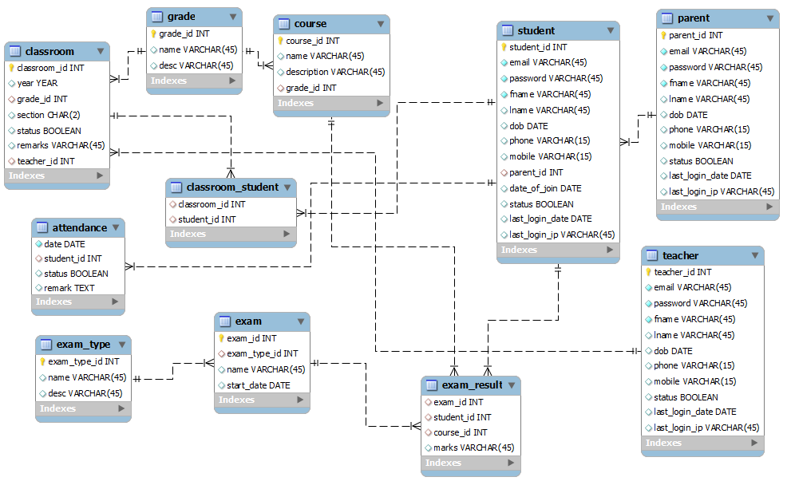
Relational database: schemas

Slide 7
Relational model
RDBMS (Relational Database Management System)
External View
o The data are represented as a set of relations.
o A relation is a two-dimensional table.
This doesn’t mean that data are stored as tables!
o The independence of physical storage and logical organization.

Slide 8
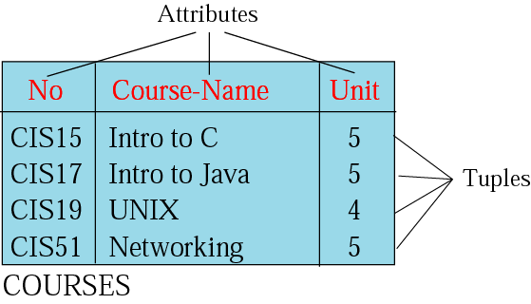
Relation
Name – unique among relations.
Attribute – column in a relation.
o degree– number of attributes.
Tuple –row in a relation.
o cardinality – number of rows.

Slide 9
Operations on relations
In a relational database, we can define several operations to create new relations out of the existing ones.
Basic operations:
Insert Delete Update Select Project Join Union Intersection Difference

Slide 10
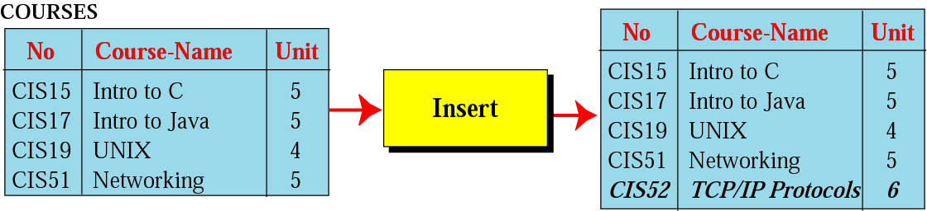
Insert operation
A unary operation.
Insert a new tuple into the relation.

Slide 11
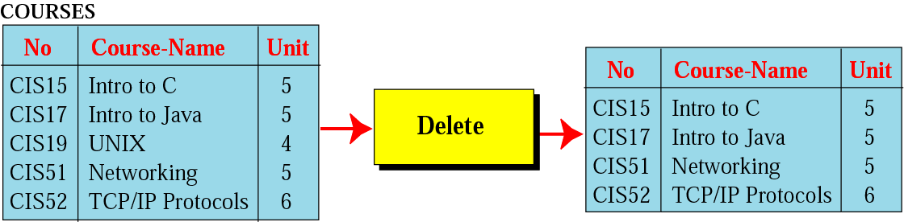
Delete operation
A unary operation.
Delete a tuple defined by a criterion from the relation.

Slide 12
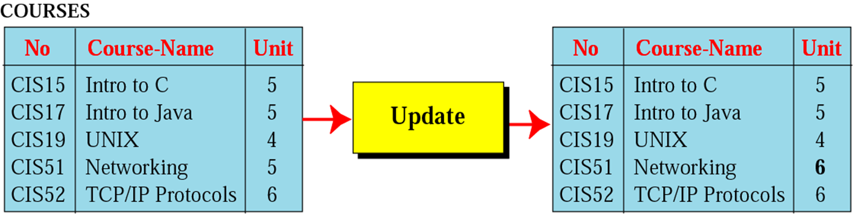
Update operation
A unary operation.
Changes the value of some attributes of a tuple.

Slide 13
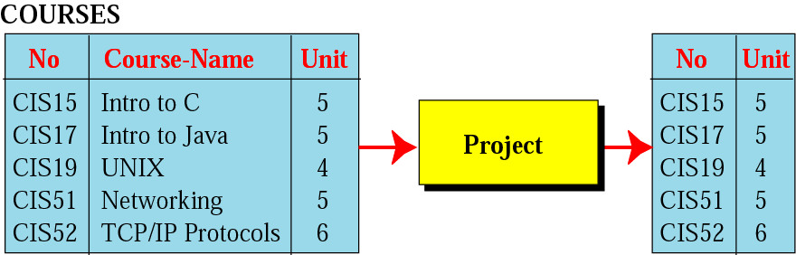
Project operation
A unary operation.
applied to one single relation
creates another relation with less attributes.

Slide 14
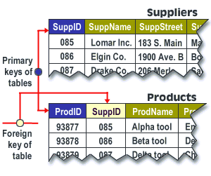
Primary and Foreign Keys
The primary key uniquely identifies each record in the table. It is a column, or set of columns,
A foreign key is a field in a relational table that matches the primary key column of another table.

Slide 15
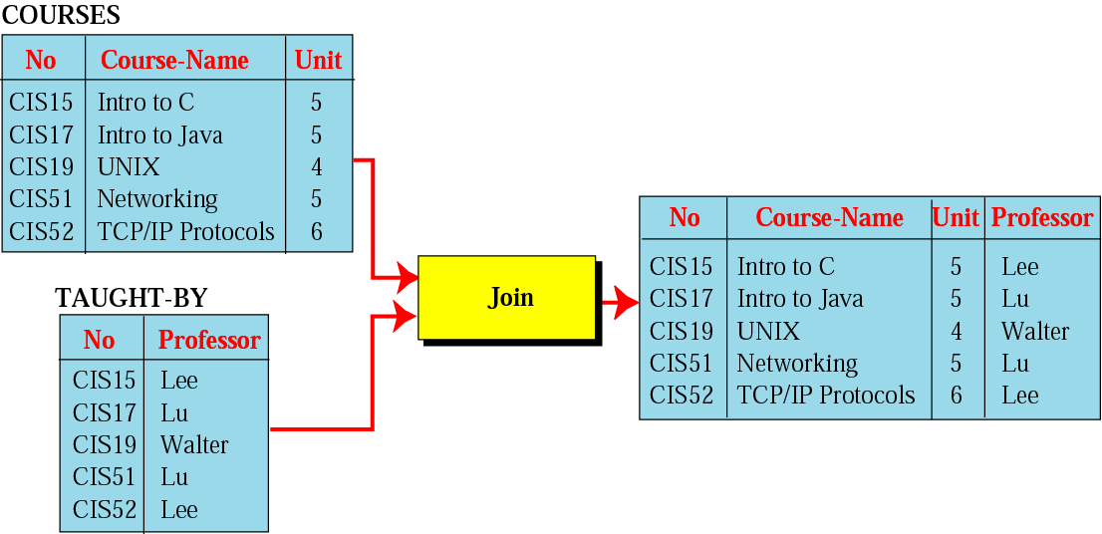
Join operation
A binary operation.
Combines two relations based on common attributes.

Slide 16
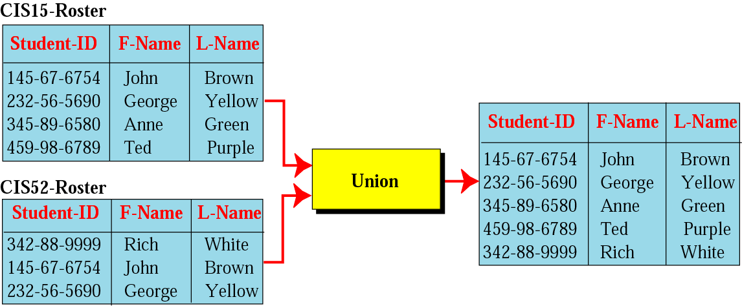
Union operation
A binary operation.
Creates a new relation with information possibly in both tables.
The two relations must have the same attributes.

Slide 17
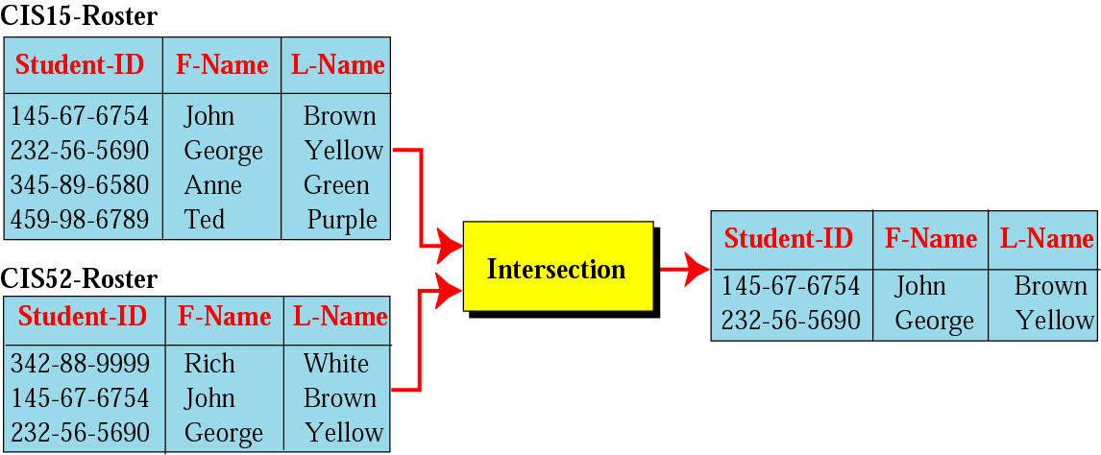
Intersection operation
A binary operation.
Creates a new relation containing members in both relations.
The two relations must have the same attributes.

Slide 18
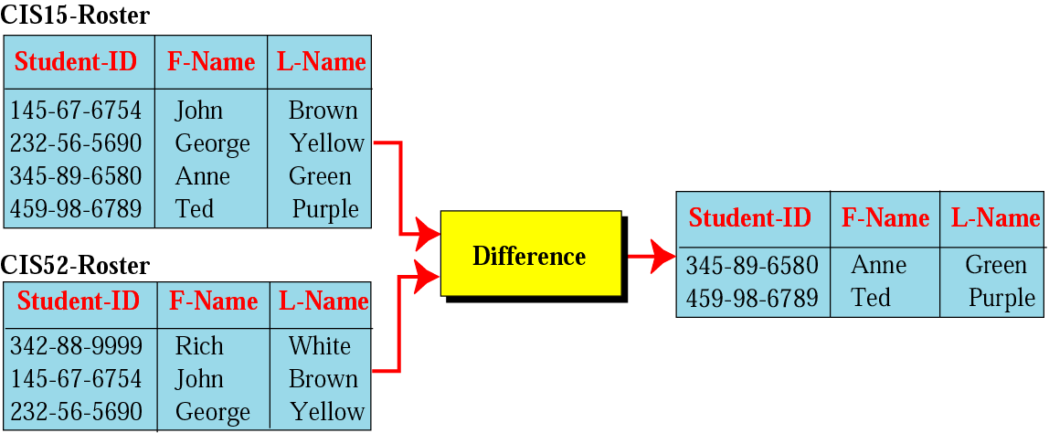
Difference operation
A binary operation.
Creates a new relation only containing members in the first relation but not the second.
The two relations must have the same attributes.

Slide 19
SQL (Structured Query Language)
All operations among relational tables can be performed in SQL
Used for relational databases.
A declarative (not procedural) language,
o users declare what they want
o without having to write a step-by-step procedure.
First implemented by Oracle in 1979.
SQL allows to extract more complex information from database.

Slide 20
Tools for Querying and managing data
Some relational DBMS that use SQL: Oracle, Sybase, Microsoft SQL Server, Access, Ingres, etc.
SQL in DBMS - usually only used on their system.
Python and R have facilities to run SQL (at least use the common SQL clauses) to query and manage data.
SAS PROC SQL - query relational tables and define analytic data sets.

Slide 21
PROC SQL and PROC FEDSQL in SAS
Structured Query Language (SQL)
o developed in the early 1970’s for managing data stored in RDBMS.
o SQL was introduced into SAS as PROC SQL in 1990.
SAS PROC FEDSQL
o introduced in SAS 9.4 M3 in 2015.
o allows the processing of queries other database(including RDBMS).

