Slide 1
Concepts of Data Wrangling
(also Cleaning)

Slide 2
Data Wrangling is the process of cleaning, organizing, structuring, and enriching the raw data to make it more useful for analysis and visualization
What is
Data
Wrangling

Slide 3
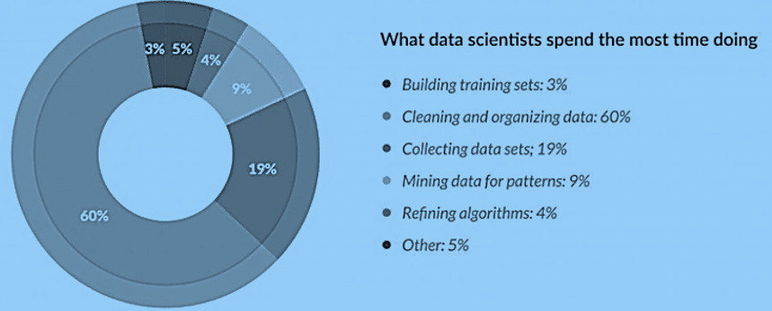
About 80% of time are used in data preparation!

Slide 4
Data discovery
Data Structuring
Data Cleaning
Data enriching
Data validating
Data publishing
Data Wrangling steps

Slide 5

Data Wrangling step: discovery
Understanding or getting familiar with data.
Organizing the data to make it easier to consume and analyze.
The goal is to compile the Disparate, Siloed data sources and configure each of them so they can be understood and examined to find patterns and trends in the data.

Slide 6
Individual data sets from different data sources with different structures
Information extraction - unstructured text data needs to parsed
Capture information of unstructured video, audio, and image data
Data Wrangling step: Structuring
Making disorganized data structured!

Slide 7

Outliers Detection
removing outliers from your dataset that can potentially skew your results when analyzing the data.
Quality Control
Changing any null values and standardizes the data format to improve quality and consistency.
Correction and Validation
Identifying duplicate values and standardizes systems of measurements, fixes structural errors and typos, and validates the data to make it easier to handle.

Slide 8
Data Wrangling step: Enriching
Combining raw data with additional data from other sources such as:
internal systems
third-party providers

Slide 9
Quality
Consistency
Accuracy
Security
Authenticity
Data Wrangling step: validating

Slide 10

Publish the newly Wrangled Data in a place such as new architecture or databases where it can be easily accessed and used.
DATA WRANGLING STEP: PUBLISHING

Slide 11
Python and R
Excel Spreadsheets
Python Pandas
Plotly
Dplyr
Purrr
Familiar
Tools for DATA wrangling

Slide 12
Dependent on the need for
Choosing
Data wrangling tools
Processing and organizing data
Cleaning and consolidating
Extracting insights from data

Slide 13
Some feature engineering tasks can be performed in the stage of data wrangle
Some big data tools may be needed during data wrangling
Concluding Remarks

