Slide 1
Concepts of Data Preparation

Slide 2

Data preparation is the process of preparing raw data so that it is suitable for statistical modeling and machine learning (ML)

Slide 3
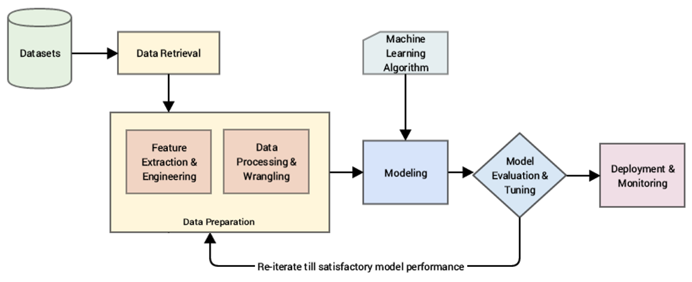
Data preparation process

