Slide 1
Basics of Relational databases
Cheng Peng
06/19/2023

Slide 2
Objectives
Understand a DBMS and define its components.
Understand the architecture of a DBMS and its levels.
Distinguish between different database models.
Understand the concept of relational database operations on a relation.

Slide 3
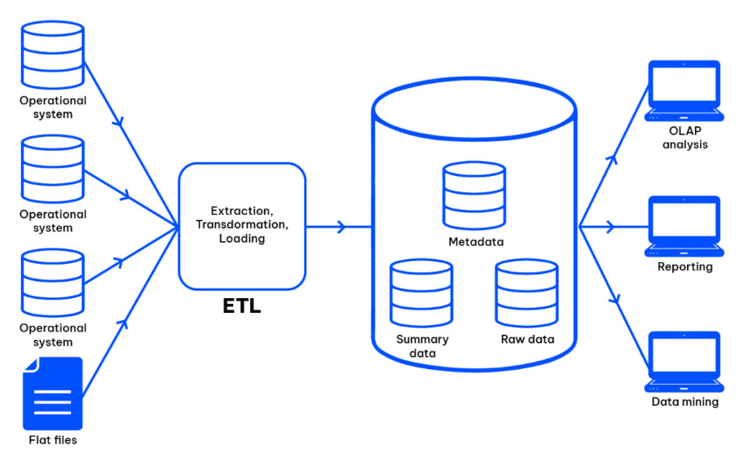
Data warehouse / databases

Slide 4
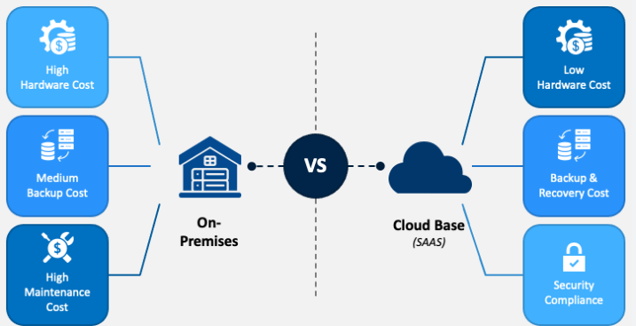
On Premises vs / Cloud base DW

Slide 5
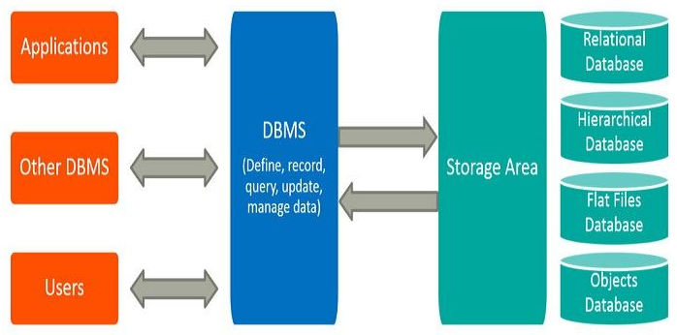
A Simple Structure of DBMS

Slide 6
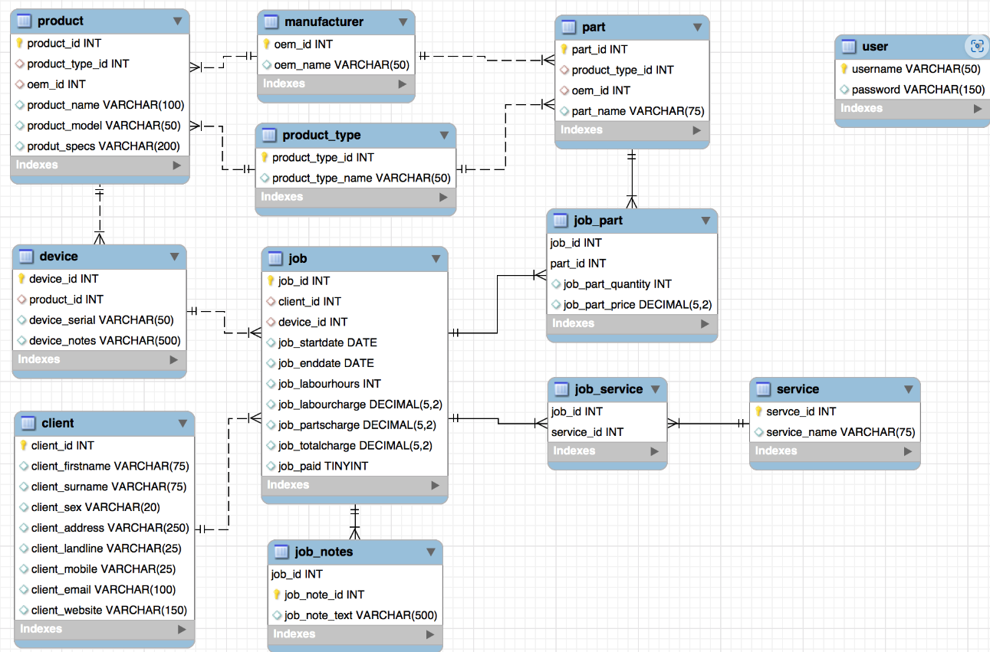
An Illustrative structure of relational database

Slide 7
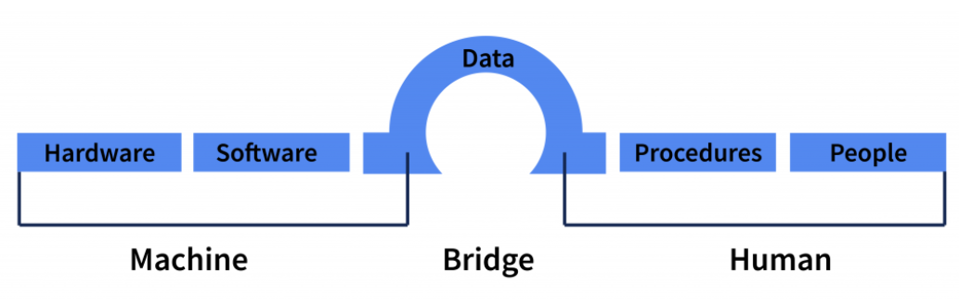
Understand a DBMS and define its components
Database – a collection of data that is logically coherent.
DBMS – Database Management System
defines, creates, and maintains a database.
Allows users-controlled access to data in the database.
A combination of 5 components:

Slide 8
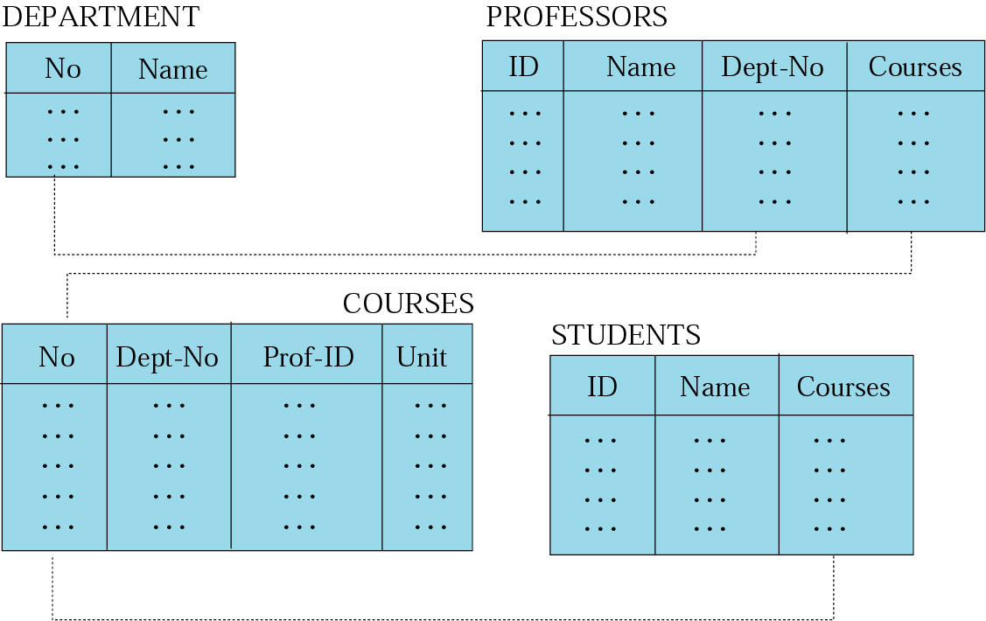
relational model
Data are organized in two-dimensional tables called relations.
The tables are related to each other.
The most popular model.

Slide 9
Relational model
RDBMS (Relational Database Management System)
External view
The data are represented as a set of relations.
A relation is a two-dimensional table.
This doesn’t mean that data are stored as tables! The physical storage of the data is independent of the way the data are logically organized.

Slide 10
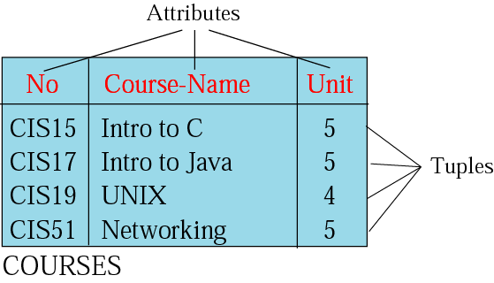
Relation
Name – each relation in a relational database should have a name that is unique among other relations.
Attribute – each column in a relation.
The degree of the relation – the total number of attributes for a relation.
Tuple – each row in a relation.
The cardinality of the relation – the total number of rows in a relation.

Slide 11
Operations on relations
In a relational database, we can define several operations to create new relations out of the existing ones.
Basic operations:
Insert, Delete, Update, Select, Project, Join, Union, Intersection, Difference

Slide 12
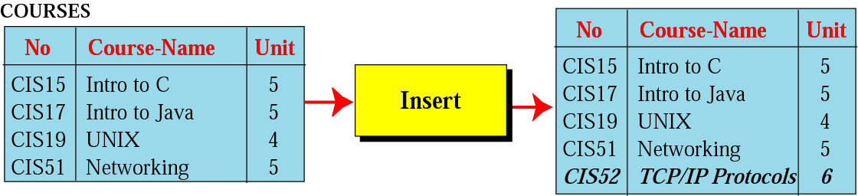
Insert operation
A unary operation.
Insert a new tuple into the relation.

Slide 13
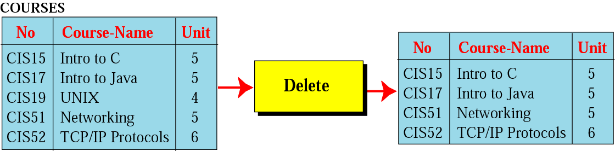
Delete operation
A unary operation.
Delete a tuple defined by a criterion from the relation.

Slide 14
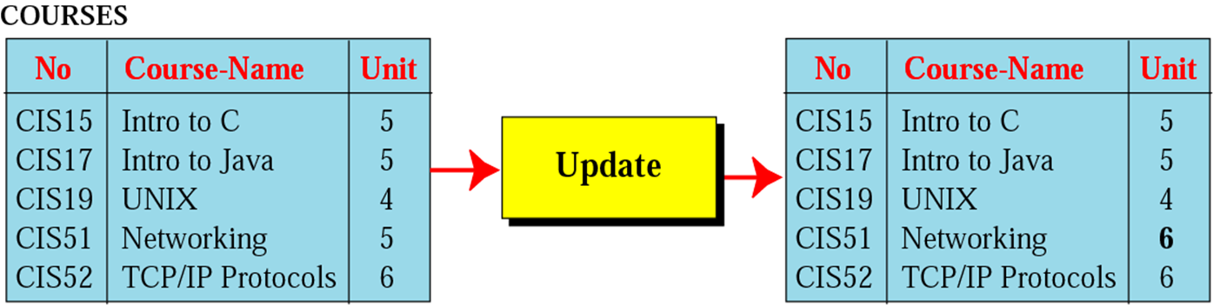
Update operation
A unary operation.
Changes the value of some attributes of a tuple.

Slide 15
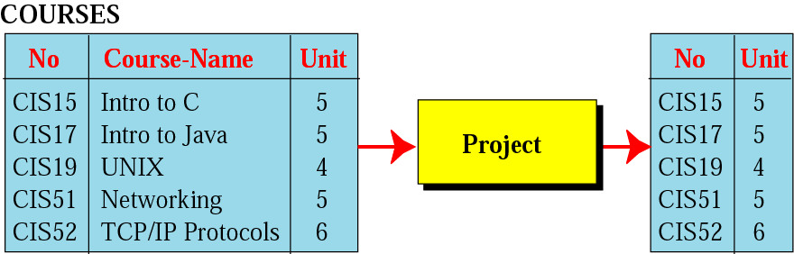
Project operation
A unary operation.
It is applied to one single relation and creates another relation.
The attributes in the resulting relation are a subset of the attributes in the original relation.

Slide 16
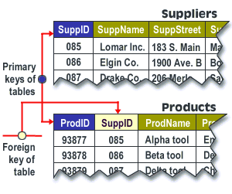
Primary and Foreign Keys
The primary key of a relational table uniquely identifies each record in the table. It is a column, or set of columns, that allows each row in the table to be uniquely identified.
A foreign key is a field in a relational table that matches the primary key column of another table.

Slide 17
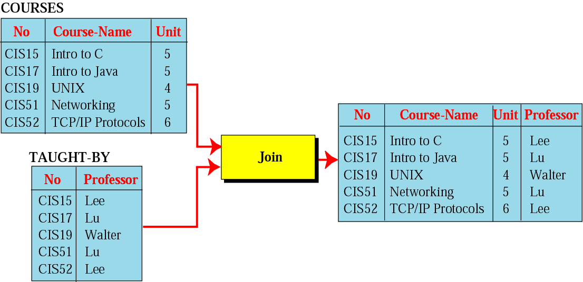
Join operation
A binary operation.
Combines two relations based on common attributes.

Slide 18
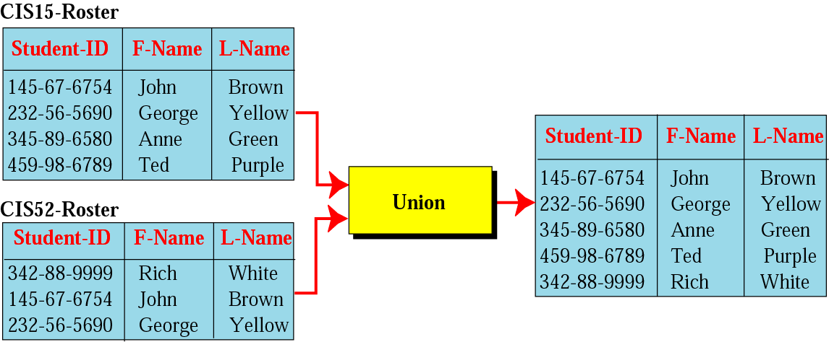
Union operation
A binary operation.
Creates a new relation in which each tuple is either in the first relation, in the second, or in both.
The two relations must have the same attributes.

Slide 19
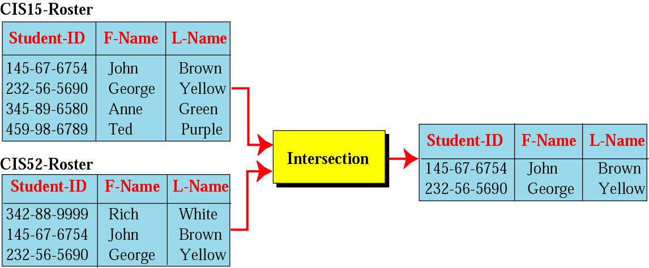
Intersection operation
A binary operation.
Creates a new relation in which each tuple is a member in both relations.
The two relations must have the same attributes.

Slide 20
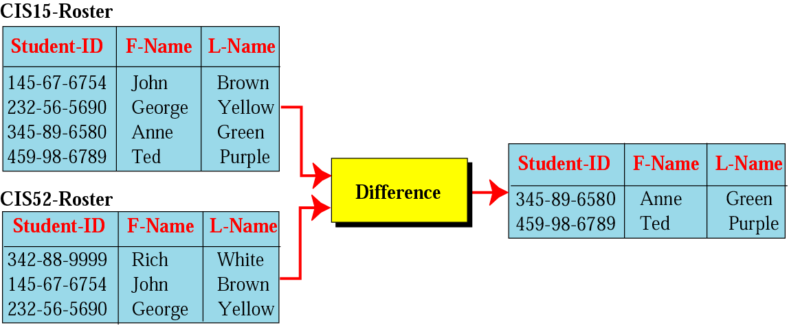
Difference operation
A binary operation.
Creates a new relation in which each tuple is in the first relation but not the second.
The two relations must have the same attributes.

Slide 21
SQL (Structured Query Language)
All operations among relational tables can be performed in SQL
Standardized by ANSI and ISO for use on relational databases.
It is a declarative (not procedural) language, which means that the users declare what they want without having to write a step-by-step procedure.
First implemented by Oracle in 1979.
SQL allows you to combine the following statements to extract more complex information from database.

Slide 22
Tools for Querying and managing data
Some common relational database management systems that use SQL are: Oracle, Sybase, Microsoft SQL Server, Access, Ingres, etc. Although most database systems use SQL, most of them also have their own additional proprietary extensions that are usually only used on their system.
Commonly data science programming languages such as Python and R have facilities to run SQL (at least use the common SQL clauses) to query and manage data.
We will use SAS PROC SQL to query relational tables and define analytic data sets.

Slide 23
PROC SQL and PROC FEDSQL in SAS
Structured Query Language (SQL) was first developed in the early 1970’s for managing data stored in Relational Database Management Systems (RDBMS). In 1986 SQL became the standard language of the American National Standards Institute (ANSI) and this standard SQL language has been revised and updated over the years. SQL was introduced into SAS as PROC SQL. For the first time in Version 6.06 in 1990.
SAS PROC FEDSQL was recently introduced in SAS 9.4 M3 in 2015 to fully conform to ANSI SQL 1999 standards and allows the processing of queries in the native languages of all other data sources (including RDBMS) that also conform to the ANSI 1999 standard.

