Slide 1
An Overview of
Feature Engineering

Slide 2
Feature engineering also called feature extraction or feature discovery is the process of using domain knowledge to extract features (characteristics, properties, attributes) from raw data
What is
Feature
Engineering?

Slide 3
Feature Assembling for raw feature extraction (unlike the conventional feature extraction, this refers to mining features from the unstructured data)
Feature Reduction for feature selection and feature extraction (in the sense of generating a subset of the original features).
Feature Extension, for derived features.
Three Types of Feature Engineering

Slide 4


Extracting information from unstructured data such as texts, audios, videos, images, etc. using certain technologies.
As an example, the dosage information from vial labels (in text format) or physicians’ handwritten prescriptions (images) is an important feature for modeling
Feature Assembling Tasks

Slide 5

Feature Reduction Tasks
Feature Extraction
Principle Components Analysis (PCA)
Independent Component Analysis (ICA)
Linear Discriminant Analysis (LDA)
Locally Linear Embedding (LLE)
t-distributed Stochastic Neighbor Embedding (t-SNE)
Feature Selection
Filters Method
Information gain
Chi-square test
Fisher’s Score
Embedded Method
LASSO methods
Random forest importance
Wrappers Method
Auto Selection
Best subset Selection
Recursive selection

Slide 6

Imputing
Missing values
Discretization
& Binning
Categorical Encoding
Feature Splitting
Handling Outliers
Variable Transformations
Scaling
(Standardization)
Creating Features
Grouping Sparse Categories
Feature extension Tasks

Slide 7
Imputation - fill in missing values with appropriate values
Categorical Imputation: Missing categorical values are generally replaced by the most commonly occurring value in other records
Numerical Imputation: Missing numerical values are generally replaced by the mean of the corresponding value in other records
Discretization - Discretization involves essentially taking a set of values of data and grouping sets of them together in some logical fashion into bins (or buckets)
Grouping of equal intervals
Grouping based on equal frequencies (of observations in the bin)
Grouping based on decision tree sorting (to establish a relationship with target)
Feature extension
–
EDA Tasks
Imputation and Discretization

Slide 8
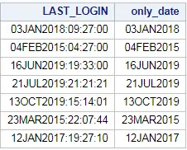
Categorical Encoding - Categorical encoding is the technique used to encode categorical features into numerical values which are usually simpler for an algorithm to understand.
Feature Splitting - Splitting features into parts can sometimes improve the value of the features toward the target to be learned.
For instance, in this case, Date better contributes to the target function than Date and Time.
Feature extension
–
EDA Tasks
Imputation and Discretization
String functions in programming language can be used to extract this types of information.

Slide 9
Variable Scaling - This technique of feature scaling is sometimes referred to as feature normalization.
Min-Max Scaling: This process involves the rescaling of all values in a feature in the range 0 to 1. In other words, the minimum value in the original range will take the value 0, the maximum value will take 1 and the rest of the values in between the two extremes will be appropriately scaled.
Standardization/Variance scaling: All the data points are subtracted by their mean and the result divided by the distribution’s standard deviation to arrive at a distribution with a 0 mean and variance of 1 (i.e., z-scores).
New Feature Creation - Feature creation involves deriving new features from existing ones.
For instance, taking the mean, difference, product and quotient of two features defines a new feature.
Feature extension
–
EDA Tasks
Variable
Scaling and redefining

Slide 10
Handling Outlier- data points far away from majority of data points.
Removal: The records containing outliers are removed from the distribution. However, this is not recommended since the resulting data is not from the original population.
Replacing values: The outliers could alternatively be treated as missing values and replaced by using appropriate imputation – also not recommended.
Capping: Capping the maximum and minimum values and replacing them with an arbitrary value or a value from a variable distribution - not recommended.
Discretization: This is commonly used in classical statistics
Variable Transformation- Variable transformation techniques could help with normalizing skewed data.
Box-Cox Transformation
Grouping Sparse Categories – small categories lead instable modeling results.
Feature extension
–
EDA Tasks
Outlier handling and variable transformation

Slide 11
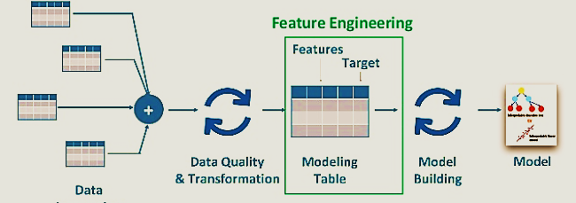
The role of Feature Engineering
in
data science

