Slide 1

Data Science The Science of Turning Data to Actionable Knowledge
Cheng Peng

Slide 2
Agenda
What is Data Science ?
Pillars of data science
Data science process
Types of data science roles
Data science job tile
Some jargons and comparisons

Slide 3
What is Data Science ?

Slide 4
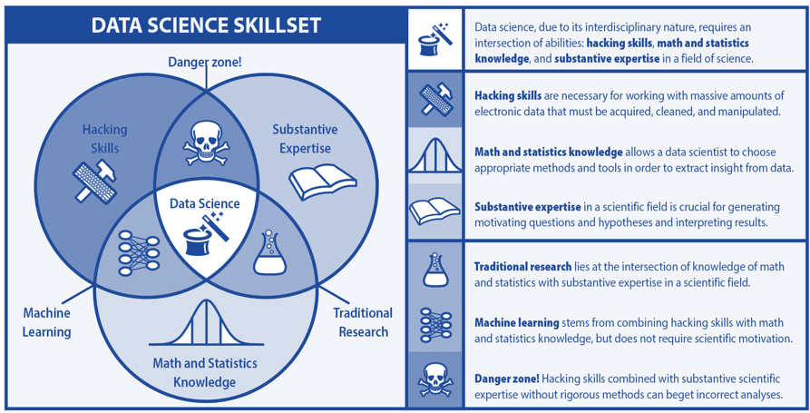
What is Data Science?

Slide 5

So, What is Data Science?
from National Consortium for Data Science (NCDS)
Data Science: Systematic study of organization and use of digital data for
research discoveries,
decision-making, and
the data-driven economy.
http://datascienceconsortium.org/

Slide 6
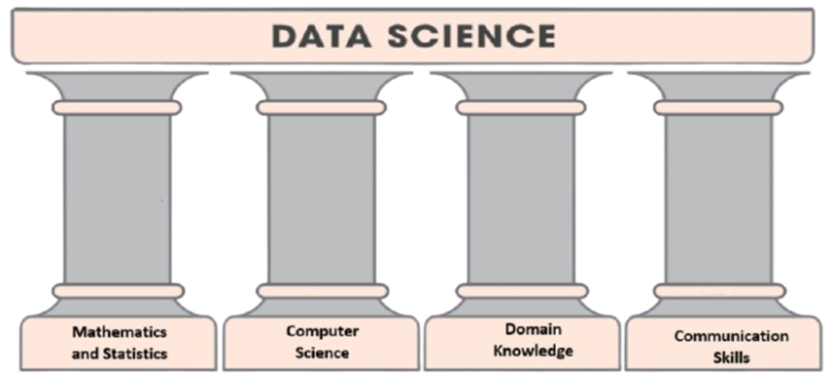
Pillars of Data Science

Slide 7

What is Data?
Data is a set of values of qualitative or quantitative variables; restated, pieces of data are individual pieces of information. Data is measured, collected and reported, and analyzed, whereupon it can be visualized using graphs or images. Data as a general concept refers to the fact that some existing information or knowledge is represented or coded in some form suitable for better usage or processing. [Wikipedia]
Data is recorded information.

Slide 8
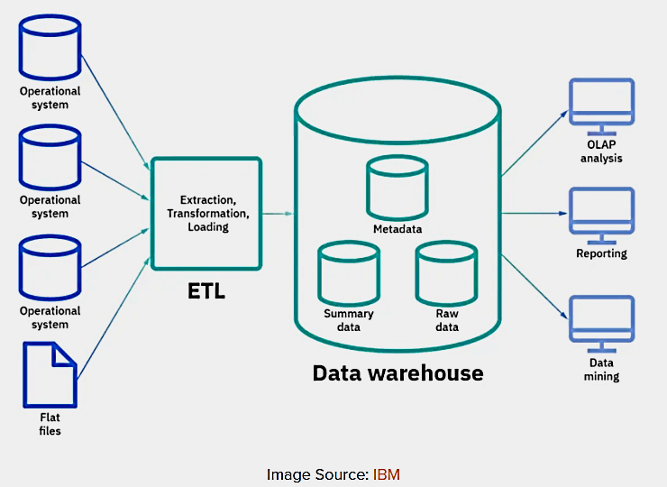
DATA STORAGE and RETRIEVAL

Slide 9
Data Science Process

Slide 10
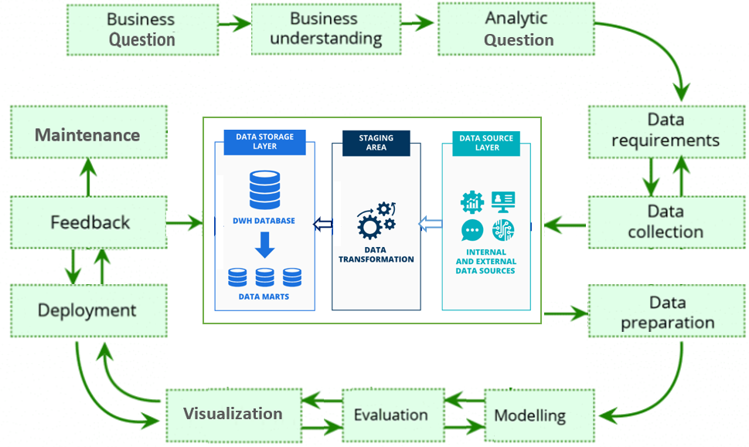
Data Science Project Lifecycle

Slide 11
Formulating the Question
Business Questions
VAGUE!
Data Science Tasks
Clear Analytic Questions
The key word in Data Science is SCIENCE that uses data to answer business questions!
Category of Analytic Questions
Trending and KPI analysis
Association analysis
Prediction and forecasting
And more….

Slide 12
What Analytic Approaches?
Types of models and algorithms based on the types of analytic questions
Data Source identification & data Preparation
What Types of Data?
Real-time data, internal and external historical data, primary data and secondary data,
Where to Find?
Location of data (databases, data warehouses, platforms that store data or generate data, etc.
Data sources are everywhere in an organization. In general, there is no central location to house all data.
Data Acquisition and Aggregation
Data retrieval and aggregation and the related tools such as DBMS, query languages, etc.

Slide 13
What Types of Models and Algorithms?
Models/algorithms:
Identification,
Feature Engineering,
Assessment,
& Communication
Descriptive analysis, various regression models and machine learning algorithms for association and prediction, etc.
How to Create Analytic Data Set?
Handling missing data, create new feature through aggregation such as PCA, reduce heterogenicity by cluster analysis, etc.
What Assessment Approaches?
An iterative process involving multiple models and algorithms and various performance measures.
Data-driven approaches such as resampling-based methods, cross-validation.
Communications
A structured approach to storytelling about the insights and influence about the project with data, visuals and narrative.

Slide 14
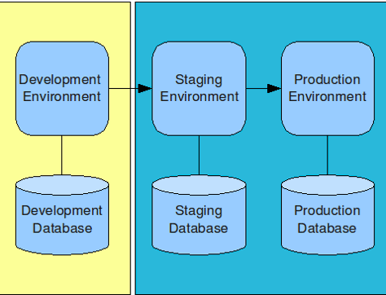
Static and Dynamic Deployment?
Deployment/implementation:
Performance Monitoring,
Continuous feedback,
Maintenance
Static deployment: models/algorithms trained and updated with batch data and in a scheduled time or based on the performance of the post-deployed models.
Dynamic deployment: models/algorithms trained and updated with a combination of online and offline data in real time.
Champion-Challenger Strategies
Implementation/deployment is not the ending point of a DS project, it is a new beginning!

Slide 15
Different Data Science roles

Slide 16
Business
Technology
Programming
Machine Learning Alg.
Statistics & Mathematics
Database query languages
Script languages: Python, R, Julia, SAS, etc.
Data wrangling and cleaning
Creating visuals via coding
Basic software development skills – APIs and library
Writing industry standard production code
Database technology
Big data technology
Data science platforms
Software programs
Collaboration tools
Communication tools
Business mind set
Project management
Communication skills
Statistics Methods
Descriptive statistics
EDA
Correlation analysis
Linear regression
Binary logistic regression
Frequency regression
Time series forecasting
Non-parametric regression
Mathematical Methods
Mixture model method – EM algorithm
Classification algorithms
Rule-based
Tree-based methods: decision tree, bagging, random forest
Kernel method – KNN
Naïve Bayes
Support vector machine – SVM
Neural networks
Clustering Algorithms
K-mean
Hierarchical clustering
Anomaly detection algorithms

Slide 17
Machine Learning
Expertise in computer fundamentals
In-depth knowledge of programming skills
Knowledge of probability and statistics
Data modeling and evaluation skills
Data Analytics
Knowledge of mathematical statistics
Fluent understanding of R/Python/SAS and SQL
Data wrangling
Familiar with Big Data tools and platforms
Data Science
Strong knowledge of Python, R, SAS, etc.
Hands-on experience in SQL database coding
Ability to work with unstructured data from various sources
Knowledge of probability and mathematical statistics
Knowledge of machine learning
Three
Related
technical fields
Programming and Statistics are the common ground!

Slide 18
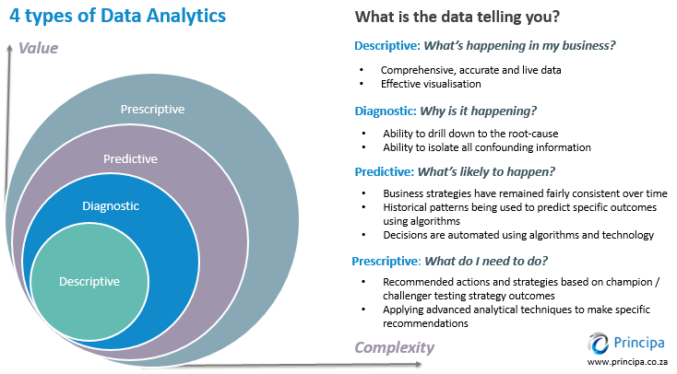

Slide 19

Data analyst
Responsibilities: Accessing and cleaning data, performing statistical analysis, visualizing and communicating the results with the management for decision.
Programming languages: Python, R, SQL
Data scientist
Responsibilities: developing, building and training machine learning algorithms and statistical models to make reliable future predictions.
Programming languages: Python, R, SQL
Business analyst
Responsibilities: Use data-driven insights to clearly communicate initiatives throughout entire organizations, often acting as the intermediary between a company’s business and tech teams
Programming languages: SQL, Tableau
Statistical Analyst
Responsibilities: Identify challenging business problems and use data to find the solution to the problems.
Programming languages: R, Python, SAS, SPSS
Machine learning engineer
Responsibilities: Processing data provided by a company’s Data Analyst using machine learning algorithms developed by the Data Scientist to glean insights that will ultimately drive business decisions
Programming languages: R, Java, Python, C++
Different Roles of Data Science

Slide 20
About the job title
‘Data Scientists’

Slide 21


The job title Data Scientist co-coined in 2008 by

Slide 22
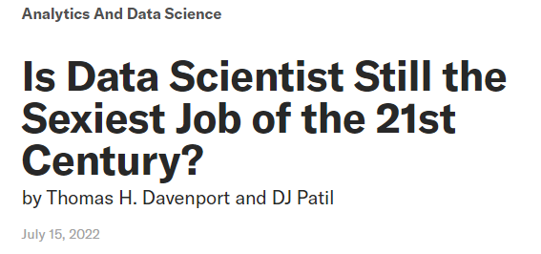
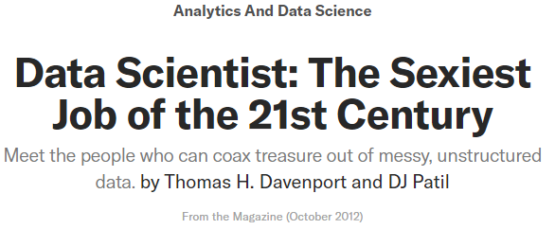
The scope of Data Science has been redefined!
More technology
emphasis
Add ethics dimension
More business focus
The data science team are more diverse than ever!
Data Science is still and will continue to be in high demand in job marketplace!

Slide 23
Different comparisons of
Data Science
With machine learning and statistics

Slide 24
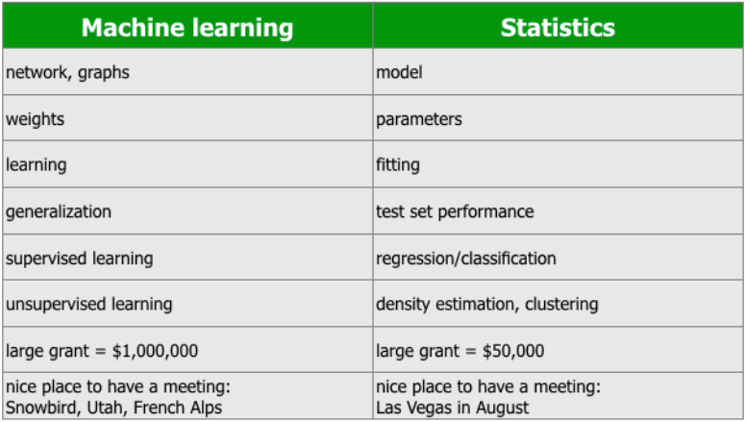

Slide 25
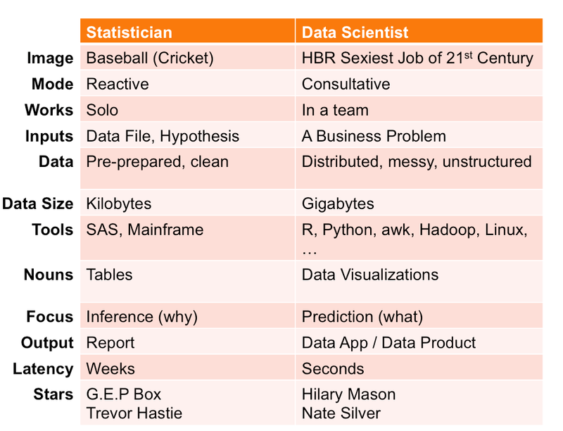

Slide 26
Cloud computing
for
Data Scientists

Slide 27
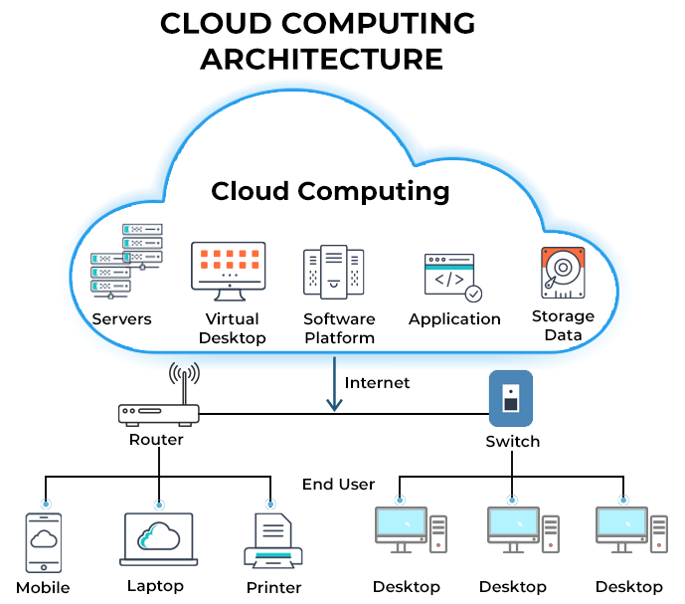

Slide 28
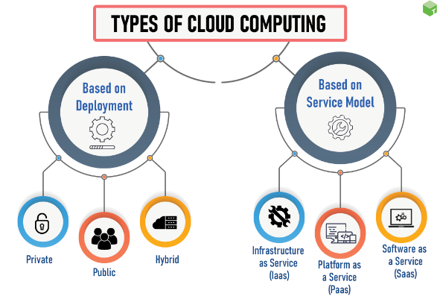

Slide 29

Top 3 cloud platforms

Slide 30
On-demand self-services: Users monitor and manage computing resources as necessary without the assistance of human administrators.
Broad network access: A wide range of hardware and established networks are usually used to deliver computing services.
Rapid elasticity: Resources for the computing services can be scaled up and down quickly as required.
Resource pooling: Ad hoc sharing of networks, servers, storage, apps, and services by several users and applications.
Characteristic of cloud computing

Slide 31
Resilient computing: computing services are ensured with high uptime and dependability.
Flexible pricing structures: including pay-per-use, subscription-based, and spot pricing.
Security: To safeguard the privacy of sensitive data and their users' data.
Automation: Cloud computing services feature a high level of automation with little to no manual input.
Characteristic of cloud computing

Slide 32
A glance at a
Data Science Project
For real-time credit card fraud detection

Slide 33
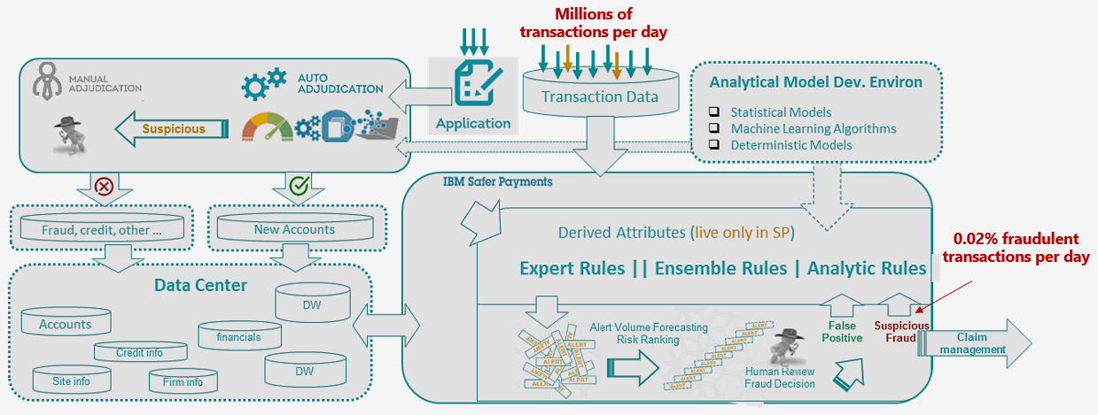
A real-time credit card fraud detection system

