Slide 1

A Semiparametric C-Log-log Model with Applications in Credit Card Fraud Detection
Cheng Pengª , Kai Peng^{b}
ª West Chester University of Pennsylvania, West Chester, 19383 PA
^{b} Ningbo University of Technology, Ningbo, 315211, Zhejiang, China
https://ww2.amstat.org/meetings/jsm/2021/onlineprogram/AbstractDetails.cfm?abstractid=318244

Slide 2

1. Description of Practical Question – Credit Fraud Detection
What is credit card fraud?
Credit card fraud is the unauthorized use of a credit or debit card, or similar payment tool to fraudulently obtain money or property.
Types of credit card fraud
Application fraud
Skimming fraud (white plastic card)
Lost and stolen fraud
Account takeover fraud
Source: https://apsalar.com/2015/07/latest-apsalar-data-on-in-app-click-and-iap-fraud/
The high cost of credit card fraud
According to The Nilson Report, global financial losses related to payment cards are estimated to reach $34.66 billion in 2022.

Slide 3

2. How to Detect Credit Card Fraud?
1. Business Rules & Common Logic Using
1. Geolocation
2. Proxy Piercing
3. Device Fingerprinting
4. Address Verification
FRAUD
5. Blacklists & Whitelists
6. Velocity Checking
2. Analytical Tools – Fraud Scoring
1. Categorical Regression Models
2. Machine Learning Algorithms
3. Challenges in Fraud Detection:
(a). Rarity (b). Insufficiency of information

Slide 4
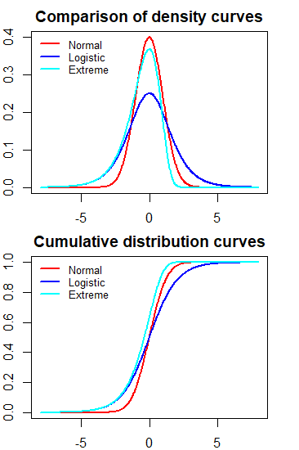
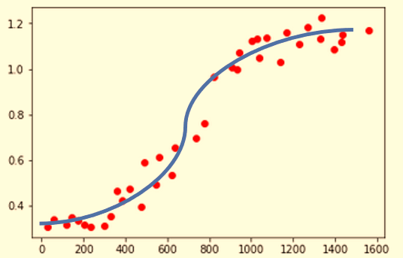
3. Statistical Models for Credit Card Fraud Detection
Three binary regression models
1. Logistic Regression Model – symmetric link function
2. Probit Regression Model – symmetric link function
3. C-loglog Regression Model – asymmetric link function
Comparison of the three models
1. Logistic and probit models yield similar results
C-loglog model yields the result that is different from that of logistic and probit models

Slide 5
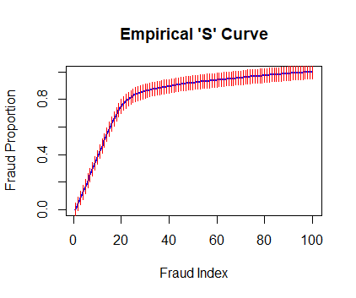
4. Semiparametric C-loglog Model for Credit Card Fraud Detection
Why C-loglog?
The cumulative fraud distribution is NOT symmetric. The C-loglog model is a more appropriate choice.
Why Semiparametric C-loglog?
1. Fraud is a rare event! A simple random sample may not be able to observe enough fraud cases to train a model.
2. Stratified sampling is a natural choice: select a random sample from fraud distribution and random sample from the fraud-free distribution!
3. A less restrictive model is the density ratio model that assumes the ratio of the density of fraud and fraud-free population to be a function of common covariates!
4. Parameter estimation uses Qing’s framework of the empirical likelihood-based density ratio model.

Slide 6
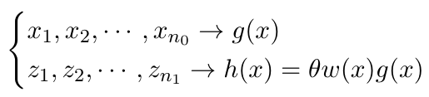



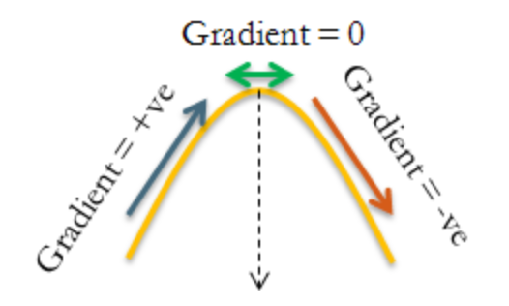
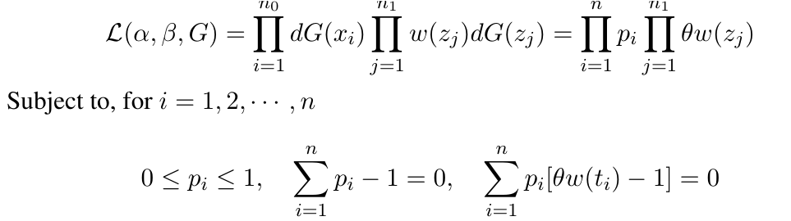
5. Specification of Semiparametric Cloglog Model
1. Cloglog Model Structure
where
2. Semiparametric Likelihood Function
Let $G(x)$ be the cumulative distribution of $g\left(x\right). pi$= $dG\left(xi\right).$

Slide 7
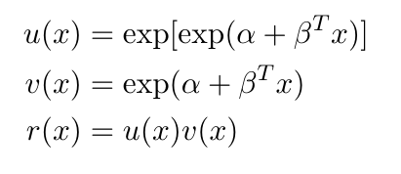
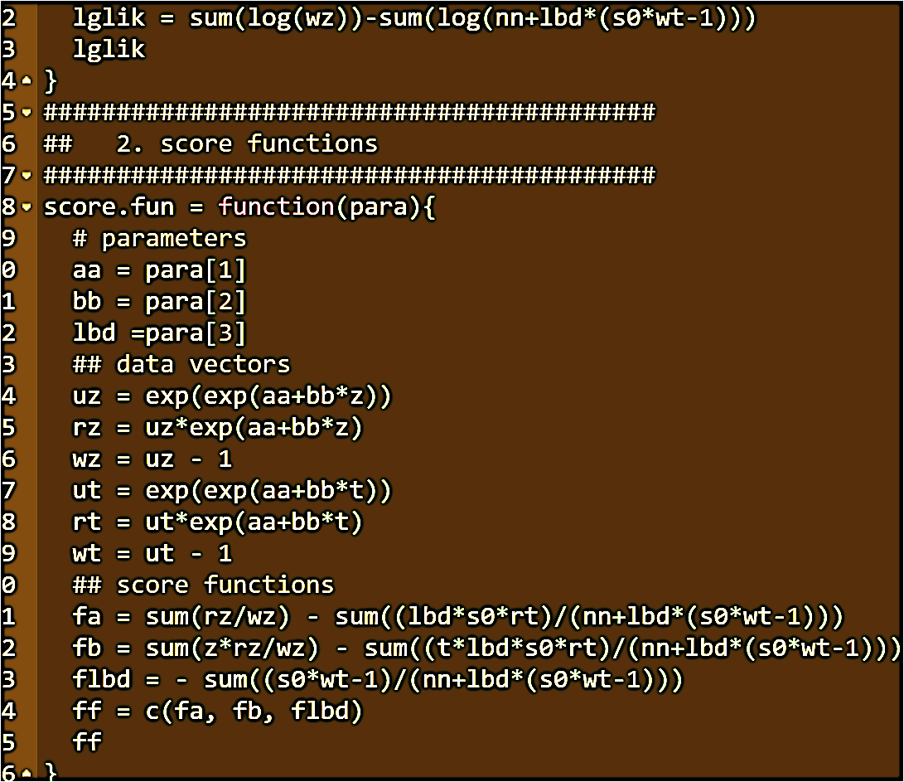
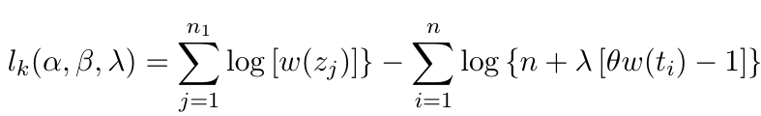
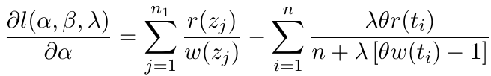
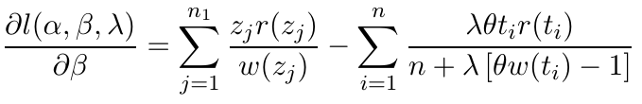
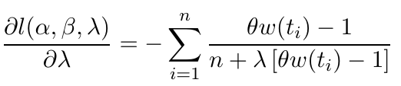
6. Algorithm for Estimating Model Parameters
1. Notations
2. Lagrange Multiplier yields following
kernel of the log-likelihood
3. Gradient function

Slide 8
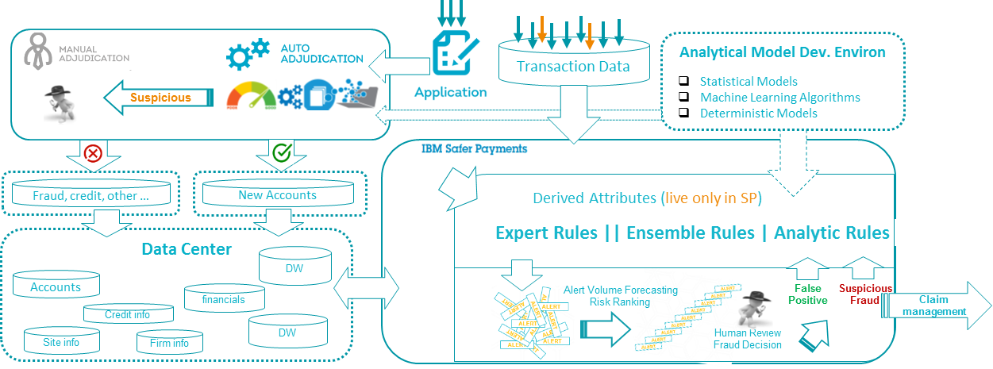
7. Numerical Example: Fraud Data Sources & Detection Work-flow
C-loglog Model training and testing
In-house fraud data sources for static training

Slide 9
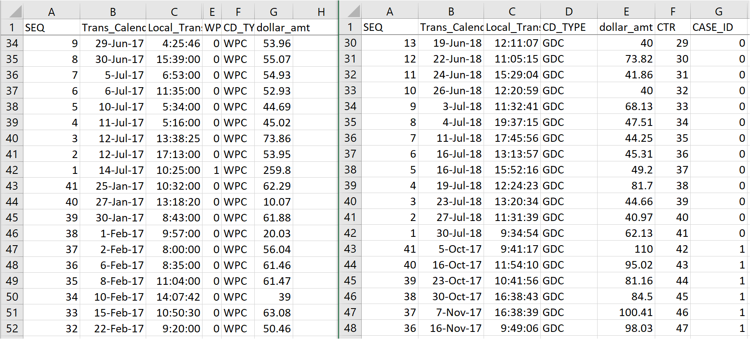
8. Numerical Example: Fraud Data & Feature Extraction
1. Only use historical transaction amounts
2. Data Description
Sample #1: Authentic Cards
24892
Sample #2: Compromised Cards
7759
Each card has 41 historical transaction amounts. For sample #2, the most recent transactions are confirmed fraudulent transactions.
3. Feature Extraction
We used an automatic feature extraction algorithm based on the idea of process capability to extract the information of customer spending behavior from the historical transaction amounts - fraud index

Slide 10
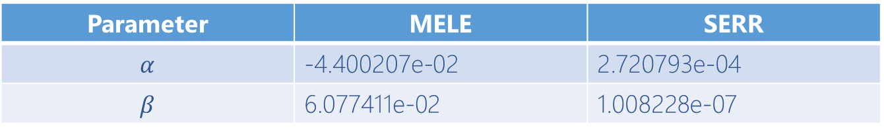
9. Numerical Example: Fitting C-loglog Model: Computing and Results
Model Specification
1. One covariate, fraud index, is used.
2. The odds of selecting an authentic cards is chosen to be 9.
3. The explicit expression of the fraud probability based on the C-loglog model is given by
$$P\left(Y=fraud | fraud.index\right)=\exp\left(exp⁡(α+βfraud.index)\right)−1$$
Results of the Proposed Semiparametric C-loglog Model
Parameter | MELE | SERR
$$α$$ | -4.400207e-02 | 2.720793e-04
$$β$$ | 6.077411e-02 | 1.008228e-07
$$P\left(Y=fraud | fraud.index\right)=\exp\left(exp⁡(−0.044+0.061×fraud.index)\right)−1$$

Slide 11
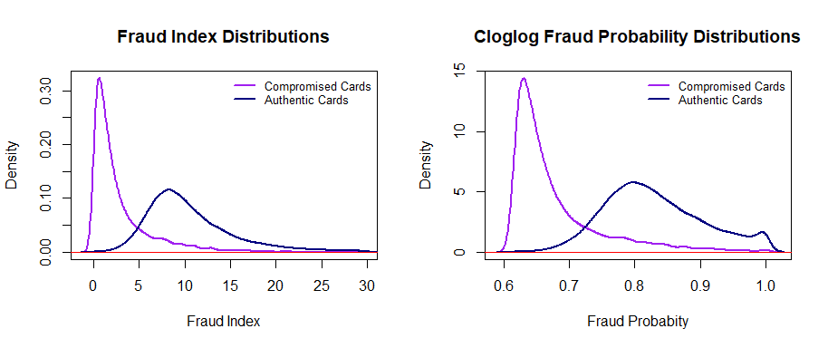
10. Numerical Example: Comparison between Fraud Index and Cloglog Fraud Probability
Left Panel: The fraud index is a based on the transaction amounts has a good discriminatory power to separate fraudulent transactions from the genuine transactions. The fraud index works since the fraudulent transactions alters the spending behavior of customers.
Right Panel: The fraud probability derived from the C-loglog model significantly elevates the discriminatory power between two distributions. This will help catch more fraud and reduce false positives.

Slide 12

Questions?
Thank You!
cpeng@wcupa.edu

