Slide 1
CS777 Pengfei Ma Project
Google Play Store Open Data Analysis

Slide 2
Introduction - Data Set
Google PlayStore Android App Data. (2.3 Million+ App Data) Backup repo: https://github.com/gauthamp10/Google-Playstore-Dataset
This Data set contains 2.3 million data of apps on Google Play Store. Several information will be implemented.
Reference: https://www.kaggle.com/gauthamp10/google-playstore-apps

Slide 3
Data Dictionary
App Name | The name of the app
App ID | Unique ID of the app on Google Play Store
Category | The category of the app on Google Play Store
Rating | Float, a total of 5.
Rating Count | The number of users who rated this app
Installs | The number of installations, only show big number with +
Minimum Install | The minimum of the installation in a period
Maximum Install | The maximum of the installation in a period
Free | Boolean, the app is free to download or not
price | The price of the app for downloading
currency | The currency of the app in its area
size | The Size of the app
Minimum Android | The lowest require Android version
Developer ID | Developer’s unique ID on Google Play Store
Developer Website | Developer’s personal website
Developer Email | Developer’s personal email
released | Released data of the app
Last updated | The date when the app was updated last time
Content rating | The rating of the content
Privacy Policy | Own policy of the app
Ad supported | Boolean, if the ads was supported in the app
In app purchase | Boolean, if there is in app purchase
Editor’s Choice | Unique choice of the editors
Scraped Time | Timestamp of the scraped time of the app.

Slide 4
Research
There are four research goals to chase.
Part 1 is figure out that if there are linear relationship between the number of Installations and the rating by simple linear regression. In addition, multi-linear relationship is expected between the number of Installations and rating, rating count, price, and the size.
Part 2. Applying big data analysis classification and models for the name of the app to find out what kind of apps are installed the most and evaluate the models by confusion matrix.
This project will use all pyspark code to do the analysis. Data will be classified in RDD.
Top 20,000 app sorted by the number of installation will be used for classification and learning models.

Slide 5
Learning Model
Linear Model
Logistic Regression
SVM

Slide 6
Expectation
There is strong simple linear relationship between the number of installation and the rating of the app.
Find out the multi-linear regression parameters between the number of installation and rating, rating count, price, and size. Expected to see the most important elements and the least important element.
Applied logistic regression to the name of apps to find out the most popular type of apps.
Evaluate the logistic regression model and get the accuracy over 70%, F1 score over 0.7 as well.
Applied SVM to the name of apps and evaluate the model with expected 0.7 accuracy and 0.7 F1 score.

Slide 7
Model Evaluation
Test file: random select 10000 apps from the data set and save as the test file
Confusion Matrix
Accuracy (if over 70%)
F1 Score (F1 = 2 * TP / (2 * TP + FN + FP) )

Slide 8
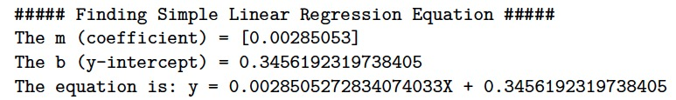
Linear Model - Simple Linear Regression
The relationship between the number of installations and rating

Slide 9
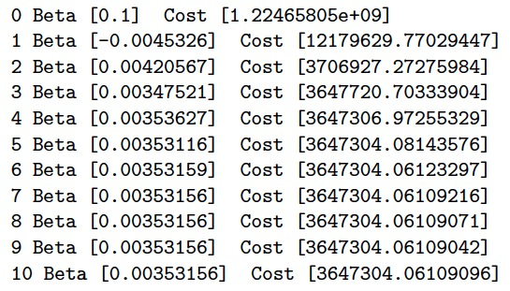
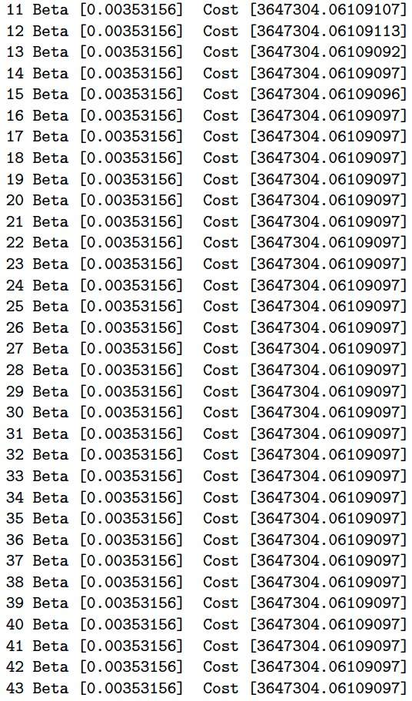
Linear Model - parameters using gradient descent
Learning rate: 0.00001
Number of iteration: 100
Size: float(len(tuple))
Beta: 0.1

Slide 10
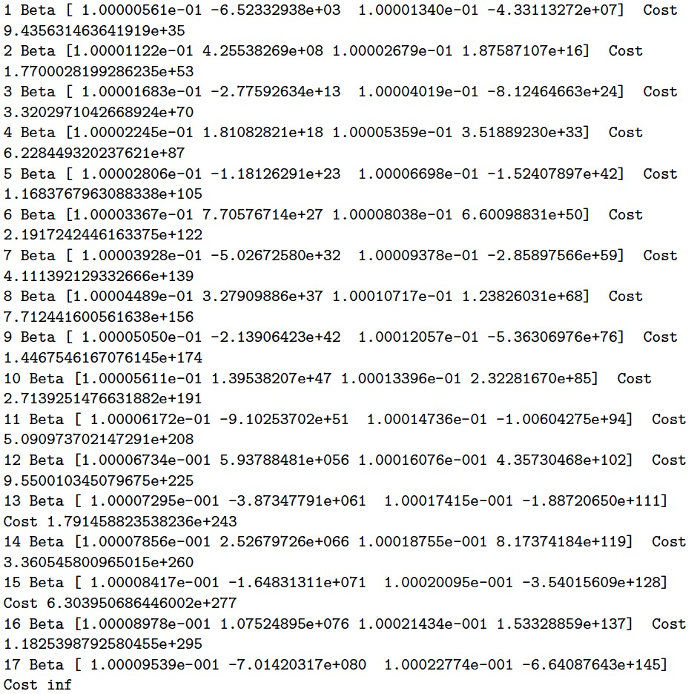
Linear Model - Multi-linear Regression
Elements: Number of installations and rating, rating count, price, and size
Learning Rate: 0.000001
Number of iterations: 100
Size: len(tuple)
Beta: 0.1, 0.1, 0.1, 0.1

Slide 11
Logistic Regression
Algorithm: Gradient Descent
Learning Rate: 0.0001
Number of Iteration: 100
Lambda coefficient: 0.01
Size: len(tuple)
Acc of Test: 0.9975432599871822
F1 of Test: 0.9974863907576629

Slide 12
SVM
Acc of Test: 0.982736100123734
F1 of Test: 0.980016837261283

Slide 13
Thanks for watching

