Slide 1
Heart Attack Prediction Neural Network Design
CS 767 Project
PRESENTED BY : Pengfei Ma

Slide 2
Abstract
This project would focus on designing a neural network prediction model for heart attacks. The data sets used in this project were collected from UCI Machine Learning Open Data Websites. processed_cleveland.data, heart.csv, and reprocessed_hungarian.data are three data sets that were used in this project. The data pre-processing step would merge these three data set as one large dataset. At first, data visualization by matplotlib and seaborn will be applied to the merged data set to describe the age, sex, trestbps, chol, and thalach values. After visualization, train and test set split will be 70/30 by train_test_split from sk-learn package. First 12 columns are features and the last column is the label.
Except multilayer perceptron, three classifiers will be used for the same data set to find out the advantage and disadvantage of the neural networks. At the end, model evaluations will be applied to rank the accuracy from the test set from highest to the lowest and rolled out the comparison of classifiers and neural networks.
Multi-layers Perceptron has four layers with 200 neurons each and 0.1 validation set. This project will use grid and random search to test different number of epochs: 100, 200, 300; and four different optimizers: adam, nadam, sgd, rmsprop. After finding the best model, evaluated and visualized the changes of the accuracy of the model by each epoch at the end to summarize the entire progress.
Logistic regression, Naïve Bayes, and Gaussian SVM will be used to compare the accuracy at the end. All three classifiers will use the built model from sk-learn

Slide 3
Keywords
Visualization
min max scale
sk-learn
Multi-layer Perceptron
Grid Search
Logistic regression
Gaussian Naïve Bayes
Gaussian SVm

Slide 4
Research scenario
This project will implement multi-layer perceptron and logistic regression, naïve bayes, and gaussian svm to find out the accuracy of the model to predict the heart attack rate.
Found out the best MLP model that have the highest prediction accuracy and evaluate the model by the test set. Compared and ranked four accuracies and conclude the advantages of the neural networks.
The main research question is that under what conditions will the neural network perform better than the classifiers.

Slide 5
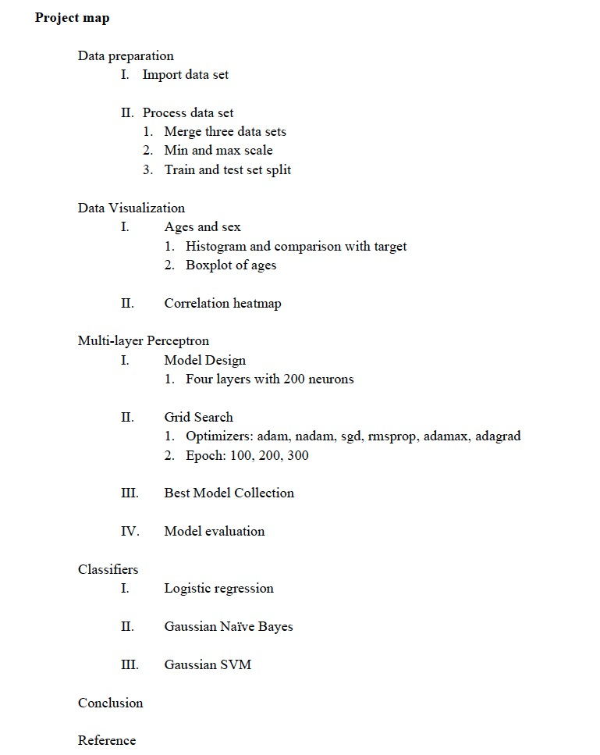
Project Map

Slide 6
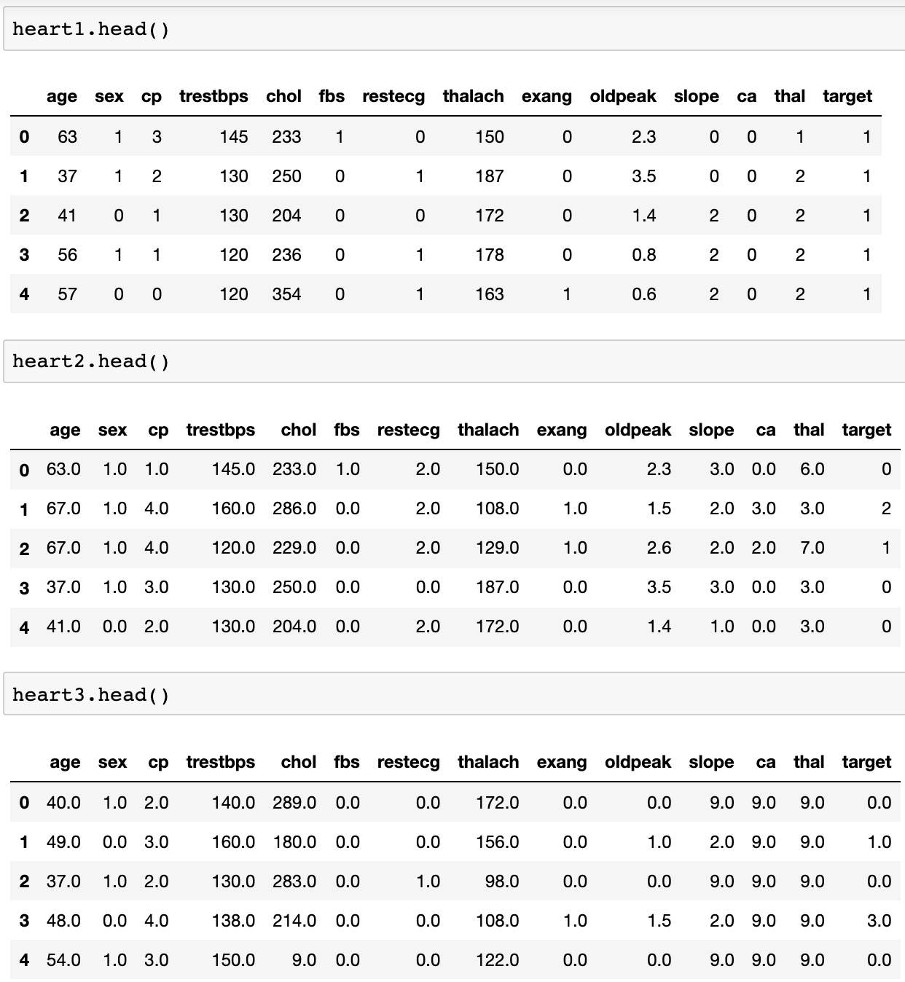
Data set overview

Slide 7
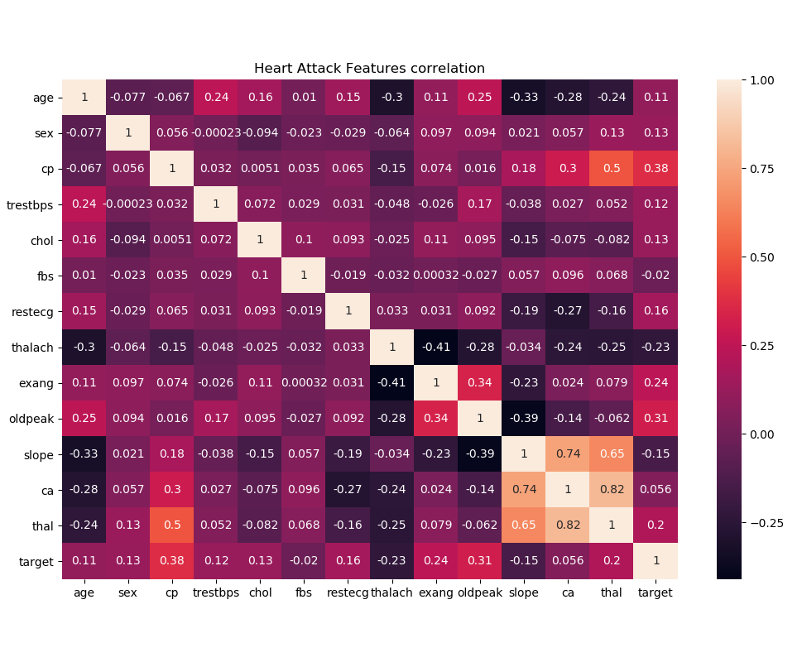
Diagrams
Correlation heatmap

Slide 8
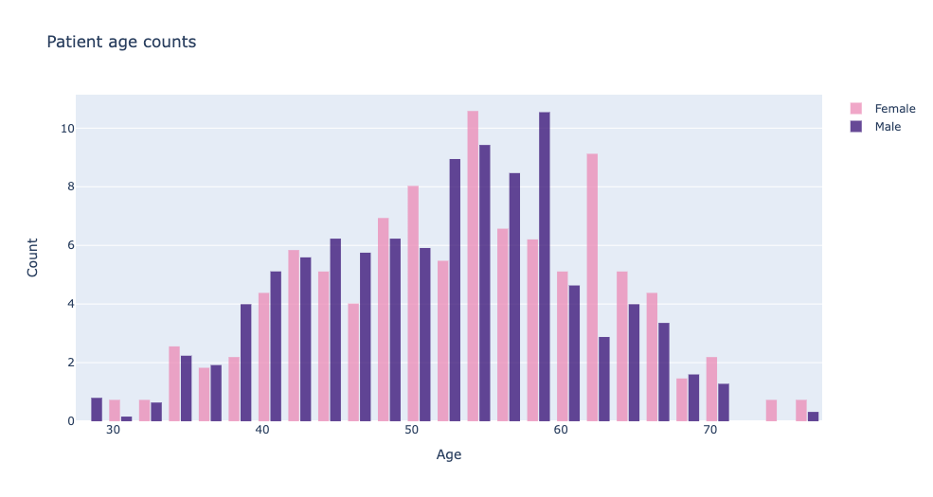
Data set
Age and Sex

Slide 9
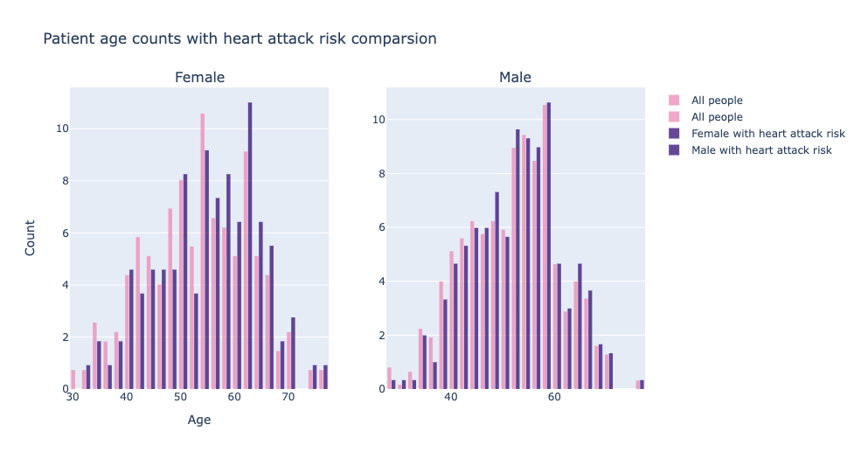
Data set
Age and Sex with risk comparison

Slide 10
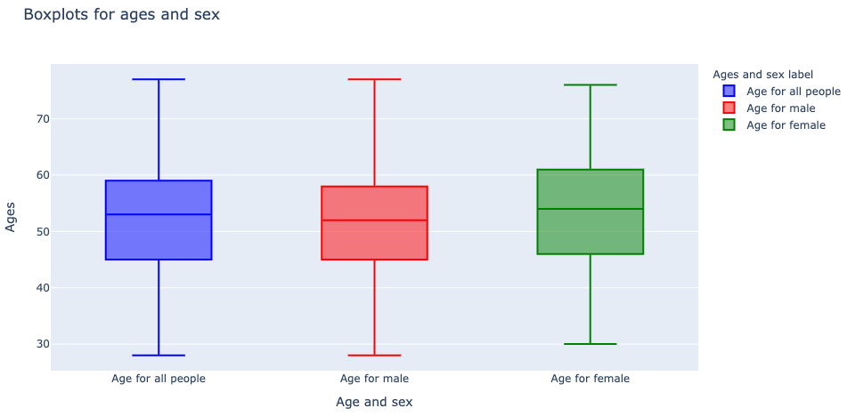
Data set
Box plot of Age and Sex

Slide 11
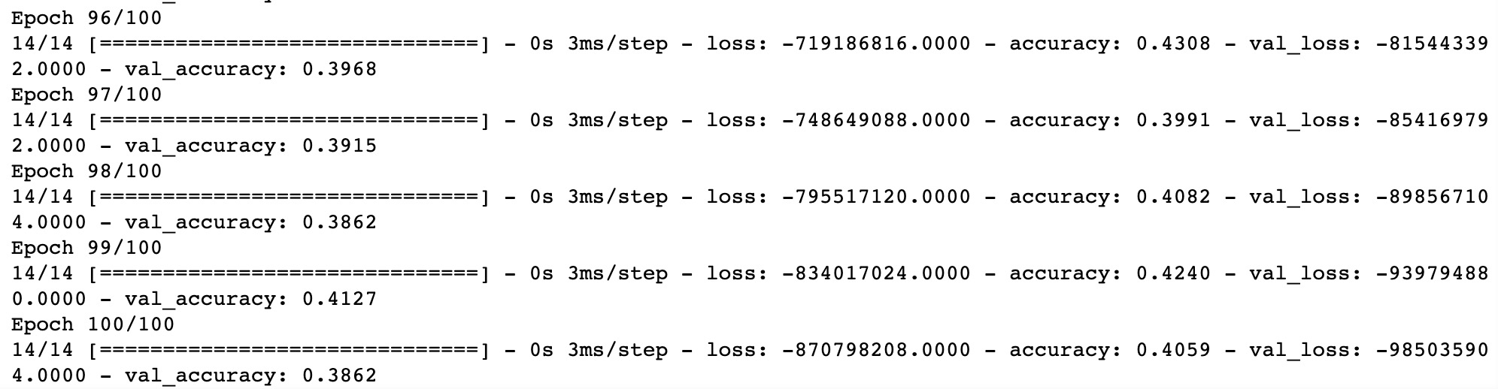
Mltilayer Perceptron
Grid Search and
The best model
Created a MLP with four hidden layers. Defined the MaxNormDense by partial function with ‘selu’ activation function, ‘lecun_normal’ kernel_initializer. The model is designed having 200 neurons each hidden layers with ‘relu’ activation function and (12, none) input shape because there are 12 features. The last layer is the output layer with 4 outputs because there are 0-4 and ‘sigmoid’ activation function.
Complied the model with binary_crossentropy for the loss and report the accuracy. Built the neural network by KerasClassifiers with the model. Then the model is ready for the grid search.

Slide 12
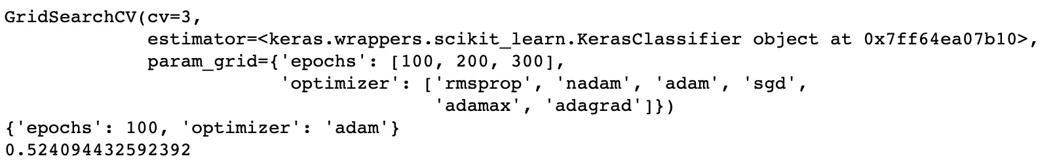
Mltilayer Perceptron
Grid Search and
The best model
Sat the list of epochs 100, 200, 300 and 6 different optimizers: rmsprop, nadam, adam, sgd, adamax, and adagrad. Applied grid search with cv = 3.
The model that provided the highest accuracy is the model by ‘adam’ optimizer and 100 epochs. The highest accuracy is 0.5241.
Evaluated the model by the test set and received 0.3838 accuracy.

Slide 13
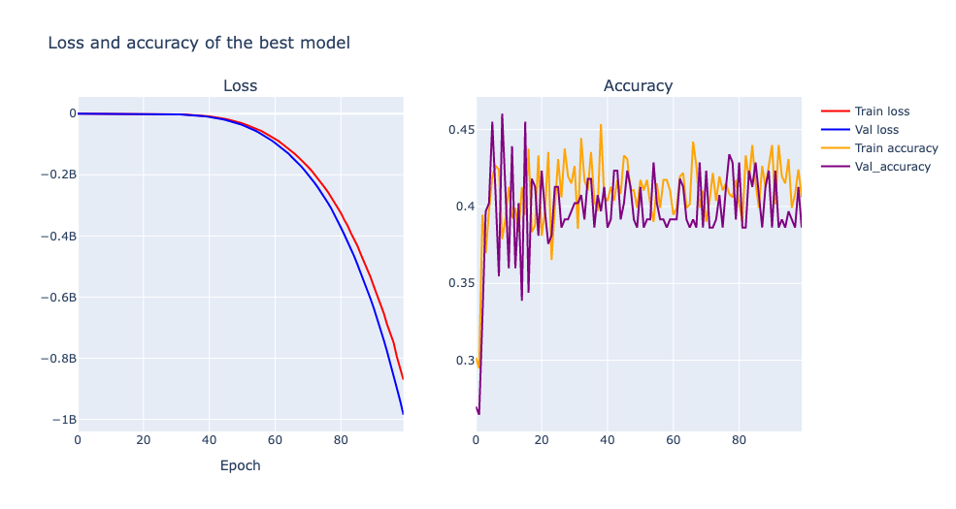
Mltilayer Perceptron
Loss and accuracy

Slide 14
Classifiers
Logistic Regression
44.81%
Gaussian Naïve Bayes
46.67%
Gaussian SVM
51.48%

Slide 15
Conclusion
Logistic regression provided 44.81%
Gaussian Naïve Bayes provided 46.67%
Gaussian SVM provided 51.48%.
MLP neural network provided the highest accuracy which is 52.41% and logistic regression provided the least.
However, the accuracy of MLP is not stable. There are two possible reasons.
First of all, the data set was not large enough.
Secondly, there are missing values.

Slide 16
THANKS FOR
WATCHING!

