Slide 1
Pinpointing Performance Inefficiencies in Java
Pengfei Su
Qingsen Wang
College of William and Mary
College of William and Mary
Milind Chabbi
Xu Liu
Scalable Machines Research
College of William and Mary

Slide 2
Software Inefficiencies
According to provenance, software inefficiencies include
Data structure/algorithm-related inefficiencies
Input-related inefficiencies
Compiler-related inefficiencies
massive
cache misses
unnecessary
computation/data moving
excessive
synchronization
…

Slide 3
Hotspot Analysis: Classical Performance Analysis
Identify hotspot — high resource utilization
Time/CPU cycles
Cache misses
Derived metrics, e.g., Cycles-Per-Instruction (CPI)
Hotspot analysis is indispensable, but
Cannot tell if resources are “well spent”
Needs significant manual efforts to investigate root causes
Pinpoint resource wastage instead of usage

Slide 4
Software Inefficiencies: Redundant Memory Operations
Dead store
Silent store
Silent load
Best Presentation Award
A[i] = 0;
A[i] = 10;
DeadSpy (CGO’12)
A[i] = 10;
x = A[i];
A[i] = 10;
Best Paper Finalist
RedSpy (ASPLOS’17)
Native languages
ACM SIGSOFT
Distinguished Paper
x = A[i];
y = A[i];
y = x;
LoadSpy (ICSE’19)
ACM SIGPLAN Research Highlight
Witch (ASPLOS’18)

Slide 5
Challenges in Java
JVM introduces abstraction for memory profiling
GC interferes with objects
Move objects
Reclaim objects
JIT compiler may produce inefficient machine code
Bytecode instrumentation tools miss machine code level inefficiencies
Fine-grained instrumentation incurs high overhead (up to 200x)

Slide 6
Software Inefficiencies: Redundant Memory Operations
Inefficient machine code generation
SPECjvm 2008 FFT
1 for (…) {
2 d[j] = d[i] - wd_real;
3 d[j+1] = d[i+1] - wd_imag;
4 d[i] = d[i] + wd_real;
5 }
vmovsd 0x10(%r9,%r8,8),%xmm2
vaddsd 0x10(%r9,%r8,8),%xmm0,%xmm0
Silent load: load d[i] twice from memory in a single iteration
Optimization: scalar replacement $⟹$ 13% speedup
1 for (…) {
3 scalar = d[i]
2 d[j] = scalar - wd_real;
3 d[j+1] = d[i+1] - wd_imag;
4 d[i] = scalar + wd_real;
5 }

Slide 7
Software Inefficiencies: Redundant Memory Operations
Suboptimal algorithm/data structure
Apache Commons Collection
1 public boolean retainAll(final Collection<?> coll) {
2 final Iterator<E> e = iterator();
3 while (e.hasNext()) {
4 if (!coll.contains(e.next())) {
5 … }}}
// coll is a list
Iterator e = {9, 3, 6}
Collection coll = {1, 5, 3, 9, 6}
1 | 5 | 3 | 9 | 6
contains()
1 | 5 | 3 | 9 | 6
1 | 5 | 3 | 9 | 6
1 | 5 | 3 | 9 | 6
e = {9, 3, 6}:
1 | 5 | 3 | 9 | 6
✔️
e = {9, 3, 6}:
1 | 5 | 3 | 9 | 6
contains()
1 | 5 | 3 | 9 | 6
1 | 5 | 3 | 9 | 6
1 | 5 | 3 | 9 | 6
✔️
e = {9, 3, 6}:
1 | 5 | 3 | 9 | 6
contains()
1 | 5 | 3 | 9 | 6
1 | 5 | 3 | 9 | 6
1 | 5 | 3 | 9 | 6
1 | 5 | 3 | 9 | 6
1 | 5 | 3 | 9 | 6
✔️
Silent load: elements in coll are repeatedly loaded from memory
Optimization: convert coll to a hash set $⟹$ orders-of-magnitude speedup

Slide 8
Observation
Pinpointing redundant memory operations requires
monitoring consecutive accesses to the same memory location
old value
first store
=?
yes, silent store
second store
new value
memory
Silent store detection

Slide 9
JXPerf: A Lightweight Performance Tool
Support
Hardware performance monitoring unit (PMU)
Sample memory locations accessed by a program
Hardware debug register
Monitor the subsequent access to the sampled memory locations
JVM tool interface (JVMTI)
A native programming interface of the JVM
Allow a user to build a profiler (aka JVMTI agent) in C/C++

Slide 10
JXPerf: A Lightweight Performance Tool

Slide 11
JXPerf: A Lightweight Performance Tool
Methodology
Redundant memory operation detection
Store (PMU sample)
Store
Memory access sequence
M₁ | M₃ | M₂ | M₅ | M₄ | M₁
M₁ | M₃ | M₂ | M₅ | M₄ | M₁
M₁ | M₃ | M₂ | M₅ | M₄ | M₁
M₁ | M₃ | M₂ | M₅ | M₄ | M₁
M₁ | M₃ | M₂ | M₅ | M₄ | M₁
M₁ | M₃ | M₂ | M₅ | M₄ | M₁
M₁ | M₃ | M₂ | M₅ | M₄ | M₁
Silent store detection
Watchpoint
Trap
Debug register
old value
=?
yes, silent store
new value

Slide 12


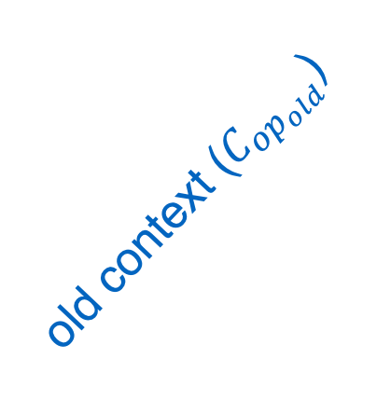
JXPerf: A Lightweight Performance Tool
Methodology
Redundant memory operation attribution
main() {
a();
b();
}
a() {
b();
}
main()
old context ($C_{{op}_{old}}$)
a()
f()
new context ($C_{{op}_{new}}$)
b()
e()
g()
h()
c()
d()
i()
old op
new op
<redundant with>
Redundancy pair: <($C_{{op}_{old}}$ , $C_{{op}_{new}}$), frequency>

Slide 13
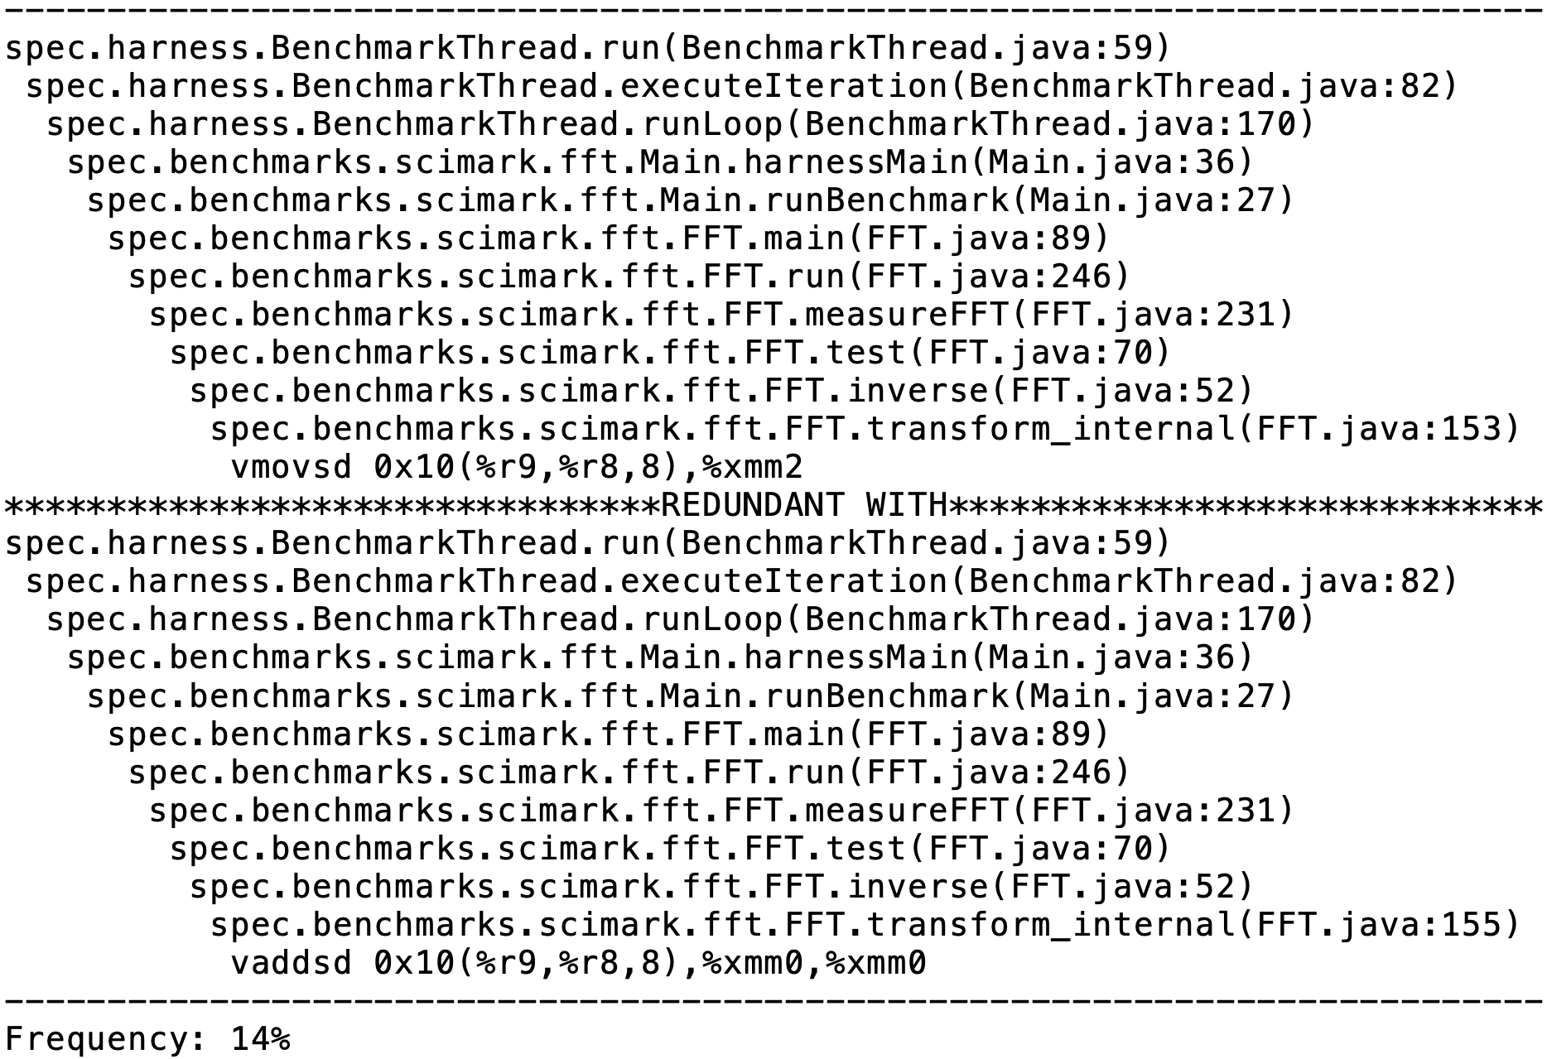


Use Case: SPECjvm2008 FFT
152 for (…) {
153 d[j] = d[i] - wd_real;
154 d[j+1] = d[i+1] - wd_imag;
155 d[i] = d[i] + wd_real;
156 }
Old calling context ($C_{{op}_{old}}$)
Old operation
New calling context ($C_{{op}_{old}}$)
New operation

Slide 14
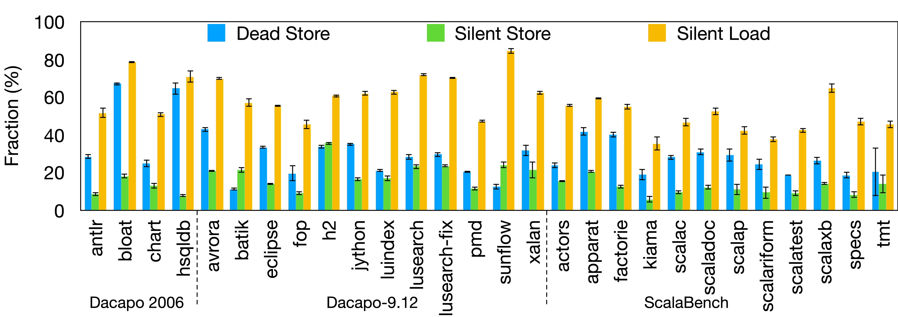
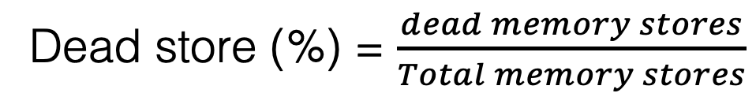
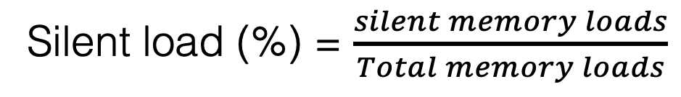
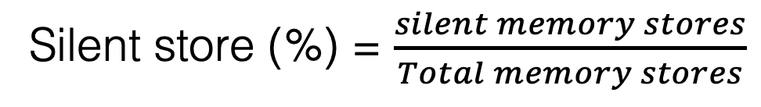
Experiments
Fraction of redundant operations on Dacapo and ScalaBench
Dead store (%) = $\frac{dead memory stores}{Total memory stores}$
Silent store (%) = $\frac{silent memory stores}{Total memory stores}$
Silent load (%) = $\frac{silent memory loads}{Total memory loads}$

Slide 15
Experiments
Overhead on Dacapo and ScalaBench
Rule of thumb: 20-200 samples per thread per second
Sampling period | Dead store detection |  | Silent store detection |  | Silent load detection
 | Time overhead | Space overhead | Time overhead | Space overhead | Time overhead | Space overhead
500K | 18% | 8% | 14% | 7% | 34% | 17%
1M | 10% | 8% | 10% | 6% | 21% | 10%
5M | 5% | 6% | 4% | 5% | 7% | 7%
10M | 3% | 5% | 4% | 5% | 5% | 6%
Sampling period | Dead store detection |  | Silent store detection |  | Silent load detection
 | Time overhead | Space overhead | Time overhead | Space overhead | Time overhead | Space overhead
500K | 18% | 8% | 14% | 7% | 34% | 17%
1M | 10% | 8% | 10% | 6% | 21% | 10%
5M | 5% | 6% | 4% | 5% | 7% | 7%
10M | 3% | 5% | 4% | 5% | 5% | 6%

Slide 16
Conclusions
Observe many kinds of software inefficiencies manifest as redundant memory operations
E.g., algorithms, data structures, input, compiler transformations
Develop JXPerf -- a lightweight performance tool to pinpoint and quantify redundant memory operations in Java
Open source JXPerf at https://github.com/ScalableMachinesResearch/JXPerf (MIT License)
Questions?

