Slide 1
Axon
terminals
Myelin sheath
Input
Signals
Output
Signals
Dendrites
Axon
Cell nucleus
Schematic of a biological neuron.

Slide 3
g(w^{T}x) = 0
g(w^{T}x)
g(w^{T}x) < 0
g(w^{T}x) ≥ 0
1
x₂
w^{T}x
-1
x₁

Slide 4
ϕ(w^{T}x) = 0
ϕ(w^{T}x)
ϕ(w^{T}x) < 0
ϕ(w^{T}x) ≥ 0
1
x₂
w^{T}x
-1
x₁

Slide 5
Linearly separable
Not linearly separable
Not linearly separable
x₂
x₂
x₂
x₁
x₁
x₁

Slide 6
g(w^{T}x)
1
w^{T}x
-1
Unit step function.

Slide 7
1
Weight update
Error
w₀
x₁
w₁
Σ
Output
w₂
x₂
Net input function
Threshold
function
w_{m}
.
.
.
x_{m}
1
Weight update
w₀
Error
x₁
w₁
Σ
Output
w₂
x₂
Net input function
Activation function
w_{m}
Threshold function
.
.
.
x_{m}
Adaptive Linear Neuron (Adaline)

Slide 8
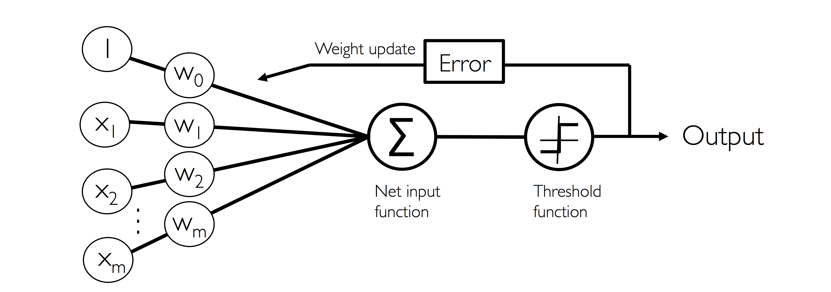
Perceptron
1
Weight update
w₀
Error
x₁
w₁
Σ
Output
w₂
x₂
Net input function
Activation function
w_{m}
Threshold function
.
.
.
x_{m}
Adaptive Linear Neuron (Adaline)

Slide 9
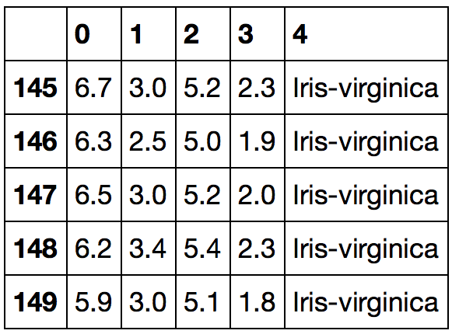

Slide 10
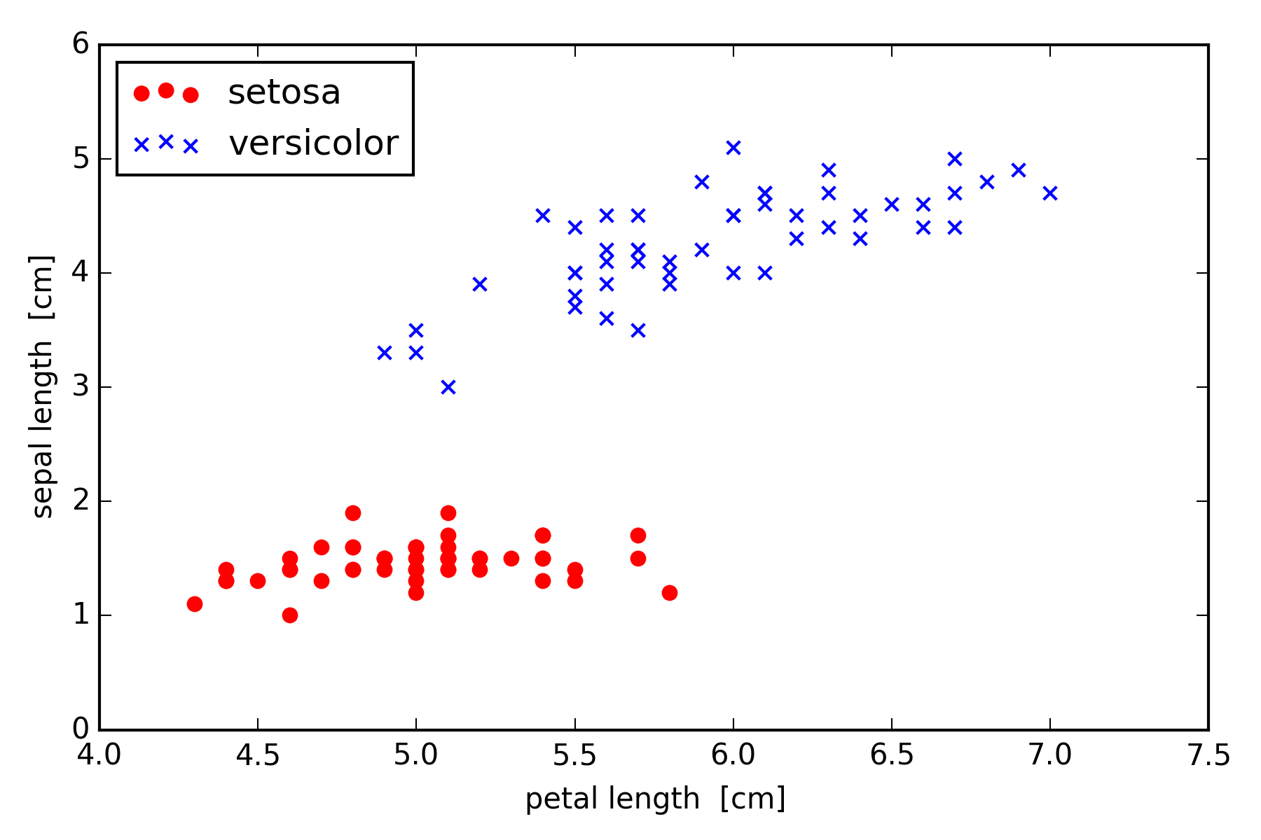

Slide 11
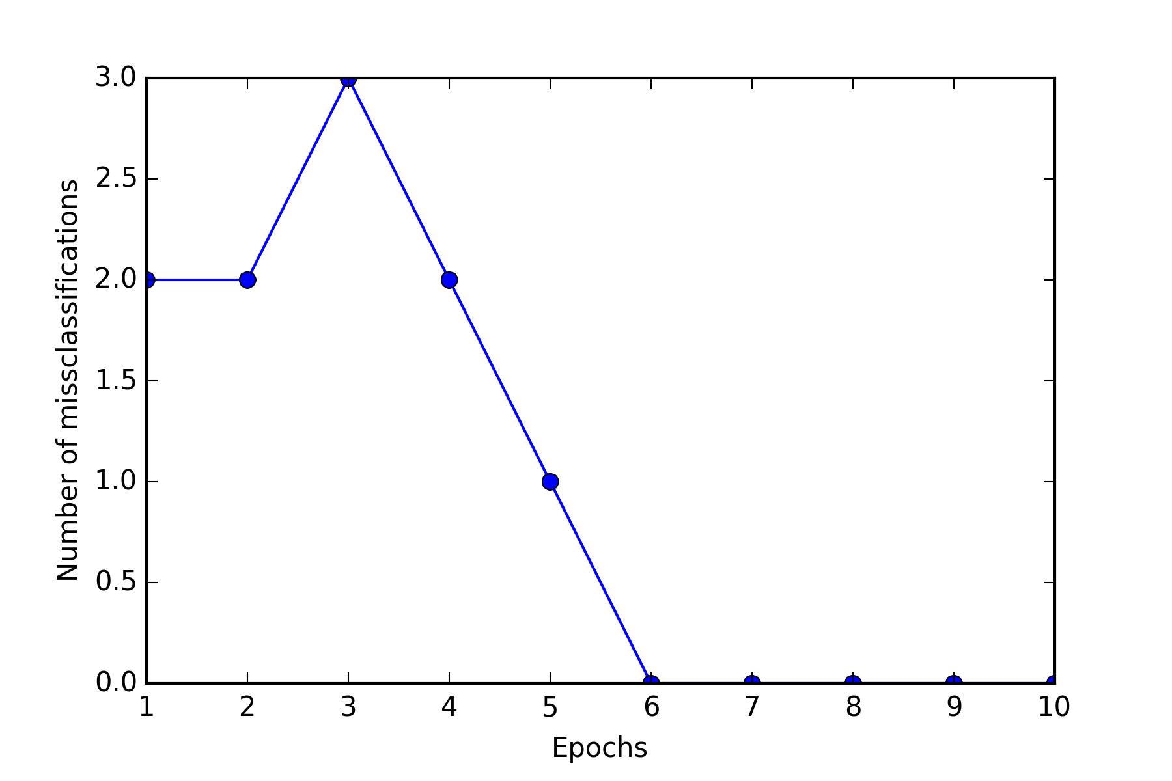

Slide 12
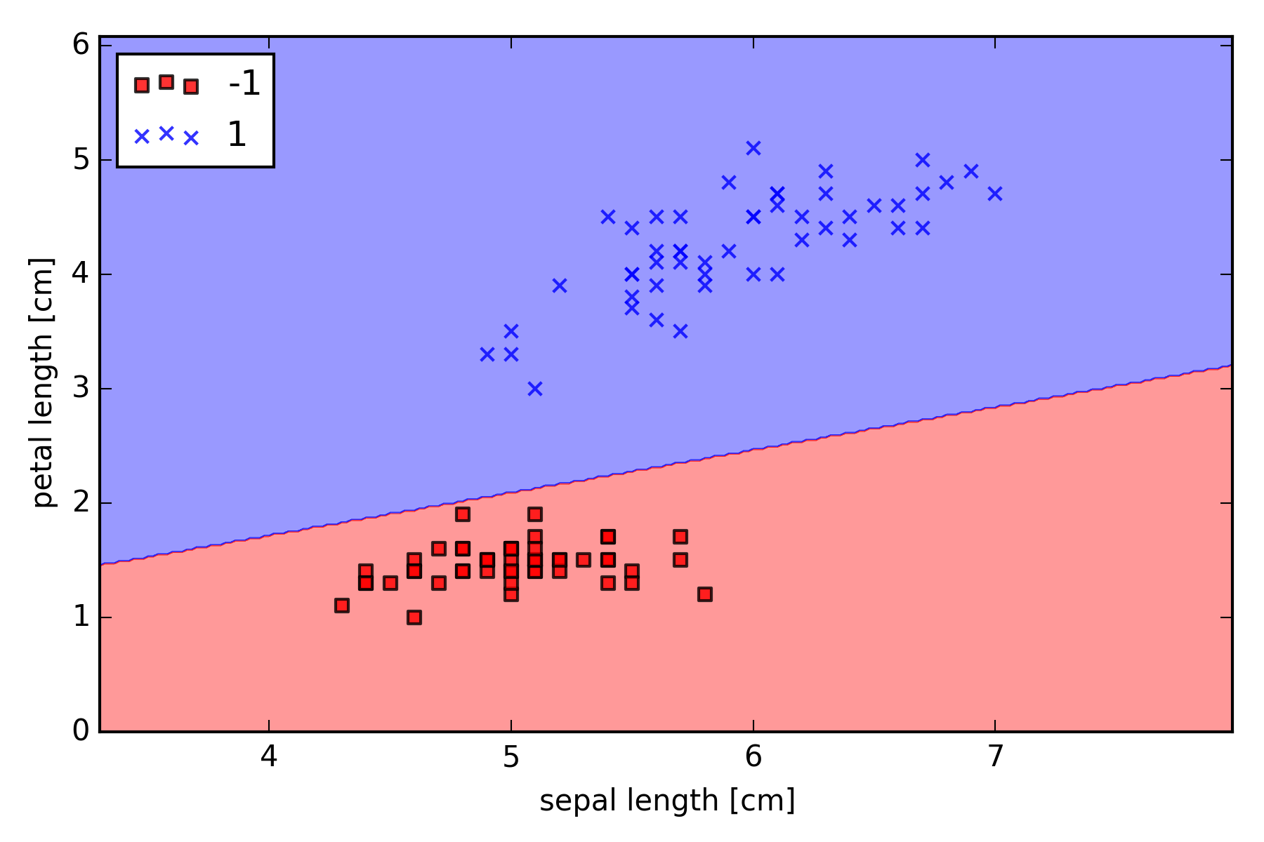

Slide 13
1
w₀
Error
x₁
w₁
Σ
Output
w₂
x₂
Net input function
Activation function
Quantizer
w_{m}
.
.
.
x_{m}
Adaline.

Slide 14
1
w₀
Error
x₁
w₁
Σ
Continuous Output
w₂
x₂
Net input function
Activation function
w_{m}
.
.
.
x_{m}
Linear Regression
1
w₀
Error
x₁
w₁
Σ
Categorical (nominal) Output
w₂
x₂
Net input function
Activation function
w_{m}
Threshold function
.
.
.
x_{m}
Adaptive Linear Neuron (Adaline)

Slide 15
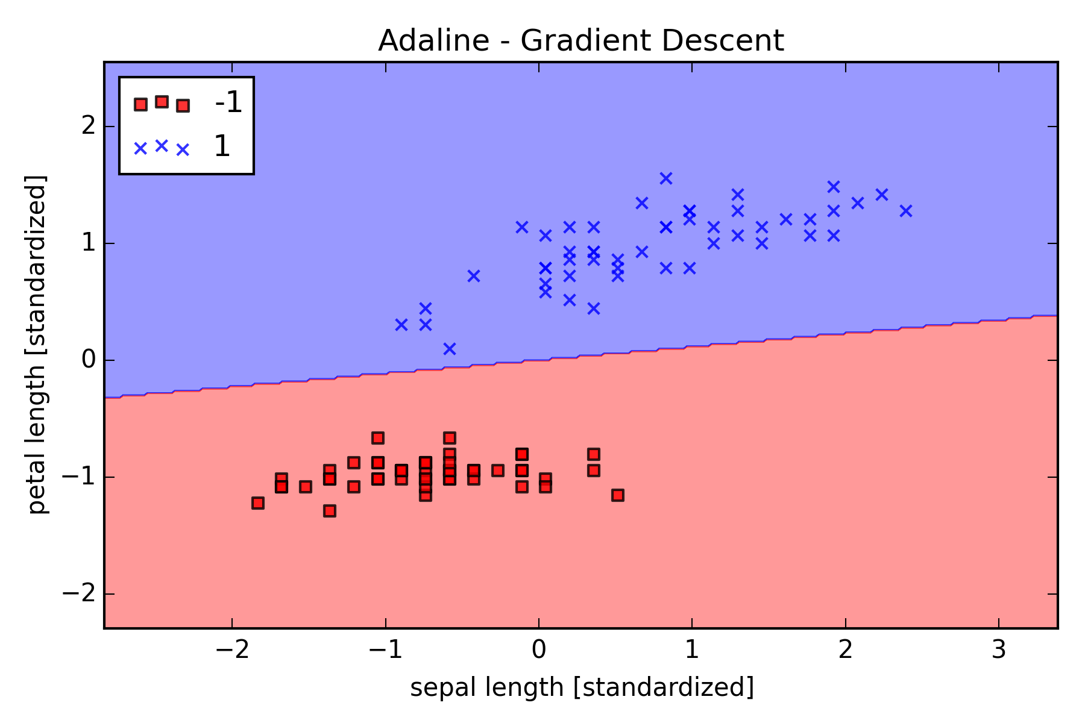
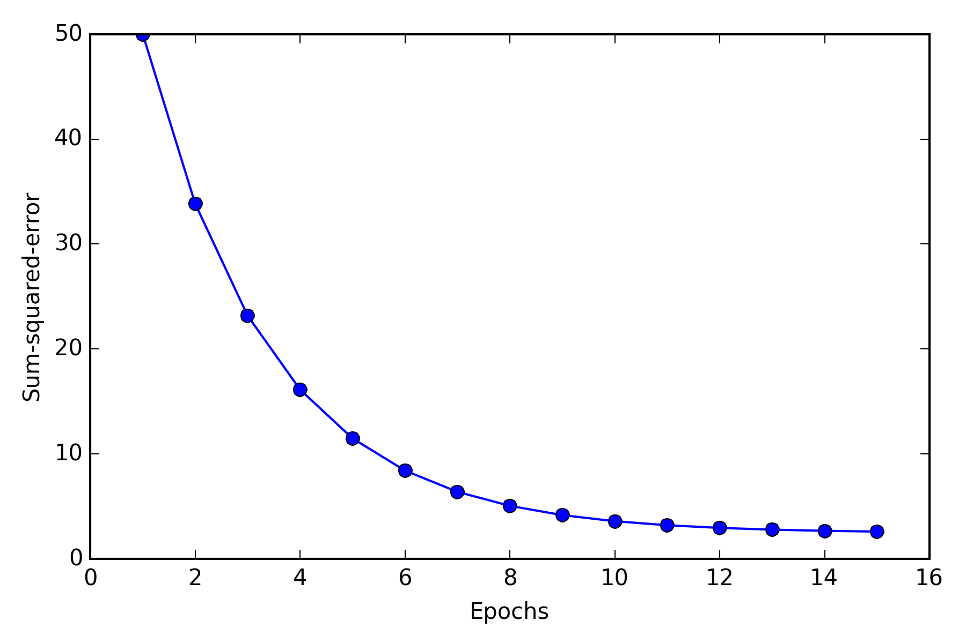
iris_adaline_gd_cost_convergence_1.png
iris_adaline_gd_cost_convergence_2.png

Slide 16
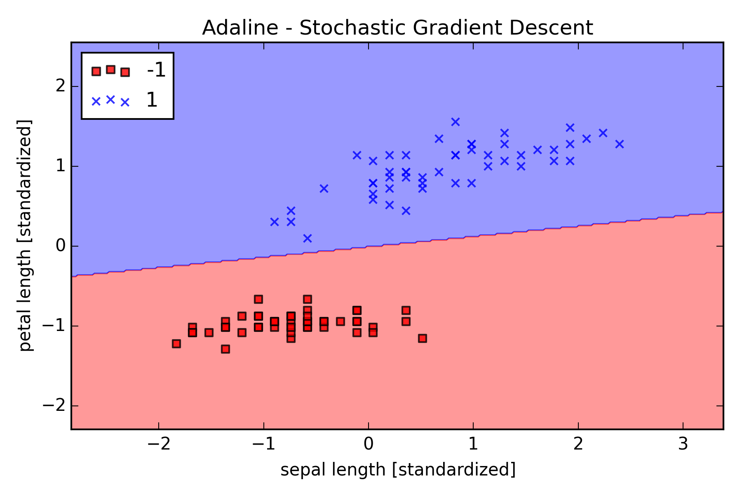
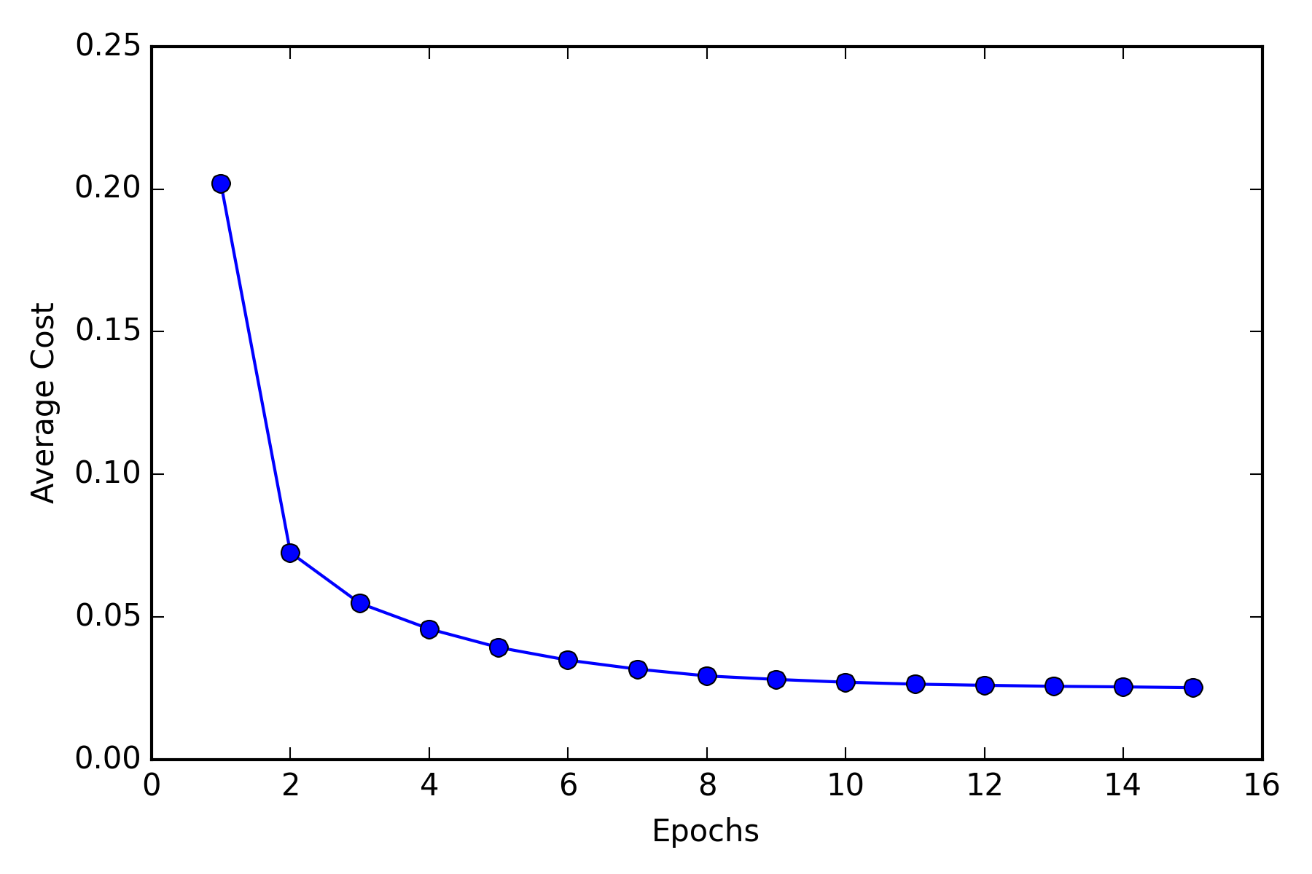
iris_adaline_sgd_cost_convergence_1.png
iris_adaline_sgd_cost_convergence_2.png

Slide 17
1
w₀
Error
x₁
w₁
Σ
Class label
w₂
x₂
Net input function
Sigmoid
function
Quantizer
w_{m}
.
.
.
x_{m}

Slide 18
4
5
6
1 2 3 ×
= 1×4 + 2×5 + 3×6 = 32

Slide 19
Initial weight
Gradient
J(w)
Global cost minimum
J_{min}(w)
w

Slide 20
Global log-likelihood maximum
l_{max}(w)
l(w)
w

Slide 21
Initial weight
J(w)
Gradient
J(w)
Global cost minimum
J_{min}(w)
w
w

Slide 22
J(w)
J(w)
w
w
Large learning rate: Overshooting.
Small learning rate: Many iterations
until convergence and trapping in
local minima.

Slide 23
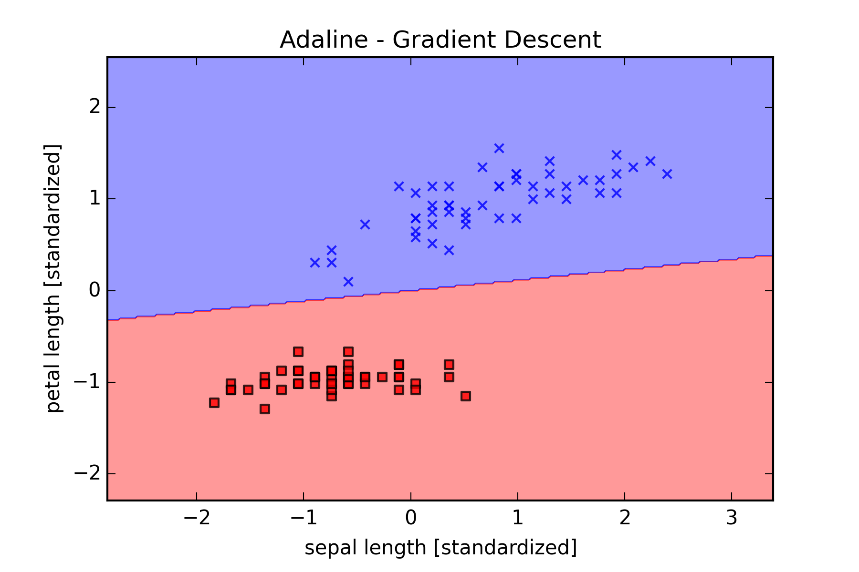

Slide 24
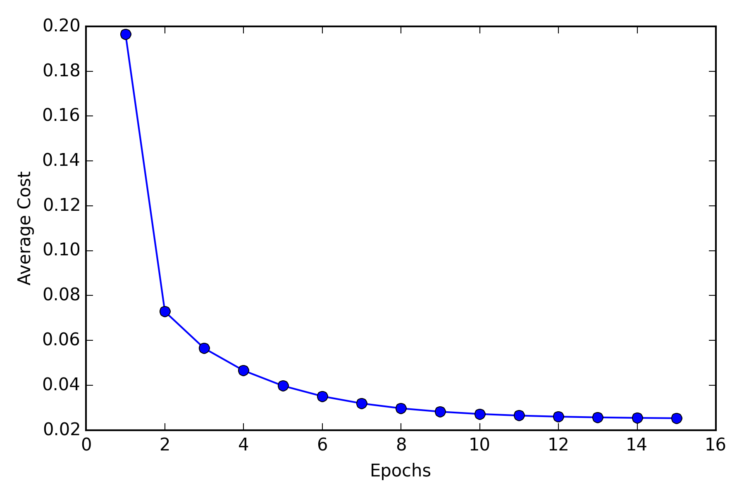
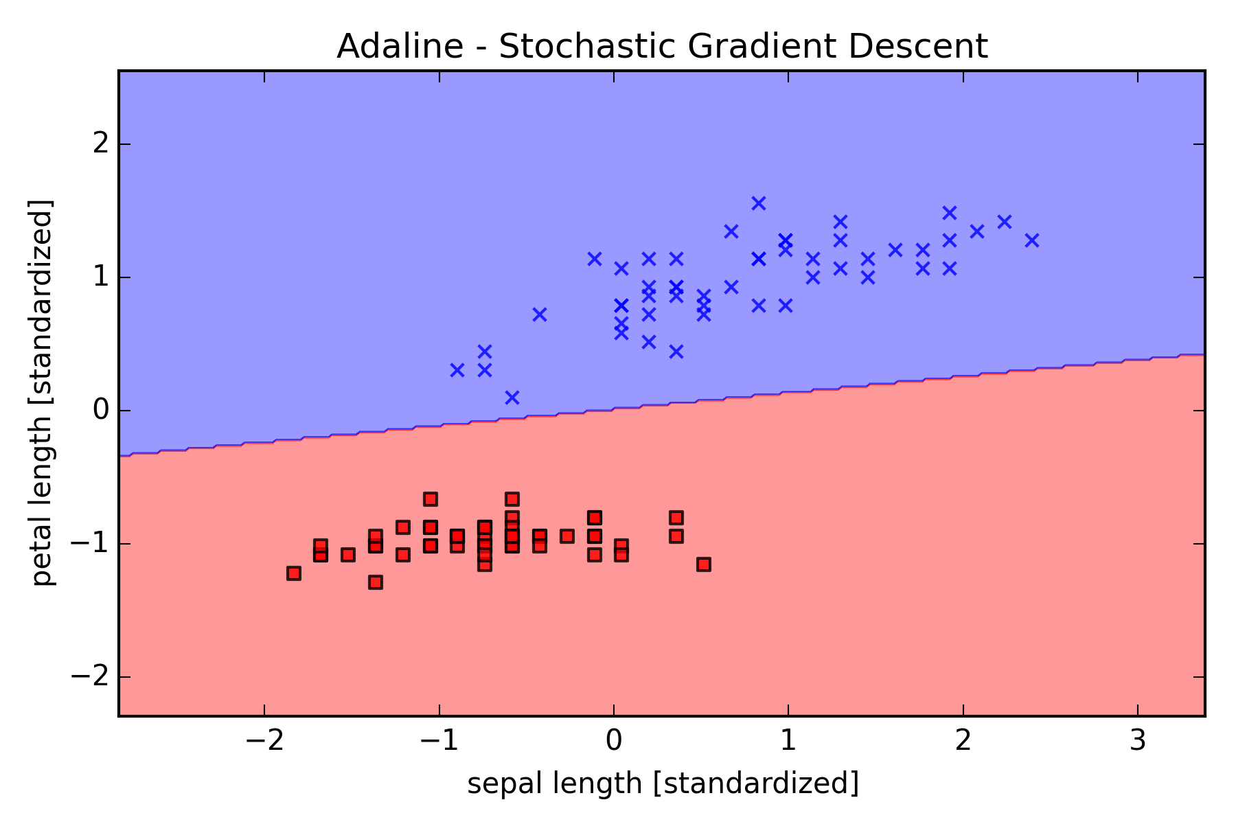

Slide 25
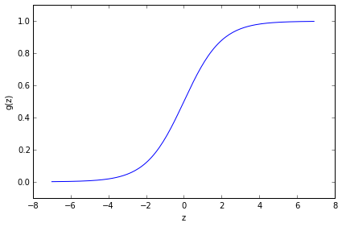

Slide 26
g(w^{T}x)
1
w^{T}x
θ
-1
Unit step function.

Slide 27
Inputs
Weights
Net input
function
Activation function
1
w₀
x₁
w₁
Σ
Output
w₂
x₂
w_{m}
.
.
.
x_{m}
Schematic of Rosenblatt’s perceptron.

Slide 28
x₂
x₁
Example of a linear decision boundary
for binary classification.

Slide 29
1
w₀
Error
x₁
w₁
Σ
output
w₂
x₂
w_{m}
Net input function
Activation function
Unit step function
.
.
.
x_{m}
Schematic of a logistic regression classifier.

Slide 30
1
Weight update
Error
w₀
x₁
w₁
Σ
Output
w₂
x₂
w_{m}
.
.
.
x_{m}
Schematic of a perceptron classifier.

Slide 31
1
w₀
Error
x₁
w₁
Σ
output
w₂
x₂
w_{m}
.
.
.
x_{m}
Schematic of an Adaline classifier.

Slide 32
1 if z ≥ 0
-1 otherwise.
Unit step
g(z) =
1 if z ≥ 0
0 otherwise.
g(z) =
Linear
g(z) = z
Logistic
(sigmoid)
g(z) =
1 / (1 + exp(-z))
Hyperbolic
tangent
(sigmoid)
exp(2z) - 1
exp(2z) + 1
g(z) =
. . .
1
w₀
x₁
w₁
Σ
output
w₂
x₂
w_{m}
.
.
.
A selection of commonly used activation functions for artificial neurons.
x_{m}

Slide 33
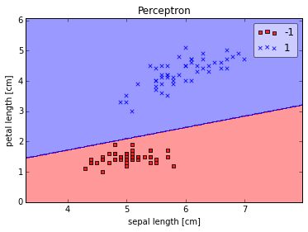

Slide 34
J(w)
Initial weight
J_{min}(w)
w
Schematic of gradient descent.

Slide 35
Global cost minimum
Zero mean and
unit variance
w₂
w₂
w₁
w₁

