Slide 1
Framework for management of bioinformatics metadata Djomangan Adama Ouattara 05 Jan. 2014
Framework for management of scientific metadata

Slide 2
Context
Data are generated with laboratory instruments
Data are stored in files / databases
Data are analyzed (models are created)
Reports are generated and stores
It is important to track
Metadata associated with raw data
Metadata associated with analysis workflows

Slide 3
Context
Need for a management system (Framework) to handles scientific data (UTEC7: MS and NMR data)
Goal: Track the fate of data (from their acquisition to their analysis and interpretation)
Example:
Fingerprinting database
Database of MS+NMR spectra associated to different biological endpoints
Generate prediction models (e.g. application to clinical diagnostics)
Generate reports

Slide 4
Framework and Toolbox
Toolbox
Collection of algorithms that are used to solve specific problems
Strongly language dependent
E.g.: Numerical Recipieces (C++), LAPACK (C), Bioconductror (R)
Framework
A working environment that defines how the system works (Architecture, Datamodel)
Is not a toolbox / Should be language independent
Says how does toolboxes can be implemented how their I/O flows are structured
Toolboxes can be implemented with a framework in a given language
Is a powerful mean to define best practices
E.g.: Zend (PHP) - MCV framework

Slide 5
Toolbox and Framework
Toolboxes are generally used in bioifnormatics and are associated to specific languages
R, Matlab, Mathematica / Python, C++, Fortran
To my knowledge no rigourous framework exists in bioinformatics
So it is generally difficult to interface toolboxes coming from different languages and worse, toolboxes that come from the same language/plateform (e.g. Galaxy)
We need both a Framework and Toolboxes
A framework to define how does the system will operate
Toolboxes to do the job

Slide 6
Metadata
How metabolomics metadata look like ?
Use of MS data as a first usecase
Raw data => mzXML file format
mzXML is an open data format for storage and exchange of mass spectroscopy data
Developed at the Seattle Proteom Center (Institute for Systems Biology)
http://sashimi.sourceforge.net/schema_revision/mzXML_2.1/Doc/mzXML_2.1_tutorial.pdf

Slide 7
How does metadata looks like
Project / Laboratory / Dates
Operators (persons who perform the experiment)
Instruments + configurations
Acquisition instruments (laboratory)
Data processing instrument (numerical software)
Protocols (Scenarios)
Experiments (Scenario realizations)
Resources (Data, samples)
Reports (html, pdf)

Slide 8
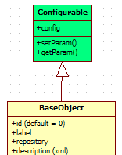
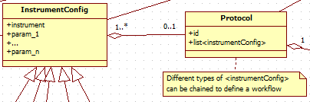
Data modelling
An object-oriented data model
Each stakeholder is implemented as an object (in the MySQL database and Matlab )
Can be implemented in any programming language
Structured and unified bioinformatics programming framework
Model specifications : UML (Unified modeling language)
http://fr.wikipedia.org/wiki/UML_%28informatique%29
Generalization
(Inheritance)
Aggregation

Slide 9


UML
Class diagrams
Give relation between each stakeholder of the datamodel
Association
Composition/Aggregation
Inheritance
…

Slide 10
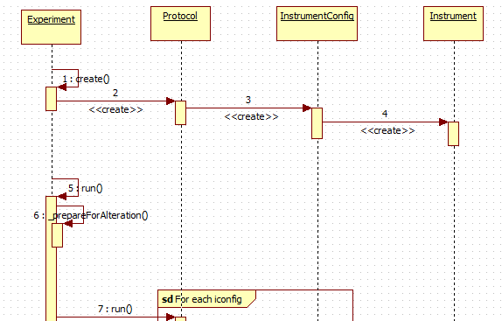
UML
Sequence diagrams
Represents how does the system work (the algorithmic workflow)

Slide 11
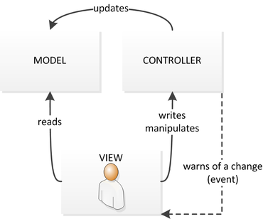
MVC model
http://fr.wikipedia.org/wiki/Mod%C3%A8le-vue-contr%C3%B4leur
Model
Stakeholders saved in database
Relatation between stakeholders
View
Representation of the model
IHM
Controller
Link between the user/the view/ and the model
Manipulate the model, update the view

Slide 12


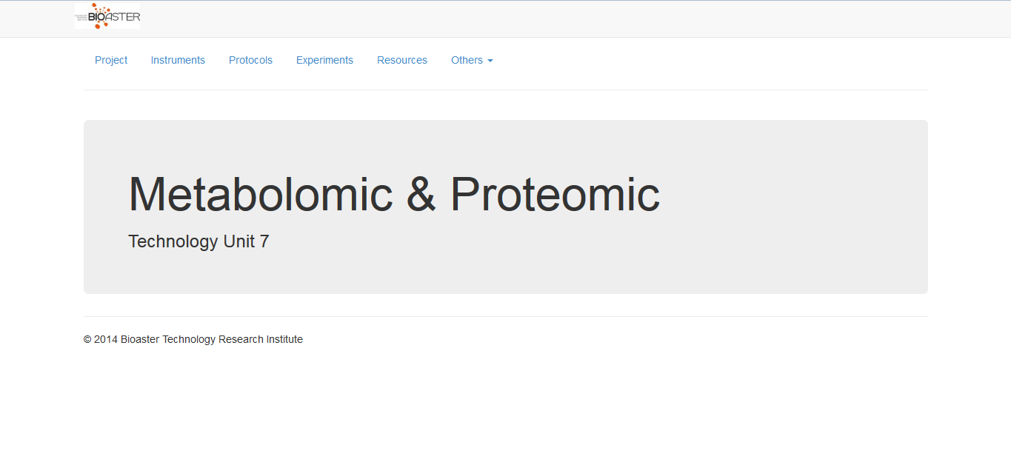
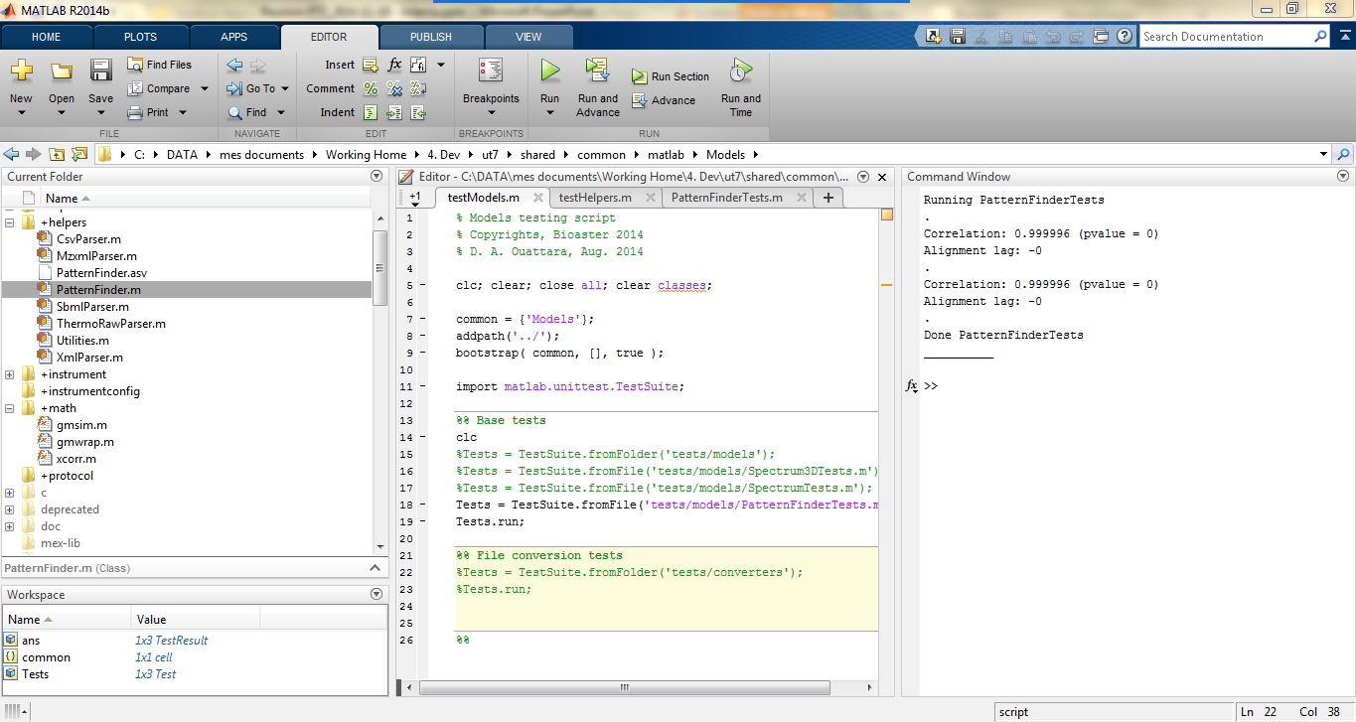

Framework overview
Web app.
Matlab
User-friendly visualization
Simple management
Advanced management
Numerical analyses
Framework PHP (Zend 2.0)
Framework Matlab (Bioinfo)
Basic objects registration
Visualization
Save numerical
analyses
Visualization
Report
e.g. html reports
use
Experiment
create
Resource
InstrumentConfig
Protocol
samples, aliquots, raw files,
results, pathways,
mathematical modèles
Project
Laboratory
Operator
Instrument

Slide 13

WebApp part
Serveur Apache2/Mysql/Php
MySQL Workbench (Free)
Oracle
Synchronize the model with the database
Zend PHP (Free)
Object-Relational Mapping (ORM)
http://en.wikipedia.org/wiki/Object-relational_mapping
Web rendering
Bootstrap CSS
Javascript/Ajax
Use of JSON as data exchange format
Code versioning
Bazaar (in2p3/utec7 PC)

Slide 14
Computing part
Currently implemented in Matlab
It could be interesting to extend the framework to other programming languages
Require an object-oriented programming language
Python
R
The computing part can communicate with the WebApp part to store/retrieve objects through APIs

