Slide 1
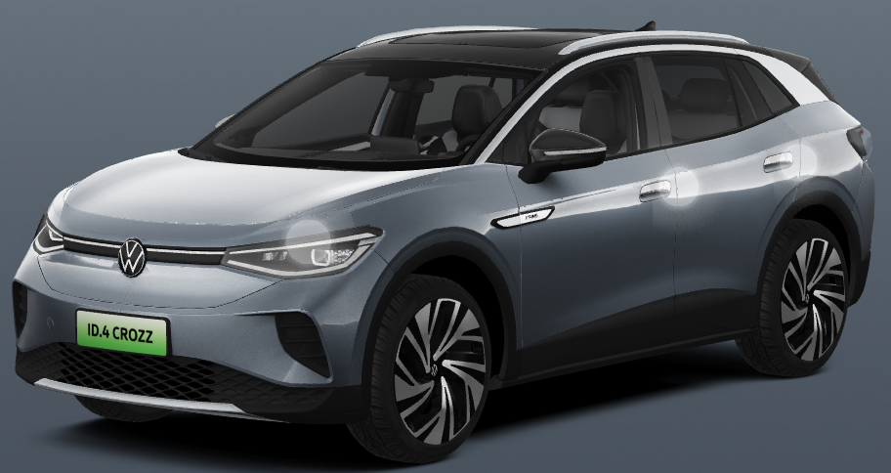
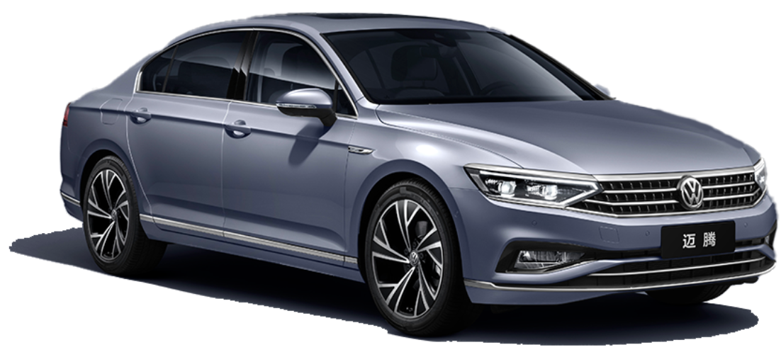
Controversial topic
Can new energy vehicles replace combustion vehicles?
VS

Slide 2
Power
The power of new energy vehicles is weak?
Acceleration is the most important part of a car's power, so naturally it depends on its peak torque.
Compared with combustion engines, pure electric vehicles can instantly reach the maximum torque by relying on the kinetic energy of the motor, so new energy must have a stronger acceleration ability than combustion.

Slide 3
Battery
The new energy vehicles have short battery life and can't run far?
Now the average new energy vehicle has a battery life of about 400 kilometers. And what is the concept of 400 kilometers?
Many consumers do not have the concept of mileage. For example, from Jinan to Beijing is 410 kilometers, and only one charge is required for the trip.
combustion vehicles do not have battery life issues.

Slide 4
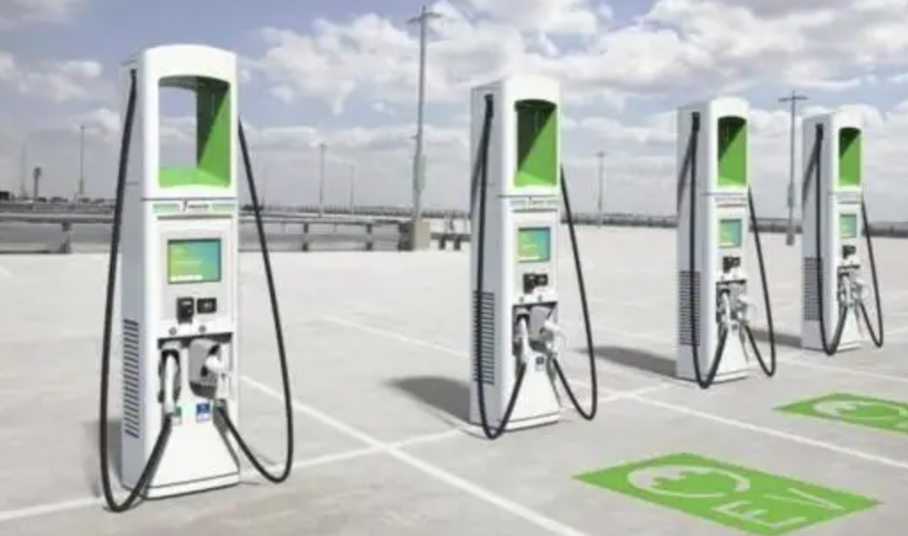

Charging
Lack of charging stations and long charging time
Although State Grid and China Southern Power Grid have made great efforts to popularize charging stations, due to the lack of maintenance of most charging stations, charging piles are often damaged.
Although some charging stations can be charged, in fact, the power is very problematic. As a result, the original half-hour fast charging vehicle costs 1, 2 hours or even more, and these are extremely unfriendly to electric vehicle owners.
State Grid 国家电网
China Southern Power Grid 中国南方电网
Popularize 推广
Problematic 有问题的
Extremely 极其

Slide 5
Resource
Automobile fuel is a limited resource
Whether it is a large car or a small car, the fuel used is gasoline or diesel. However, gasoline and diesel are non-renewable resources. The more we use, the less we have left.
Gasoline 汽油
Diesel 柴油
Non-renewable 不可再生

Slide 6
Environmental
Environmental issues
The exhaust of fuel vehicles is not environmentally friendly, it will cause air pollution, and it will also cause a certain degree of harm to our health.
Exhaust 尾气

Slide 7
1、Consumption 消耗
2、Encounter 遇到
3、In severe cases 在严重情况下
4、Spontaneously ignite 自燃
Conclusion
Conclusion
Although new energy vehicles can replace traditional fuel vehicles in the future, it is impossible in the short term. Although the development of new energy vehicles is very fast, the battery life have not been fully resolved. Especially affected by the weather, such as cold and snowy days, the power consumption of the battery will increase.
Also, if the battery encounters water, it will be damaged, and in severe cases, it may spontaneously ignite.
In terms of charging speed, the current fastest charging time can reach 2 hours, and if you use fast charging, you can charge 80% of the power in 30 minutes.
Therefore, charging time is also a difficulty faced by new energy vehicles at present.

