Slide 1
Self-driving Cars
Taxonomy for driving automation (levels)
The driving task
Conclusion
Notes:
Welcome to the first module of the Introduction to Self-driving Cars.
Throughout this module you will learn about the main components needed to create a self-driving car and the technical requirements that drive their design.
Before we begin, it's important that you understand autonomous vehicle requirements or how we define self-driving car.
Firstly , I will introduce you to the taxonomy for self-driving cars.
Next, I'll describe the perception needs for the driving task.
And finally I will conclude with the limitations of our proposed taxonomy classification system.
Hopefully this will help you appreciate just understand autonomous vehicle. So, let’s dive into the first part , the taxonomy for self-driving cars .

Slide 2
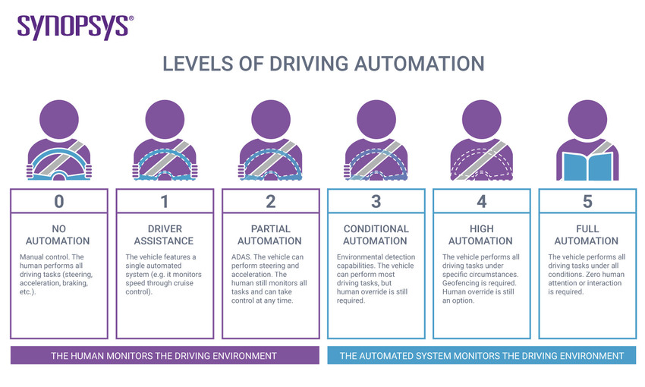
Taxonomy for driving automation (levels)
Level 0 - No Automation
Level 1 - Driving Assistance
Level 2 - Partial Driving Automation
Level 3 - Conditional Driving Automation
Level 4 - High Driving Automation
Level 5 - Full Driving Automation
The self-driving organization defines 6 levels of driving automation, its ranging from 0 to 5.
Notes:
About Level 0, Most vehicles on the road today are Level 0: manually controlled. The human provides the "dynamic driving task“.
Level 1, This is the lowest level of automation. In this level, The vehicle features a single automated system for driver assistance.
Level 2, This means advanced driver assistance systems or ADAS. The vehicle can control both steering and accelerating.
Level 3, vehicles have “environmental detection” capabilities and can make informed decisions for themselves.
Level 4, The key difference between Level 3 and Level 4 automation is that Level 4 vehicles can intervene if things go wrong or there is a system failure.
Level 5 , vehicles do not require human attention the “dynamic driving task”.

Slide 3
Driving task
Perception
perceiving the environment that we're driving in.
Motion Planning
allows us to reach our destination successfully
Vehicle Control
need to operate the vehicle itself with vehicle control
Notes:
I will use these throughout the self-driving specialization , if you're working in this industry, The first term on our list is the driving task.
Broadly speaking, the driving task is made up of 3 sub-tasks.
The first sub-task is perception, or perceiving the environment that we're driving in. This includes tracking a car's motion , identifying the various elements in the world around us, just something like the road surface, road signs, vehicles, pedestrians and so on. We also need to track all moving objects and predict their future motions. So we can drive safely and accurately.
The second sub-task is motion planning. This allows us to reach our destination successfully. For example, you may want to drive from your home to your office. So you'll need to consider which roads you should take, when you should change lanes or cross an intersection, the planning system should give the best way which you want.
Finally, we need to operate the vehicle itself with vehicle control. So we need to take the appropriate steering, break and acceleration decisions to control the vehicle's position and velocity on the road.
These three sub-tasks are the main driving task and need to be performed constantly while driving a vehicle.

Slide 4
Conclusion
Taxonomy for driving automation (levels)
The driving task
Notes:
So, let's summarize.
In this presentation, we covered various concepts relating to automation.
We covered some basic definitions including taxonomy for driving automation .
And we also explored driving task.

