Slide 1
Self-driving Cars
Taxonomy for driving automation (levels)
The driving task
Conclusion

Slide 2
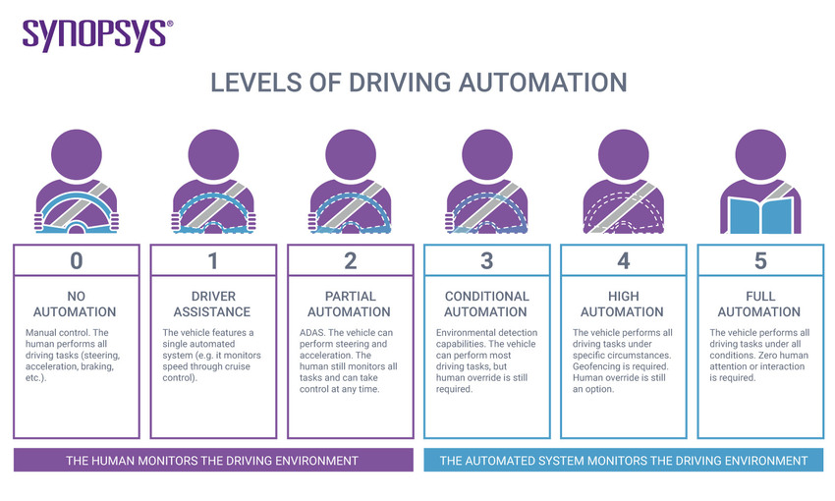
Taxonomy for driving automation (levels)
Level 0 - No Automation
Level 1 - Driving Assistance
Level 2 - Partial Driving Automation
Level 3 - Conditional Driving Automation
Level 4 - High Driving Automation
Level 5 - Full Driving Automation
The self-driving organization defines 6 levels of driving automation, its ranging from 0 to 5.

Slide 3
Driving task
Perception
perceiving the environment that we're driving in.
Motion Planning
allows us to reach our destination successfully
Vehicle Control
need to operate the vehicle itself with vehicle control

Slide 4
Conclusion
Taxonomy for driving automation (levels)
The driving task

