Slide 1
数据的增删改查

Slide 2
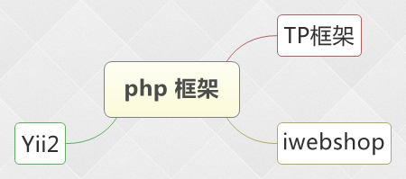
框架

Slide 3
原生增删改查
Insert into tablename () values()
Delete from table_name where column_name=column_value
Update tablename set column_name=column_value
Select * from tablename

Slide 4
TP 框架 CRUD
$dir = D(‘Dir’); ===> dir 表
$_POST[‘des’] = htmlspecialchars($_POST[‘des’]);
$dir -> add($_POST);
$dir->create(); $dir->save();
$id = I(‘get.id’); $dir->delete($id);
$dir -> where(array(‘flag’=>’0’, ‘pid’=>$pid)) -> select()

Slide 5
修改框架中的配置
Cd \f\data\shop\App\Home\Conf
Vim confing.php
‘DB_HOST’ => ‘localhost’
‘DB_NAME’ => ‘shop’
‘DB_USER’ => ‘root’
‘DB_PWD’ => ‘’
修改 C:\Windows\System32\drivers\etc\hosts 文件
127.0.0.1 www.shop.com
http://www.shop.com/ 访问项目

Slide 6
修改后台配置
…\shop\App\Admin\Conf\config.php
配置修改如前台
http://www.shop.com/index.php/Admin
admin
123456

Slide 7
Thank You!

