Slide 1
Introduction to Computing for Data Analysis
Pairwise association mining
Richard Vuduc, Ph.D.
Associate Professor
School of Computational Science and Engineering
Assessing efficiency
Notes:
[Rich] Rachel did a terrific job helping us come up with a basic algorithm.
Now it’s time for the part that’s even more fun, which is writing up the code!
For that, I’ve asked Vaishnavi to help me with her hacking expertise.

Slide 2
Notes:
[Rich] Vaishnavi, Rachel came up with a good algorithm which I think is correct.
The next question is whether it’s efficient.
What do you think?
[Vaishnavi] I would say there is potential to make it much faster.
[Rich] Really? How so?

Slide 3



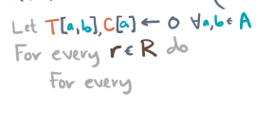
Notes:
[Vaishnavi] As-is, I see two potential limitations.
First, it might do too much work.
Second, it might use too much intermediate storage.
[Rich] I think I know what you mean, but can you elaborate?

Slide 4
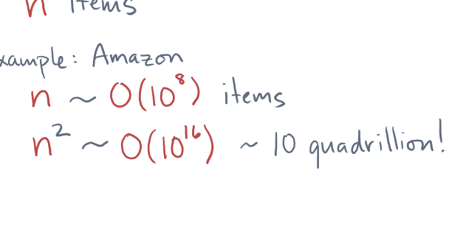
Notes:
[Vaishnavi] Sure.
Let’s say there are m receipts and n possible items.
If all possible pairs of items actually co-occur then in terms of storage, the table might need up to n^2 entries,
[Rich] Right.
Amazon has hundreds of millions of products in its inventory.
That number squared is in the tens of quadrillions.
[Vaishnavi] I read somewhere that ten quadrillion dollars in one dollar bills would cover the entire surface of the earth 10 times over.

Slide 5
Notes:
[Rich] That’s a lot cash.
So what about the work?

Slide 6
Notes:
[Vaishnavi] The work is similar.
If any itemset pair exists in the data, the algorithm visits it.
But later it filters out many of these against the user’s threshold.

Slide 7
Notes:
[Rich] Good point.
Depending on how large the threshold is, it’s possible most of the rules won’t be viable.

Slide 8
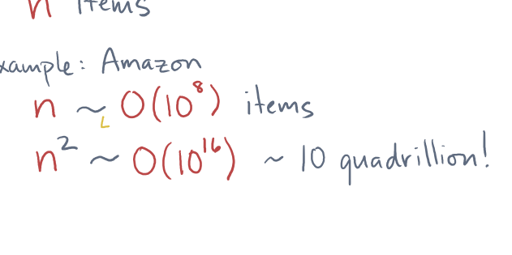



Notes:
Your main point is that we want to handle lots of data, or “big n.”
So algorithms that scale like n-squared in time or storage are bad.
[Vaishnavi] Yes, exactly.
It would be better to design algorithms that scale like O(n log n) or O(n).

Slide 9
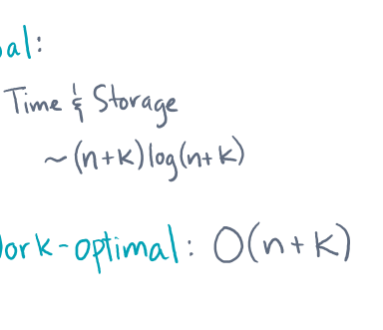
Notes:
[Vaishnavi] Here’s a more general way to think about our algorithm design goals.
[Rich] Great, please enlighten me.
[Vaishnavi] Let’s say the problem has an input of some size, call it ‘n’.
The output, or results, will also have some size, call it ‘k’.
Ideally, what you really want is an algorithm whose scaling is proportional to O(n + k), or maybe O((n + k) \log (n + k)).

Slide 10
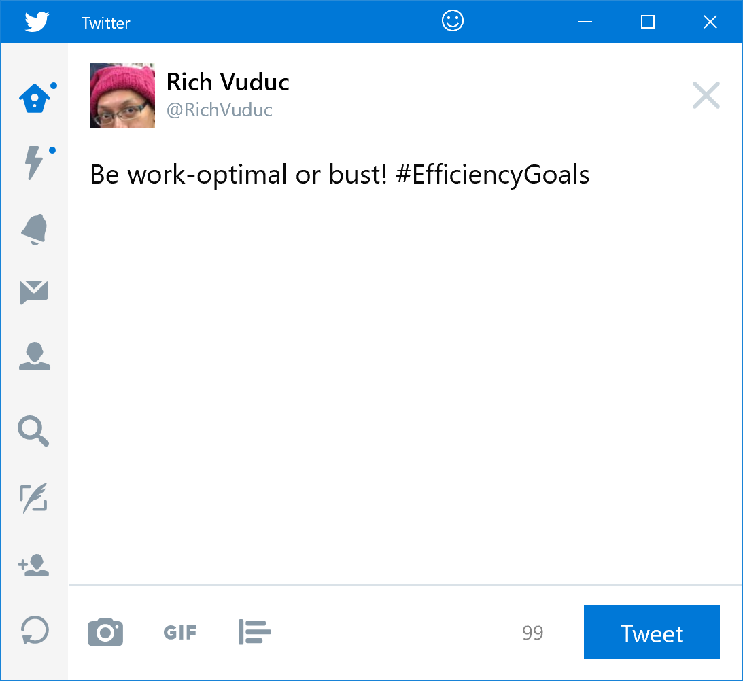
Notes:
[Rich] That makes perfect sense.
In the computer science world, we call an algorithm that scale linearly, like O(n+k), “work-optimal.”
And goals are good!

Slide 11
Notes:
[Rich] It might be hard to come up with a work-optimal method for this problem, but I’m happy you brought it up.
So maybe now would be a good time to take a short break and think a little bit more about work optimality.

