Slide 1
Introduction to “Spark”
Haoruo Peng
2013/05/08

Slide 2
Basic Information
Developed at the University of California, Berkeley, Algorithms, Machines, and People(AMP) Lab.
Although it can load data from any Hadoop input source, Spark is a completely separate codebase optimized for low latency.
Starting in version 0.7, Spark supports Scala, Java and Python.

Slide 3
Motivation
Build large-scale and low-latency data analytics applications.
Design a programming model that extends the MapReduce model to better support two common classes of analytics apps:
Iterative algorithms (such as gradient descent)
Interactive data mining
Maintaining the feature of automatic fault tolerance.

Slide 4
Drawback of MapReduce
Most current cluster programming models are based on acyclic data flow from stable storage to stable storage
Map
Reduce
Benefits of data flow: runtime can decide where to run tasks and can automatically recover from failures
Input
Map
Output
Reduce
Map

Slide 5
Drawback of MapReduce
Iterative algorithms, including many machine learning algorithms and graph algorithms like PageRank.
Interactive data mining, where a user would like to load data into RAM across a cluster and query it repeatedly.
OLAP(online analytical processing)reports that run multiple aggregation queries on the same data.
Acyclic data flow is inefficient

Slide 6
Resilient Distributed Datasets (RDDs)
An RDD is a read-only collection of objects distributed across a set of nodes.
They can be rebuilt if a portion of the dataset is lost. The process of rebuilding a portion of the dataset relies on a fault-tolerance mechanism that maintains lineage (or information that allows the portion of the dataset to be re-created based on the process from which the data was derived).
The elements of an RDD need not exist in physical storage; instead, a handle to an RDD contains enough information to compute the RDD starting from data in reliable storage.

Slide 7
Resilient Distributed Datasets (RDDs)
Controllable persistence (e.g. caching in RAM) for reuse
Retain the fault tolerance property of MapReduce
Automatically rebuilt on failure
Created through parallel transformations (map, filter, groupBy, join, …) on data in stable storage
Immutable collections of objects spread across a cluster

Slide 8
RDD Construction
From a file in a shared file system, like HDFS
By “parallelizing” a Scala collection (e.g., an array) in the driver program, which means dividing it into a number of slices that will be sent to multiple nodes.
By transforming an existing RDD.

Slide 9
RDD Construction
By changing the persistence of an existing RDD.
By default, RDDs are lazy and ephemeral. That is, partitions of a dataset are materialized on demand when they are used in a parallel operation, and are discarded from memory after use.
A user can alter the persistence of an RDD through two actions:
Cache action
Save action

Slide 10
Fundamental Considerations
Trade off between
The cost of storing an RDD
The speed of accessing it
The probability of losing part of it
The cost of recomputing it.
Differences from DSM
Fault tolerance mechanism: lineage VS checkpointing
RDDs push computation to the data as in MapReduce, rather than letting arbitrary nodes access a global address space.

Slide 11
Programming Model
Applications in Spark are called drivers
A driver can perform two types of operations on a dataset: an action and a transformation.
Actions (e.g. count, collect, save)
Return a result or write it to storage
Eg. Reduce operation (using a function)
Eg. Iterating a dataset (running a function on each element)
Transformations (e.g. map, filter, join)
Lazy operations to build RDDs from other RDDs
Eg. Map operation
Eg. Cache operation

Slide 12
Variables
Normally, when Spark runs a closure on a worker node, variables are copied to the worker.
Broadcast variables: for a large read-only piece of data with multiple parallel operations, copied only once.
Accumulators: workers can only “add” to using an associative operation, and that only the driver can read.

Slide 13

Example: Log Mining
Load error messages from a log into memory, then interactively search for various patterns
Transformed RDD
Cache 1
Base RDD
lines = spark.textFile(“hdfs://...”)
errors = lines.filter(_.startsWith(“ERROR”))
messages = errors.map(_.split(‘\t’)(2))
cachedMsgs = messages.cache()
Worker
results
tasks
Block 1
Driver
Action
cachedMsgs.filter(_.contains(“foo”)).count
cachedMsgs.filter(_.contains(“bar”)).count
Cache 2
. . .
Worker
Cache 3
Result: full-text search of Wikipedia in <1 sec (vs 20 sec for on-disk data)
Worker
Block 2
Result: scaled to 1 TB data in 5-7 sec (vs 170 sec for on-disk data)
Block 3
Notes:
Key idea: add “variables” to the “functions” in functional programming

Slide 14
RDD Fault Tolerance
RDDs maintain lineage information that can be used to reconstruct lost partitions
Ex:
messages = textFile(...).filter(_.startsWith(“ERROR”))
.map(_.split(‘\t’)(2))
HDFS File
Filtered RDD
Mapped RDD
filter (func = _.contains(...))
map (func = _.split(...))

Slide 15
Example:Logistic Regression
Goal: find best line separating two sets of points
random initial line
+
+
+
+
+
+
–
+
+
–
–
–
+
+
–
–
–
–
–
–
target
Notes:
Note that dataset is reused on each gradient computation

Slide 16
Example: Logistic Regression
val data = spark.textFile(...).map(readPoint).cache()
var w = Vector.random(D)
for (i <- 1 to ITERATIONS) {
val gradient = data.map(p =>
(1 / (1 + exp(-p.y*(w dot p.x))) - 1) * p.y * p.x
).reduce(_ + _)
w -= gradient
}
println("Final w: " + w)
Notes:
Key idea: add “variables” to the “functions” in functional programming

Slide 17
Logistic Regression Performance
127 s / iteration
first iteration 174 s
further iterations 6 s
Notes:
This is for a 29 GB dataset on 20 EC2 m1.xlarge machines (4 cores each)

Slide 18
Implementation
You can use either the standalone deploy mode, which depends only on Java, or the Apache Mesos cluster manager.
Note that you can also run Spark locally (possibly on multiple cores) without any special setup by just passing local[N]as the master URL, where N is the number of parallel threads you want.

Slide 19
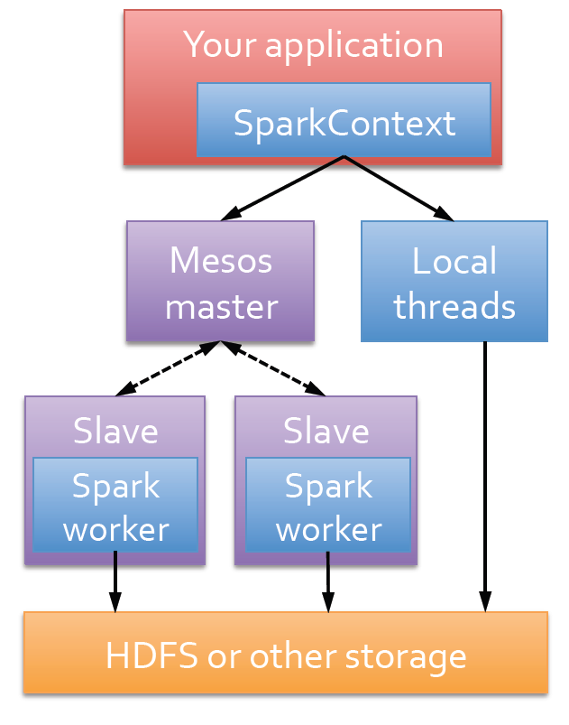
Implementation
It's complementary to Hadoop and can run side by side over the Hadoop file system.
This behavior is supported through a third-party clustering framework called Mesos.

Slide 20
Other Features
Only one reducer
not support parallel reduction
no “shuffle” like in Hadoop
still work efficiently

Slide 21
Main References
www.spark-project.org
Shark: SQL and Rich Analytics at Scale. Reynold Xin, Joshua Rosen, Matei Zaharia, Michael J. Franklin, Scott Shenker, Ion Stoica. Technical Report UCB/EECS-2012-214. November 2012.
Discretized Streams: An Efficient and Fault-Tolerant Model for Stream Processing on Large Clusters. Matei Zaharia, Tathagata Das, Haoyuan Li, Scott Shenker, Ion Stoica. HotCloud 2012. June 2012.
Shark: Fast Data Analysis Using Coarse-grained Distributed Memory (demo). Cliff Engle, Antonio Lupher, Reynold Xin, Matei Zaharia, Haoyuan Li, Scott Shenker, Ion Stoica. SIGMOD 2012. May 2012.
Resilient Distributed Datasets: A Fault-Tolerant Abstraction for In-Memory Cluster Computing. Matei Zaharia, Mosharaf Chowdhury, Tathagata Das, Ankur Dave, Justin Ma, Murphy McCauley, Michael J. Franklin, Scott Shenker, Ion Stoica. NSDI 2012. April 2012.
Resilient Distributed Datasets: A Fault-Tolerant Abstraction for In-Memory Cluster Computing. Matei Zaharia, Mosharaf Chowdhury, Tathagata Das, Ankur Dave, Justin Ma, Murphy McCauley, Michael J. Franklin, Scott Shenker, Ion Stoica. Technical Report UCB/EECS-2011-82. July 2011.
Spark: Cluster Computing with Working Sets. Matei Zaharia, Mosharaf Chowdhury, Michael J. Franklin, Scott Shenker, Ion Stoica. HotCloud 2010. June 2010.

Slide 22
Behavior with Not Enough RAM

Slide 23
Fault Recovery Results
Notes:
These are for K-means

Slide 24
Spark Operations
Transformations (define a new RDD) | map filter sample groupByKey reduceByKey sortByKey | flatMap union join cogroup cross mapValues
Actions (return a result to driver program) | collect reduce count save lookupKey

Slide 25
What have not included here
Variable serialization
Scala Interpreter
Streaming System
Lineage
Cache Strategy
Scheduler & Deterministic Partition
Support for Checkpointing
A lot of other applications of Spark

