Slide 1
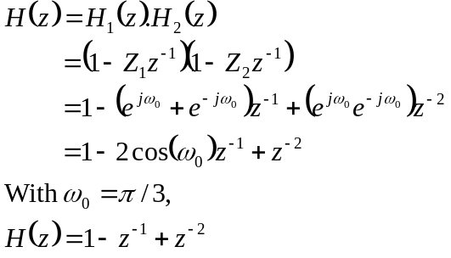



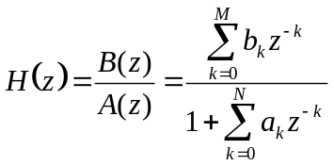
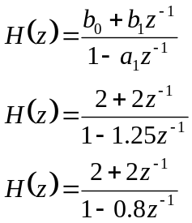
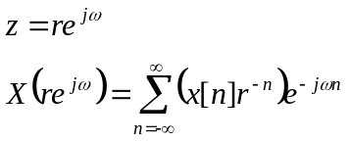
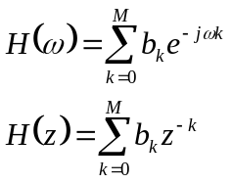




Slide 2
Complex z-plane
1
z = e^{jω}
0.5
ω
Imaginary Part
0
-0.5
-1
-1
-0.5
0
0.5
1
Real Part

