Slide 1
PPL: Simplifying Observability Queries
Peng Huo & Ashwin Pc — AWS

Slide 2
Outline
Why PPL?
OpenSearch PPL Introduction
OpenSearch PPL Language
Future of OpenSearch PPL
Resource

Slide 3
Problem: Observability query friction
Different DSLs and tools create a steep learning curve.
Semantics are inconsistent and non‑portable.
Hard to correlate logs, metrics, and traces in one workflow.
Slow iteration during incidents due to complex queries.

Slide 4
Our approach: Piped Processing Language (PPL)
Unix‑like pipe syntax that matches engineers’ mental model.
Stage‑by‑stage filtering, transformation, and aggregation.
Composable and explainable queries across data sources.
OpenTelemetry‑aligned field semantics for portability.

Slide 5
PPL – Simplifying Observability Queries
Timechart span=1d limit=5 useOther=true count by api
buckets events by time and aggregates metrics into series (optionally split by a field), with limit capping how many series are shown and useOther merging all remaining categories into an OTHER bucket.

Slide 6
PPL – Equivalent SQL
SELECT s.ts AS `@timestamp`, s.host, SUM(s.cnt) AS `count`
FROM (
SELECT CAST(e.ts AS TIMESTAMP) ts,
CASE WHEN th.host IS NOT NULL THEN e.host
WHEN e.host IS NULL THEN NULL ELSE 'OTHER' END host,
SUM(e.c) cnt
FROM (SELECT SPAN(`@timestamp`,1,'h') ts, host, COUNT(*) c
FROM `scott`.`events` GROUP BY host, SPAN(`@timestamp`,1,'h')) e
LEFT JOIN (SELECT host, SUM(c) g
FROM (SELECT SPAN(`@timestamp`,1,'h') ts, host, COUNT(*) c
FROM `scott`.`events` GROUP BY host, SPAN(`@timestamp`,1,'h')) x
WHERE host IS NOT NULL GROUP BY host
ORDER BY 2 DESC NULLS FIRST LIMIT 10) th
ON e.host IS NOT DISTINCT FROM th.host
GROUP BY CAST(e.ts AS TIMESTAMP),
CASE WHEN th.host IS NOT NULL THEN e.host
WHEN e.host IS NULL THEN NULL ELSE 'OTHER' END
UNION ALL
SELECT CAST(d.ts AS TIMESTAMP), hb.host, 0
FROM (SELECT DISTINCT SPAN(`@timestamp`,1,'h') ts FROM `scott`.`events`) d
CROSS JOIN (
SELECT CASE WHEN th.host IS NOT NULL THEN e.host
WHEN e.host IS NULL THEN NULL ELSE 'OTHER' END host
FROM (SELECT SPAN(`@timestamp`,1,'h') ts, host, COUNT(*) c
FROM `scott`.`events` GROUP BY host, SPAN(`@timestamp`,1,'h')) e
LEFT JOIN (SELECT host, SUM(c) g
FROM (SELECT SPAN(`@timestamp`,1,'h') ts, host, COUNT(*) c
FROM `scott`.`events` GROUP BY host, SPAN(`@timestamp`,1,'h')) y
WHERE host IS NOT NULL GROUP BY host
ORDER BY 2 DESC NULLS FIRST LIMIT 10) th
ON e.host IS NOT DISTINCT FROM th.host
GROUP BY CASE WHEN th.host IS NOT NULL THEN e.host
WHEN e.host IS NULL THEN NULL ELSE 'OTHER' END
) hb
) s
GROUP BY s.ts, s.host
ORDER BY s.ts NULLS LAST, s.host NULLS LAST;

Slide 7
OpenSearch PPL State
Initial PPL focused on simple search and transformations
Powered by calcite since in OpenSearch 3.0
Support 38 commands
Support 173 functions

Slide 8
Architecture at a glance
PPL parser → AST → Calcite logical plan.
Pushdown filters, projections, and aggregations to OpenSearch when possible.
Operators: where, fields/project, eval, stats, sort, dedup, lookup/join.
Extensible to logs, metrics, and traces with shared semantics.
More reading. Enhanced log analysis with OpenSearch PPL: Introducing lookup, join, and subsearch

Slide 9
OpenTelemetry semantics in PPL
Common attributes: service.name, service.namespace, host.name.
Trace context fields: trace_id, span_id available when present.
Default time semantics over @timestamp; explicit span() bucketing.
Benefit: portable queries and shared dashboards.

Slide 10
Command overview (selected)
Processing
Eval, rename, fields
rex (regex extract), regex (regex filter), spath (json path)
sort, top, rare, dedup.
Aggregation
timechart/span for time bucketing and rollups.
stats (count, sum, avg, min, max, percentile),
eventstats (window function)
Correlation
lookup, join, subsearch.

Slide 11
Function overview (selected)
Aggregation: count, sum, avg, min, max, percentile, approximate variants.
Date/time: span, now, from_unixtime, timestamp arithmetic.
String: concat, substr, upper/lower, regex functions.
Numeric: abs, round, ceil, floor, coalesce/null handling.

Slide 12
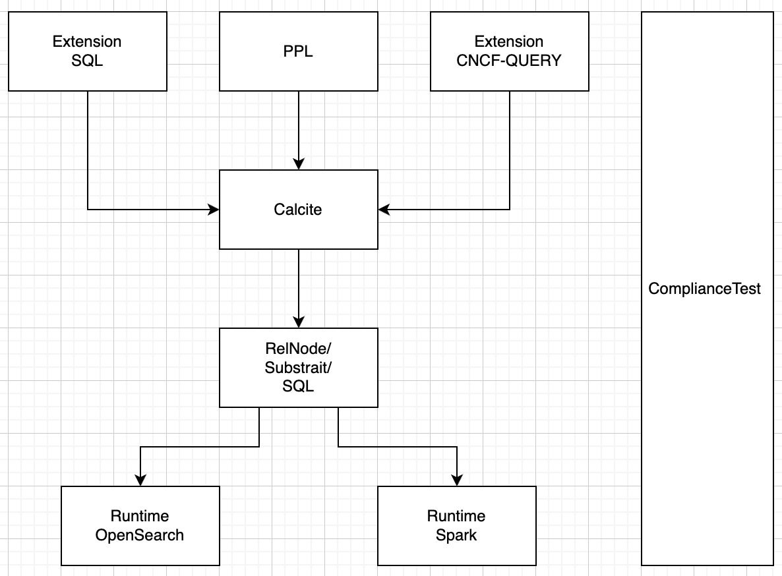
Future work: Unified PPL

Slide 13
Future work: CNCF alignment
Collaborate with CNCF efforts on query language semantics.
Codify OTel‑aligned field and time semantics for portability.
Share use cases, gaps, and proposals with the community.
Call to action: try PPL in OpenSearch 3.x and give feedback.

Slide 14
Future work: Unified PPL
Consistent PPL language behavior across OpenSearch and Spark.
Reusing the same underlying library to eliminate duplication and reduce maintenance overhead.

Slide 15
Future work: Compliance Test Suite
Goal: consistent semantics and outputs across engines.
Golden test cases with datasets and expected results.
Differential runner and CI integration.
Public contribution model for new commands and functions.

Slide 16
Resource
OpenSearch PPL Repo
OpenSearch PPL Reference Docs
Blogs
Enhanced log analysis with OpenSearch PPL: Introducing lookup, join, and subsearch

Slide 17
Live Demo

