Slide 1
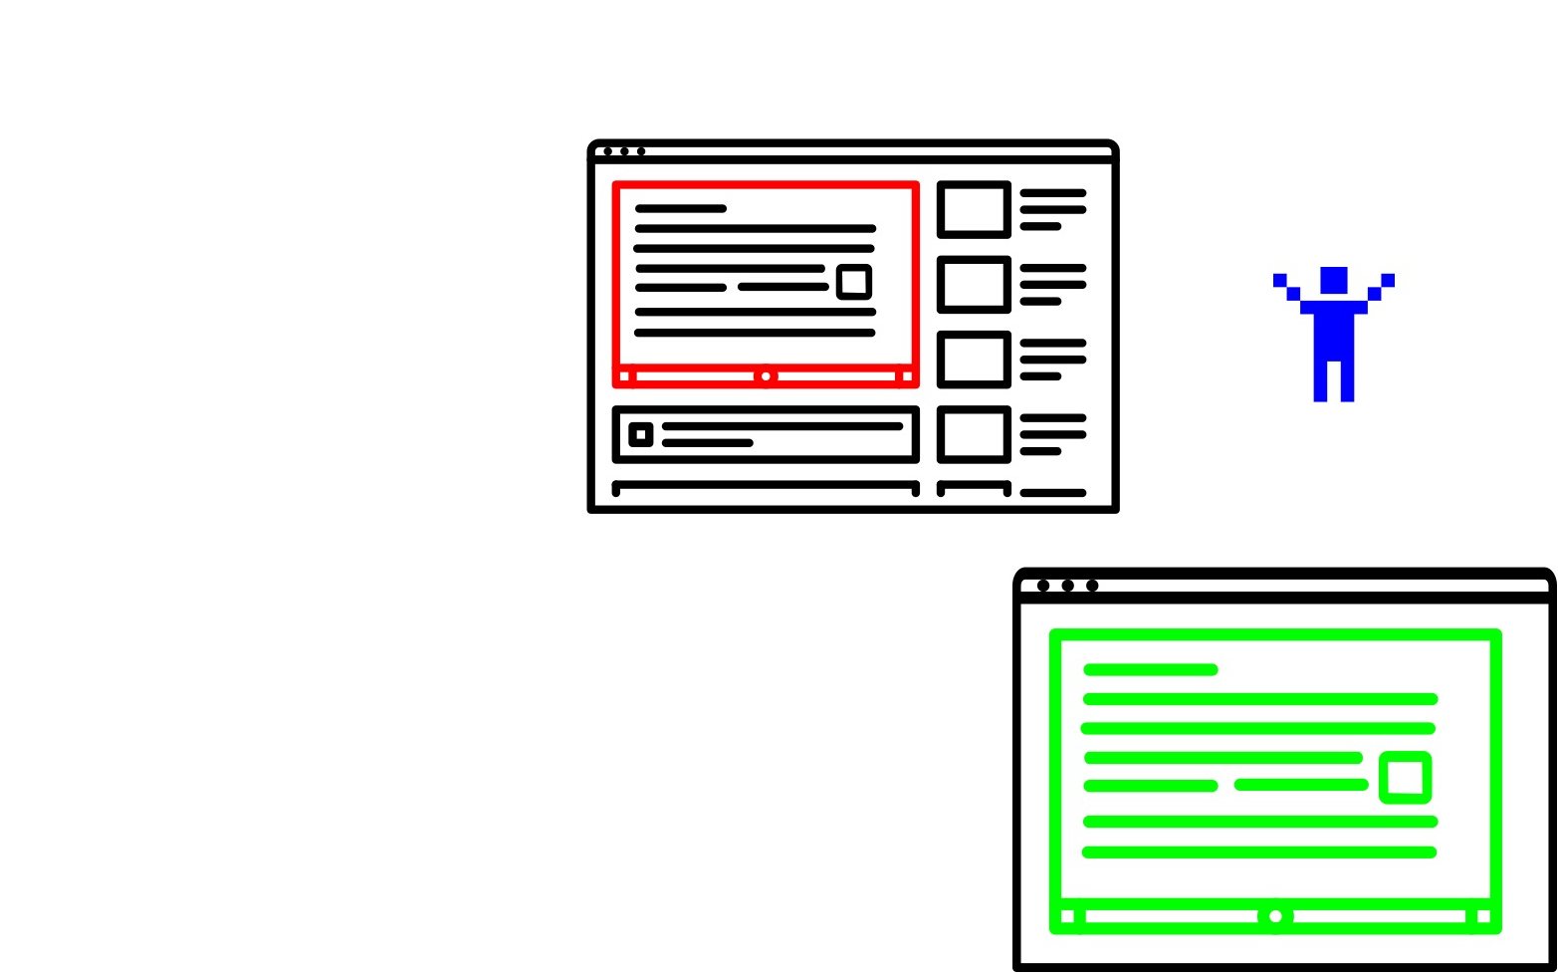
Hover and press 'z'
Zoom in on the area you're forced on

