Slide 1
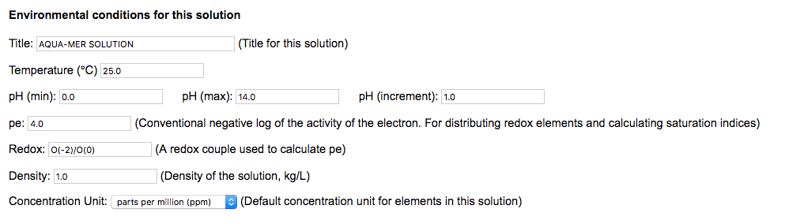
Default parameters for the solution
Will create a pH range between the min and max values
Redox parameters

Slide 2
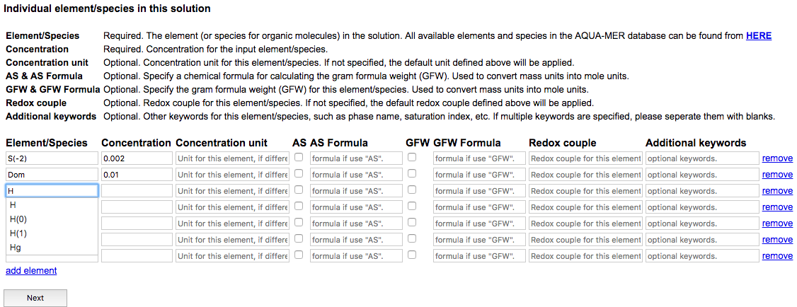
Keyword explanation
Elements/Species in the solution
As you type, the drop-down menu autocompletes with
elements/species available in AQUA-MER.

Slide 3
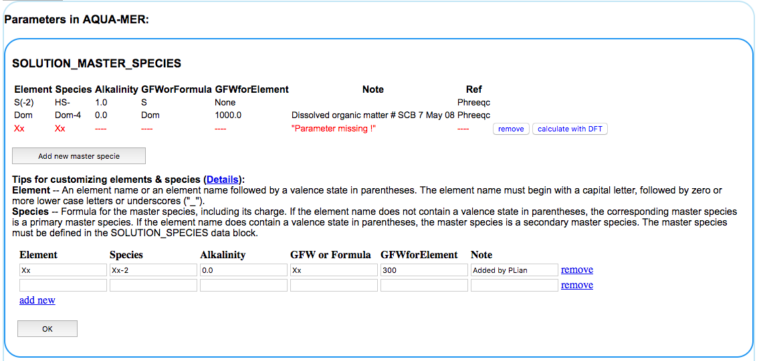
This part will be generated automatically after you input the element/species.
If no parameters can be found in AQUA-MER,
you can add them or calculate them using DFT.
The new parameters must follow the format required by PHREEQC.

