Slide 1




Discovering Graph Patterns for Fact Checking in Knowledge Graphs
Peng Lin Qi Song Jialiang Shen Yinghui Wu
Washington State University
Beijing University of
Posts and Telecommunications
Washington State University
Pacific Northwest National Laboratory

Slide 2




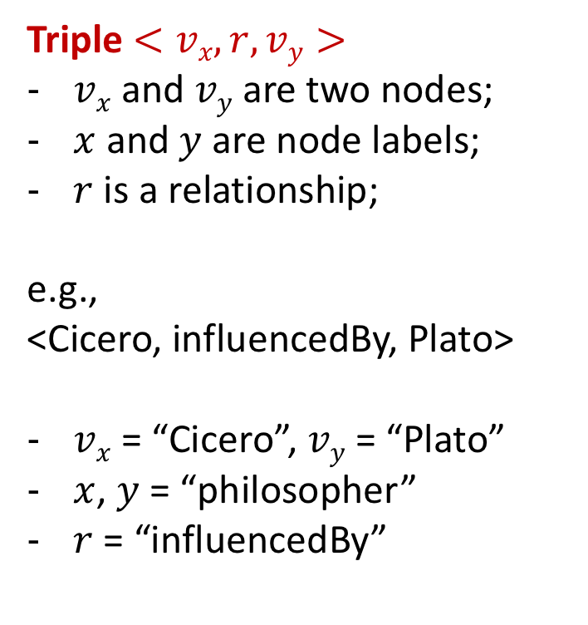
What is fact checking?
Knowledge Graph (KG): G=(V, E, L)
Fact: a triple predicate
(philosopher)
(philosopher)
Triple $<vx, r,vy>$
$vx$ and $vy$ are two nodes;
$x$ and $y$ are node labels;
$r$ is a relationship;
e.g.,
<Cicero, influencedBy, Plato>
$vx$ = “Cicero”, $vy$ = “Plato”
$x$, $y$ = “philosopher”
$r$ = “influencedBy”
Cicero
Plato
gaveBy
cited
published
cited
Against
Piso
Against
Verres
Dialogues
belongsTo
belongsTo
Ancient
Philosophy
Fact checking answers if a fact belongs to the missing part of KG.
Notes:
Question: Is there a missing relationship between two philosophers Cicero and Plato?
E.g., a true fact is a triple predicate <Philosopher, influencedBy, Philosopher>.
Notion maps.
Let’s look at the example. What is graph and what is fact? How do we know. Usually a fact can be identified by substructures. Regularities.

Slide 3
Fact Checking in Graphs
(philosopher)
(philosopher)
Cicero
Plato
“If a philosopher X gave one or more speeches, which cited a book of another philosopher Y with the same topic, then the philosopher X is likely to be lnfluencedBy Y.”
influencedBy?
gaveBy
cited
published
cited
Against
Piso
Against
Verres
Dialogues
belongsTo
belongsTo
A fact can be supported by its surrounded substructures!
Ancient
Philosophy
Graph structure can be evidence for fact checking.
Notes:
Let’s look at the example. What is graph and what is fact? How do we know.. Usually a fact can be substructures. Regularities.
Question: Is there a missing relationship between two philosophers Cicero and Plato?
E.g., a true fact is a triple predicate <Philosopher, influencedBy, Philosopher>.

Slide 4


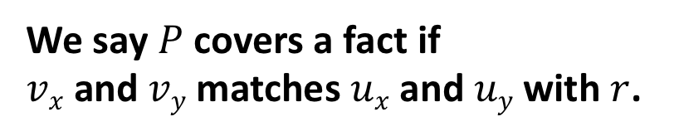



Fact Checking via Graph Patterns
Pattern: regularity in KG
(philosopher)
(philosopher)
$$vx$$
(philosopher)
(philosopher)
Cicero
$$r$$
Plato
$$vy$$
$$ux$$
$$uy$$
gaveBy
cited
published
(speech)
(book)
cited
Against
Piso
Against
Verres
Dialogues
(topic)
belongsTo
belongsTo
Ancient
Philosophy
We say $P$ covers a fact if
$vx$ and $vy$ matches $ux$ and $uy$ with $r$.
Graph structure can be evidence for fact checking.
Notes:
If pattern P occurs many times.
Speech has two matches
2 questions: ranking and discovery
Note: $x$ and $y$ are node labels.
Question 2: what graph patterns best distinguish true and false facts?
Question 3: how can we discover rules efficiently?

Slide 5
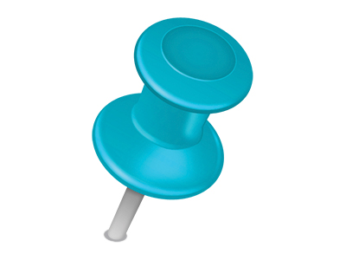

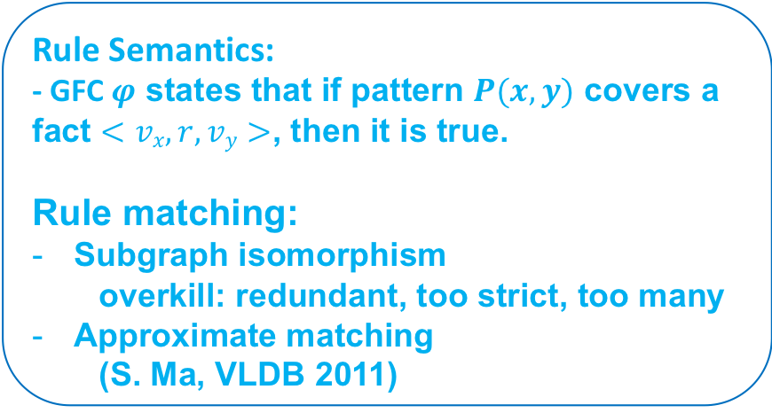



Rule Model: Graph Fact Checking Rules (GFC)
GFC $φ :P\left(x, y\right)→r(x, y)$
LHS
RHS
(philosopher)
(philosopher)
(philosopher)
(philosopher)
$$ux$$
$$uy$$
$$ux$$
$$r$$
$$uy$$
Rule Semantics:
- GFC $φ$ states that if pattern $P(x, y)$ covers a fact $<vx, r,vy>$, then it is true.
Rule matching:
Subgraph isomorphism
overkill: redundant, too strict, too many
Approximate matching
(S. Ma, VLDB 2011)
(speech)
(book)
(topic)
A GFC rule contains two patterns connected by two anchored nodes.
Notes:
$P$ and $r$are two graph patterns. $r$is a triple pattern not in $P$.
$P$ and $r$share two anchored nodes $\left(ux, uy\right)$ (like two pins).

Slide 6





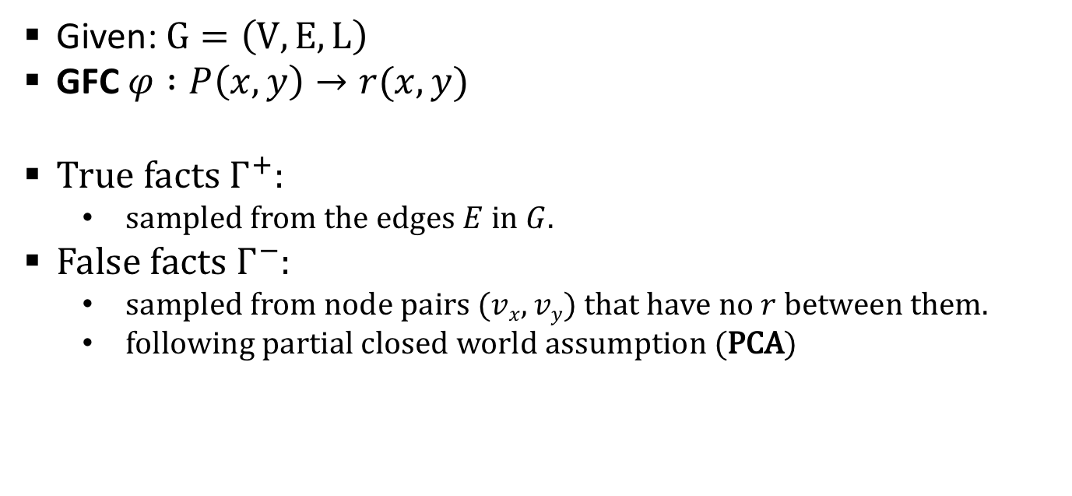

Rule Statistics
Given: $G=\left(V, E, L\right)$
GFC $φ :P\left(x, y\right)→r(x, y)$
True facts $Γ^{+}$:
sampled from the edges $E$ in $G$.
False facts $Γ^{−}$:
sampled from node pairs $(vx, vy)$ that have no $r$ between them.
following partial closed world assumption (PCA)
$$Γ^{+}$$
$$Γ^{−}$$
$$r\left(Γ^{+}\right)$$
$$P\left(Γ^{+}\right)$$
$$r\left(Γ^{−}\right)$$
$$P\left(Γ^{−}\right)$$
Statistical measures are defined in terms of graph and a set of training facts.
Notes:
V

Slide 7







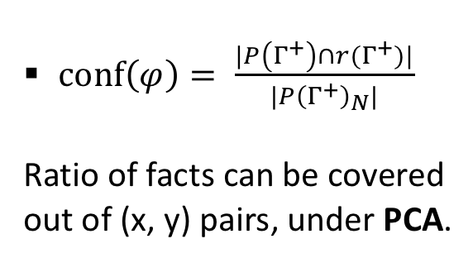




Support and Confidence
GFC: $φ :P\left(x, y\right)→r(x, y)$
$supp\left(φ\right)= \frac{|P\left(Γ^{+}\right)∩r(Γ^{+})|}{|r(Γ^{+})|}$
Ratio of facts can be covered
out of r(x, y) triples.
$$r(vx, vy)$$
$$r(vx, vy)$$
$$r(vx, vy)$$
supp = 2/3
$$P$$
$$P$$
$conf\left(φ\right)= \frac{|P\left(Γ^{+}\right)∩r(Γ^{+})|}{|P{\left(Γ^{+}\right)}_{N}|}$
Ratio of facts can be covered
out of (x, y) pairs, under PCA.
$$(vx, vy)$$
$$(vx, vy)$$
$$(vx, vy)$$
conf = 1/2
$$P$$
$$P$$
Support and confidence are for pattern mining.
Notes:
Anti-monotonicity holds.
The number $\left(v_{x}, v_{y}\right)$ pairs covered by $P$, normalized by the total pairs of $\left(v_{x}, v_{y}\right)$, under Partial Closed World Assumption (PCA).
PCA assumes that every false fact should have at least one true counter part.
PCA is a convention to generate false facts in fact checking tasks (see AMIE WWW 2013, Knowledge Vault KDD 2014).
E.g. <Beijing, isCapitcalOf, China> is true, and then <Beijing, isCapitcalOf, France> is false.
However, <Beijing, isCapitcalOf, AmazonRiver> cannot be sampled as false,
since no true fact of <city, isCapitcalOf, river> exists.

Slide 8
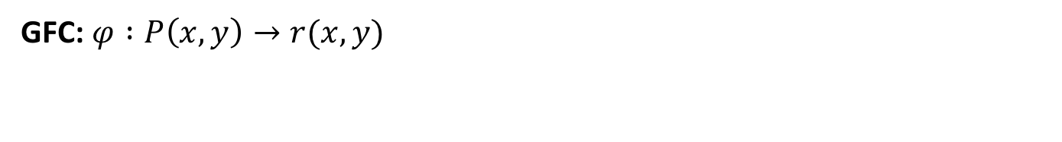
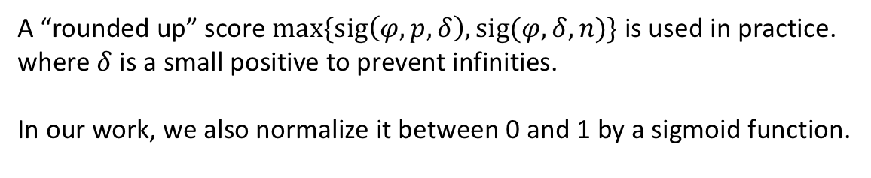
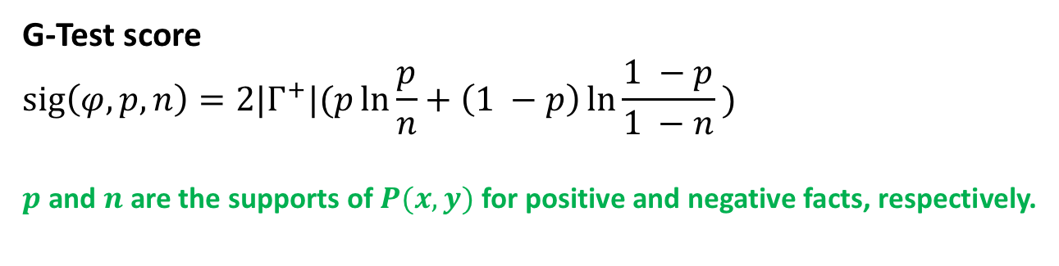
Significance
GFC: $φ :P\left(x, y\right)→r(x, y)$
G-Test score
$$sig\left(φ,p,n\right)=2|Γ^{+}|(p\ln{\frac{p}{n}}+\left(1 −p\right)\ln{\frac{1 −p}{1 −n}} )$$
$p$ and $n$are the supports of $P(x, y)$for positive and negative facts, respectively.
A “rounded up” score $\max{\{sig\left(φ, p, δ\right), sig(φ, δ, n)\}}$ is used in practice.
where $δ$ is a small positive to prevent infinities.
In our work, we also normalize it between 0 and 1 by a sigmoid function.
Significance is the ability to distinguish true and false facts.
Notes:
Only support and confidence is not enough.
- So many redundant patterns are on the decision boundary, which cannot tell true or false facts.
G-Test: the significance of $P$ between true and false facts.
The larger, the stronger evidence to distinguish facts.
$p$ and $n$ are supports for true and false facts, respectively.
In our work, we also normalize the significance in range [0, 1] by a sigmoid function.
Low G-Test score is on the decision boundary.
Xifeng Yan, et al. Leap Search. SIGMOD 2008.

Slide 9

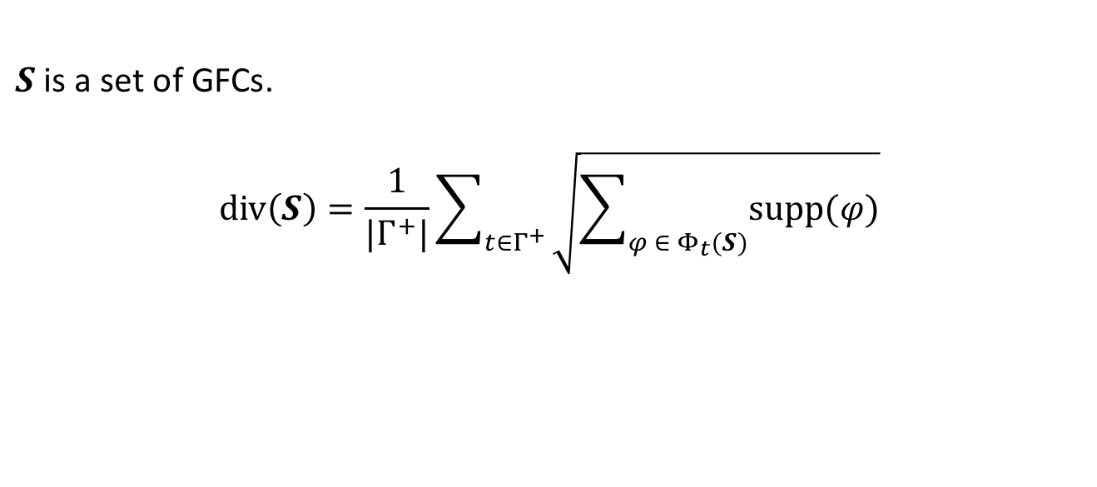

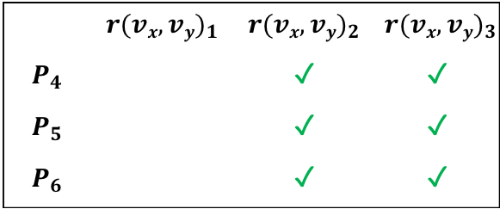
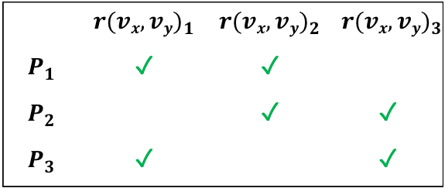
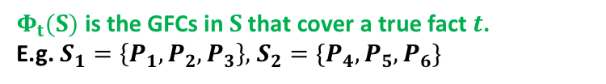
Diversity
$S$ is a set of GFCs.
$$div\left(S\right)=\frac{1}{|Γ^{+}|}\sum_{t∈Γ^{+}}{\sqrt{\sum_{φ ∈ Φ_{t}(S)}{supp(φ)}}}$$
$Φ_{t}(S)$ is the GFCs in $S$that cover a true fact $t$.
E.g. $S_{1}=\left\{P_{1}, P_{2}, P_{3}\right\},$ $S_{2}=\{P_{4}, P_{5}, P_{6}\}$
 | $${r(vx, vy)}_{1}$$ | $${r(vx, vy)}_{2}$$ | $${r(vx, vy)}_{3}$$
$$P_{1}$$ | ✓ | ✓
$$P_{2}$$ |  | ✓ | ✓
$$P_{3}$$ | ✓ |  | ✓
 | $${r(vx, vy)}_{1}$$ | $${r(vx, vy)}_{2}$$ | $${r(vx, vy)}_{3}$$
$$P_{4}$$ |  | ✓ | ✓
$$P_{5}$$ |  | ✓ | ✓
$$P_{6}$$ |  | ✓ | ✓
$div\left(S_{1}\right)$ = 2
>
$div\left(S_{2}\right)$ = 1.6
Diversity is to measure the redundancy of a set of GFCs
Notes:
Diversity: a single score over all true facts to measure the total coverage for a set of rules.
Intuitively, $S_{1}$ should be more diverse than $S_{2}$, since $P_{4}$ and $P_{5}$ are redundant.

Slide 10
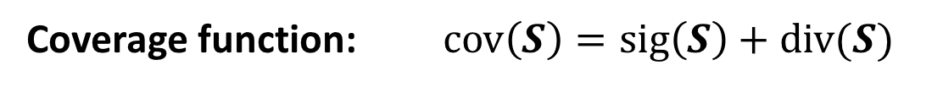
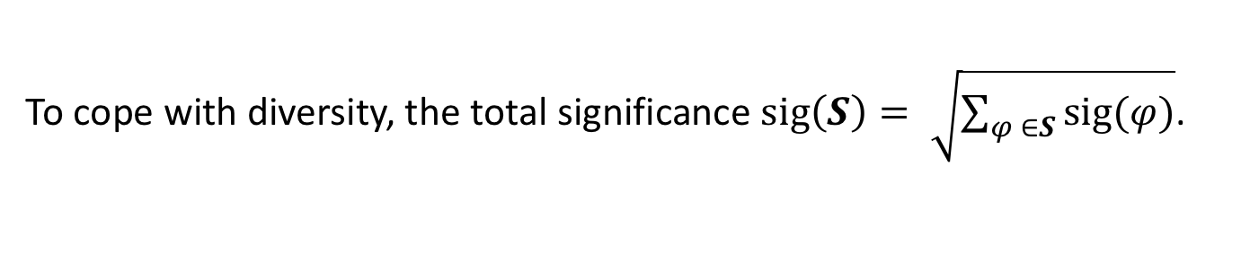
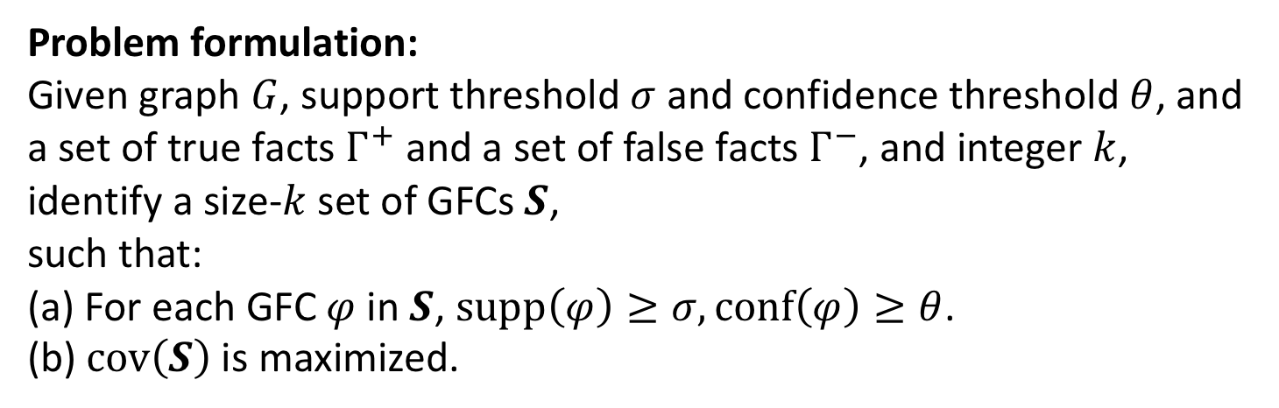
Top-$k$ GFC Discovery Problem
To cope with diversity, the total significance $sig\left(S\right)= \sqrt{\sum_{φ ∈S}{sig(φ)}}$.
Coverage function: $cov\left(S\right)=sig\left(S\right)+div(S)$
Problem formulation:
Given graph $G$, support threshold $σ$ and confidence threshold $θ$, and a set of true facts $Γ^{+}$ and a set of false facts $Γ^{−}$, and integer $k$, identify a size-$k$ set of GFCs $S$,
such that:
(a) For each GFC $φ$ in $S$, $supp\left(φ\right)≥σ, conf\left(φ\right)≥θ$.
(b) $cov\left(S\right)$ is maximized.
More significance, less redundancy.
Notes:
Our target:
find a set $S$ of size-$k$ GFCs that best distinguish true and false facts.
each GFC rule passes the thresholds of support and confidence.
$S$ should have most total significance and least redundancy.

Slide 11
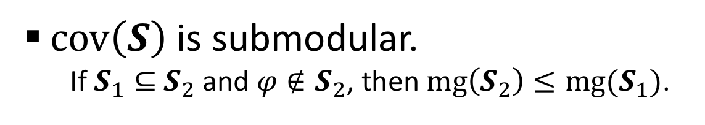
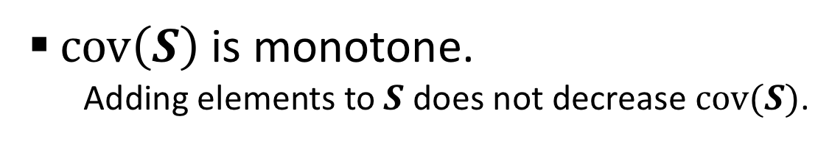
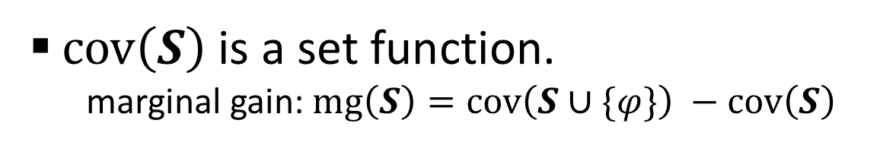
Properties of $cov(S)$
$cov\left(S\right)$ is a set function.
marginal gain: $mg\left(S\right)=cov\left(S∪\{φ\}\right) −cov\left(S\right)$
$cov\left(S\right)$ is monotone.
Adding elements to $S$ does not decrease $cov(S)$.
$cov\left(S\right)$ is submodular.
If $S_{1}⊆$ $S_{2}$ and $φ∉S_{2}$, then $mg\left(S_{2}\right)≤mg(S_{1})$.
Submodularity is a good property for set optimization problem.
Notes:
For any $S_{1}⊆$ $S_{2}$, $F\left(S_{1}\right)≤F(S_{2})$.
Marginal gain has anti-monotonicity with GFC

Slide 12
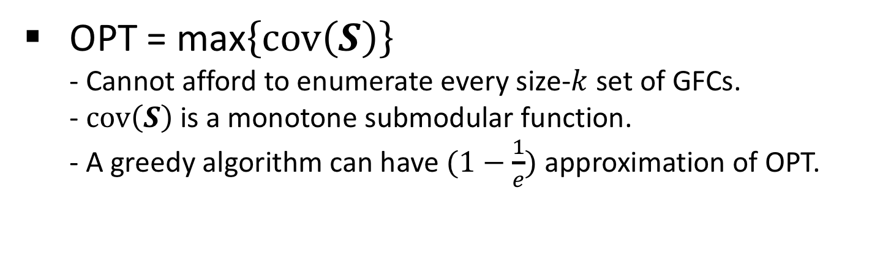
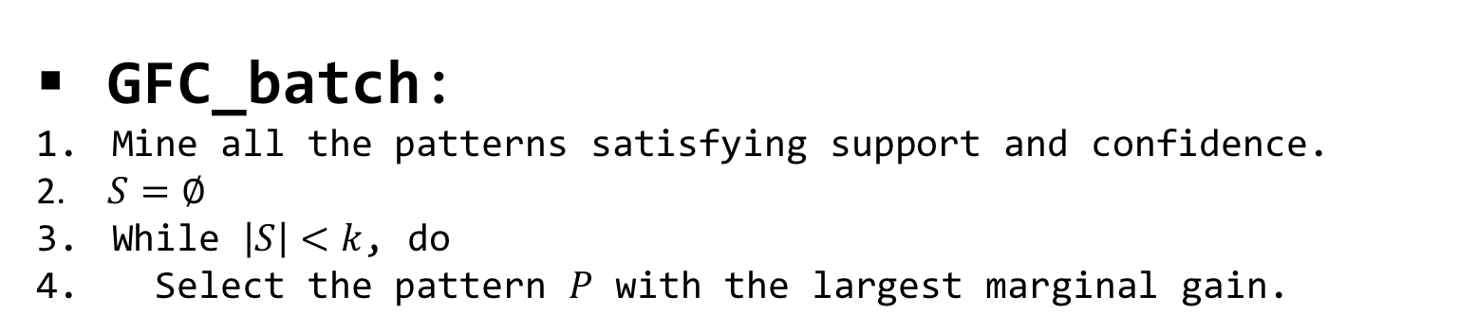
Discovery Algorithms
OPT = max$\left\{cov\left(S\right)\right\}$
- Cannot afford to enumerate every size-$k$ set of GFCs.
-$cov\left(S\right)$ is a monotone submodular function.
- A greedy algorithm can have $(1−\frac{1}{e})$ approximation of OPT.
GFC_batch:
Mine all the patterns satisfying support and confidence.
$S=∅$
While $\left|S\right|<k$, do
Select the pattern $P$ with the largest marginal gain.
GFC_batch: mining in batch and selecting greedily
Notes:
It is infeasible to enumerate every size-$k$ subset of patterns to find the optimal $S$ for $cov(S)$, since there can be exponentially large number of graph patterns.
Still, GFC_batch requires to mine all patterns first!

Slide 13
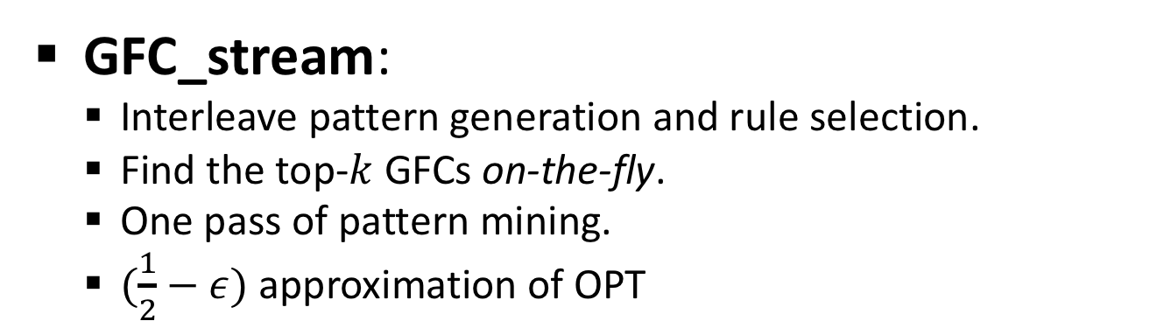
Discovery Algorithms
GFC_batch is infeasible and slow.
Still, it requires mine all patterns first.
Can we do better?
GFC_stream:
Interleave pattern generation and rule selection.
Find the top-$k$ GFCs on-the-fly.
One pass of pattern mining.
$(\frac{1}{2}−ε)$ approximation of OPT
GFC_stream: mining and selecting on-the-fly!

Slide 14
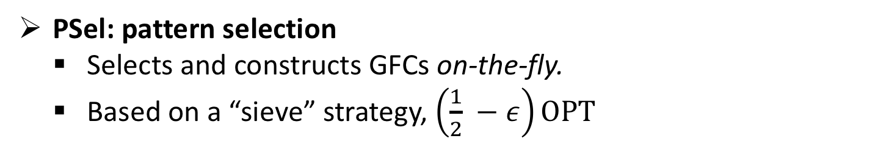
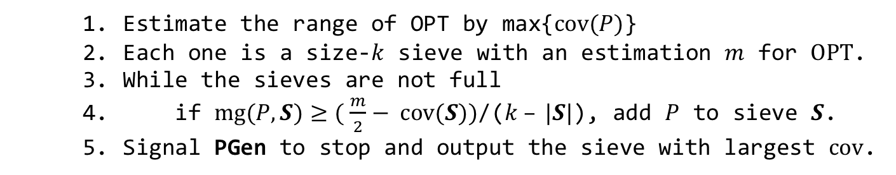
Discovery Algorithms
PGen: pattern generation
Generates patterns in a stream way.
Pass the patterns for selection
Can be in any order, e.g., Apriori, DFS, or random.
PGen
pattern
stream
decision
PSel: pattern selection
Selects and constructs GFCs on-the-fly.
Based on a “sieve” strategy, $\left(\frac{1}{2} −ε\right)OPT$
PSel
Fast compute!
Estimate the range of OPT by max{$cov(P)$}
Each one is a size-$k$ sieve with an estimation $m$ for $OPT$.
While the sieves are not full
if $mg(P, S)≥( \frac{m}{2}− cov(S))$/($k – |S|$), add $P$ to sieve $S$.
Signal PGen to stop and output the sieve with largest $cov$.
GFC_stream: mining and selecting on-the-fly!
Notes:
Add arrow fast compute!
Why is that? We found that anti-monotonicity for size-1 pattern. But this let us kickstart stream but the final patterns much larger size-1 pattern.

Slide 15
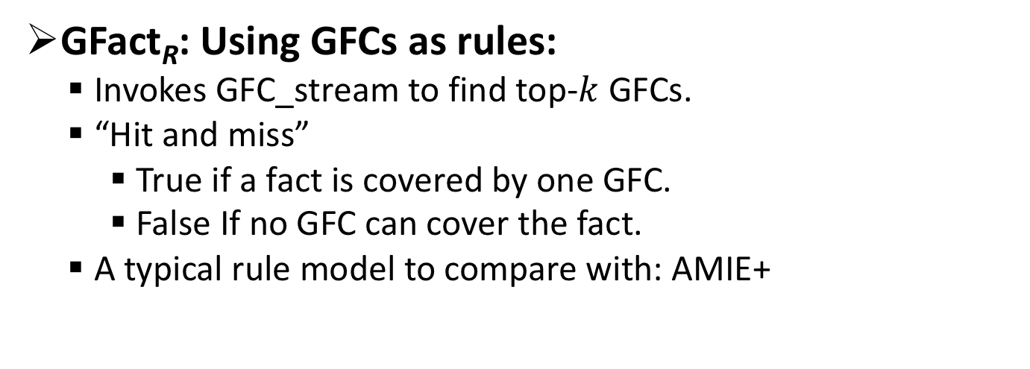
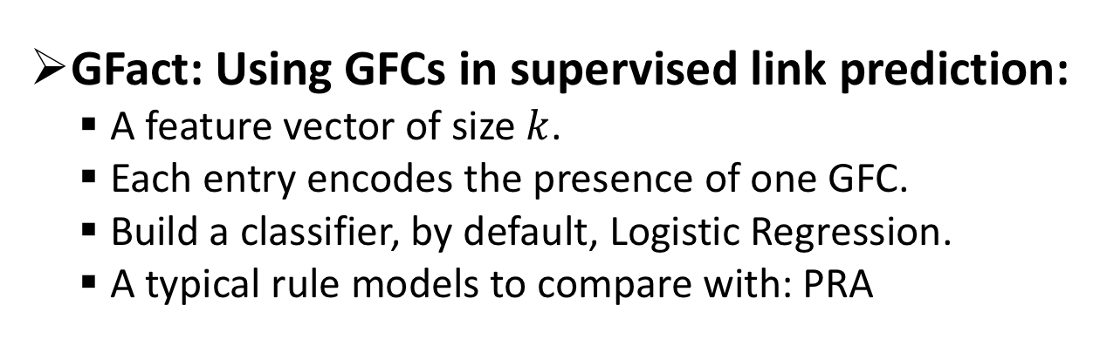
GFC-based fact checking
GFact_{R}: Using GFCs as rules:
Invokes GFC_stream to find top-$k$ GFCs.
“Hit and miss”
True if a fact is covered by one GFC.
False If no GFC can cover the fact.
A typical rule model to compare with: AMIE+
GFact: Using GFCs in supervised link prediction:
A feature vector of size $k$.
Each entry encodes the presence of one GFC.
Build a classifier, by default, Logistic Regression.
A typical rule models to compare with: PRA

Slide 16
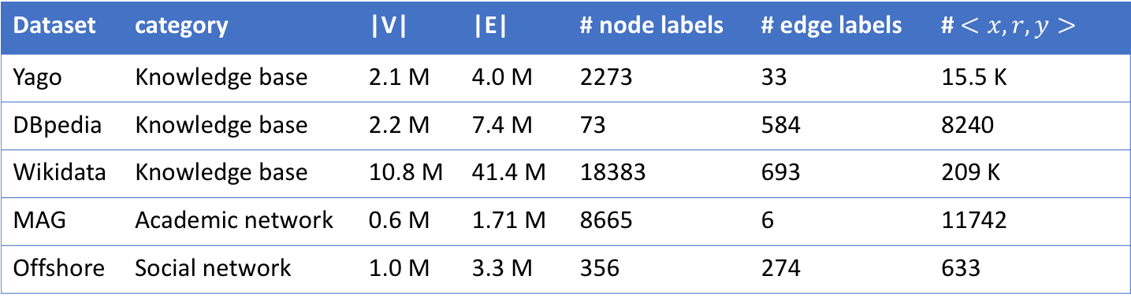
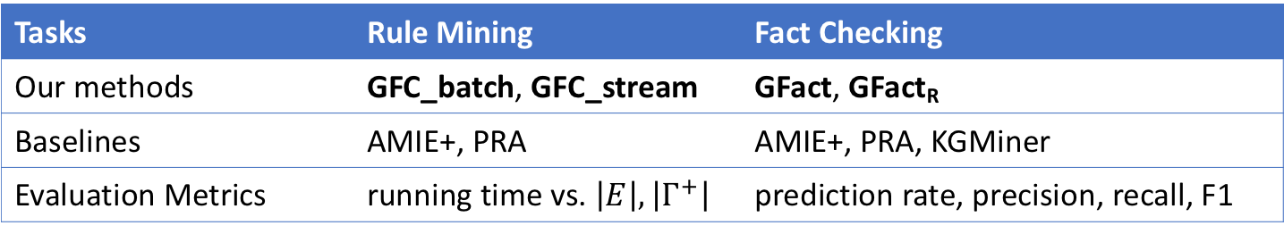
Experiment settings
Dataset | category | |V| | |E| | # node labels | # edge labels | # $<x, r, y>$
Yago | Knowledge base | 2.1 M | 4.0 M | 2273 | 33 | 15.5 K
DBpedia | Knowledge base | 2.2 M | 7.4 M | 73 | 584 | 8240
Wikidata | Knowledge base | 10.8 M | 41.4 M | 18383 | 693 | 209 K
MAG | Academic network | 0.6 M | 1.71 M | 8665 | 6 | 11742
Offshore | Social network | 1.0 M | 3.3 M | 356 | 274 | 633
Tasks | Rule Mining | Fact Checking
Our methods | GFC_batch, GFC_stream | GFact, GFact_{R}
Baselines | AMIE+, PRA | AMIE+, PRA, KGMiner
Evaluation Metrics | running time vs. $\left|E\right|, \left|Γ^{+}\right|$ | prediction rate, precision, recall, F1

Slide 17
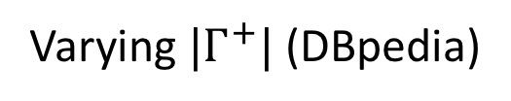
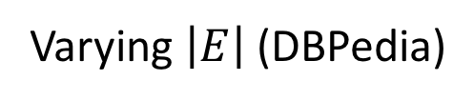
Experiment: efficiency
Overview
GFC_stream takes 25.7 seconds to discover 200 GFCs over Wikidata with 41.4 million edges and 6000 training facts.
On average, GFC_stream is 3.2 times faster than AMIE+ over DBpedia.
Varying $\left|E\right|$ (DBPedia)
Varying $|Γ^{+}|$ (DBpedia)
Notes:
PCA

Slide 18
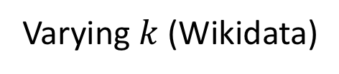
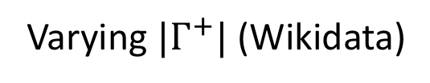
Experiment: effectiveness
Compared with AMIE+, PRA and KGMiner, respectively, on average:
GFact achieves additional 30%, 20%, and 5% gains of precision over DBpedia.
GFact achieves additional 20%, 15%, and 16% gains of F1-score over Wikidata.
Varying $|Γ^{+}|$ (Wikidata)
Varying $k$ (Wikidata)
Notes:
In practice how to set k. Binary search.
Feature set selection

Slide 19








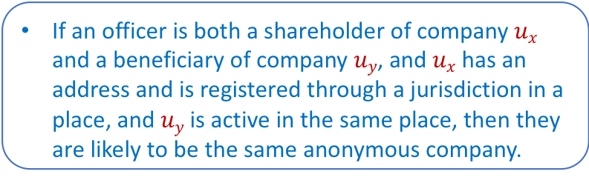

Case study: are two anonymous companies same? (Offshore)
GFC
AMIE+
(officer)
shareholder
beneficiary
$$⋀$$
registerIn( , )
registerIn( , )
(A. Company)
(A. Company)
isSameAs?
$$ux$$
$$uy$$
(jurisdiction)
$$⟹$$
isSameAs( , )
registeredIn
isActiveIn
isIn
isIn
If two anonymous companies are registered in the same place, then they are same.
Low accuracy.
(address)
(place)
If an officer is both a shareholder of company $ux$ and a beneficiary of company $uy$, and $ux$ has an address and is registered through a jurisdiction in a place, and $uy$ is active in the same place, then they are likely to be the same anonymous company.
Notes:
Give examples
Fix one unchanged.

Slide 20


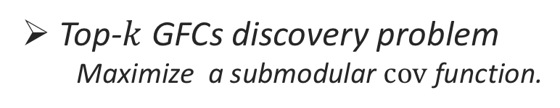
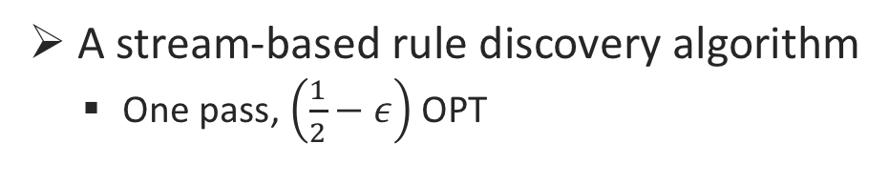
Conclusions and future work
Graph Fact Checking Rules (GFCs)
Top-$k$ GFCs discovery problem
Maximize a submodular $cov$ function.
A stream-based rule discovery algorithm
One pass, $\left(\frac{1}{2}−ε\right)$ OPT
Evaluation of GFCs-based techniques
Rule models, fact checking (2 methods), efficiency, and case studies.
Our future work: scalable GFC-based methods
Parallel mining, Distributed learning
Sponsored by:
Notes:
Evaluated with real-world rule and pattern models.
Find useful GFCs on-the-fly, in one pass.

Slide 21


Discovering Graph Patterns for Fact Checking
in Knowledge Graphs
Thank you!
Related work: Gstream (IEEE BigData 2017)
Event Pattern Discovery by Keywords in Graph Streams
Mohammad Hossein Namaki, Peng Lin, Yinghui Wu
https://ieeexplore.ieee.org/abstract/document/8258019/
Notes:
Rule based AMIE
Learning PRA
Okay. That’s all. I am ready for question.
Related work:
GStream.
One related work is from our group, which is a real online-style algorithm.

Slide 22
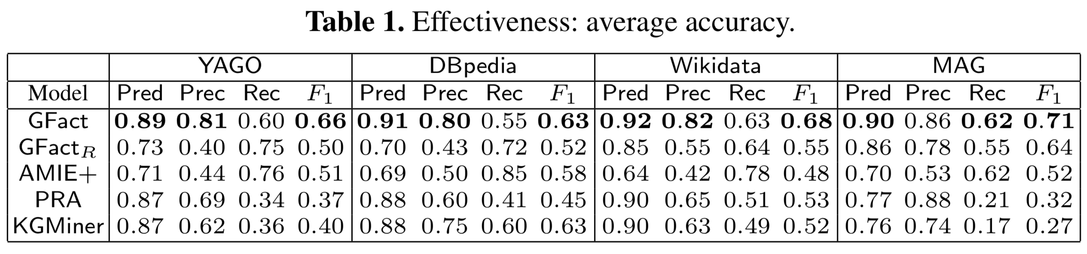
More effectiveness results
Notes:
Rule based AMIE
Learning PRA

Slide 23
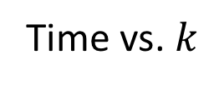
Time vs. $k$
Time vs. support
More efficiency results
Notes:
Rule based AMIE
Learning PRA

Slide 24
More thorough experiments to compare various methods:
http://eecs.wsu.edu/~plin1/pdfs/2017-Preprint-Factchecking-experiments.pdf
Notes:
Rule based AMIE
Learning PRA

