Slide 1
Robot Grasping of Deformable Planar Objects
Yan-Bin Jia
(with Ph.D. students Feng Guo and Huan Lin)
Department of Computer Science
Iowa State University
Ames, IA 50010, USA

Slide 2




Rigid Body Grasping – Form Closure
The object has no degree of freedom (Reuleaux, 1875).
frictionless contacts
$$y$$
$$x$$
What cannot be generated by the contact force?
♦ forces in the $y$-direction
♦ torques about the $z$-direction
Notes:
Two types of analysis have been developed: form closure and force closure.
Contact points are the two closest.

Slide 3
Rigid Body Grasping – Force Closure
The contacts can apply an arbitrary wrench (force + torque)
to the object (Nguyen 1988).
Form closure does not imply force closure.
♦ Each force (normal or tangential)
at a contact generates a vector in
the 3D wrench space W (6D for a
3D object).
♦ These wrench vectors positively
span the 3D wrench space W.
contact friction cones
♦ Equivalently, their convex hull
contains the origin in the interior.
Not form closure.
♦ They can resist an arbitrary
external wrench.
Notes:
Composition of forces along the contact friction cone edges.
Line segment connecting the two contact points inside the friction cone.
The rectangle can move vertically.
Go back to the previous slide to show that it is not force closure.
First order form closure equates force closure with frictionless contacts.

Slide 4
Related Work on Rigid Body Grasping
♦ Form closure grasps
• Bounds on # contact points: Mishra et al. (1986); Markenscoff et al. (1987)
• Synthesis: Brost & Goldberg (1994); van der Stapper et al. (2000)
• Caging: Rimon & Blake (1999); Rodriguez et al. (2012)
♦ Force closure grasps
• Testing & synthesis: Nguyen (1988); Trinkle (1988); Ponce et al. (1993);
Ponce et al. (1997)
• Grasp metrics: Kerr & Roth (1986); Li & Sastry (1988); Markenscoff &
Papadimitriou (1989); Mirtich & Canny (1994); Mishra (1995); Buss et al.
(1988); Boyd & Wegbreit (2007)
Notes:
Minimum possibility of violating kinematic constraints. (Kerr, Li)
Maximize the worst-case adversary force resistible by a unit grasping force.
Minimize the maximum contact force for any grasping finger under unit disturbance.

Slide 5
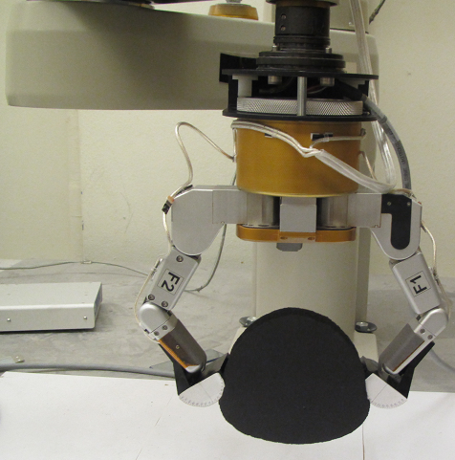
Barrett Hand Grasping a Foam Object
Notes:
Barrett Hand with semicircular tips.

Slide 6
Deformable Body Grasping Is Difficult
♦ Form closure impossible (infinite degrees of freedom)
♦ Force closure inapplicable (changing geometry, growing contacts)
♦ High computation cost of deformable modeling using the finite
element methods (FEM)
♦ Contact constraints needed for modeling do not exist at the
start of a grasp operation.
Very little research done in robotics (most limited to linear objects)
Wakamatsu et al. (1996); Hirai et al. (2001); Gopalakrishnan & Goldberg (2005);
Wakamatsu & Hirai (2004); Saha & Isto (2006); Ladd & Kavraki (2004)
Notes:
Linear objects do not need to resort to elasticity theory

Slide 7
Displacement-Based Deformable Grasping
A change of paradigm from rigid body grasping.
Specify finger displacements rather than forces.
• Specified forces cannot guarantee equilibrium after deformation.
• Deformation computed under geometric constraints ensures
force and torque equilibrium.
• Easier to command a finger to move to a place than to exert a
prescribed grasping force.
Notes:
Because of changing geometry

Slide 8
Positional Constraints & Contact Analysis
Instantaneous deformation is assumed in classical elasticity theory.
Deformation update during a grasp needs positional constraints.
How can we predict the final contact configuration from the start of
a grasp operation?
Resort to varying finger contacts
• They are maintained by friction.
• Contact regions grow or shrink.
• Individual contact points slide or stick.
Incrementally track contact configuration!

Slide 9
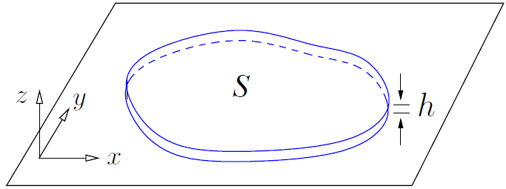
Assumptions
• Deformable, isotropic, planar or thin 2-1/2 D object.
• Two rigid grasping fingers coplanar with the object.
• Frictional point or area contacts.
• Gravity ignored.
• Small deformation
(linear elasticity).
Notes:
So linear theory is applicable.

Slide 10


Linear Plane Elasticity
$$f_{2}$$
$$f_{1}$$
Displacement field:

Slide 11
Strains
Extensional strain – relative change in length
after
before
Shear strain – rotation of perpendicular lines toward (or away) from each other.

Slide 12
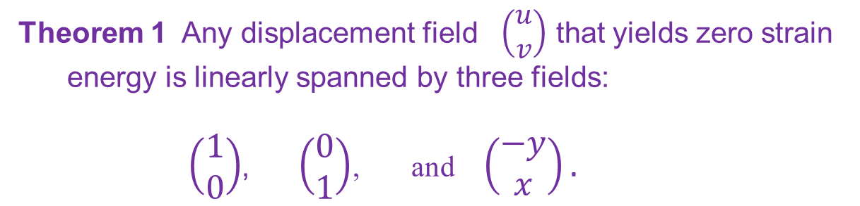
Strain Energy
Theorem 1 Any displacement field $\left(\begin{matrix}u \\ v\end{matrix}\right)$ that yields zero strain
energy is linearly spanned by three fields:
$\left(\begin{matrix}1 \\ 0\end{matrix}\right)$, $\left(\begin{matrix}0 \\ 1\end{matrix}\right)$, and $\left(\begin{matrix}−y \\ x\end{matrix}\right).$
translation
rotation

Slide 13
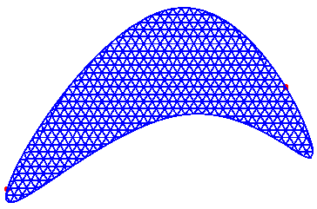

Finite Element Method (FEM)
a) Discretize the object into a triangular mesh.
b) Obtain the strain energy of each triangular
element in terms of the displacements of its
three vertices.
c) Sum up the strain energies of all elements.
displacements at $n$ nodal points
stiffness matrix (symmetric & positive semidefinite)

Slide 14
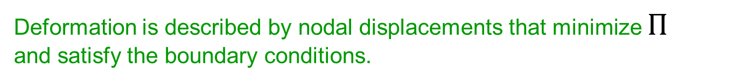
Energy Minimization
Total potential energy:
load potential
vector of all nodal forces
Deformation is described by nodal displacements that minimize $Π$
and satisfy the boundary conditions.

Slide 15

Stiffness Matrix
Null space is spanned by three $2n$-vectors:
translations of all nodes
rotation of all nodes
Spectral decomposition:
orthogonal matrix
Notes:
Null space represents all Euclidean motions.

Slide 16


Deformation from Contact Displacements
Boundary nodes $p_{i1}, …, p_{im}$ in contact with grasping fingers:
$$p_{j}$$
known
$$p_{i}$$
Forces at nodes not in contact:
Problem 1 Determine $δ_{k}$, $k≠i_{1}$, …, $i_{m}$, and .

Slide 17

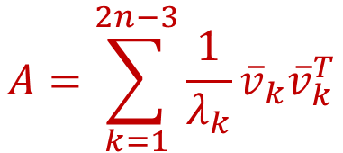
Submatrices from Stiffness Matrix
contact node indices
$$B$$
$$A=\sum_{k=1}^{2n−3}{\frac{1}{λ_{k}}{\overline{v}}_{k}{\overline{v}}_{k}^{T}}$$
null space
Notes:
Look at selected rows and columns corresponding to contact indices.
Form a submatrix.

Slide 18
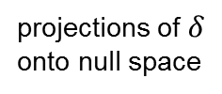
Solution Steps
projections of $δ$
onto null space
Notes:
Inverse exists when m >= 2.

Slide 19
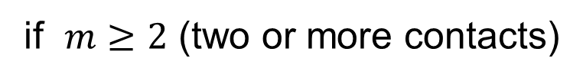
Matrix for Solution of Deformation
if $m≥2$ (two or more contacts)
Notes:
Inverse exists when m >= 2.

Slide 20

Uniqueness of Deformation
Theorem 2 $\overline{δ}$ uniquely determines the displacement field $δ$ (and thus the deformed shape) if $m≥2$.
Computational complexity
a) Singular value decomposition (SVD) of $K$.
b) Deformed shape (i.e., $δ$)
m is small
Notes:
If all contacts stick and do not vary, then deformation is determined from finger movements.
Execution time in terms of # nodes.

Slide 21
Reduced Stiffness Matrix
Forces at m contact nodes:
Strain energy:

Slide 22
Squeeze by Two Point Fingers
Minimizing potential energy is
equivalent to minimizing strain
energy.
Solution:
Stable squeeze: $ρ\hat{u} ($the two point fingers move toward each other).
squeeze depth
Notes:
Minimizes strain energy among all delta with |delta| = 1.

Slide 23


Pure Squeeze
Issues with a stable squeeze $\overline{δ}:$
• object translation or rotation during deformation.
• namely, $δ$ not necessarily orthogonal to $null(K)$.
Pure squeeze $\overline{δ}$:
where
squeeze depth
Notes:
Undesired effect

Slide 24
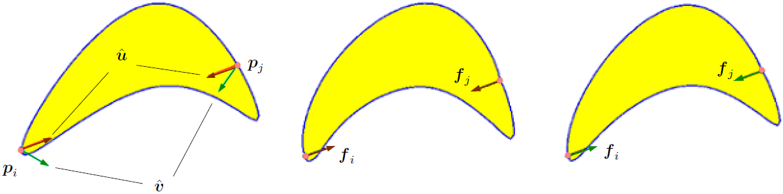




Example for Comparison
(stable squeeze)
$$=(0.91,0.35)$$
$$=(0.55,0.21)$$
(pure squeeze)
Deformation under $\hat{u}$
Deformation under $\hat{v}$
Notes:
Pure squeeze bends the object with slightly over 50% of the contact forces for a stable squeeze.

Slide 25
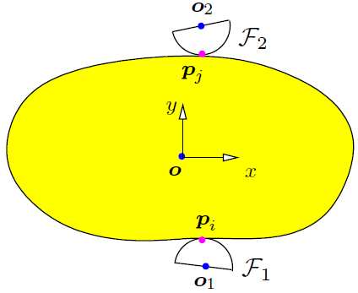
Squeeze Grasp with Rounded Fingers
Translate the fingers to squeeze the object.
• Initial point contacts $p_{i}$ and $p_{j}$.
• Contact friction.
• Contacts growing into segments.
To prevent rigid body motion, $p_{i}$ and $p_{j}$ must form force closure on an identical rigid object.
$\overline{p_{i}p_{j}}$ lies inside the two contact friction cones.

Slide 26
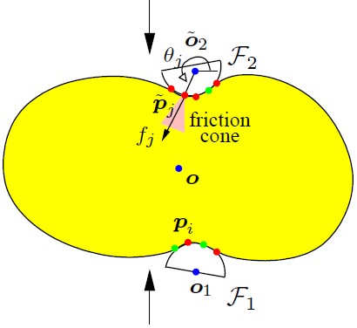


Contact Configuration
• Which nodes are in contact.
• Which of them are sticking and which
are sliding.
Maintain two sets:
sliding
sticking
$T:$indices of nodes sticking on a finger
$P:$indices of nodes slipping on a finger
Deformation update based on FEM:
• Sliding nodes $→$ position constraints.
• Sticking nodes $→$ force constraints.

Slide 27

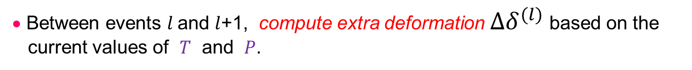
Overview of Squeeze Algorithm
• $T$ and $P$ change whenever a contact event happens:
• Squeeze depth $ρ$is sequenced by all such contact events:
$ρ_{0}$= 0, $ρ_{1}$, $⋯$
• Between events $l$and $l$+1, compute extra deformation $∆δ^{(l)}$ based on the
current values of $T$ and $P$.
• Total deformation when event $l$+1 happens:

Slide 28

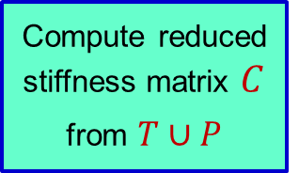
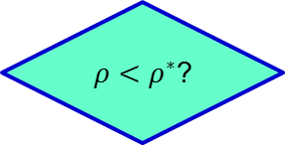
Squeeze Grasp Algorithm
success
no
Compute reduced stiffness matrix $C$ from $T∪P$
Contact Event Analysis
$ρ<ρ^{∗}$?
yes
no
Either finger slips?
Update $T∪P$
min extra squeeze
yes
failure

Slide 29




Movement of a Contact Node
• A sticking node moves with its contacting finger.
$$p_{k}$$
$$p_{k}$$
• A sliding node also slides on its contacting finger.
$$p_{k}$$
$$p_{k}$$

Slide 30
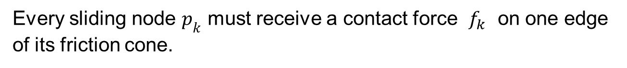

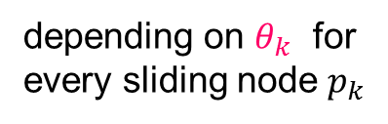


Deformation under Extra Squeeze
depending on $θ_{k}$ for
every sliding node $p_{k}$
Every sliding node $p_{k}$ must receive a contact force $f_{k}$ on one edge
of its friction cone.
$\left|P\right|$ variables $θ_{k}$
All $θ_{k}$s are solvable.
$\left|P\right|$ constraint equations

Slide 31







Contact Events
Check for all values of extra squeeze depth at which a event
could happen, and select the minimum.
• Event A – New Contact
$$O$$
$$r$$
$$O$$
$$p_{k}$$
$$p_{k}$$
• Event B – Contact Break
$$p_{k}$$
$$p_{k}$$
Notes:
Determine the mode of new contact in Event A by hypothesis and test.

Slide 32
More Contact Events
• Event C – Stick to Slip
Contact force $f_{k}$ is rotating out of the inward friction cone at $p_{k}$.
• Event D – Slip to Stick
The polar angle at $p_{k}$ stops changing at squeeze depth.

Slide 33
Termination of Squeeze
At either one of the following situations:
♦ A grasping finger starts to slip.
All contact nodes with the finger are slipping in the same direction.
♦ Strain at some node exceeds the material’s proportional limit.
♦ The object can be picked up against its weight vertically.

Slide 34
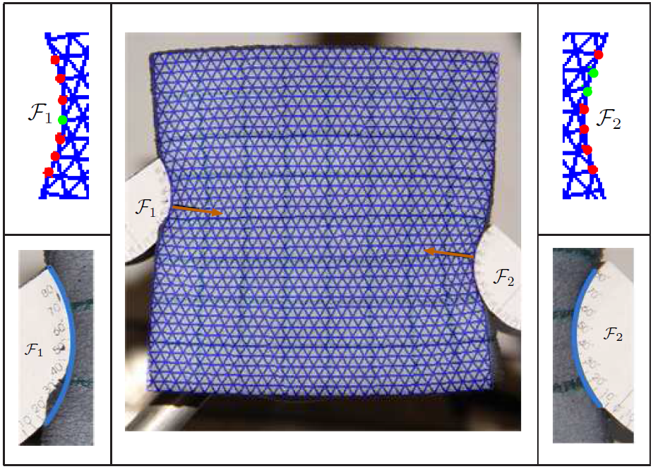


Experiment
slip
stick
Young’s modulus $E=50000$ Pa
Poisson’s ration $θ=0.3$
Contact cof $μ=0.4$
Notes:
Deformed mesh superposed on the real shape with error 1.3mm per node.
Distance between initial contact points reduces by 12%.
Green dot on the left finger was established as a sliding contact.

Slide 35
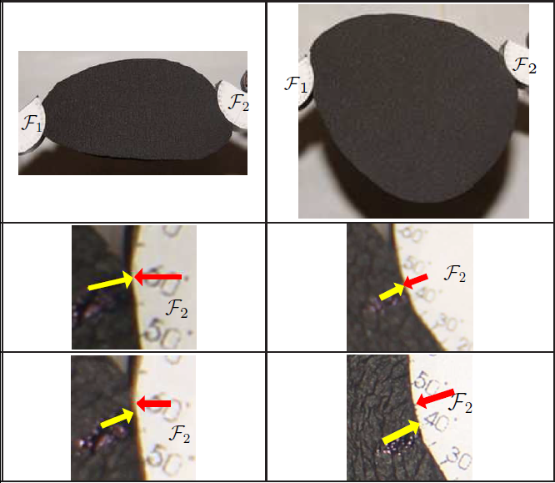
Stick to Slip

Slide 36
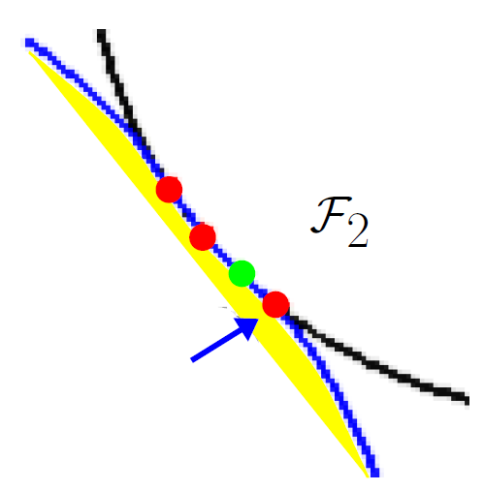
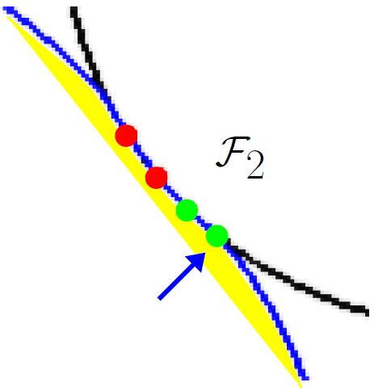
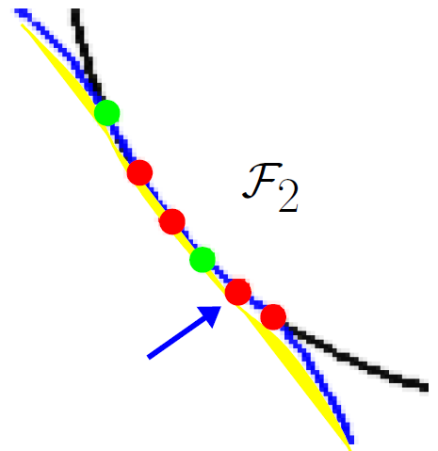
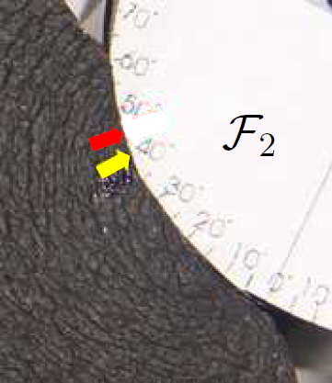
Stick to Slip back to Stick
Second (convex) shape
Notes:
Same locations linked by arrowed curves.

Slide 37
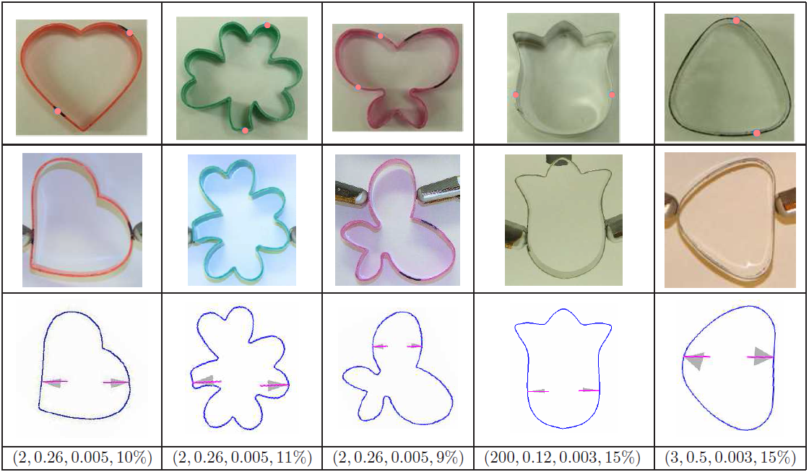

Experiment with Ring-like Objects
Degenerate shells.
$$(E,μ,h,ρ)$$
Notes:
Young’s modulus, cof, thickness, change in the distance between two contacts.

Slide 38
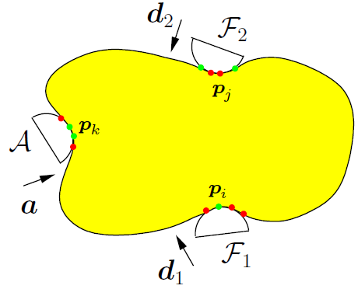

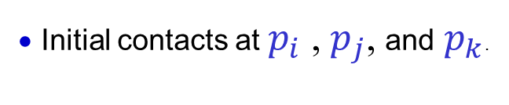
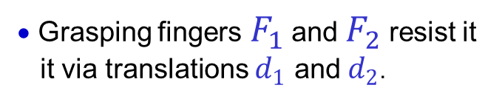
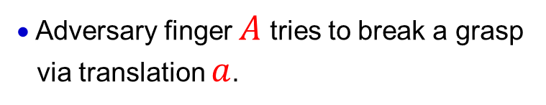
Adversary Finger Resistance
• Adversary finger $A$ tries to break a grasp
via translation $a$.
• Grasping fingers$F_{1}$ and $F_{2}$ resist it
it via translations $d_{1}$ and $d_{2}$.
• Initial contacts at $p_{i}$ ,$p_{j}$, and $p_{k}$.
Either $F_{1}$ and $F_{2}$ squeeze the object first or three fingers make contact with it
simultaneously.
Problem 2 What are the optimal $d_{1}$ and $d_{2}$?

Slide 39
What Optimality?
Optimality criterion should reflect the effort of resistance.
Rigid body grasping
Total force/wrench to resist unit adversary force/wrench.
Deformable body grasping
Work to resist unit translation by adversary finger.
System potential energy can be made as large as possible. $×$

Slide 40
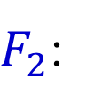
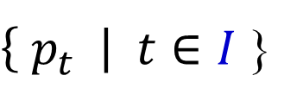
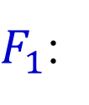
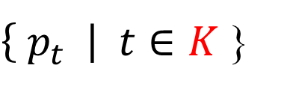

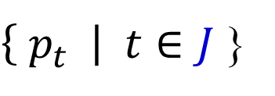
Work Minimization
Finger contact sets change during resistance:
$F_{1}$:
$\left\{ p_{t} \right| t∈I$}
$F_{2}$:
$\left\{ p_{t} \right| t∈J$}
$A$:
$\left\{ p_{t} \right| t∈K$}
Solution steps:
1) Fixed point contacts ( $\left|I\right|=\left|J\right|=\left|K\right|=1$).
2) Fixed setment contacts ( $\left|I\right|,\left|J\right|,\left|K\right|≥1$).
3) Change of contacts under Coulomb friction
(general case).

Slide 41

The Case of Fixed Point Contacts
Work done by grasping fingers:
Minimization is subject to
Stable squeeze:
Pure squeeze:
Closed forms exist for optimal resisting translations $d_{1}$ and $d_{2}$ except in
some degenerate cases.
Notes:
As if the fingers were glued at their contacts.
Degenerate case when p_k = 0.5 * (p_i + p_j) and d_1 * (p_i – p_j) = 0 for a stable resist.

Slide 42
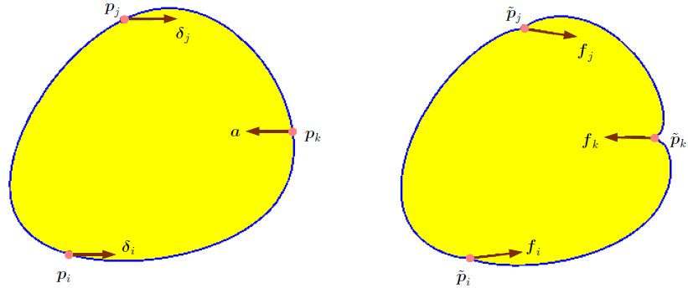
An Example
Resistance by a stable squeeze.
Notes:
Same Young’s modulus & Poisson’s ratio (50000 & 0.3)
Undeformed shape with translations
Deformed shape with forces

Slide 43




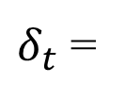
The Case of Fixed Segment Contacts
Contact node $p_{t}$ is displaced by
$d_{1},$ if $t∈I;$
$δ_{t}$ =
$d_{2},$ if $t∈J;$
$a,$ if $t∈K;$
Generalize over the case of fixed point contacts.
Generally, closed forms exist for optimal resisting translations $d_{1}$ and $d_{2}$.
Notes:
Same Young’s modulus & Poisson’s ratio (50000 & 0.3)

Slide 44

General Case of Frictional Segment Contacts
♦ Sequence the translation by $A$ based on contact events.
♦ Between two events the contact configuration does not change.
• Treat as fixed contact sets (only approximately for sliding nodes).
• Directions of new translations $∆d_{1}$ and $∆d_{2}$from minimizing extra work
under hypothesized extra unit translation by $A$.
• Distances of new translations are subject to the next contact event.
Notes:
Same Young’s modulus & Poisson’s ratio (50000 & 0.3)

Slide 45

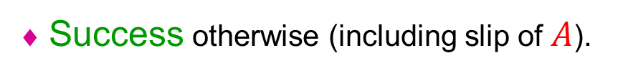
Outcomes of Resistance
♦ Failure if either $F_{1}$ or $F_{2}$ slips before $A$completes its translation.
♦ Success otherwise (including slip of $A$).
♦ Typically, $F_{1}$ and $F_{2}$ have squeezed the object for a grasp before $A$
makes contact with the object.
Notes:
Same Young’s modulus & Poisson’s ratio (50000 & 0.3)

Slide 46
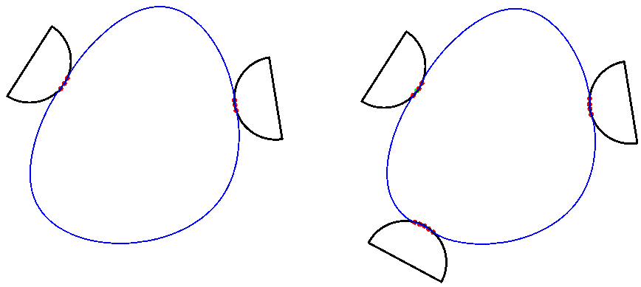





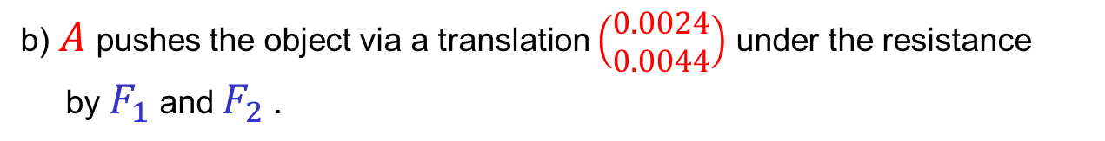
Simulation
a) $F_{1}$ squeezes the object toward $F_{2}$ via a translation $\left(\begin{matrix}−0.00068 \\ 0.002\end{matrix}\right)$.
b) $A$ pushes the object via a translation $\left(\begin{matrix}0.0024 \\ 0.0044\end{matrix}\right)$ under the resistance
by $F_{1}$ and $F_{2}$ .
$$F_{2}$$
$$F_{2}$$
$$F_{1}$$
$$F_{1}$$
$$A$$
Notes:
F_2 still.

Slide 47
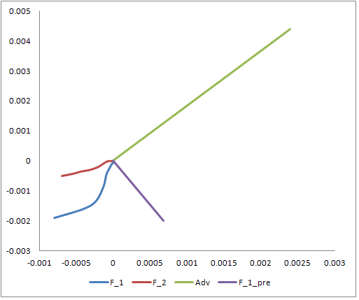




Resistance Trajectories
$$A$$
$$F_{2}$$
$F_{1}$ squeeze
$F_{1}$ resist
Notes:
Straight trajectories used in experiment

Slide 48
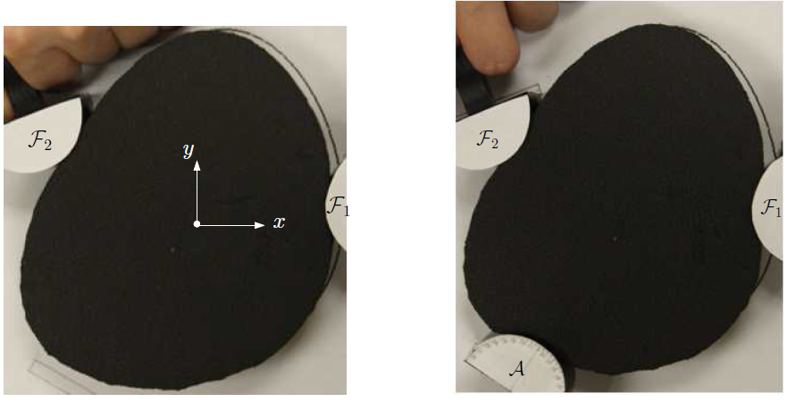
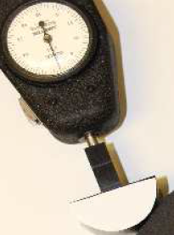
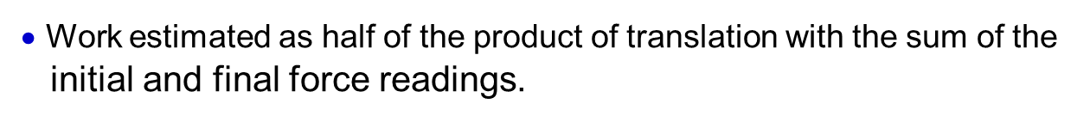
Resistance Experiment
• Straightened trajectories for $F_{1}$ and $F_{2}$ for ease of control.
• Work estimated as half of the product of translation with the sum of the
initial and final force readings.
force meter
Notes:
foam object
Involvement of human hands

Slide 49
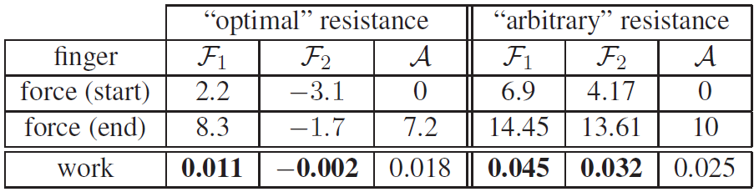

Simulation vs Experiment
Reasons for discrepancies:
♦ Straightened trajectories for $F_{1}$ and $F_{2}$.
♦ Measurement errors.
Experiment (“Optimal”)
Simulation
2.1
0.82
2.1
8.0
1.53
6.57
0.008
0.0027
0.018

Slide 50

“Optimal” vs “Arbitrary” Resistances
♦ “Optimal” resistance as just presented.
♦ “Arbitrary” resistance with a translation direction chosen arbitrarily.
stable resistance
Notes:
Same Young’s modulus & Poisson’s ratio (50000 & 0.3)

Slide 51
Summary
♦ Displacement-based grasping strategy for deformable objects.
♦ Stable and pure squeezes.
♦ Event-driven algorithm combined with contact mode analysis.
♦ Energy-based grasp optimality.
♦ Computational efficiency from one-time matrix decomposition.
Notes:
Rigid body grasping based on forces.

Slide 52
Future Work
♦ Computationally efficient grasp outcome prediction.
♦ Rigid body grasping vs. deformable body grasping.
• Why deformable objects are often easier to grasp?
• Soft fingers on a rigid body vs. Hard fingers on a deformable body
♦ Design of grasping algorithms for 3D deformable objects.
♦ Energy-based grasping metrics.
Notes:
Ongoing work in purple

Slide 53


Acknowledgement
US National Science Foundation
IIS-0915876

Slide 54
Online Papers
IEEE International Conference on Robotics and Automation (2013, published)
http://www.cs.iastate.edu/~jia/papers/ICRA13.pdf
IEEE/RSJ International Conference on Intelligent Robots and Systems (2013, accepted)
http://www.cs.iastate.edu/~jia/papers/IROS13-submit.pdf
Extended version (submitted to International Journal of Robotics Research)
http://www.cs.iastate.edu/~jia/papers/IJRR13-submit.pdf

