Slide 1
Simultaneous Three-Dimensional Impacts with Friction and Compliance
Yan-Bin Jia
Department of Computer Science
Iowa State University
Ames, IA 50010, USA
Sep 27, 2012

Slide 2
Why Impact?
♦
Because impact is everywhere …
Accomplishing tasks otherwise very difficult.
Reduction of harmful impulsive forces
Efficiency over static and dynamic forces
♦
Because it is relevant to robotics…
Collision between robots and environments, walking robots …
Impulsive manipulation being underdeveloped in robotics
Higuchi (1985); Izumi and Kitaka (1993); Hirai et al. (1999)
Huang & Mason (2000); Han & Park (2001), Tagawa et al. (2010)
Foundation of impact not fully laid out
Notes:
Easiness: hammering a nail, punching a staple through a stack of documents, cracking an egg,
Reduction of harmful impulsive forces: air bags, football helmets
Efficiency: bowl feeder for parts sorting
Collision with environments: space robots, humanoids
Higuchi: electromagnetic forces for parts positioning
Izumi & Kikata: hammering
Hirai: sorting with air floating
Han & Park: impulsive motion planning for orienting polygonal parts
Huang & Mason: tapping

Slide 3
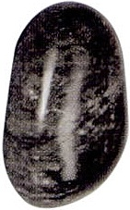
Describing Impact by Impulse
♦ “Infinitesimal” duration
before
after
♦ “Infinite” contact force
♦ Finite change in momentum
impulse

Slide 4
Impact Phase 1 – Compression
♦ Contact point → virtual spring.
♦ The spring changes its length by ,
storing elastic energy .
p
♦ Compression ends when the spring length
stops decreasing:
Notes:
During compression, kinetic energy is transformed into internal energy of deformation.

Slide 5
Transition at End of Phase 1
♦ Loss of energy at transition to restitution:
energy coefficient of restitution
p
♦ Increase in stiffness at transition to restitution:
change in spring length
Notes:
During compression, kinetic energy is transformed into internal energy of deformation.

Slide 6
Impact Phase 2 – Restitution
♦ During restitution the normal spring (n-spring)
releases the remaining .
♦ Restitution ends when
Notes:
With this loss of energy, the material hardens but the contact force remains.
Contact force is continuous at transition
During restitution, the elastic part of the energy is released.

Slide 7
Impulse-Energy Relationship
Energy is a piecewise quadratic function of impulse.
One-to-one correspondence between impulse and time.
Describe the process of impact in terms of impulse.

Slide 8
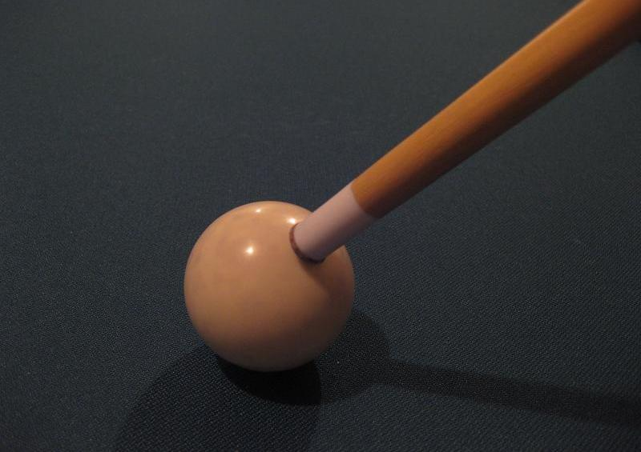
Example of General 3D Impact – Billiard Shooting
♦ Two contacts:
- cue-ball
- ball-table
normal impulses
♦ At each contact:
- normal impulse
- tangential impulse
How are they related
at the same contact?
(compliance & friction)
tangential
impulses
♦ At different contacts:
How are the normal
impulses related?
(simultaneous impacts)
Notes:
Multiple collisions often happen together with one object hitting a collection of still objects that are in contact with each other.
In the case of a billiard shot, the cue stick hits the cue ball, which in turn hits the table.

Slide 9
Talk Outline
I. Impact with Compliance
Relationship of tangential impulse to normal impact at single contact
(also with friction)
II. Simultaneous Impacts
Relationships among normal impacts at different contacts
(no friction or compliance)
III. Model Integration (Billiard Shooting)
Simultaneous impacts with friction and compliance

Slide 10
Related Work on Impact
♦ Newton’s law (kinematic coefficient of restitution)
Maclaurin (1742); Bernoulli (1969); Ivanov (1995)
• Energy increase
Wang et al. (1992); Wang & Mason (1992)
• No post-impact motion of a still object
Brogliato (1999); Liu, Zhao & Brogliato (2009)
♦ Poisson’s hypothesis (kinetic coefficient of restitution)
Routh (1905); Han & Gilmore (1989); Ahmed et al. (1999); Lankarani (2000)
Darboux (1880); Keller (1986); Bhatt & Koechling (1994);
Glocker & Pfeiffer (1995); Stewart & Trinkle (1996); Anitescu & Portta (1997)
• Energy increase
Notes:
All impacts conserve momentum.
Ratios between the velocities, impulses, energy after and before the impact
Maclaurin, Bernoullis, and Ivanov all considered solving multiple impacts under Newton’s law.
Routh: graphical method to construct trajectory of impulse accumulation
Darboux: described impact dynamics using ODE in terms of normal impulse
Keller: varying of the direction of slip
Bhatt & Koechling: flow pattern of the tangential velocity in the contact area

Slide 11
Related Work (cont’d)
♦ Energy-Based Restitution (energetic coefficient of restitution)
Stronge (1990); Wang et al. (1992);
• Energy conservation
♦ Simultaneous Collisions
Chatterjee & Ruina (1998); Ceanga & Hurmulu (2001); Seghete & Murphey (2010)
Liu, Zhao & Brogliato (2008, 2009); Jia, Mason & Erdmann (2008)
♦ Tangential Impulse & Compliance
Mindlin (1949); Maw et al. (1976)
Smith (1991); Bilbao et al. (1989); Brach (1989)
Stronge (1994; 2000); Zhao et al. (2009); Hien (2010) ; Jia (2010)
Notes:
Wang: integrated Stronge’s model with rigid body dynamics
Chatterjee & Ruina: impact sequencing by order of approaching velocity
Ceanga & Hurmulu: impulse correlation ratio
Liu et al: described a framework for frictionless multiple impacts;
Mindlin: using Hertz contact theory
Smith, Bilbao, Brach: empirical way not following Coulomb friction
Zhao: correlation coefficient of friction

Slide 12
Impact with Compliance
Normal impulse:
1. accumulates during impact
(compression + restitution)
2. energy-based restitution
3. variable for impact analysis
Tangential impulse:
1. due to friction & compliance
2. dependent on contact modes
3. driven by normal impulse

Slide 13
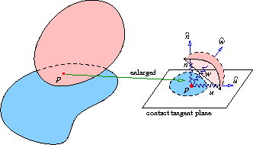
Compliance Model
♦
Gravity ignored in comparison with impulsive force.
♦
Extension of Stronge’s contact structure to 3D.
♦
Analyze impulse in contact frame:
tangential
impulse
opposing initial
tangential contact
velocity
massless
particle
Notes:
Horizontal contact plane.

Slide 14
Normal vs Tangential Stiffnesses
stiffness of normal spring (value varying with impact phase)
stiffness of tangential u- and v-springs (value invariant)
Stiffness ratio:
Depends on Young’s moduli and Poisson’s ratios of materials.
(compression)
(restitution)
Notes:
Since k varies, we use the eta^2 to keep track of the ratio which takes on different values during compression and restitution.

Slide 15
Normal Impulse as Sole Variable
Idea: describe the impact system in terms of normal impulse.
Key fact:
♦ Derivative well-defined at the impact phase transition.
♦
(1 if extension of tangential u- and w-springs
–1 if compression)
Notes:
‘ refers to differentiation w.r.t. normal impulse.

Slide 16
Tangential Springs
♦ Cannot determine changes and in length without knowing stiffness.
♦ Can keep track of integrals
of
over
♦ Elastic strain energies:

Slide 17
System Overview
Impact
Dynamics & Contact
Kinematics
Contact
Mode
Analysis
integrate
integrate

Slide 18

Sliding Velocity
tangential contact velocity
from contact kinematics
sliding velocity represented by
velocity of particle p
Sticking contact if .
Notes:
The difference between the two velocities are the rates of length changes of the two tangential springs.

Slide 19
Stick or Slip? Energy-Based Criteria
By Coulomb’s law, the contact sticks , i.e., if
Slips if

Slide 20
Contact Mode Transitions
♦ Stick to slip when
♦ Slip to stick when
i.e,

Slide 21
Sticking Contact
♦ Rates of change in spring length.
♦ Particle p in simple harmonic motion like a spring-mass system.
(No energy dissipation tangentially)

Slide 22
Sliding Contact
♦ can also be solved (via involved steps).
♦ Energy dissipation rate (tangentially):

Slide 23
System of Impact with Compliance
Differential equations with five functions and one variable :
Tangential impulses
Length (scaled) of
tangential springs
Energy stored by
the normal spring

Slide 24
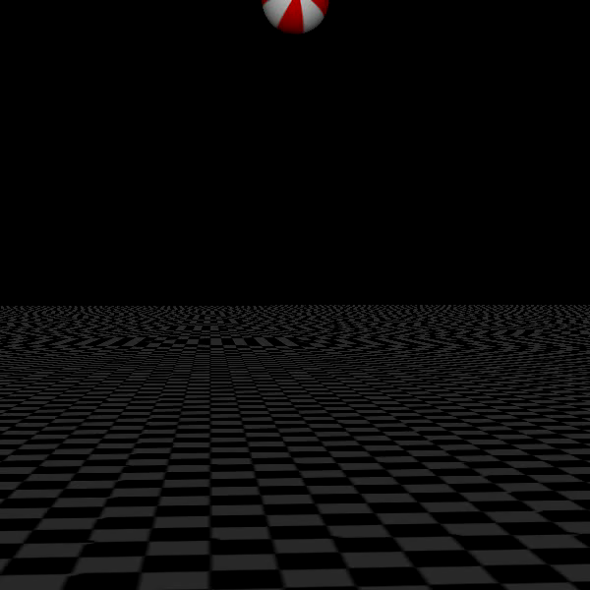
Bouncing Ball
Physical parameters:
Before 1st impact:
After 1st impact:
All bounces are in one vertical plane
Notes:
Y-axis inward
At ½ speed
Rotation reversal – counterclockwise about y-axis -> clockwise

Slide 25

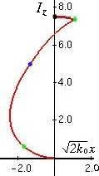
Impulse Curve (1st Bounce)
contact mode
switch
Notes:
Sliding velocity is the difference between vt and xdot, which remains zero during sticking.
The second slip turns out to be a reverse slip.
Discontinuity in xdot at slip reversal. Happens under slip during restitution when x * xdot < 0 (same sign with Ezdot). But they are both positive before reversal.

Slide 26
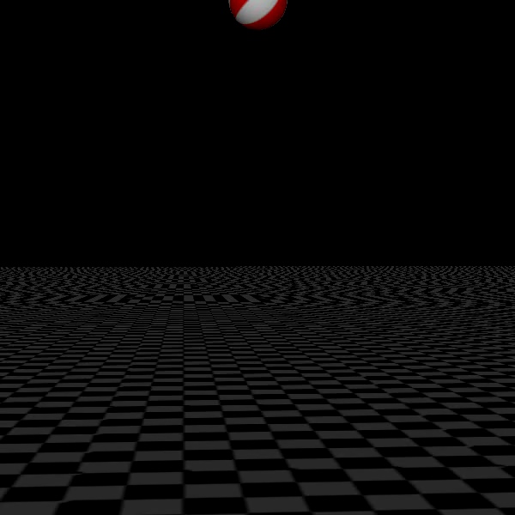
Non-collinear Bouncing Points

Slide 27
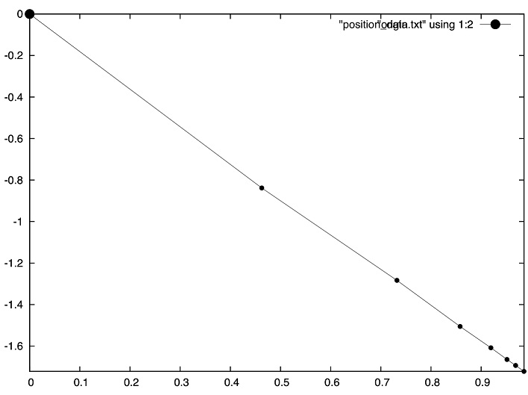
Trajectory Projection onto Table
Notes:
Not exactly a line.

Slide 28
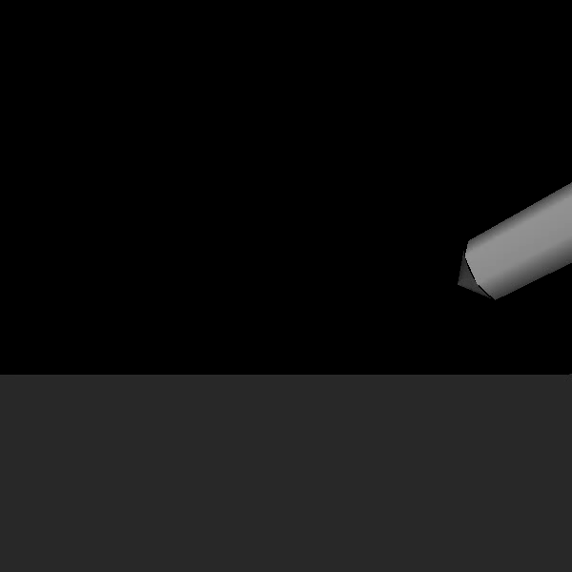
Bounce of a Pencil
Pre-impact:
Post-impact:
z
x
Notes:
1/10 speed
z-component of omega is not affected.
The pencil bounces upward with reduced speed.
New motion along the y-axis

Slide 29
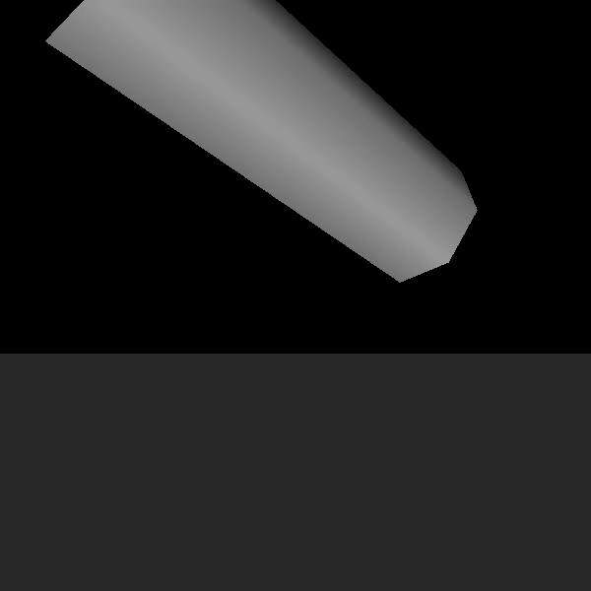
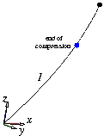

Impulse Curve
end of
compression
z
stick
slip
y
slip
Slipping direction varies.
Notes:
Slip direction along the curve tangent and opposes the direction of accumulation.
continuous change of the slip direction

Slide 30
Where Are We?
I. Impact with Compliance
Relationship of tangential impulse to normal impact at single contact
(also with friction)
II. Simultaneous Impacts
Relationships among normal impacts at different contacts
(no friction or compliance)
III. Model Integration (Billiard Shooting)
Simultaneous impacts with friction and compliance

Slide 31
Simultaneous Collisions in 3D
• High-speed photographs shows >2 objects simultaneously
in contact during collision.
• Lack of a continuous impact law.
Our model
♦ Collision as a state sequence.
♦ Within each state, a subset of impacts are “active”.
♦ Energy-based restitution law.

Slide 32
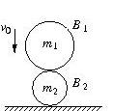
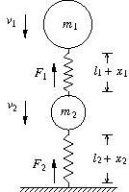
Two-Ball Collision
Problem: One rigid ball impacts another
resting on the table.
Question: Ball velocities after the impact?
virtual springs
(kinematics)
(dynamics)
Notes:
If only one ball, then it would be a high school problem.

Slide 33
Impulses, Velocities & Stain Energies
Ball-ball impulse:
Ball-table impulse:
Velocities:
Rates of change in contact strain energies:
Notes:
Only I1 & I2 are variables.

Slide 34
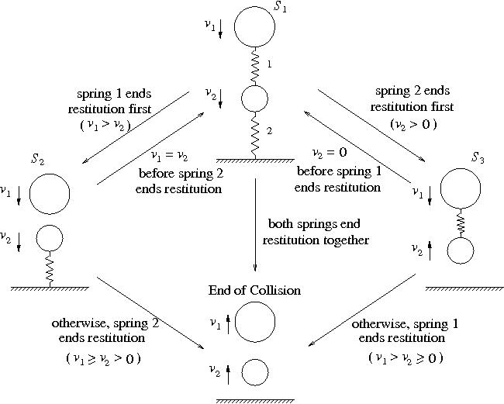
State Transition Diagram
♦ The two impacts almost never start or end restitution at the same time.
♦ An impact may be reactivated after restitution.
spring 1 ends
restitution first
spring 2 ends
restitution first
and
before
spring 1 ends
restitution
and
before
spring 2 ends
restitution
both springs end
restitution together
otherwise, spring 2
ends restitution
otherwise, spring 1
ends restitution
Notes:
There are a cue-ball impact and a ball-table impact.

Slide 35
Some Facts
♦ A change of state happens when a contact disappears or a
disappeared contact reappears.
♦ Impulse & strain energy for one impact also depend on those
for the other (correlation).
♦ Compression may restart from restitution within an impact
state due to the coupling of impulses at different contacts.
Notes:
Drs. Liu, Zhao, Brogliato discovered in their paper.

Slide 36
Assumptions on Simultaneous Impacts
Every end of compression of single impact:
♦ increase in stiffness
♦ invariance of contact force
No change in stiffness
♦ when restitution switches back to compression, or
♦ when a contact is reactivated.
Notes:
Stiffness ratio increases/decreases exponentially in the number of times compression ends.

Slide 37
Stiffness, Mass, and Velocity Ratios
Theorem 2
♦ Collision outcome depends on the contact stiffness
ratio but not on individual stiffness.
♦ The outcome does not change if the ball masses
scale by the same factor.
♦ Output/input velocity ratio is constant (linearity).
Consider upper ball with unit mass and unit downward velocity.

Slide 38
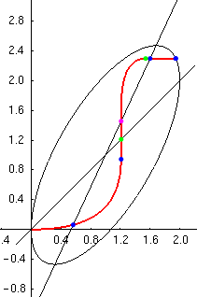
Impulse Curve
Theorem 3 During the collision,
the impulses
accumulate along a curve
that is first order continuous
and bounded within an ellipse.
lines of
compression
Notes:
The curve reaches the ellipse if there is no energy loss as shown in this instance.
Lines of compression

Slide 39
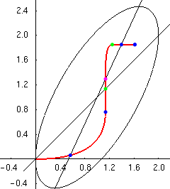
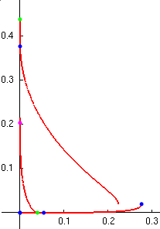
Example with Energy Loss
energy
loss
energy
loss
Notes:
No energy loss in state 3 because impact didn’t end compression.

Slide 40
Convergence
impulses at the end of the ith state in the sequence.
Sequence
♦ monotone non-decreasing
♦ bounded within an ellipse
Theorem 4 : The state transition will either terminate with
or the sequence will converge with
either or .

Slide 41
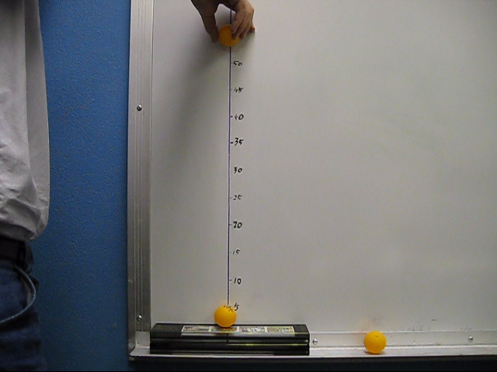
Ping Pong Experiment

Slide 42
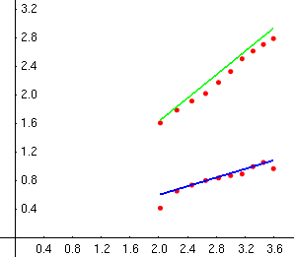
Experiment
kg
Measured values:
(ball-ball)
(ball-table)
Guessed value:
same trial

Slide 43
Where Are We?
I. Impact with Compliance
Relationship of tangential impulse to normal impact at single contact
(also with friction)
II. Simultaneous Impacts
Relationships among normal impacts at different contacts
(no friction or compliance)
III. Model Integration (Billiard Shooting)
Simultaneous impacts with friction and compliance

Slide 44
Billiard Shooting
Simultaneous impacts: cue-ball and ball-table!

Slide 45
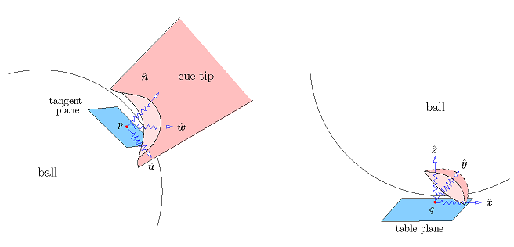
Contact Structures
Cue-ball contact
Ball-table contact
♦ Normal impulses at the two contacts are described by the simultaneous
impact model.
♦ At each contact, normal impulse drives tangential impulse as described
by the compliance model.

Slide 46
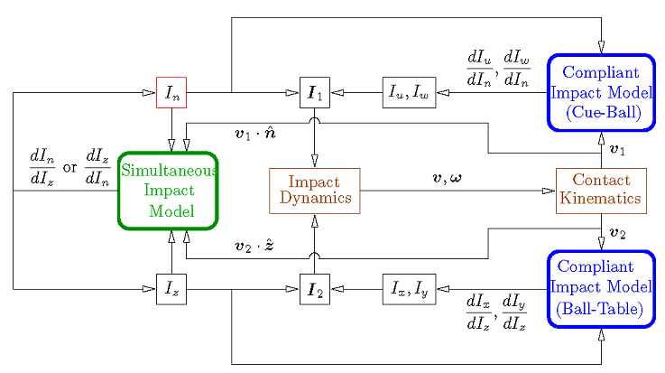
Combing the Two Impact Models
normal CB
impulse
normal BT
impulse
The two normal impulses take turns to drive the system.

Slide 47
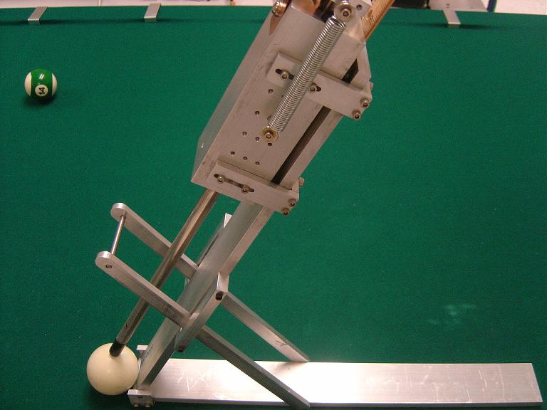
Mechanical Cue Stick

Slide 48
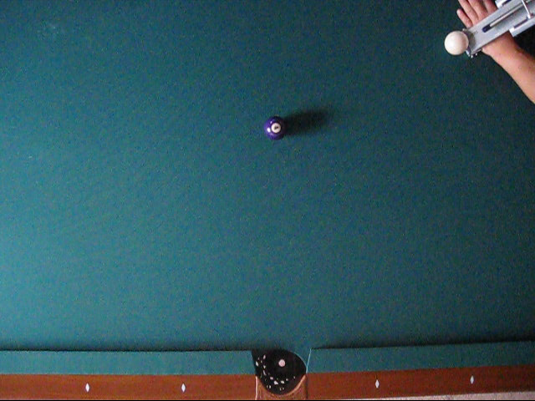
A Masse Shot

Slide 49
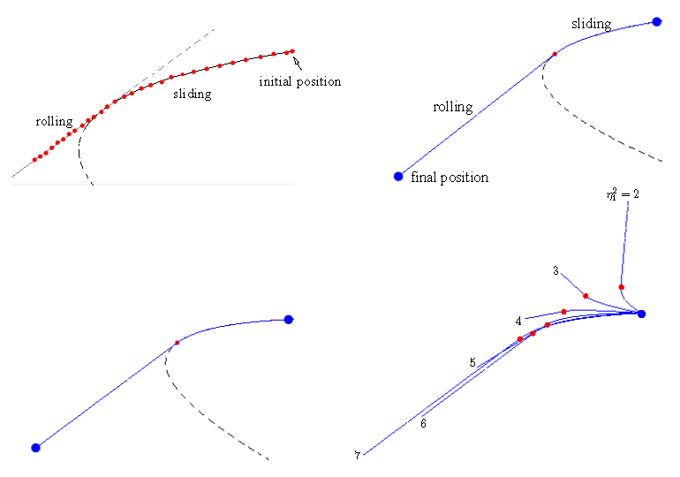
reconstructed trajectory
from video
if not ended by cushion
Shot video
Trajectory fitting
Post-shot ball velocities
Impact model
Predicted post-shot ball velocities
increasing cue-ball
compliance
predicted trajectory
by model
Notes:
It can be shown that, after the hit, the ball first slides along a parabolic curve until its contact velocity reduces to zero. Then pure rolling happens along a straight line.

Slide 50
Conclusion
3D impact modeling with compliance and friction
elastic spring energies
impulse-based not time-based
contact mode analysis (stick / slip)
sliding velocity computation
Multiple impacts
state transition diagram
impulse curve
stiffness ratio
scalability
convergence
Physical experiment.
Integration of two impact models

Slide 51
Extensions of Collision Model
♦ Rigid bodies with arbitrary geometry
♦ General simultaneous multibody collision
◊ ≥3 contact points
◊ State transition templates
◊ Measurement of relative contact stiffness
♦ Robot pool player!

Slide 52



Acknowledgement
HR0011-07-1-0002
Matt Mason, Michael Erdmann, Ben Brown (CMU)
Amir Degani (Israel Institute of Technology)
Rex Fernando, Feng Guo (ISU students)

Slide 53
Online Papers
International Journal of Robotics Research, 2012:
1. Yan-Bin Jia. Three-dimensional impact: energy-based modeling of tangential
compliance. DOI: 10.1177/0278364912457832.
http://www.cs.iastate.edu/~jia/papers/IJRR11a-submit.pdf
2. Yan-Bin Jia, Matthew T. Mason, and Michael A. Erdmann. Multiple impacts:
a state transition diagram approach. DOI: 10.1177/0278364912461539.
http://www.cs.iastate.edu/~jia/papers/IJRR11b-submit.pdf

Slide 54
Appendix 1: Start of Impact
Initial contact velocity
♦
♦ Under Coulomb’s law, we can show that
sticks if
…
slips if
…
♦

Slide 55
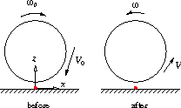
Bouncing Ball – Integration with Dynamics
Velocity equations:
(Dynamics)
Contact kinematics
Theorem 1 During collision, is collinear with .
Impulse curve lies in a vertical plane.

Slide 56
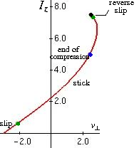
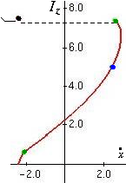
Impulse Curve (1st Bounce)
Tangential contact velocity
vs. spring velocity
contact mode
switch
Notes:
Sliding velocity is the difference between vt and xdot, which remains zero during sticking.
The second slip turns out to be a reverse slip.
Discontinuity in xdot at slip reversal. Happens under slip during restitution when x * xdot < 0 (same sign with Ezdot). But they are both positive before reversal.

Slide 57
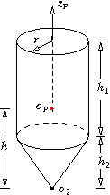
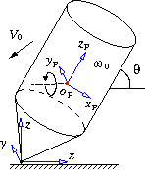
Bouncing Pencil
Notes:
Geometric dimensions
Physical coefficients

