Slide 1
TOC
The Front End (IF + ID)
The Execution Engine (EX + MEM + WB)
Vector Extentions

Slide 2
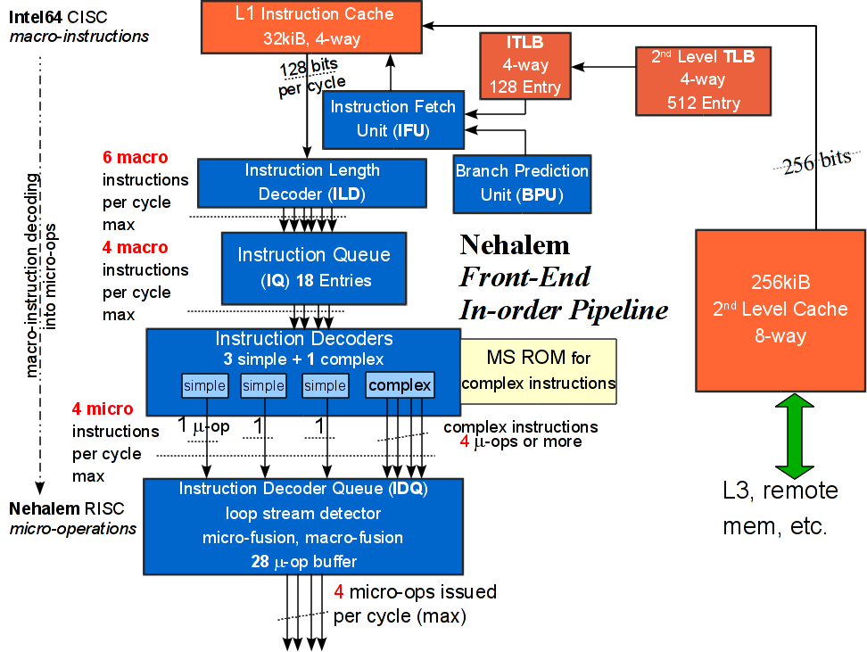
Front End
Notes:
The traditional IF and ID units are implemented in Front End of the processor, which has been attached in previews sides.
There are several key points:
The instruction fetch unit always fetches up 16 bytes of instruction bytes from L1 I-cache in one cycle. So to reach the peak fetching rate, the instruction must be aligned to 16 bytes.
The number 16 is not a coincidence. Programs average slightly less than 4 bytes per instruction, and since most instructions can be decoded by 4 decoders, an entire fetch can often be consumed by the decoders in one cycle.

Slide 3
Front End
Notes:
The function of Front End is to fetch CISC instructions from I cache and decode them into RISC style micro-instructions.

Slide 4
Front End
Notes:
The instruction fetch unit always fetches up 16 bytes of instruction bytes from L1 I-cache in one cycle. So to reach the peak fetching rate, the instruction must be aligned to 16 bytes.
The number 16 is not a coincidence. Programs average slightly less than 4 bytes per instruction, and since most instructions can be decoded by 4 decoders, an entire fetch can often be consumed by the decoders in one cycle.

Slide 5
Front End
Notes:
The instruction fetch unit always fetches up 16 bytes of instruction bytes from L1 I-cache in one cycle. So to reach the peak fetching rate, the instruction must be aligned to 16 bytes.
The number 16 is not a coincidence. Programs average slightly less than 4 bytes per instruction, and since most instructions can be decoded by 4 decoders, an entire fetch can often be consumed by the decoders in one cycle.

Slide 6
Front End

Slide 7
Front End
Notes:
The instruction fetch unit always fetches up 16 bytes of instruction bytes from L1 I-cache in one cycle. So to reach the peak fetching rate, the instruction must be aligned to 16 bytes.
The number 16 is not a coincidence. Programs average slightly less than 4 bytes per instruction, and since most instructions can be decoded by 4 decoders, an entire fetch can often be consumed by the decoders in one cycle.

Slide 8
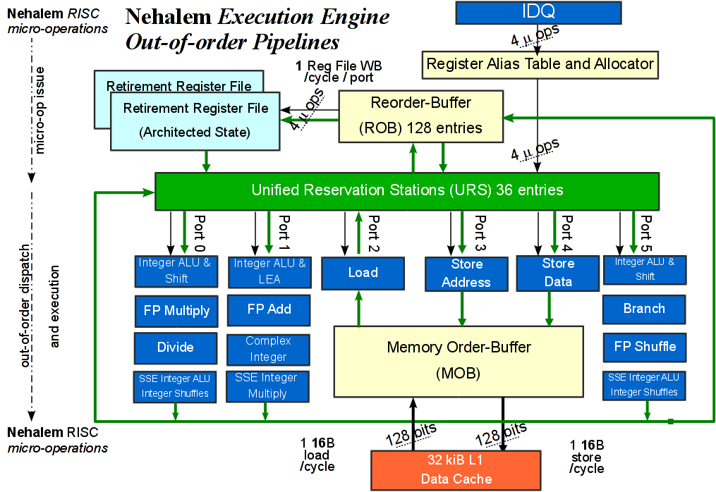
Execution Engine
Notes:
There is another multiple issue procedure.
6 Micro-Operations can be issued to the specific execution clusters.

Slide 9
Execution Engine
Notes:
The Throughput of each executable operation is 1, which means all operations are pipelined.

Slide 10
Execution Engine
Notes:
An interesting part here is operations fall into three bypass domains of integer/FP/SIMD. Forwarding the result within the same bypass domain from a producer micro-op to a consumer micro is done efficiently in hardware without delay. Forwarding the result across different bypass domains may be subject to additional bypass delays.
Integer ↔ FP = 2
SIMD ↔ FP = 2
Integer ↔ SIMD =1

Slide 11
Vector Extentions

