Slide 1

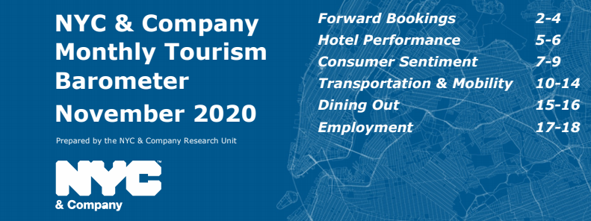
Hospitality Company & HDAG Case Study: A Streamlined Process for Updating a Travel Dashboard
Summary Deck
November 2020
HDAG Group 2020 ® All Rights Reserved.

Slide 2
1: Purpose
Goals:
Develop a slide deck illustrating information from various travel-related data sources, public and private
Create visualizations, and a design that is easy to interpret
Semi-automate the whole process, so the main buffer in pumping out a new presentation is the updating of new data
Solution:
A dashboard with production integrated with both python and tableau scripts. A dashboard template and design scheme is preset, and all data can be updated and processed through a few clicks within python and tableau scripts to create new visuals. Those can be converted to the dashboard, to easily make a monthly report.
Data Source
Summary
Visual
+
Description of Data

Slide 3
2: Data, Workflow
Data Sources:
Unique sources amassed from both online (government, other free agencies), and private sources were used. Those include MTA, BLS, TSA, and additional confidential sources.
Data Handling:
Each source has a unique script assigned, either through Python or Tableau scripts, for which visuals can be easily updated. They’re made to take in the strict format of how the data is given from the vendor.
Final Product:
Multi-page dashboard to be updated monthly. Pages assigned per category of relation to travel (i.e., Hotel Performance, Consumer Sentiment, Employment).

Slide 4
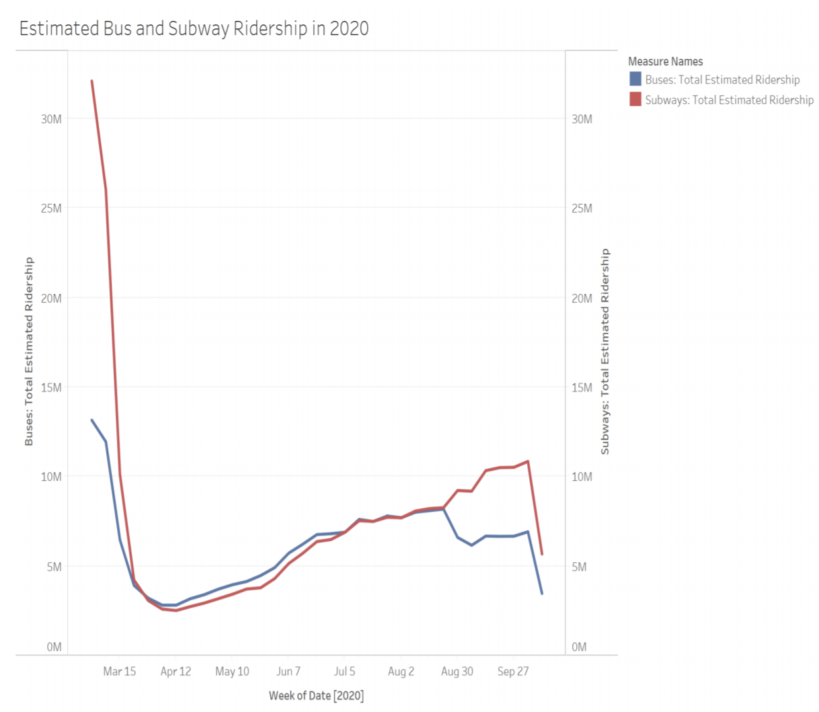
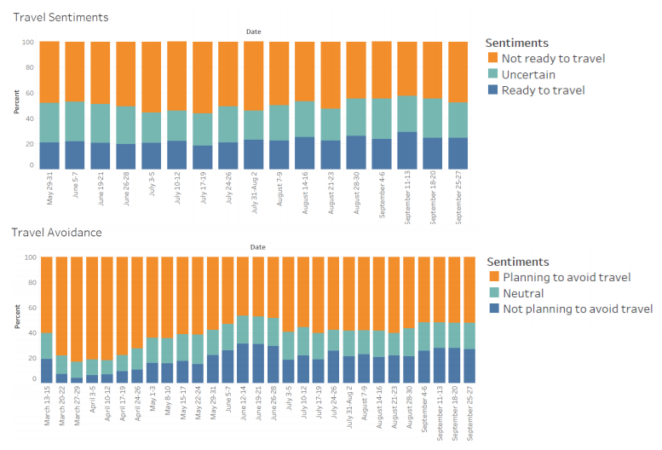
3: Example Visualizations

Slide 5
Hospitality Company: Master Summary
Challenge:
Project Guidelines:
Synthesize various data sources regarding travel information for Company City into a presentable format to forward to clients and serve as an effective informational tool.
Technical Scope: Data Handling, Web Scraping, Data Visualization, Tableau Programming
Final Deliverable:
A semi-auto process for updating a dashboard that integrates usage of Python and Tableau to created updated visuals with newly published data each month, from each unique vendor. With our process, client can create and update monthly dashboards of the quality we’ve given, without any of our help.

