Slide 1

Fintech Automation: Using and Validating Data More Effectively
Semester Project Overview
HDAG Group 2020 ® All Rights Reserved.

Slide 2
Executive Summary
01
Overview
Network Calendars | Parsing PDFs into clean Excel sheets (or other formats) | The workflow: view, merge, and analyze network calendars with ease
Prospectuses | Given a list of CUSIPs, create a database of prospectuses from scraping the SEC website and extract relevant data en masse to validate internal schemas | The MVP: Easily generate a JSON db with CUSIP, maturity date, issuer, denomination, and underwriting discount
3

Slide 3
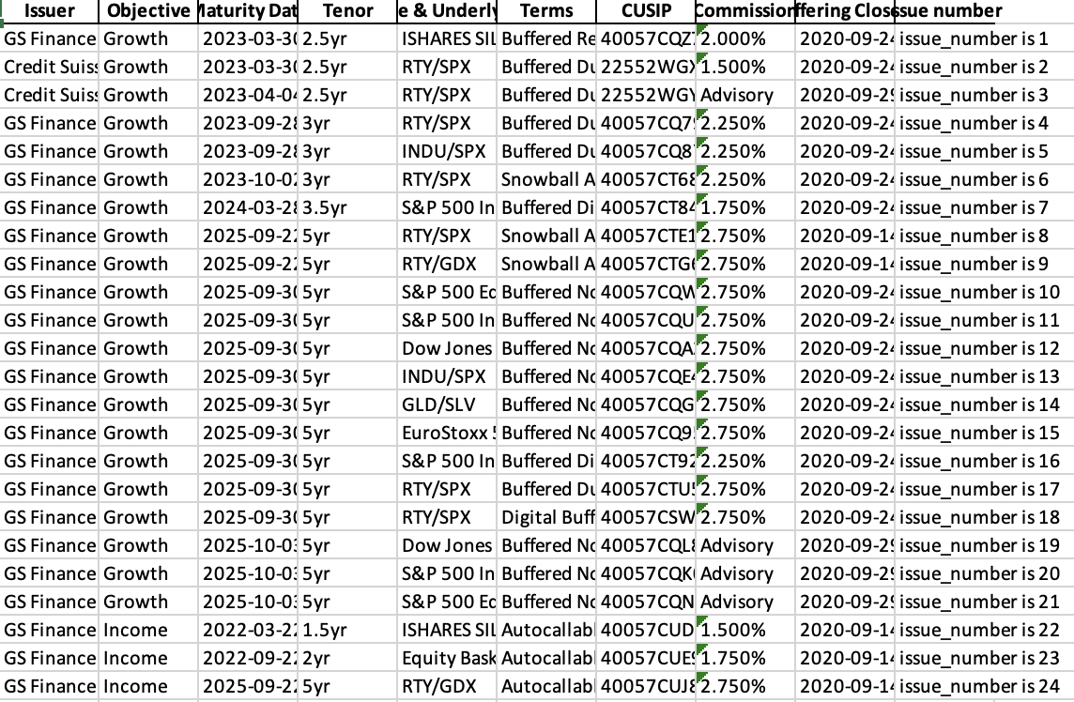
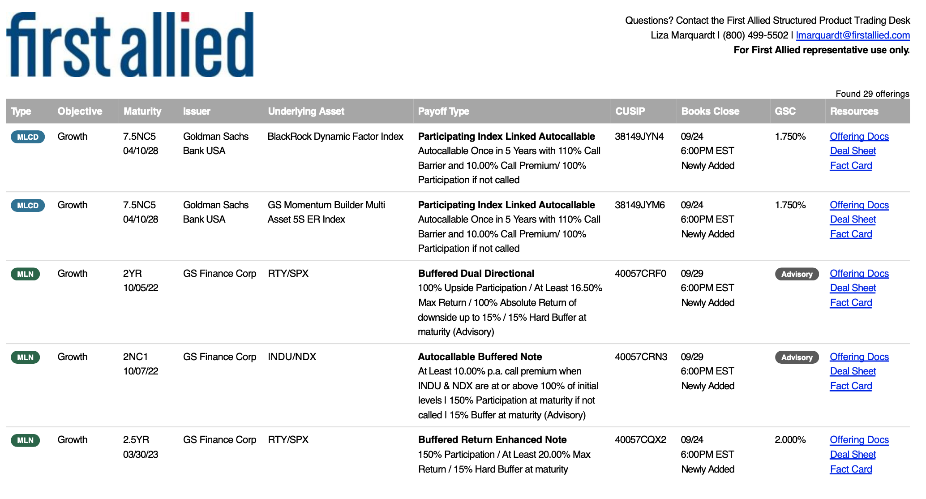
Automated PDF parsing
Convert vendor specific pdf formats to excel in one click
Automatically merge calendar offerings from different sources
Replace manual entry process to save time and avoid errors
5

Slide 4
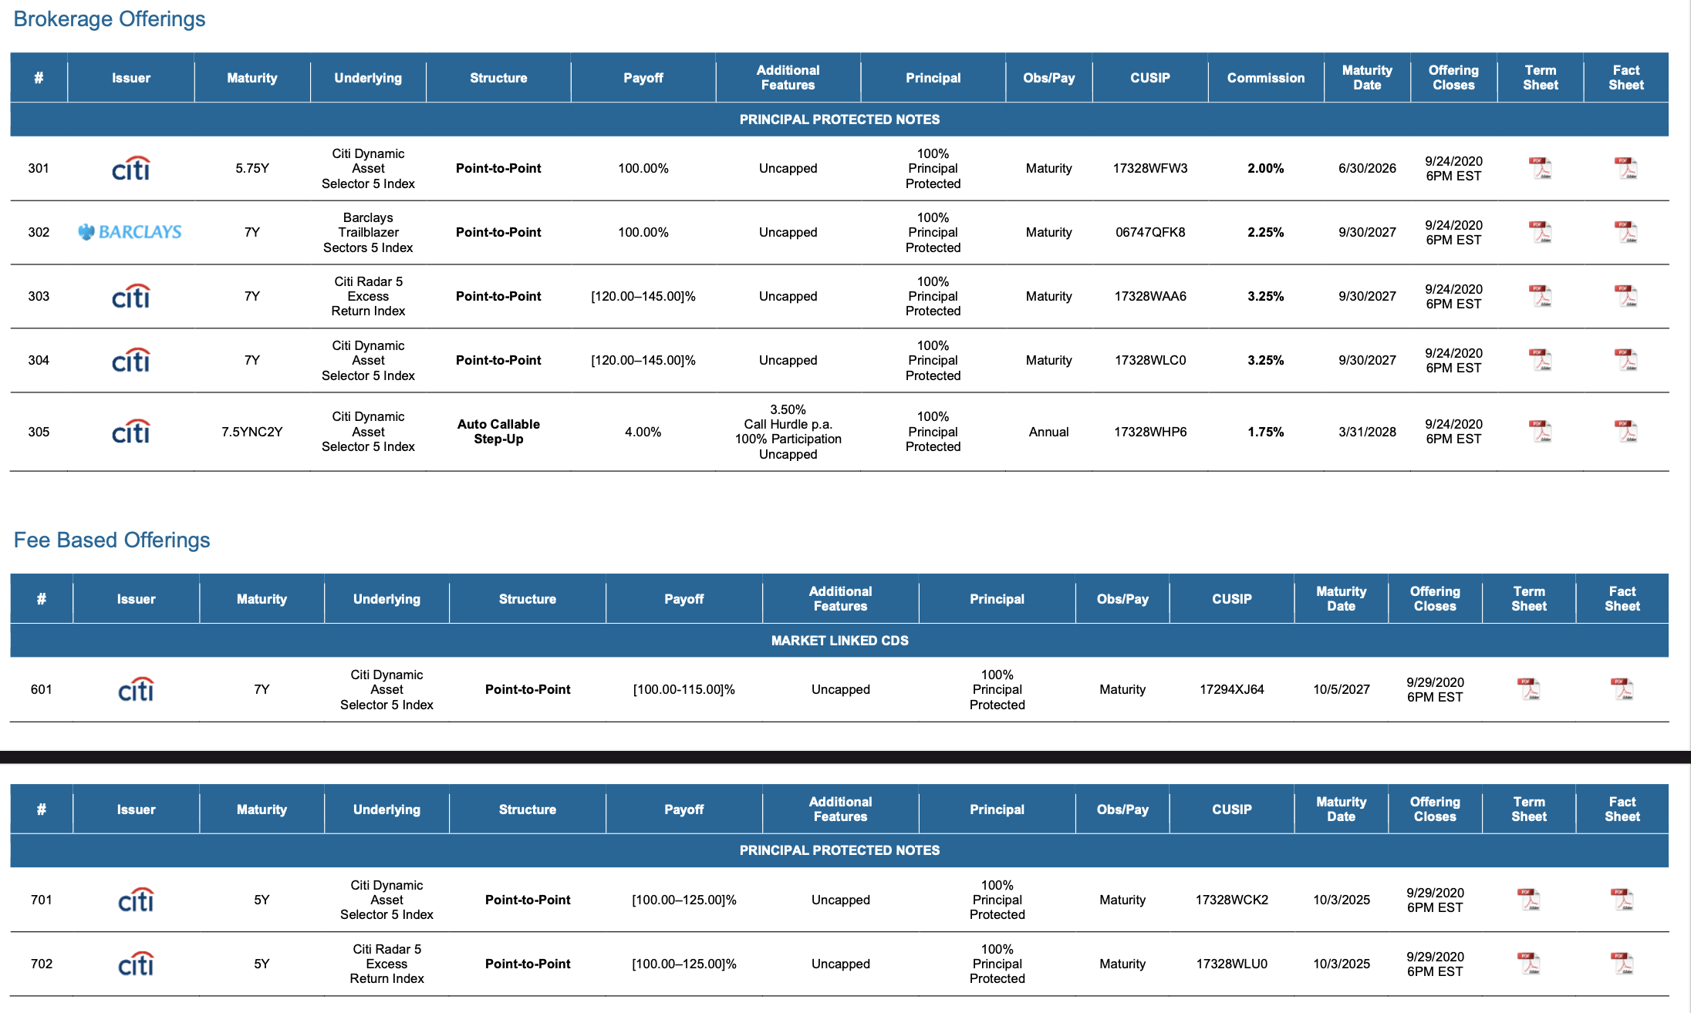
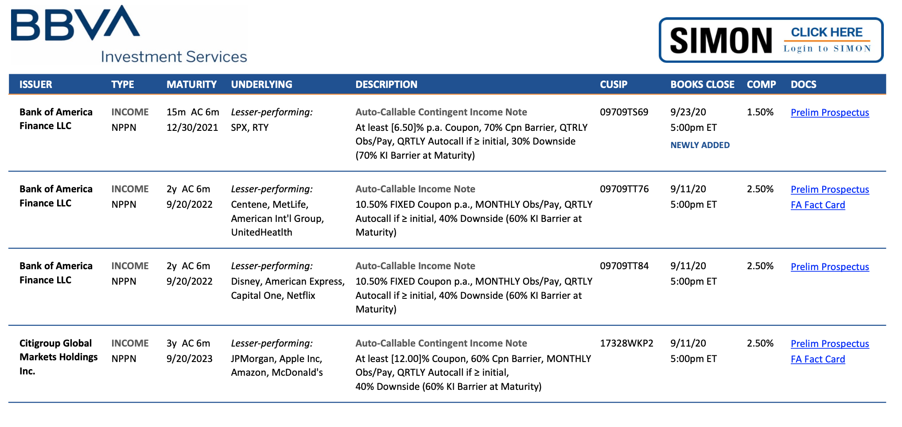
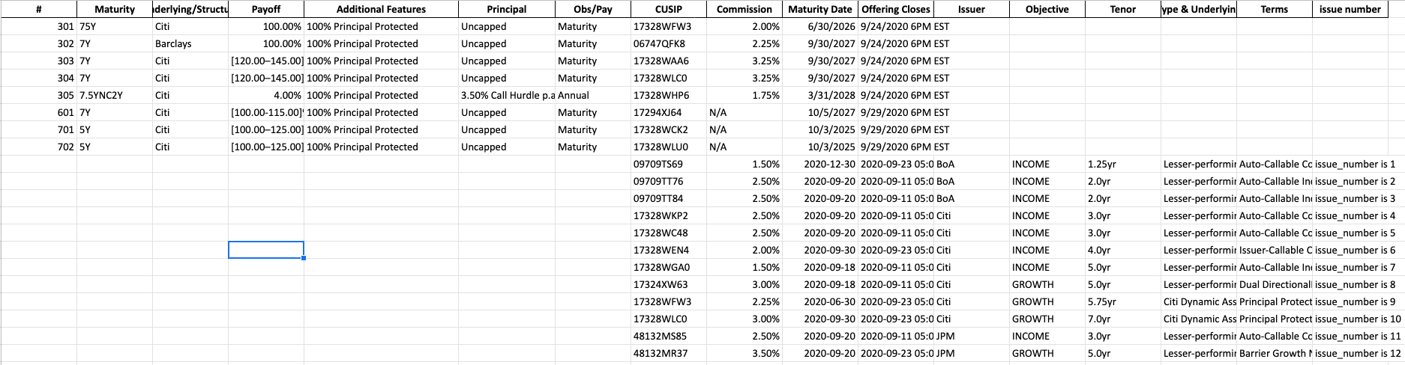
Quickly merge network calendars

Slide 5
Executive Summary
02
Overview
Network Calendars | Parsing PDFs into clean, nicely formatted Excel sheets (or any other format) | The workflow: view, merge, and analyze network calendars with ease
Prospectuses | Given a list of CUSIPs, create a database of prospectuses from scraping the SEC website and extract relevant data en masse to validate internal schemas | The MVP: Easily generate a JSON db with CUSIP, maturity date, issuer, denomination, and underwriting discount
3

Slide 6
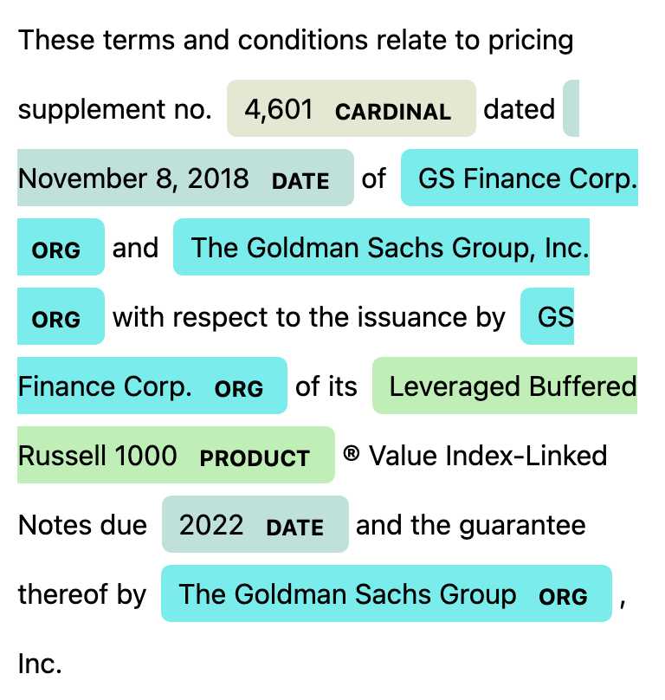
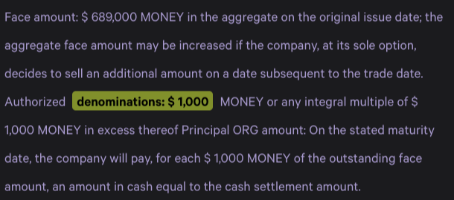
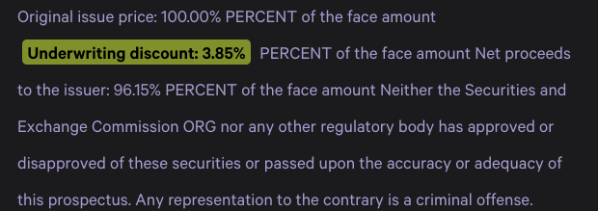
Use an NLP model to extract data from SEC website
12

Slide 7
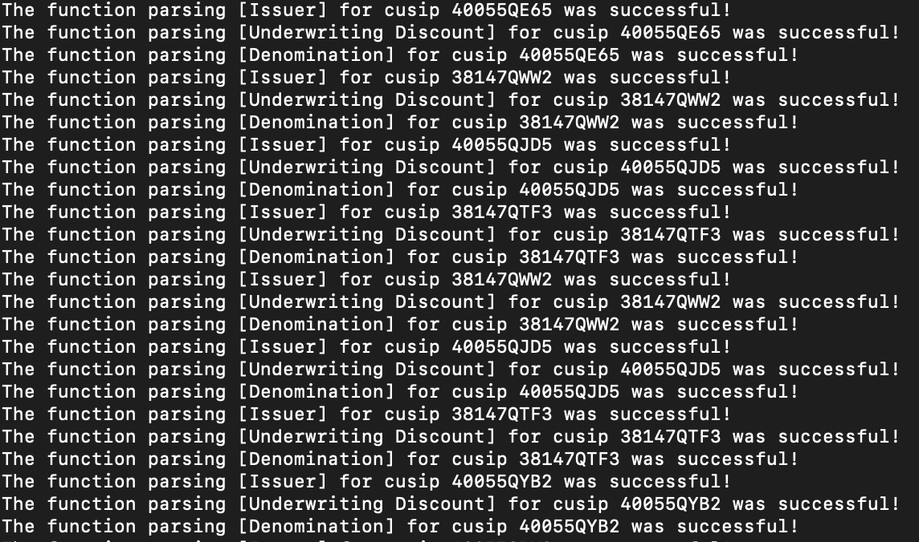
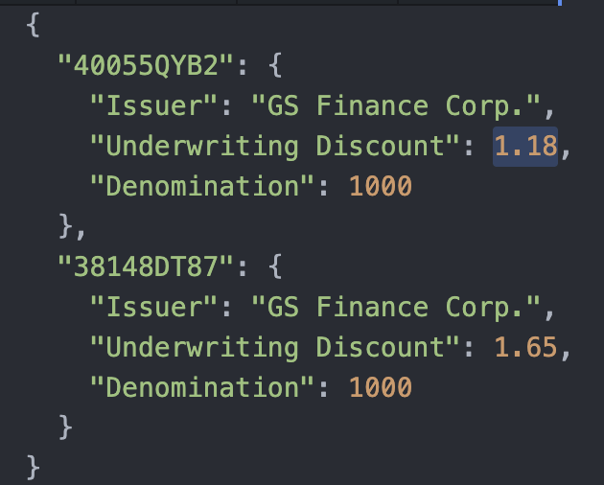
Run once. Get an up to date DB.
12

