Slide 1

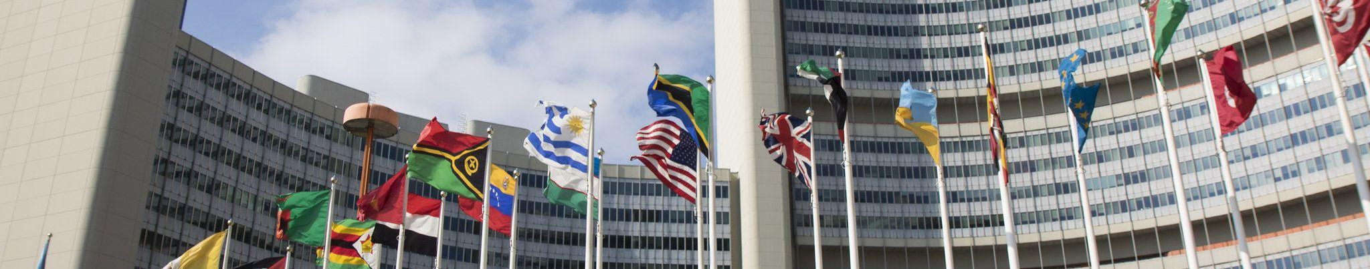
Programs for Impact: Quantifying UNIDO’s Contributions to the Sustainable Development Goals
How the IRPF links UNIDO programs to SDG results achievement
January 2021
HDAG Group 2021 ® All Rights Reserved.

Slide 2
Glossary of Acronyms
00
UNIDO
United Nations Industrial Development Organization
IRPF
Integrated Results and Performance Framework
ISID
Inclusive and Sustainable Industrial Development
SDGs
Sustainable Development Goals

Slide 3
Executive Summary
01
Overview
Challenge | Evaluating UNIDO contributions under the new IRPF | IRPF, results based management, and Theory of Change The Sustainable Development Goals
Data Insights | Link ISID results areas to SDG progress | ODI literature-based matrix Global SDG Indicators Database
Analytics Solution | Use matrix coefficients to predict ISID progress impacts on SDGs and validate coefficients using data-based evidence | Matrix-based predictions SDG vs ISID regressions
Next Steps | Extrapolate matrix-based method to new UNIDO internal data, evaluate COVID-19 impacts | Matrix-based prediction framework COVID-19 data Adaptation to Open Data Platform
3

Slide 4
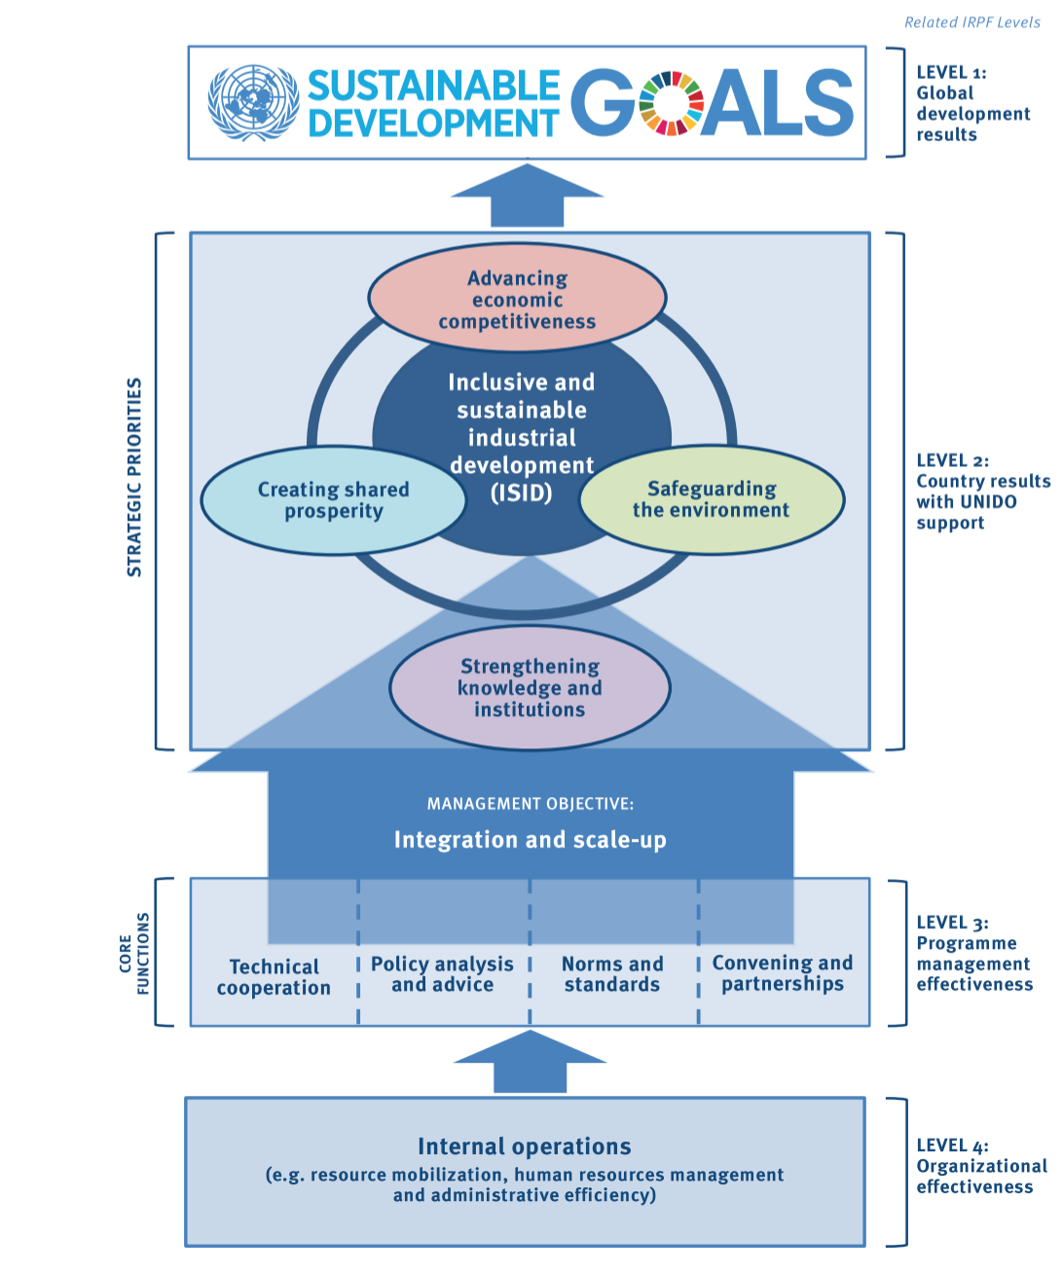
1: What is the IRPF?
The United Nations uses results-based management (RBM) systems to improve programs and activities and increase effectiveness and accountability for results and performance
In 2019, UNIDO adopted a new Integrated Results Performance Framework (IRPF), an RBM system
Complements Medium Term Program Framework (MTPF) 2018-2021
Based on a shift from project-based logical framework approach to a Theory of Change (ToC) model
IRPF lays out projected achievements in the short, medium, and long term, to be monitored and reported via performance indicators at several levels (continuously fine-tuned)
IRPF indicators provide a qualitative and quantitative measure of UNIDO’s contributions to ISID and SDGs
Challenge:
5

Slide 5

1: What are the Sustainable Development Goals?
“The Sustainable Development Goals (SDGs) constitute the core of the 2030 Agenda for Sustainable Development and guide all global, regional and national development endeavours for the next 15 years. The United Nations Industrial Development Organization (UNIDO) is fully committed to contributing to the achievement of the SDGs, while delivering on its mandate to support Member States in achieving inclusive and sustainable industrial development (ISID)...Due to the interlinked nature of the SDGs, many of UNIDO’s activities contribute to more than one SDG.” – UNIDO
Challenge:
5

Slide 6
1: How can UNIDO’s contributions to the SDGs be quantified?
Challenge:
UNIDO IRPF Guide, 2020
5

Slide 7
Executive Summary
02
Overview
Challenge | Evaluating UNIDO contributions under the new IRPF | IRPF, results based management, and Theory of Change The Sustainable Development Goals
Data Insights | Link ISID results areas to SDG progress | ODI literature-based matrix Global SDG Indicators Database
Analytics Solution | Use matrix coefficients to predict ISID progress impacts on SDGs and validate coefficients using data-based evidence | Matrix-based predictions SDG vs ISID regressions
Next Steps | Extrapolate matrix-based method to new UNIDO internal data, evaluate COVID-19 impacts | Matrix-based prediction framework COVID-19 data Adaptation to Open Data Platform
3

Slide 8
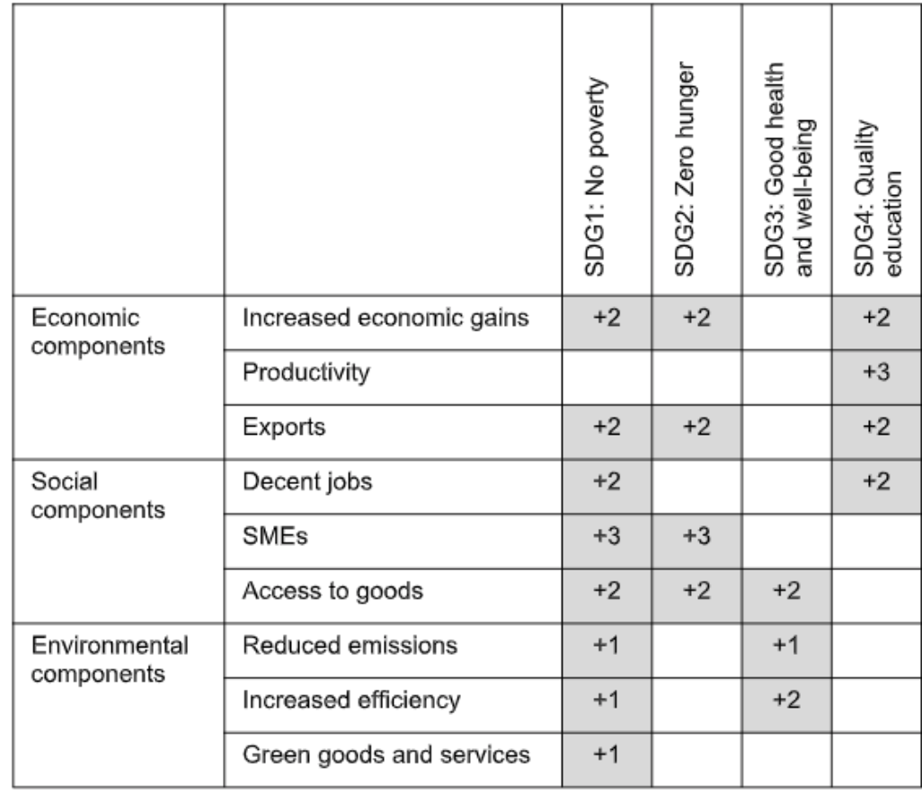
2: Through a review of evidence, links between the ISID and SDGs can be characterized
Data Insights: ODI literature-based matrix
Excerpt from matrix of coefficients
Categorized 9 IRPF areas and 17 SDGs, reviewed over 250 studies for evidence, and divided the evidence into 29 cases exploring ISID-SDG links
For each connection, identified direction (type of impact, positive/negative) and strength (0 to 3 based on quality and quantity of evidence) of link
Overall results point to strong and positive connection between ISID and SDGs
Relationship often strongly positive, but in some cases weakly significant
Some areas where contribution of ISID to SDGs still to be proven
12

Slide 9

2: Connecting existing SDG Indicators to IRPF Indicators
Data Insights: Global SDG Indicators Database
Mapped indicators from Levels 1 (UNIDO-related SDG indicators) and 2 (ISID and related SDG indicators) of the IRPF to each results area according to “Managing for Results: A Guide to UNIDO’s Integrated Results and Performance Framework Approaches and Tools”
EX: 1.3 SDG 9.2.2: Manufacturing employment as a proportion of total employment mapped to Decent Jobs results area
Equivalents for new IRPF indicators without documented data were found among SDG indicators, e.g. ENV.3: Cumulative improved energy efficiency and SDG 7.3.1: By 2030, double the global rate of improvement in energy efficiency
Data on these indicators found in the UN Global SDG Indicators Database
12

Slide 10
Executive Summary
03
Overview
Challenge | Evaluating UNIDO contributions under the new IRPF | IRPF, results based management, and Theory of Change The Sustainable Development Goals
Data Insights | Link ISID results areas to SDG progress | ODI literature-based matrix Global SDG Indicators Database
Analytics Solution | Use matrix coefficients to predict ISID progress impacts on SDGs and validate coefficients using data-based evidence | Matrix-based predictions SDG vs ISID regressions
Next Steps | Extrapolate matrix-based method to new UNIDO internal data, evaluate COVID-19 impacts | Matrix-based prediction framework COVID-19 data Adaptation to Open Data Platform
3

Slide 11
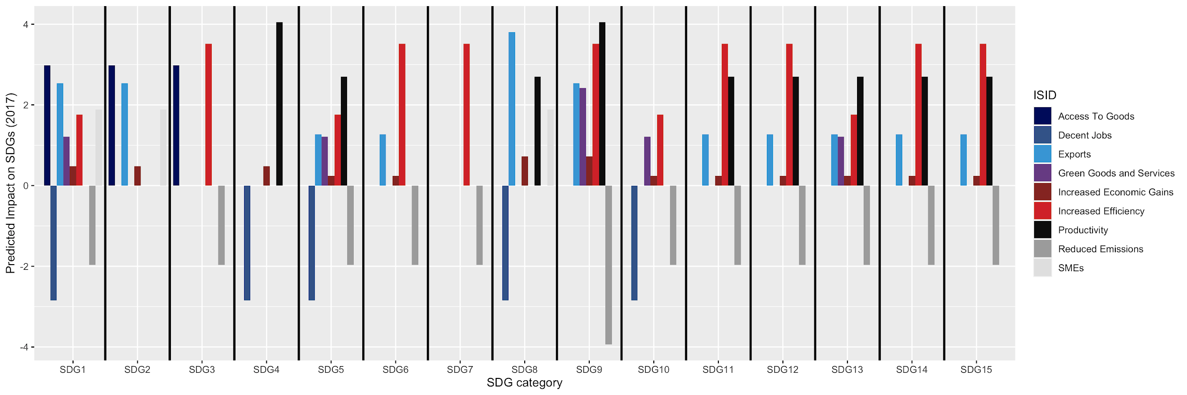
“Reduced emissions” and “Decent Jobs” areas are predicted to negatively impact SDGs
“Productivity” predicted to have greatest positive impact.
A single representative “change score” was calculated for each ISID area. Then, using the matrix of coefficients (literature-based), we can predict the impact of ISID results area changes on SDGs.
3: Predicted SDG impacts by ISID results area
12

Slide 12
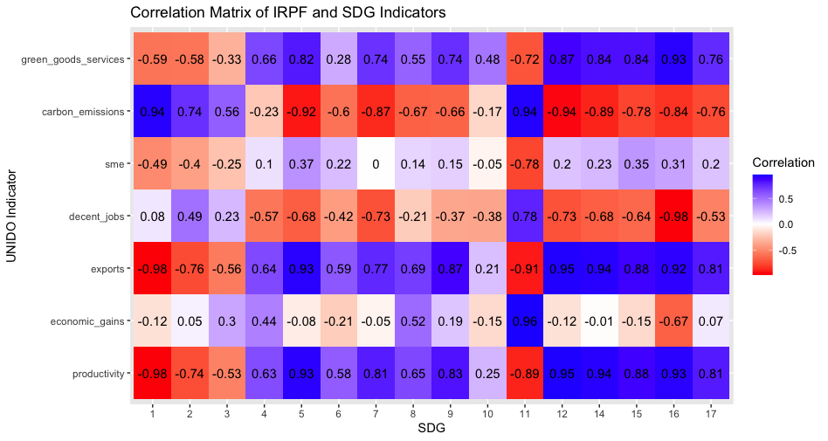
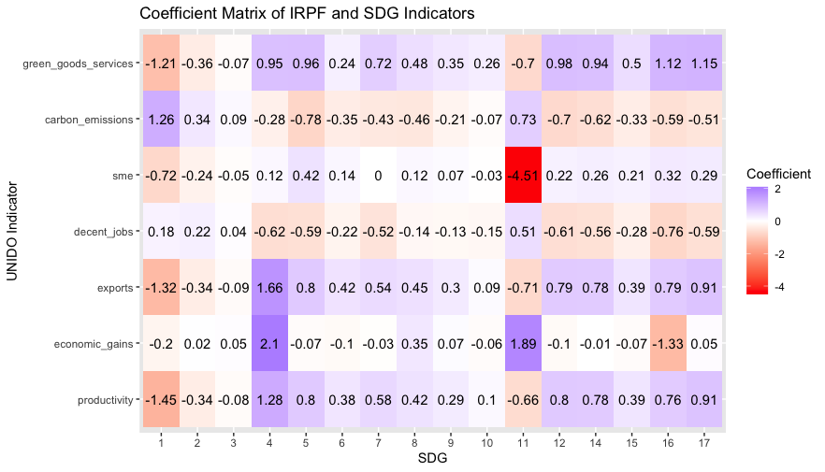
3: SDG vs ISID correlations and regressions
We can find the correlations between our indicator datasets and the SDGs from year to year...
As well as the implied regression coefficients between the two, an implicit comparison of how much a one standard deviation change in each indicator affects each SDG
Source: HDAG analysis of SDG indicators data
Results differ from the literature-based matrix, suggesting that further analysis is required.
12

Slide 13
Executive Summary
04
Overview
Challenge | Evaluating UNIDO contributions under the new IRPF | IRPF, results based management, and Theory of Change The Sustainable Development Goals
Data Insights | Link ISID results areas to SDG progress | ODI literature-based matrix Global SDG Indicators Database
Analytics Solution | Use matrix coefficients to predict ISID progress impacts on SDGs and validate coefficients using data-based evidence | Matrix-based predictions SDG vs ISID regressions
Next Steps | Extrapolate matrix-based method to new UNIDO internal data, evaluate COVID-19 impacts | Matrix-based prediction framework COVID-19 data Adaptation to Open Data Platform
3

Slide 14
Next Steps
Matrix-based prediction framework
Apply this method to UNIDO’s most recent internal IRPF data.
COVID-19
Investigate the impact of COVID-19 on progress towards the SDGs via the IRPF.
Communicate results
Update reports and visualizations on the UNIDO Open Data Platform.
Thank you for your collaboration thus far! We look forward to working with you in Spring 2021.
04

