Slide 1

AI for best in class Help Desk Operations
Harvard Data Analytics Group x [Pharmaceutical Company]

Slide 2
Agenda
Background 5 mins
AI Categorization 15 mins
AI-Generated Categorization Schema with NLP
AI Prediction of Risk and Resolution Time
AI Time Series 15 mins
Evolution of Existing Sub-Categories
Priority of Tickets Time to Resolve
Next Steps 5 mins
Top votes Q&A on Slido 20 mins
Scan this QR code to ask questions and upvote

Slide 3
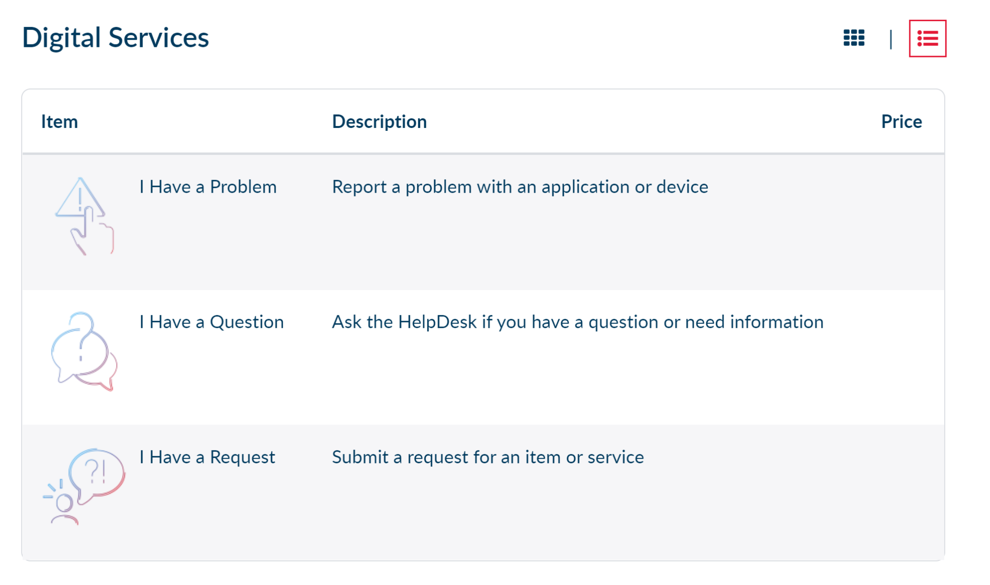
Background - Categorize, Perceive, Predict, Recommend, ServiceNow cases for faster resolution and better routing to departments.
Objective: Classify → Prioritize → Assign
Problem / Request
Case Creation
Resolution / Escalation
Challenges:
Inaccurate user-selected categories
Analyzing trends in cases
Classify high-priority cases
ServiceNow Data Leveraged:
Helpdesk Cases (access requests & cases) from 2012 to 2022.

Slide 4

Proposed Use Case
Problem / Request
Case Creation
Resolution / Escalation
“As part of clinical biomarker lab, I require to access, create, edit the Veeva QualityDocs for SOPs and Work instructions.”
Assignment Group
Class User Access Request
Priority 1 Target Resolution <2 hours
Distance from target resolution time
Classification Algorithm
Priority 1 / n
Resolution Time 4.2 hours
“As part of clinical biomarker lab (GCLP), I require to access, create, edit the Veeva QualityDocs for SOPs and Work instructions.”
1
2
3
Issue generated by user.
Model predicts issue to be a user access request, and predicts a resolution time.
The issue is instantly forwarded to the relevant assignment group, inserted into the stack based on priority score.

Slide 5
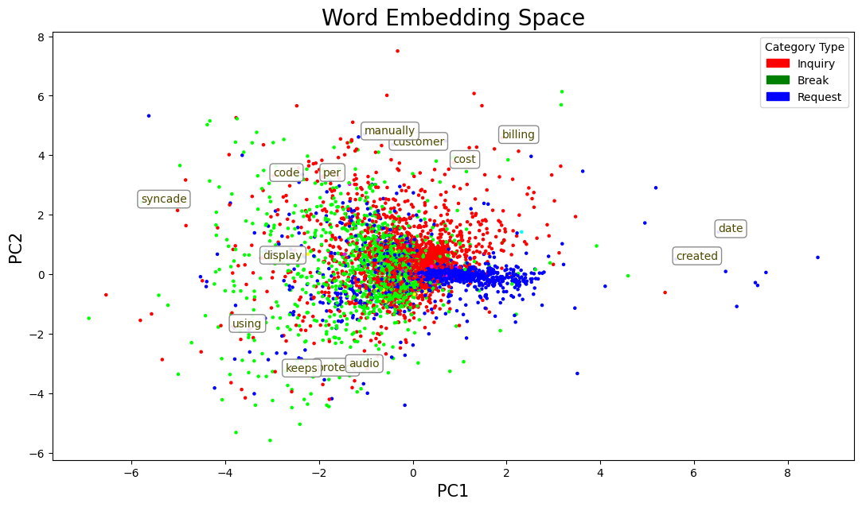
Case Study: Isolation of User Access Requests with AI
ServiceNow Cases Short & Long Descriptions
Word2Vec language model for word embedding vectors
Multinomial Bayes classifier
Semi-supervised label propagation for partially labeled data
New data-generated classification labels for access requests, to supplement the existing ambiguous data
approach
Inquiry
Break
Request
Validation accuracy: 98.67%
F1 Score: 0.9842

Slide 6
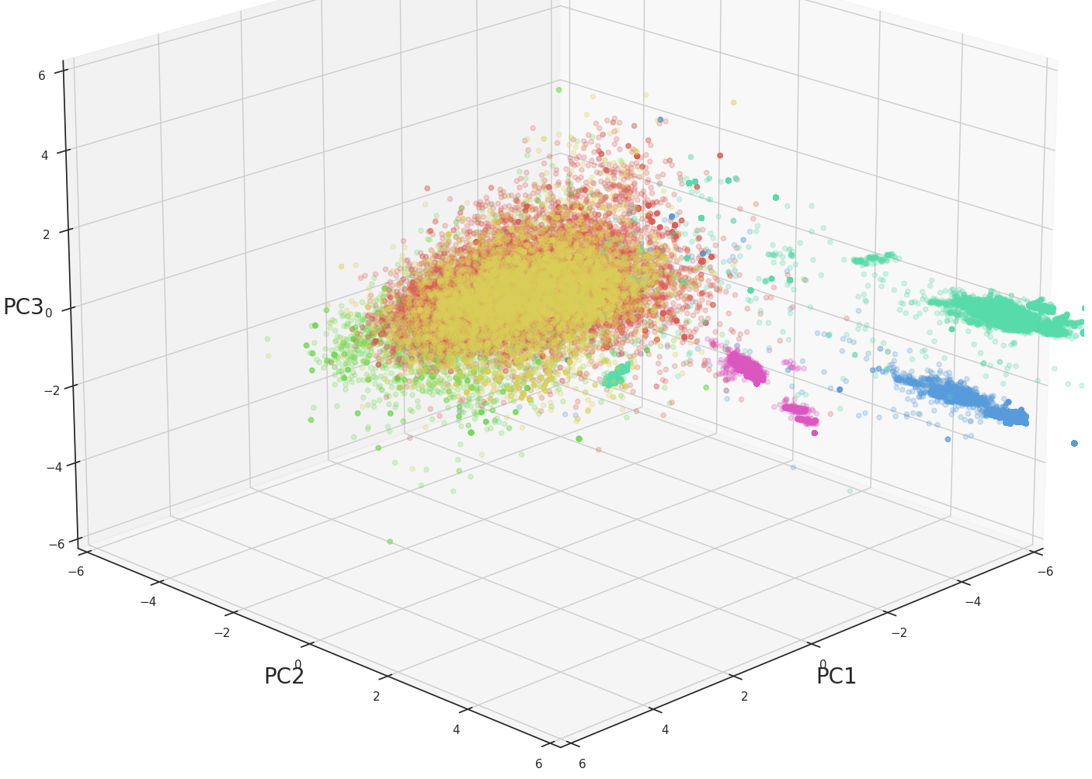
AI-Generated Categorization Schema
ServiceNow Cases Short & Long Descriptions
NLP
Word Embeddings
Principal Component Analysis
k-Means Clustering
TF-IDF Topic Modeling
6 AI-Generated Categories
approach
Hardware
Offboarding
Installations
Login
User Account
Onboarding
Automatically identify new incoming ticket descriptions as one of these categories. e.g. k-nearest neighbors algorithm
“requesting sap service account (unlock)”

Slide 7

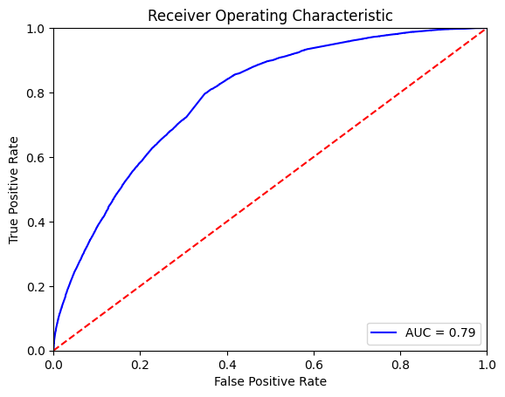



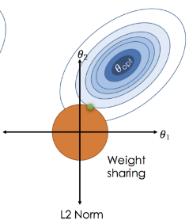
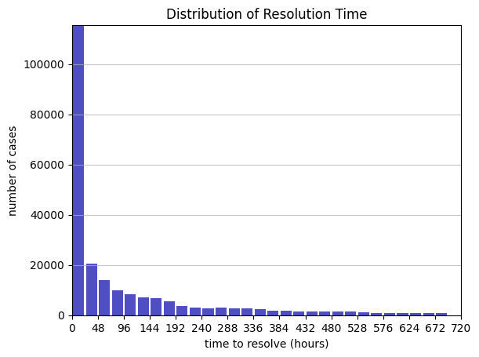

Risk Prediction
Case Description 1
prediction task
Use description to generate risk score and predict >96 hour resolution.
Case Description 2
…
…
Risk Scoring (Multinomial Naïve Bayes)
Case Description N
Case Descriptions & Resolution Times
prediction task
Use description to predict resolution time in hours.
Time Estimation (Ridge Regression)

Slide 8
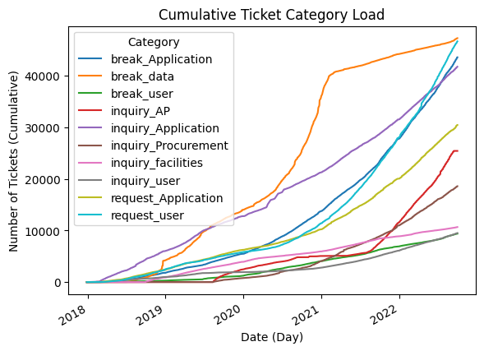
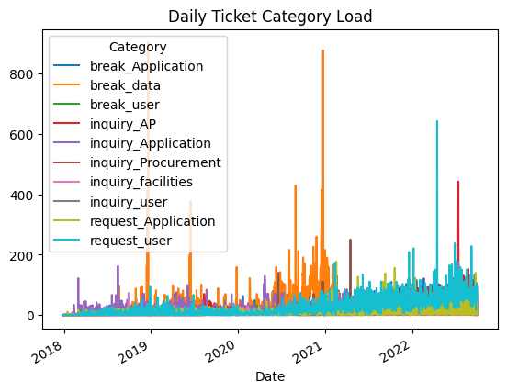
Exploratory Data Analysis - Visualizing Incidents over time by Category
High Load: break_data, request_user, break_Application, inquiry_Application
inquiry_Application load is linear, break_data was exponential and leveled off, request_user and break_Application are growing exponentially
break_data peak load late 2018, mid 2019, late 2020
request_user daily load has steadily increased to a peak in mid 2022
other category loads are relatively distributed across longer timeframes

Slide 9
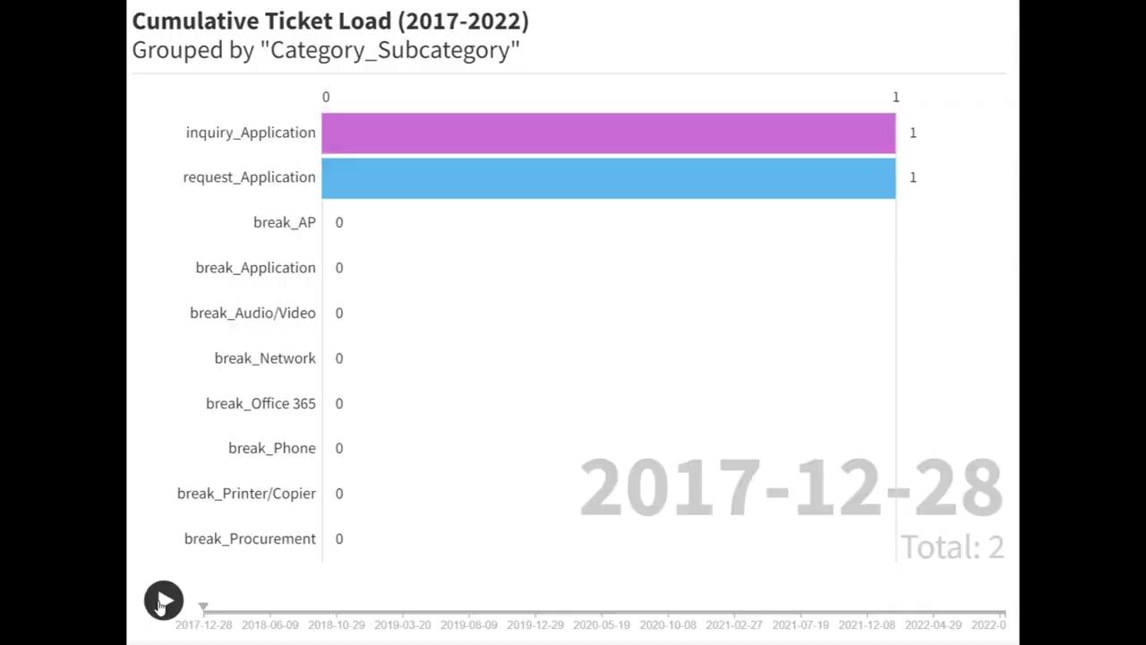
Exploratory Data Analysis - Visualizing Incidents over time
Evolution of case categories over time → real time breakdown of cumulative case category load shown in the previous slide
Until the end of 2018, inquiry_application cases were dominant
Beginning in 2019, break_data cases rapidly grew and became dominant case category after that point

Slide 10
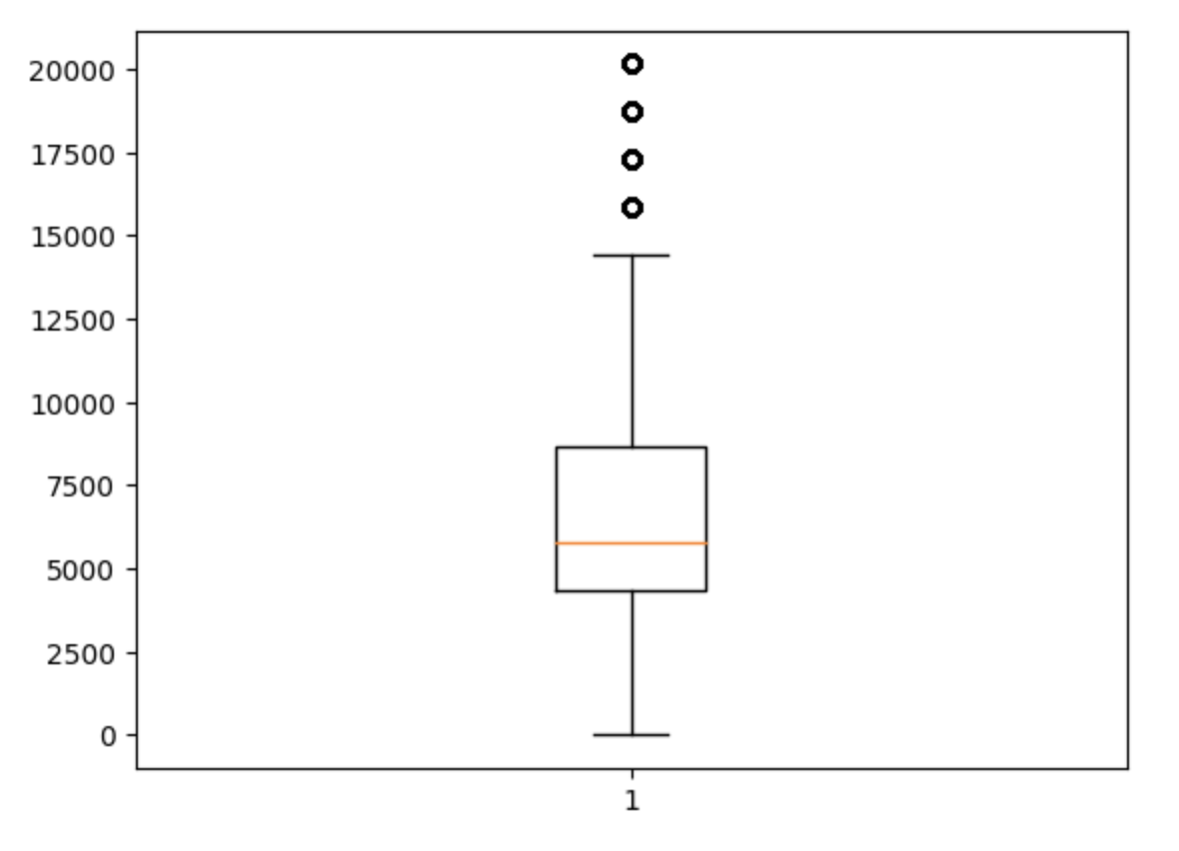
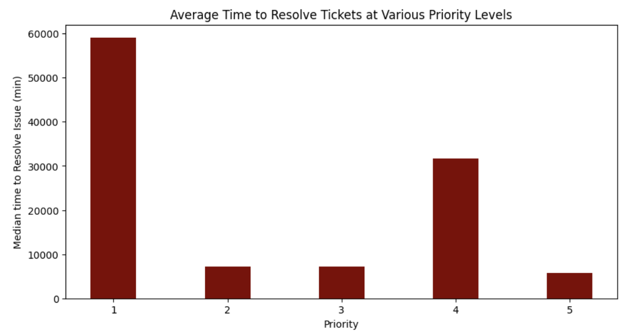
Exploratory Data Analysis - Time to Resolve and Priority of Cases
Before removing outliers, mean time to resolve requests = 28 days, median time = 5 days
For 76% of the requests, the average time to resolve was approximately 4.7 days after removing outliers
Unusual pattern in data → median time to resolve priority 4 cases is higher than both priority 2 and 3
Priority 1: Average 41 days to solve.

Slide 11
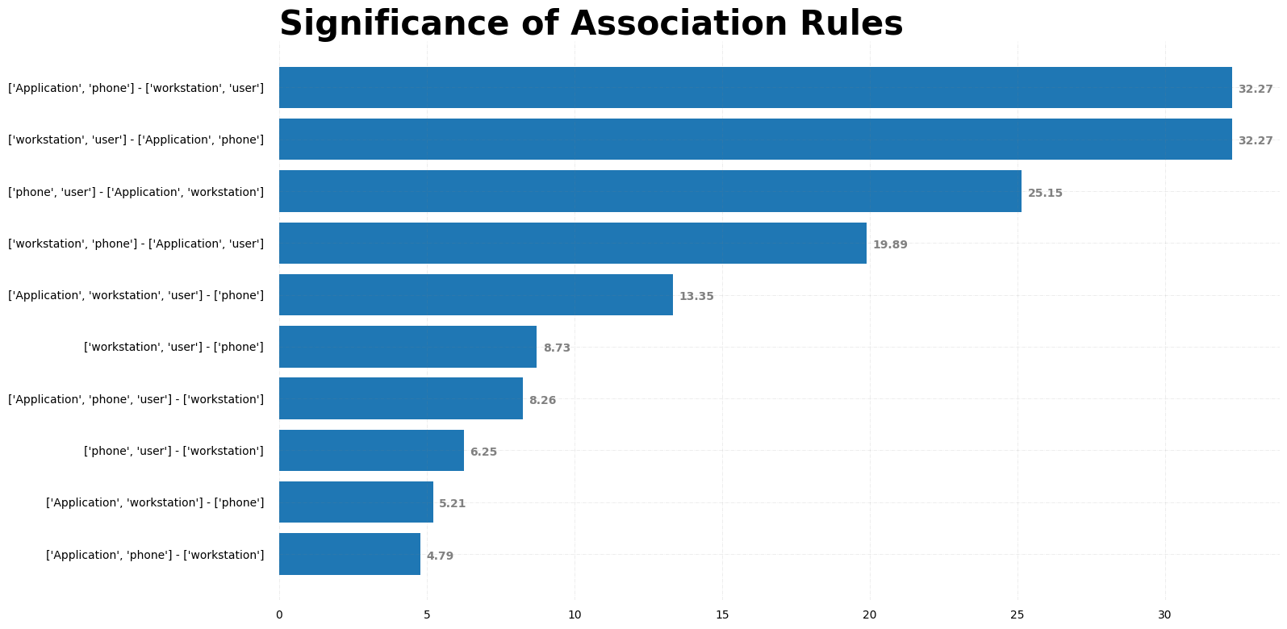
Association Rule Discovery
Driving Questions:
If User A submits request 1, what are likely requests that will be made in the next period of time?
Can we find actionable data that managers can use to inform decisions?
Chart on the Right:
Correlations restricted to 6 week intervals
Likelihood: Likelihood that initial requests lead to predicted requests
Significance: > 1 implies the relationship is statistically significant
Ex: Phone-Workstation
Phone: “Norwood Response Team - Please patch Corporate C-169 for room 1214”
Workstation: “Norwood Response Team - Setup R&D Meeting Room 1214”

Slide 12
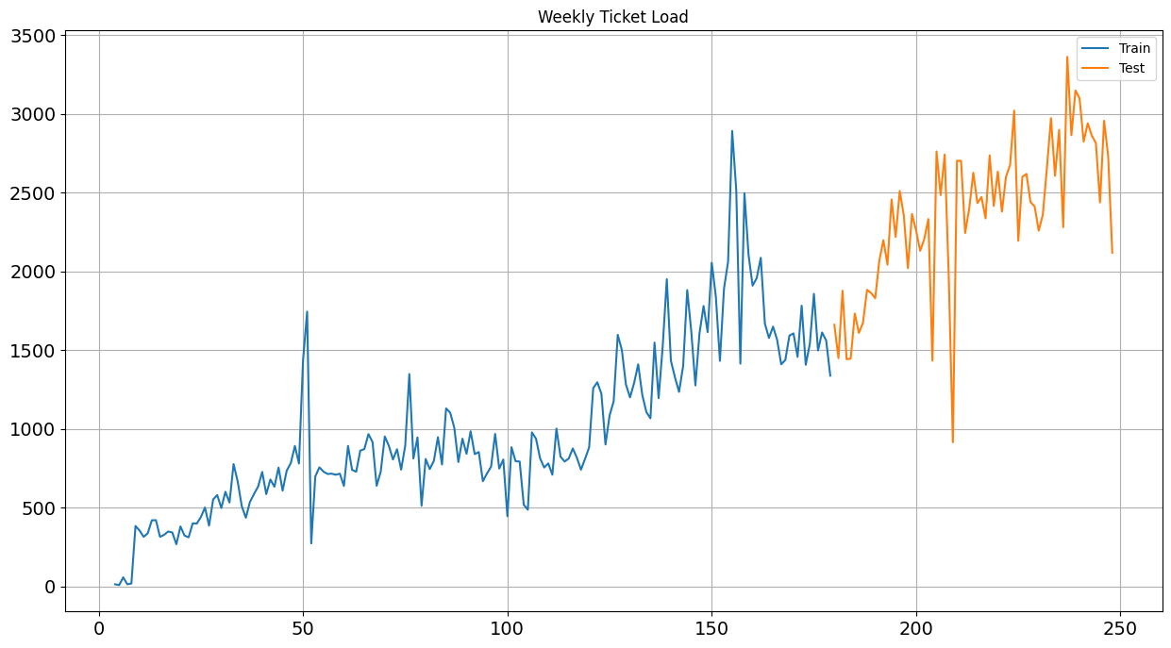
Modeling - Introduction
Overview
Modeling via Random Forest Model:
Algorithm that ensembles many decision trees (e.g. flowcharts) to generate predictions based on data.
Motivation
Predicting caseload allows for advance adjustment of support bandwidth and resource allocation.
Workflow
Convert daily data to weekly data
Generate “point-in-time” features
Train model on 70% of data, test on 30% of data.

Slide 13
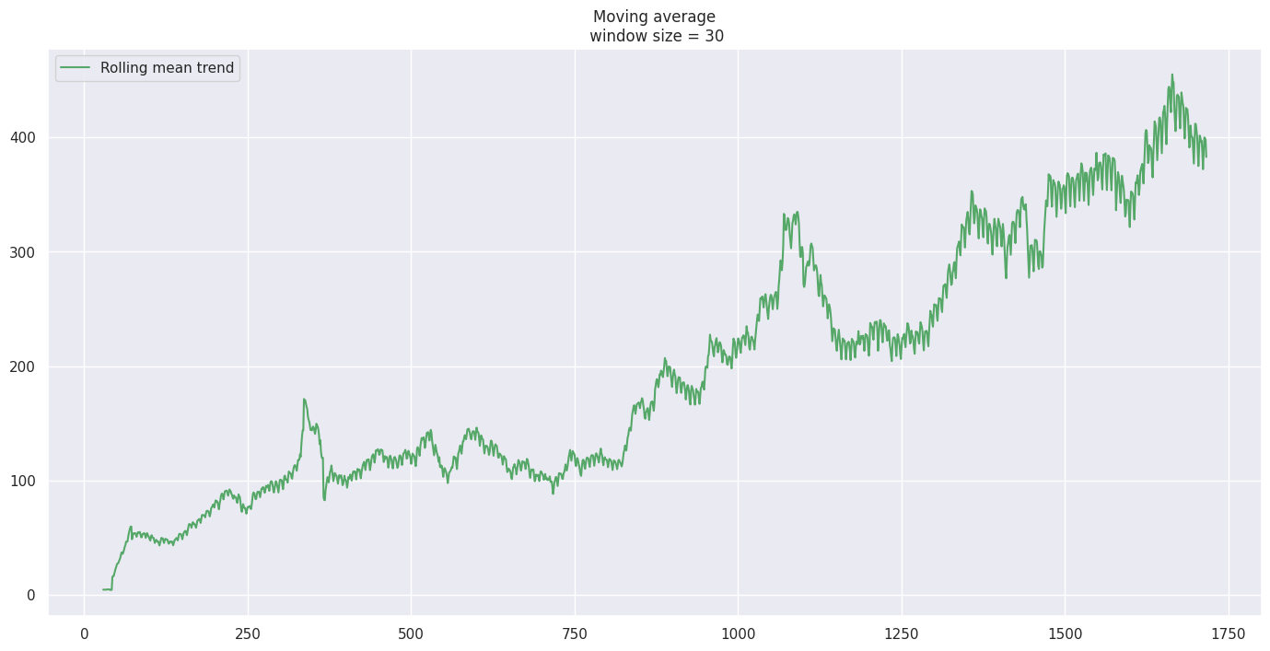
Modeling - Feature Engineering
Driving Question
What data do we predict next week’s load with?
Generate “point-in-time” features
Previous week
Rolling Moving Average (RMA)
Last 2 & 3 weeks
Exponential Moving Average (EMA)
4 weeks
Use Case
Given just caseload history and a prediction model, a user can now forecast next week’s data.

Slide 14
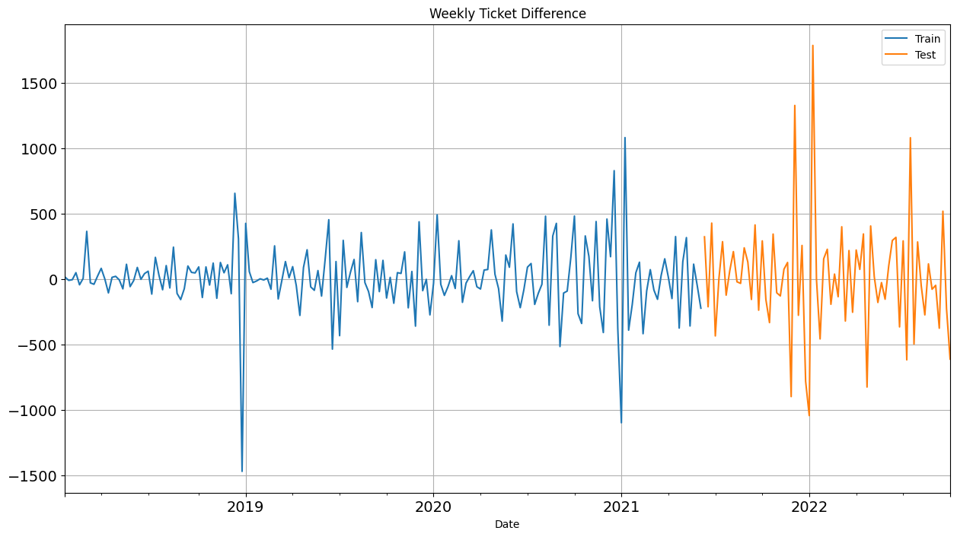
Modeling - Processing Data
Case load increases naturally overtime (year-by-year) due to underlying patterns (e.g. company growth, hiring)
The model considers a maximum 4-week history, making long-range data difficult to incorporate
Convert absolute caseload to difference vs. last week.
Normalizing data addresses this problem and improves accuracy.
Clear categorization of case spikes

Slide 15
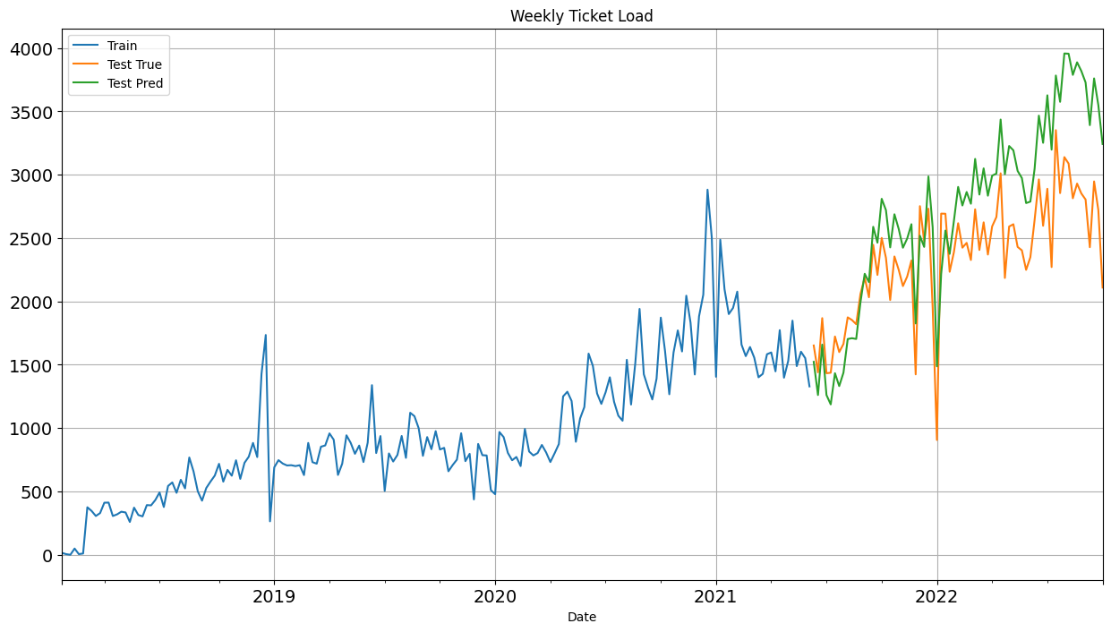
Modeling - Evaluation
Effectively tracks first half of test data, including spikes and dips.
Predictions overshoot as test data becomes farther away from training data.
General ticket trend still captured
Addressable by retraining model on new data periodically
Average error: ±200 cases
~9.5% error
4-week exponential moving average is the most important feature
Green is predicted value, Orange is true value

Slide 16
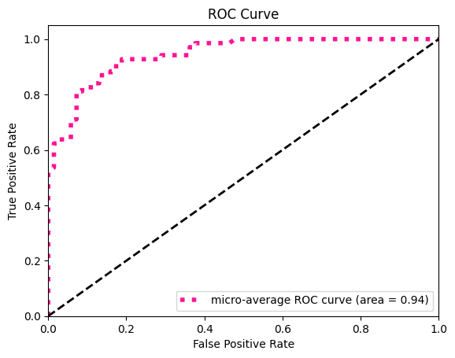
Modeling - Spike Prediction
How can we maximize our model’s utility?
“Spike” prediction provides more actionable data.
Defined as an X% increase in case load vs. the last Y weeks’ average.
In our case, a 15% increase vs. the last 3 weeks’ average - 60 spike weeks vs. total 250 weeks.
Zoom in on high severity cases - the most time-consuming cases to solve (Priority 1)
87% of predictions yielded correct spike status (Y/N)
0.94 Area Under ROC Curve - measure of True vs. False Positive Rate

Slide 17
Conclusions and Next Steps
Vectorization and clustering → generating novel labeling
User access request classification → implementing classifier within ServiceNow
Retrospective classification → labeling all tickets in dataset to better identify trends
Association rules → flag certain tickets that are associated with future tickets
Predictive Model → implement into support allocation workflow

Slide 18
Thank you!
Scan this QR code to ask questions and upvote

