Slide 1

Understanding Consumer Perception for Retail Company
Harvard Undergraduate Data Analytics Group
Final Presentation
HDAG Group 2019 ® All rights reserved

Slide 2
Executive Summary
Overview
Challenge | Remain competitive on the market by understanding existing consumer sentiment and outreach to younger audiences | Disconnects between Retail Company’s values and consumers Problems in efficiency and usability with Retail Company’s current services Consumer perception within the young adult range
Approach | Use platforms such as Infegy and Qualtrics to create data insights from text-based analysis | Infegy web-scraping social media analytics Qualtrics product reviews
Data Insights | Analyze key trends and barriers in consumer sentiment by using various queries and sentiment analysis | Time series analysis Text analysis Sentiment analysis
Appendix | Offer recommendations based on the data insights and experience with data platforms | Infegy and Qualtrics review Future Metrics and Data Key Takeaways

Slide 3




To analyze consumer data and their relationship with Retail Company, we used data from social media platforms through Infegy and consumer reviews through Qualtrics.
Approach
Infegy
Qualtrics
1
Social media data, querying on keywords
1
Product reviews
2
2
Key metric: Document counts
Key metric: Average ratings
Key metric: Sentiment analysis
Key metric: Sentiment analysis
3
3
4
Data validation: Sample posts
4
Data validation: Sample posts

Slide 4
We analyzed keywords in the company’s mission, vision, and values to identify areas that did not resonate with consumers on social media platforms.
Key Insight: Value Ecosystem Analysis
Company
Extended
Competitor
Total Posts Captured
Purpose (%)
Vision (%)
Mission (%)
Value 1 (%)
Value 2 (%)
Value 3 (%)
Value 4 (%)
Value 5 (%)
159975
5.47
2.43
5.23
4.49
3.84
3.27
0.68
0.08
159975
7.34
6.89
5.52
6.91
4.02
5.56
0.86
0.28
3699023
3.24
1.26
2.86
1.98
2.49
1.77
0.48
0.03
Consumers are matching Retail Company’s language around values relating to Value 1, Value 2, and Value 3.
Top discussions clustered around themes
Query Keywords (1 year) | Count
check, share, items, loving, Facebook | 6361
run, miles, today, shoes, starting | 4435
work, hard, hard work, today, always | 4211
workout, Squat, body, today, exercises | 4069
today, gift, respect, launch, session | 2719
Source: Infegy

Slide 5
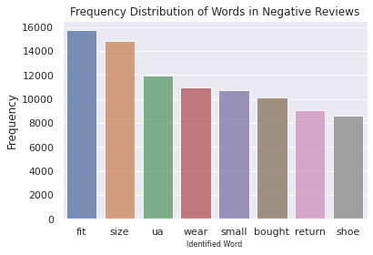
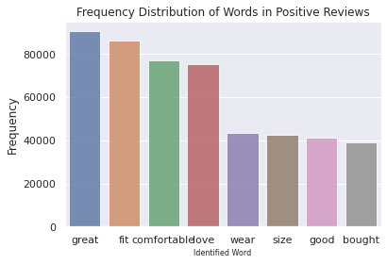
We used keyword filtering on Qualtrics feedback data to understand patterns in consumer reviews.
Key Insight: Product Sizes
Product sizes are not accurately reflected by the sizing guide. This problem is especially pertinent in shoes. Common complaints include “snug”, “narrow,” and “loose.” There is a particular relevance of small products, with nearly 14.1% of reviews containing sizing complaints in regard to being too “snug.” Another 9% are too loose. Women’s garments have notably fewer options for size, i.e. narrow vs. 1 size fits all.
“@RetailCompanyYou may want to do some quality control on the t-shirts being made in Egypt .I just ordered some "Loose" Heat Gear t-shirts and they are significantly smaller (by 2 sizes) than the shirts made in Vietnam or China. Literally just wasted $50.” [March 21, 2021]
Top Products described as too tight:
Swimwear - 36.2%
Underwear - 22.8%
Outerwear - 22.3%
Fit types:
Semi-Fitted - 35.2%
Fitted - 18.7%
Compression - 17%
Source: Qualtrics Product Review Data from Q1 2019 to Q1 2021
‹#›

Slide 6
We identified text proxies to segment consumer and identify trends in sentiment across consumers.
Key Insight: Customer Reviews
Reviews do not capture user demographics. However reviews mentioning children can be used a proxy for sentiment among a younger demographic.These review rate highly, with the weighted average of query ratings being higher than the average rating overall.
Sentiment with these keywords have been positive as well.
Query Keywords | # of Reviews | Average Rating (out of 5) | Positive Sentiment (%)
“son” | 651 | 4.5 | 75
“daughter” | 214 | 4.4 | 73
“kids” | 85 | 4.25 | 70
“boys” | 47 | 4.17 | 65
“girls” | 16 | 4.31 | 55
Weighted Average | 1013 | 4.44 | 73
All Queries | 387841 | 4.31 | 61
Source: Qualtrics customer reviews
‹#›

Slide 7
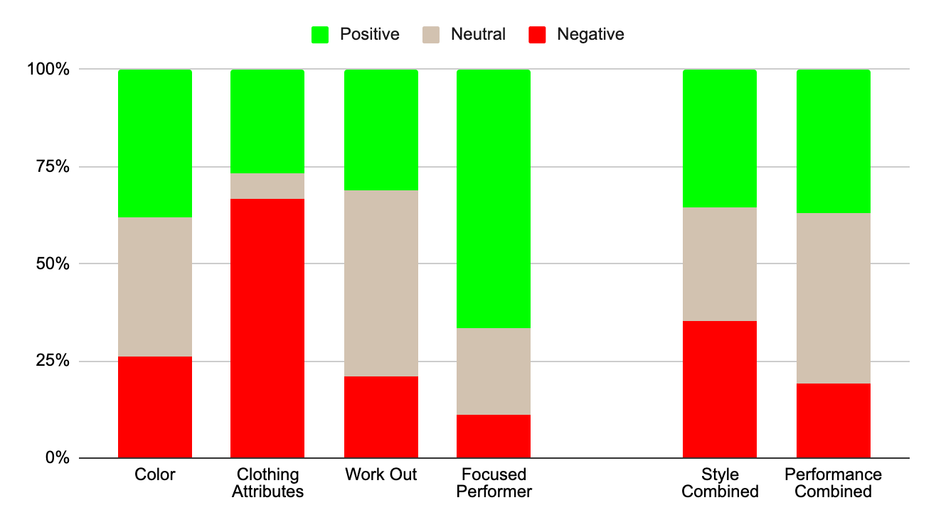
We conducted sentiment analysis between review classifications to understand younger consumer perception.
Key Insight: Performance vs. Style Among Youth
Across all sports average rating is about the same, in the low-mid 4 range. We only tracked sports where there were at least 30 reviews in the past year.
For style, we tracked two labels, “color” and “clothing attributes”, and for performance “work out” and “focused performance” among posts in the last year.
Review Text | # of Reviews | Average Rating
Football | 33 | 4.55
Golf | 124 | 4.44
Tennis | 44 | 4.34
Soccer | 37 | 4.27
Basketball | 92 | 4.22
Baseball | 51 | 4.12
Weighted Average | 381 | 4.33
All Queries | 387841 | 4.31
Source: Qualtrics customer reviews
‹#›

