Slide 1

HDAG ACE Final Presentation
May 2022
Insights from our team’s work analyzing grants in the animal altruism space
HDAG 2022 ® All Rights Reserved.
Notes:
Doris

Slide 2
Summary
Grants
Slaughter Data
2,100 grants from 6 websites
2017 - present
Food and Agriculture Organization of the UN
Country assignment tool
Grant database
Time series analysis
Country analysis
Categorized database
Time series analysis
Normalizing metric for grant analysis
Notes:
Doris

Slide 3
1 Grant Analysis: Overview
Grant Compilation
Time Series Analysis
Country Assignment
Time Series Analysis by Country
We used Python, a popular programming language, to scrape and standardize the desired data from 6 websites:
Open Philanthropy Project
Centre for Effective Altruism
ProVeg Grants
ACE Movement Grants
ACE RCF Grants
Open Wing Alliance Grants
We conducted preliminary time series analysis using Python to track # of grants and amount awarded by year since 2017
We created a python tool to determine the country associated with ~1,000 recipient organizations.
We broke down the general time series analysis to track trends by country.
Notes:
Doris

Slide 4
1.1 Country Assignment Tool: Overview
Step 1
Step 2
Step 3
Step 4
Open the Tool
Select Excel Sheet
Run Tool
Review Data
You can still use the computer in the meantime
Notes:
The country assignment tool is a program that finds out in which companies certain companies are based. Here’s how the Country Assignment Tool works: you open the application, load the excel sheet that you want to have filled out, wait for the tool to finish running, then review the data.

Slide 5
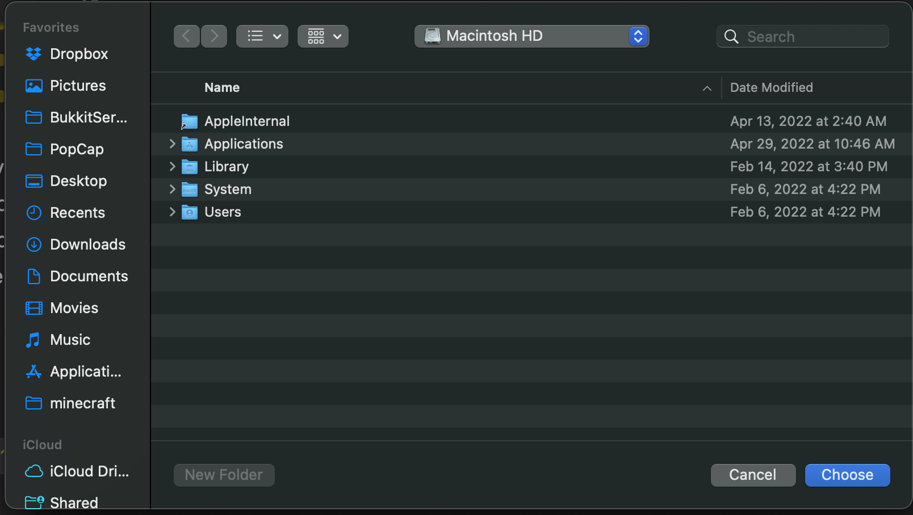
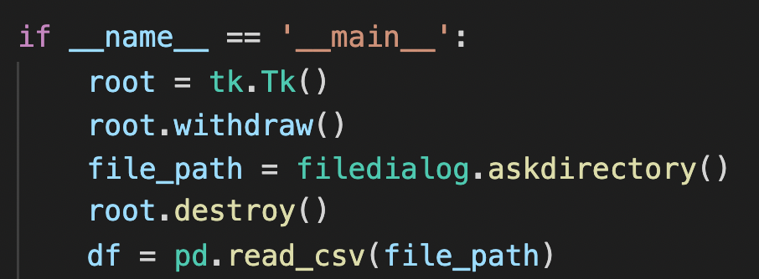
1.1 Country Assignment Tool: Steps 1-2
Notes:
Here’s an in depth look on how it works. First, a small script runs that allows you to open an excel sheet as a CSV file (you can easily export excel sheets to this format within the application).

Slide 6
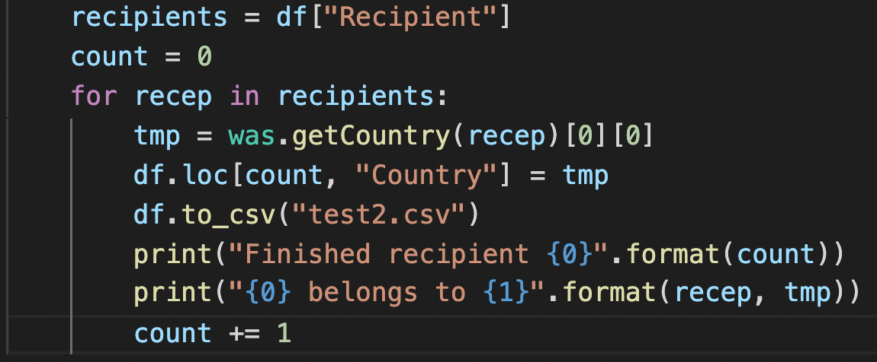
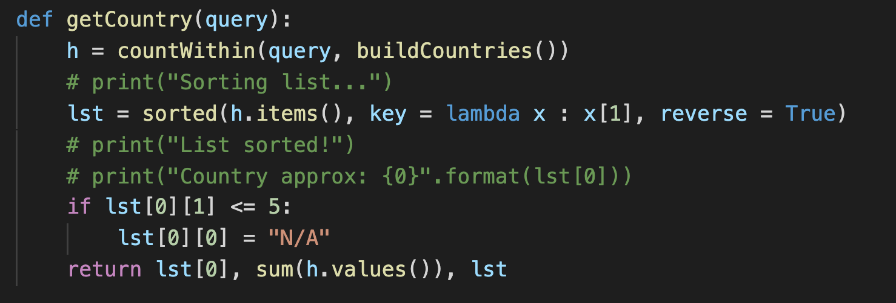
1.1 Country Assignment Tool: Step 3
Notes:
Then, the code runs a loop through each “Recipient” company and calls an algorithm that we created to search through google for any mentions of a base country. If none are found, the program will write “N/A” and move on.

Slide 7

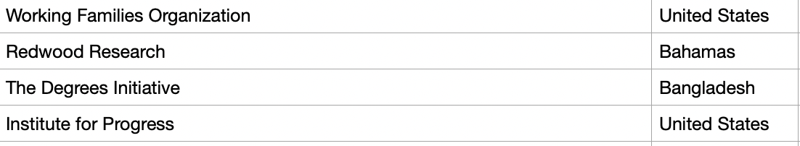
1.1 Country Assignment Tool: Step 4
Notes:
Here it is working on a few companies. Full instructions on how to use this application are included in the “README” file included with the program.

Slide 8
1.2 Giving Metrics Report Data
4 Categories
Donated through ACE (ACE)
Donated through ACE’s RCF (RCF)
Donated directly to Charity (Charity)
Total (Total)
Merged the 2 types of charities (Top & Standard)
Country data - total number of charities & monetary donations broken down by country of origin
Notes:
Alexis

Slide 9
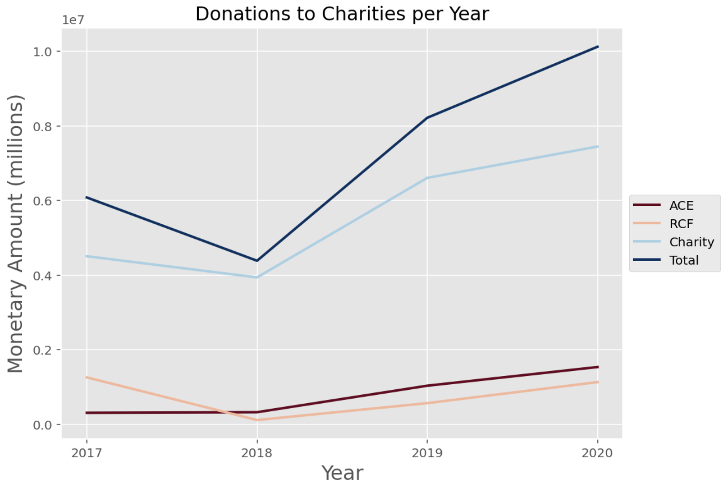
1.2 Giving Metrics Report - Donations per Year
Insights from time series analysis of the monetary amount awarded through the ACE, RCF, and Charity divisions over 2017-2020:
Total denotes the sum of these three divisions
General increase over time
Slight decline in 2018, followed by largest increase in 2019
Charity division accounts for a majority of monetary total
ACE surpassed RCF in 2018
Notes:
Alexis

Slide 10
1.3 Giving Breakdown by Country
Data Preparation
Breakdown by Country and Year
Normalize and Refine
We aggregated and broke down data in multiple ways to draw more nuanced insights:
Internal vs. external grant donations
Internal: RCF vs. Movement grants
Number and $ amount of donations
We created pie-charts and map-based visualizations of giving breakdowns by country and year.
Tools used: pycountry (support for standardizing geographic codes), plotly (generate geographic visualizations), pandas (general data science support)
We used FAOSTAT slaughter counts by country to normalize our analysis, since slaughter counts can provide a proxy by which to view animal need.
We displayed data on a logarithmic scale to give a clearer picture of the gradations in giving metrics.
Notes:
Amulya

Slide 11
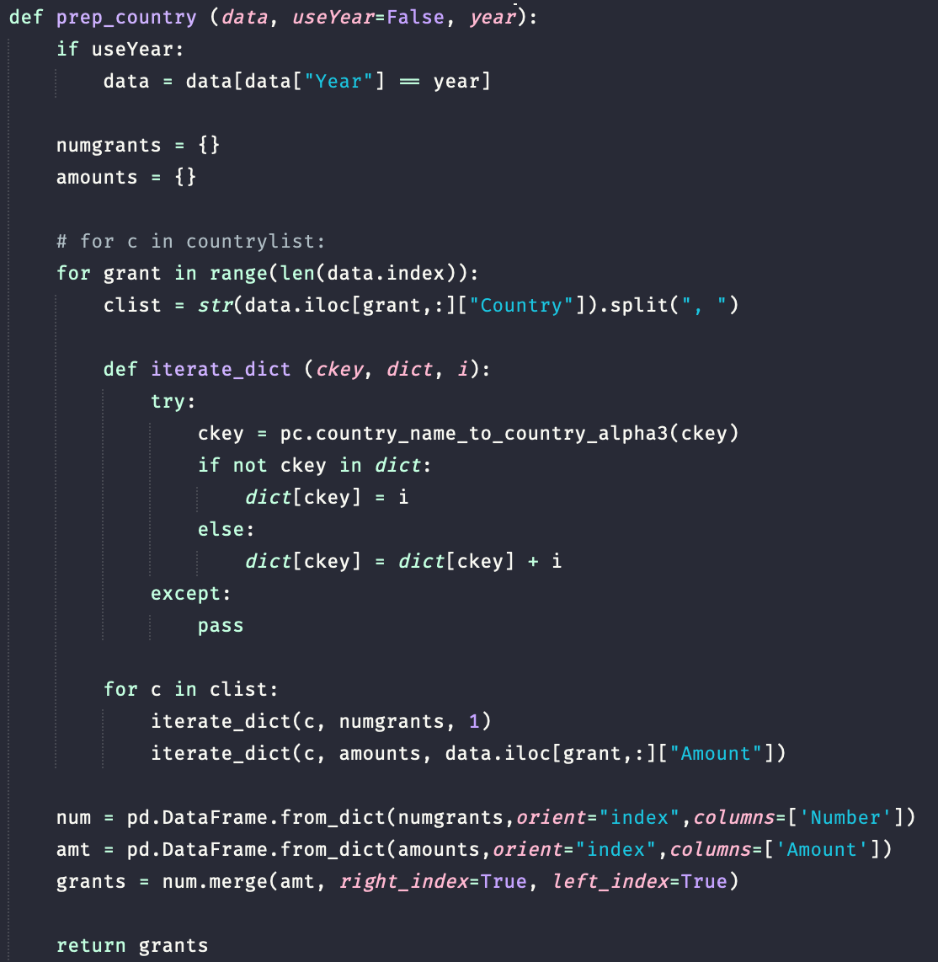
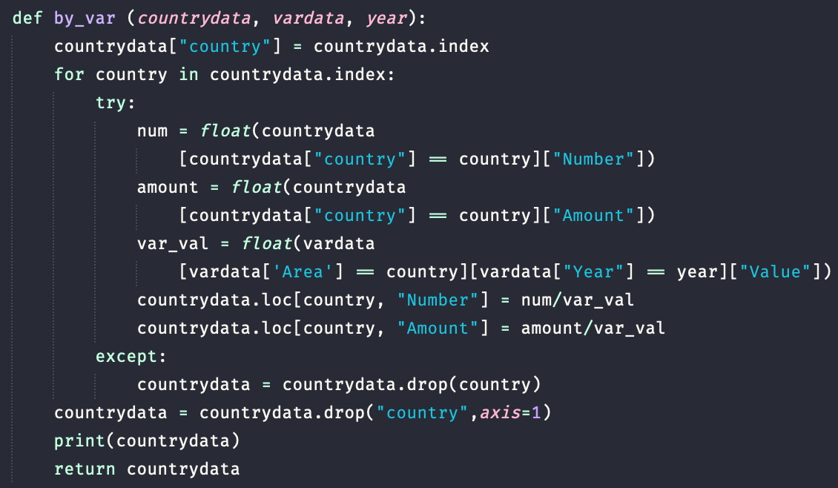
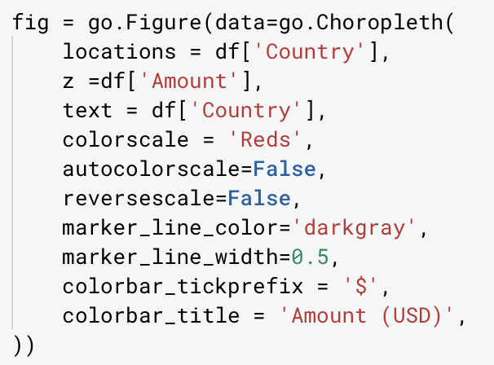
1.3 Giving Breakdown by Country: Code Snapshots
Data Preparation
Breakdown by Country and Year
Normalize and Refine
Notes:
Amulya
We start by cleaning and assembling relevant data, then break down data by country and year and display it using a map visualization. Then we normalize data using a log scale, as well as the animal slaughter data that Alexis will present later!

Slide 12
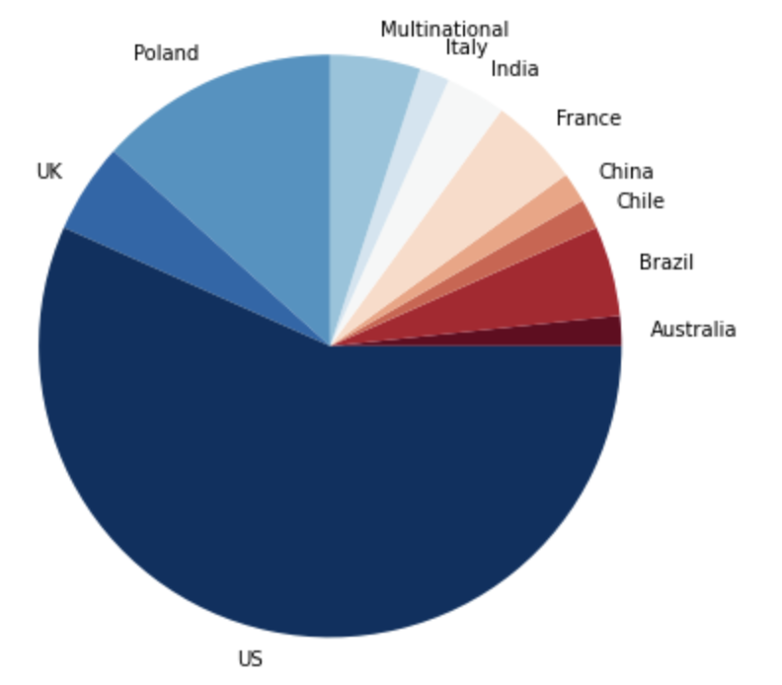
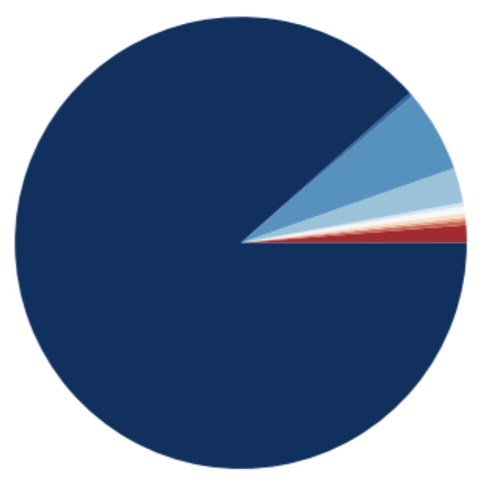
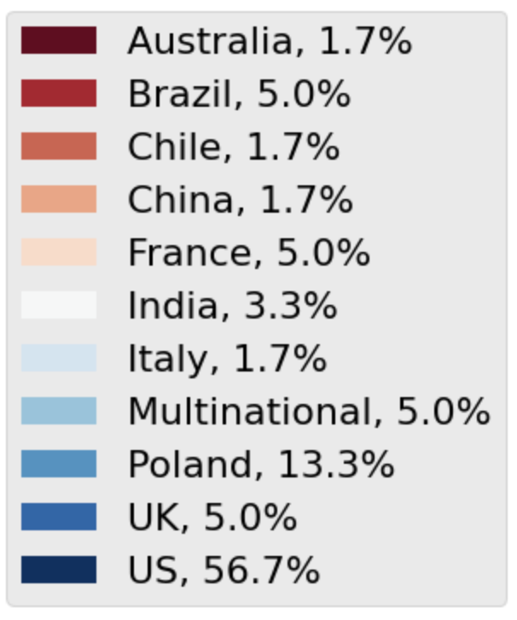
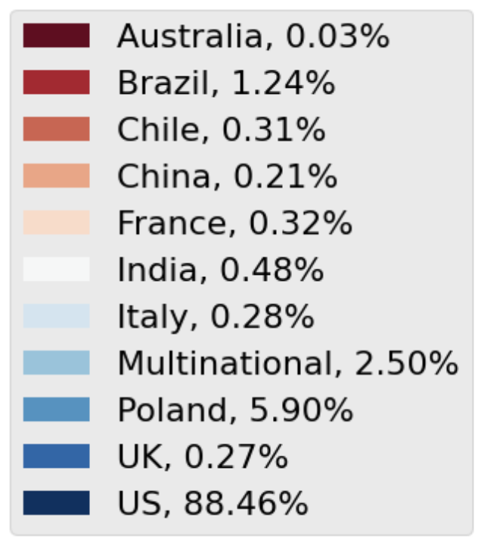
1.3 Giving Metrics Percentages Per Country
Number of Donations by Country
Monetary Amount by Country
The above charts show the percentage share of the total monetary donations per country represented over the time period 2017-2020. While charities from the United States receive the most number of donations at 56.7%, they are granted a disproportionately higher amount of money, accounting for 86.7% of the total awarded. All other countries receive a considerably lower percentage share of money than their percentage share of the number of donations.
Notes:
Alexis

Slide 13
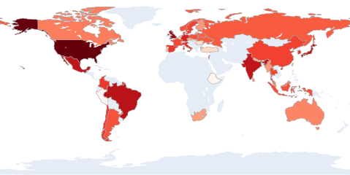
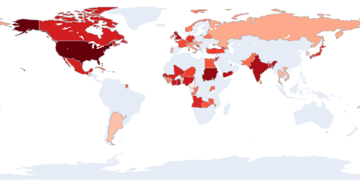
1.4 Giving Metrics: Internal vs. External, all years
*By amount in USD, log scale
Internal donations (via ACE)
External donations
Key insight: Non-ACE donors effectively target organizations in areas that ACE has not yet reached (e.g. Africa and the Middle East), but ACE effectively targets organizations in areas not reached by other donors (e.g. Indonesia, China, South America, Oceania)
*By amount in USD, log scale
Notes:
Amulya
It’s impressive that ACEmanages the same reach just being one org as opposed to the composite of other donors

Slide 14
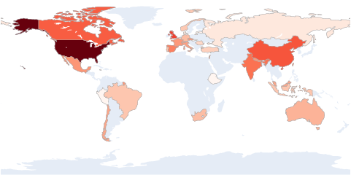
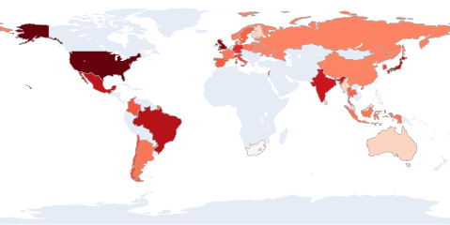
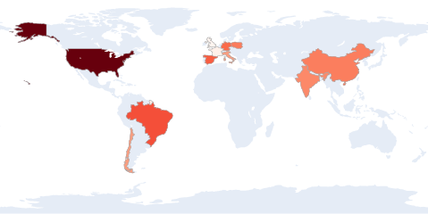
1.4 Giving Metrics: Internal Breakdown, all years
*By amount in USD, log scale
Donations via RCF
all organization branches
Donations via RCF
main branches only
Donations via Movement Grants
RCF donations are diverse when all organization branches are included, but showing only main organization branches reveals where RCF donations primarily go.
Key insight: While the Middle East and Africa remain underserved regions, it’s clear that Movement Grants have made a huge impact for diversifying giving.
Notes:
Amulya
RCF donations are very diverse when we include all org branches
Not as diverse with just main branches
Movement grants have made a significant impact in diversifying

Slide 15
2 Slaughter Data Analysis: Overview
Data Collection and Organization
Time Series Analysis by Country
Apply to Grant Analysis
We downloaded data from FAOSTAT and divided it into
Laying
Milk Animals
Production Population
Producing Animals, Slaughtered
for ease of analysis
We created visualizations for country trends since 1990 (when complete data was available)
We used slaughter counts as a normalization metric for our previous grant analysis
Notes:
Doris

Slide 16
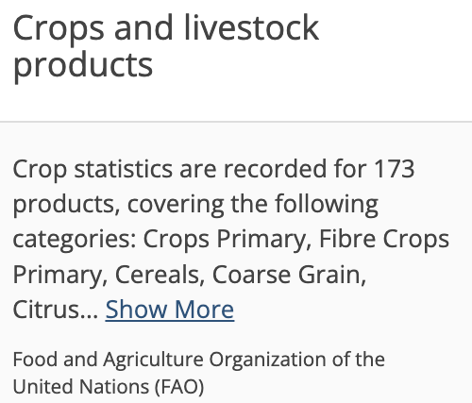
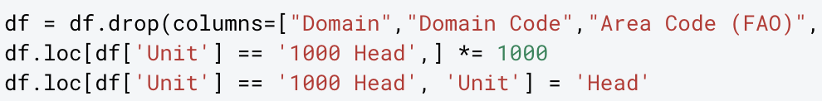
2.1 FAOSTAT Data Collection
FAO Statistic Division Data
Selection
Organization
Sourced data from Food and Agricultural Organization of the United Nations - FAOSTAT provides food and agricultural data for over 245 countries
Downloaded all of FAOSTAT’s available Livestock Product data:
4 categories: Laying, Milk Animals, Livestock, Production Population, Producing Animals/Slaughtered
2.8 million elements
Cleaned and organized all data in preparation for analysis:
Removed all unnecessary FAOSTAT identifiers and codes
Standardized all units
Prepared navigable spreadsheet
All data collection and organization was performed using Python and Excel
Notes:
Alexis

Slide 17
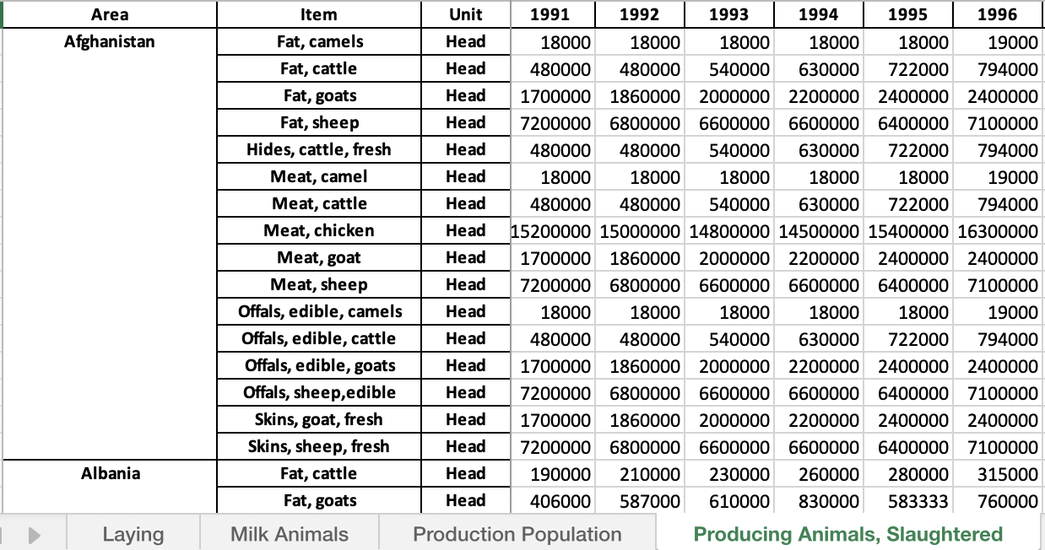
2.2 Livestock Product Data Organization
Organized available FAOSTAT Livestock Product data from 1961 through 2022 into easily navigable spreadsheet
Area
All data is primarily organized by country
Item
Varies within each category
Unit
All units are normalized within each category
Year
Date range 1961-2020
4 categories: Laying, Milk Animals, Production Population, Producing Animals/Slaughtered
Notes:
Alexis

Slide 18
2.3 Data Analysis - Insights
Increase in Meat Production
China, US, and Brazil dominate
Chicken, Ducks, and Pigs are most popular
1
2
3
*** FAOSTAT performed a methodological overhaul in 2016, and revised all of their agricultural and production data, but only dating back to 1991. While some data is available dating back to 1961, it is not fully complete. For this reason, our analysis begins after 1991.
Notes:
Alexis

Slide 19
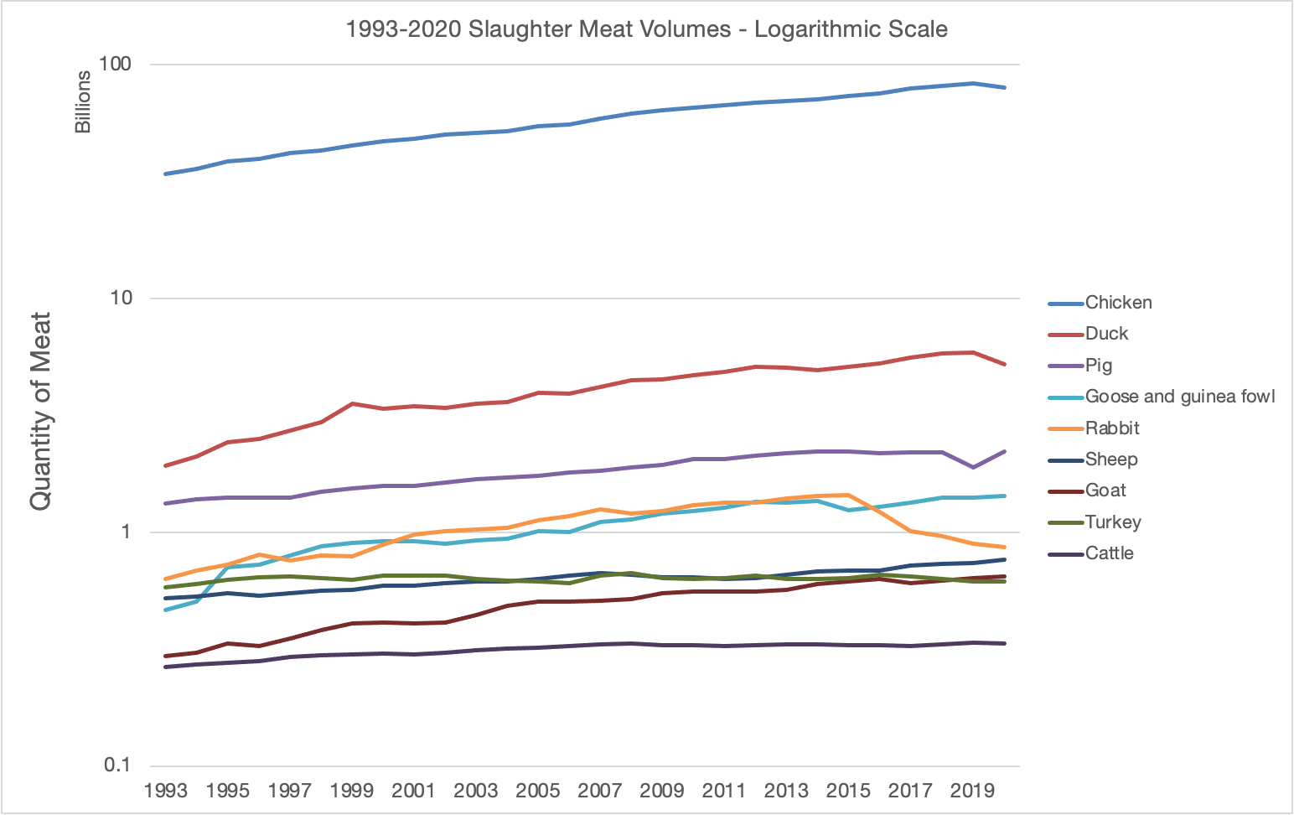
2.3 Production Meat Volumes Over Time
The time series shows the meat production volumes from 1992 to 2020 in a base 10 logarithmic scale
Top meats (Chicken and Duck) were significantly higher, logarithmic scale allows us to better identify relationships
Even under logarithmic scale, Chicken is dominant
All meat types show relatively stable rates of increase
Notes:
Alexis

Slide 20
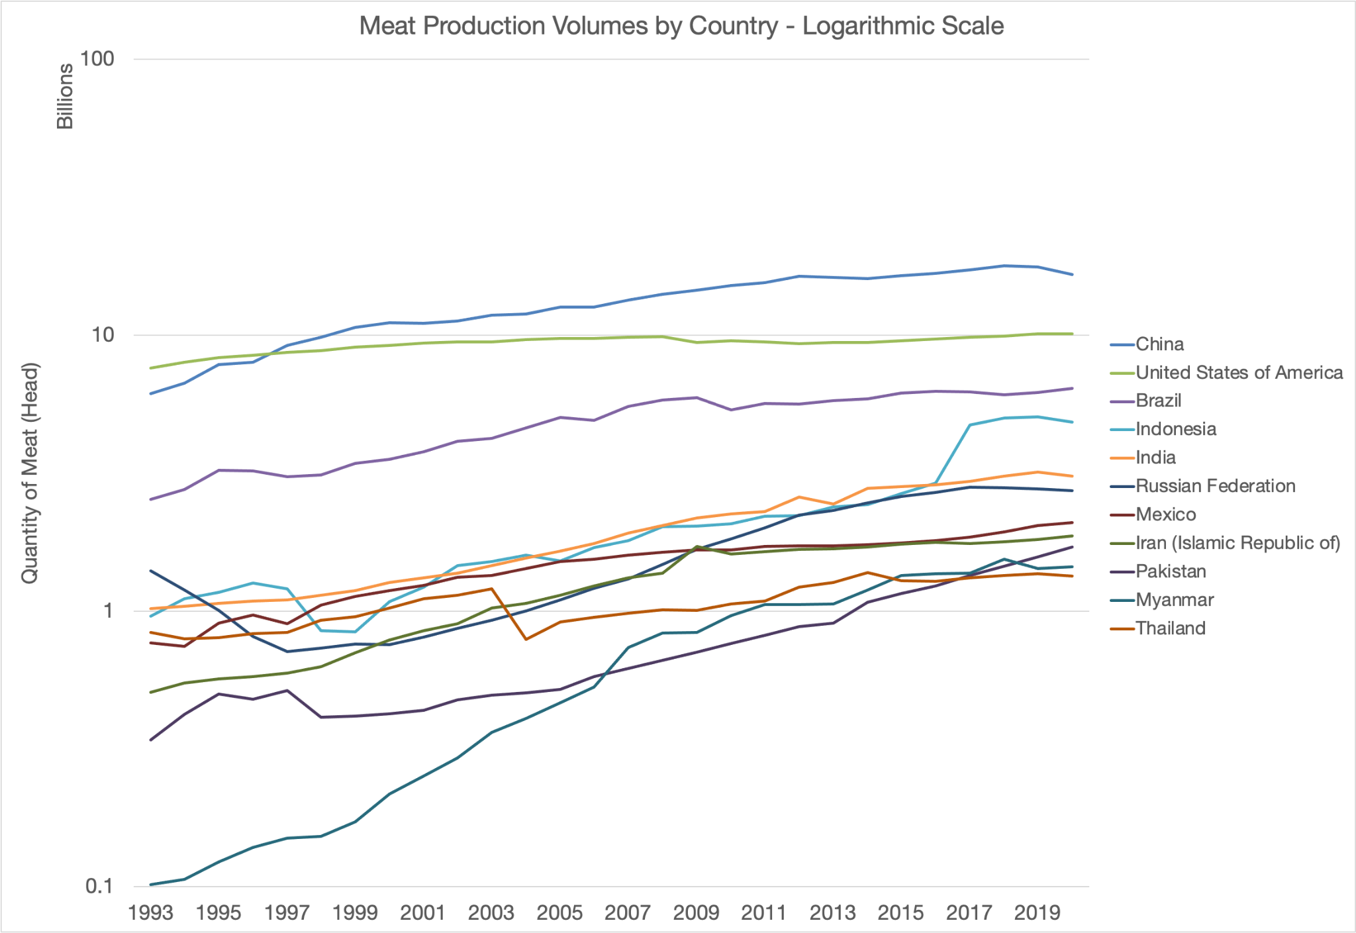
2.3 Country Slaughter Volumes Over Time
The time series shows the total meat production volumes by country from 1993 to 2020 in a base 10 logarithmic scale
Top countries were significantly higher, logarithmic scale allows us to better identify relationships
Overall increase at similar rates over time
China, US, and Brazil are considerably above
Indonesia separated into top 4 in 2016 with rapid increase
Myanmar had considerable steepest increase
Notes:
Alexis

Slide 21
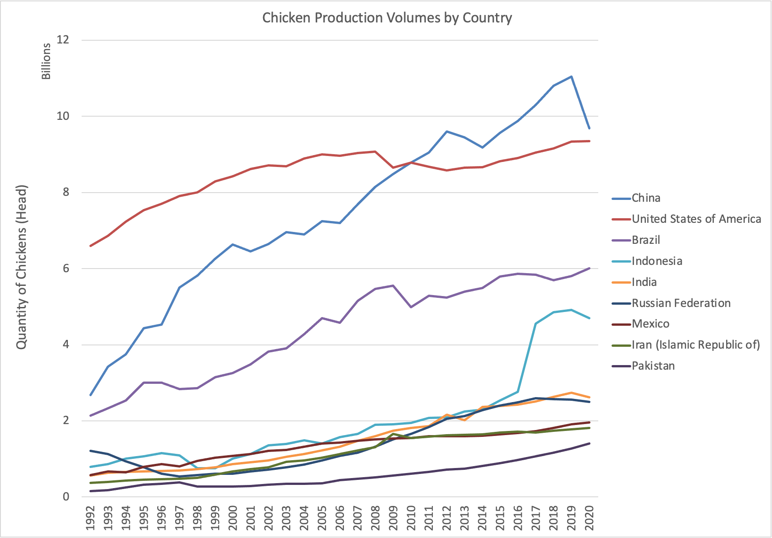
2.3 Chicken Production Volumes by Country
The time series shows the chicken production volumes by country from 1992 to 2020
China surpassed the US in 2009, largest rate of increase until 2020
US and Brazil are increasing at about the same rate over time
Indonesia separated into top 4 in 2016 with rapid increase
India, Russia, Mexico, Iran, and Pakistan round out the bottom and are increasing at about the same rate
Notes:
Alexis

Slide 22
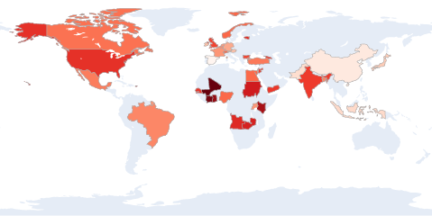
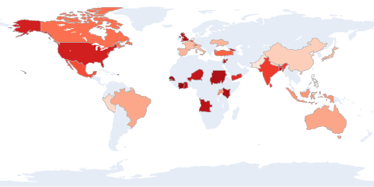
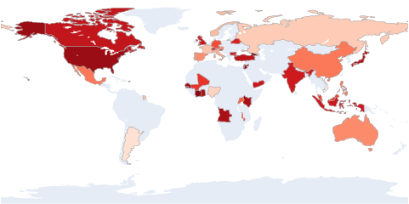
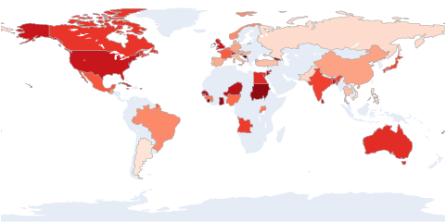
2.4 Normalized Giving Metrics by Country Over Time
*By amount in USD, log scale, normalized by # animals killed for meat production
External Donations, 2017 to 2020
2017
2018
2020
2019
Notes:
Amulya
Giving tends to stay pretty consistent for other orgs aggregated, we see changes in countries/regions that are more underserved while other country remain constant

Slide 23
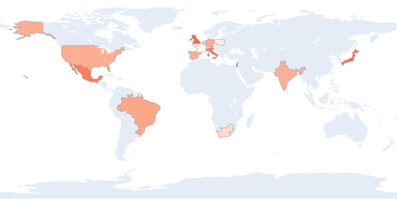
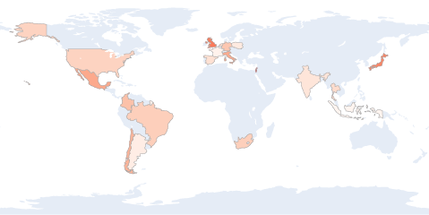
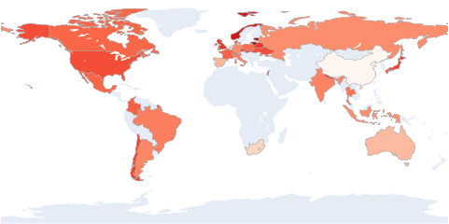
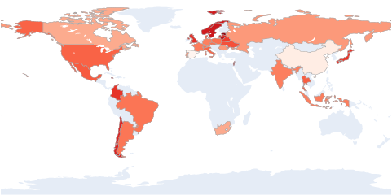
2.4 Normalized Giving Metrics by Country Over Time
*By amount in USD, log scale, normalized by # animals killed for meat production
Internal Donations, 2017 to 2020
2017
2018
2020
2019
Notes:
Amulya
Internal donations hae dramatically increased over time!!

Slide 24
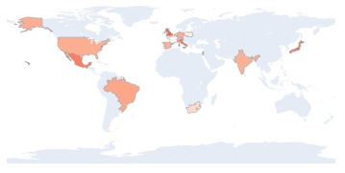
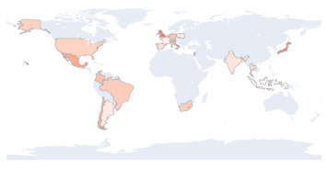
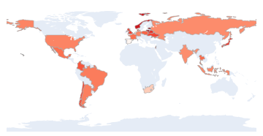
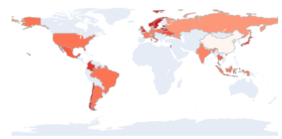
2.4 Normalized Giving Metrics by Country Over Time
*By amount in USD, log scale, normalized by # animals killed for meat production
Donations via RCF, 2017 to 2020
(all branches included)
2017
2018
2019
2020
Notes:
Amulya
Mention we only have 2019-2020 data for mvmt

Slide 25
Summary
Grants
Analysis
Tools
Grants over time
Grants by country
Normalization by FAOSTAT data
Country assignment code tool for ACE’s future use
~2100, organized by name and relevant info
Next Steps
ACE use HDAG tools, reach out anytime for support!
Notes:
Doris

