Slide 1

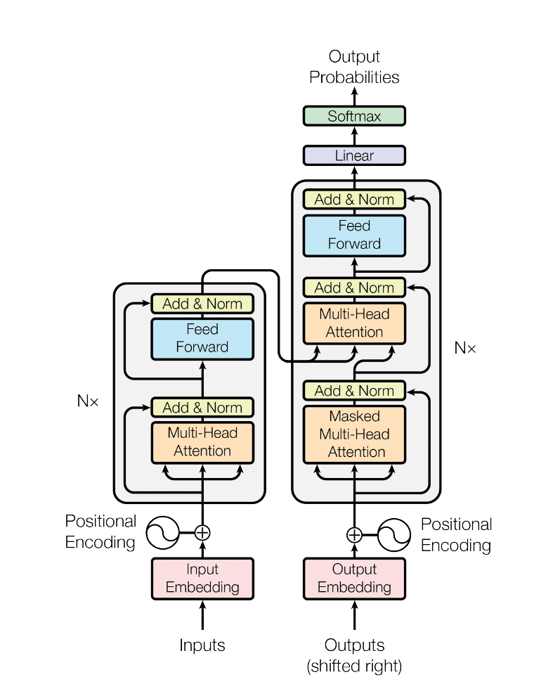
NEURIPS 2017 · ARXIV:1706.03762
Attention Is
All You Need
The Transformer: sequence transduction based entirely on attention — no recurrence, no convolution.
Ashish Vaswani · Noam Shazeer · Niki Parmar · Jakob Uszkoreit
Llion Jones · Aidan N. Gomez · Łukasz Kaiser · Illia Polosukhin
The Transformer — model architecture
Figure 1, paper p. 3
Google Brain · Google Research · University of Toronto

Slide 2
01 · BACKGROUND
The Problem: The Limits of Recurrence
Sequence transduction (e.g., machine translation) was dominated by recurrent (LSTM / GRU) and convolutional encoder–decoder models.
RNNs compute hidden states one position at a time: inherently sequential, so training cannot parallelize across positions in a sequence.
Signals between distant positions must travel a path of O(n) operations — the longer the path, the harder long-range dependencies are to learn.
Attention mechanisms already existed, but only as an accessory layered on top of RNNs or CNNs.
O(n)
sequential operations per layer in a recurrent network
O(n)
maximum path length between any two positions
Source: Vaswani et al., “Attention Is All You Need”, §1 Introduction (paper p. 1–2).

Slide 3
02 · KEY IDEA
The Transformer: Attention Is All You Need
No Recurrence
No Convolution
Self-Attention Only
Sequential RNN hidden states are removed entirely — positions are processed in parallel.
No fixed-width kernels; every position can connect to every other position directly.
Multi-headed self-attention computes all representations, in both encoder and decoder.
First sequence transduction model based entirely on attention, replacing recurrent layers with multi-headed self-attention.
Highly parallelizable — reaches a new state of the art in translation with a fraction of the training cost.
Generalizes beyond translation (e.g., English constituency parsing) and yields interpretable attention patterns.
Source: Vaswani et al., Abstract and §1 (paper p. 1–2).

Slide 4
03 · METHOD
Model Architecture: Stacked Self-Attention
Encoder–decoder structure built from stacked self-attention and point-wise, fully connected layers (left and right halves of Figure 1).
Encoder: N = 6 identical layers — each with multi-head self-attention, then a position-wise feed-forward network.
Decoder: N = 6 layers; adds a masked multi-head self-attention sub-layer (positions only attend to earlier positions) plus attention over the encoder output.
A residual connection wraps every sub-layer, followed by layer normalization.
Inputs/outputs are embedded (d_model = 512) and combined with positional encodings, since the model has no notion of order on its own.
Encoder (left) and decoder (right) stacks.
Figure 1, paper p. 3.
Visual: Figure 1, “The Transformer - model architecture” (paper p. 3); text: §3.1 (paper p. 3).

Slide 5
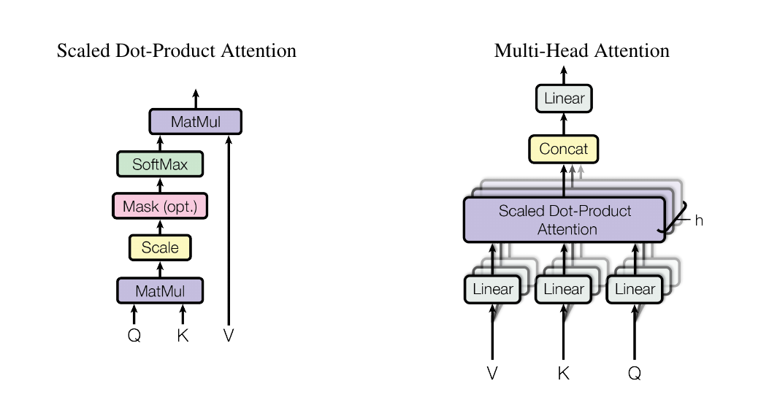
04 · METHOD
Scaled Dot-Product & Multi-Head Attention
Attention(Q,K,V) = softmax(QK^T / √d_k)V
Attention maps a query and key–value pairs to an output: a weighted sum of values, weights from query–key compatibility.
Dot products are scaled by 1/√d_k — for large d_k they would push softmax into tiny-gradient regions.
Multi-head: queries, keys, values are linearly projected h = 8 times (to d_k = d_v = 64), attention runs in parallel, outputs are concatenated and re-projected.
Different heads jointly attend to information from different representation subspaces at different positions.
(left) Scaled Dot-Product Attention; (right) Multi-Head Attention — several attention layers in parallel. Figure 2, paper p. 4.
Visual: Figure 2 (paper p. 4); formula and text: §3.2 (paper p. 4–5).

Slide 6
05 · METHOD
Anatomy of the Building Blocks
Multi-Head Attention
Position-wise Feed-Forward
h = 8 parallel heads; d_k = d_v = d_model/h = 64, so total compute stays close to single-head attention at full dimension.
FFN(x) = max(0, xW₁+b₁)W₂+b₂, applied identically to every position; inner dimension d_ff = 2048.
Add & Norm
Positional Encoding
Residual connection around each sub-layer: LayerNorm(x + Sublayer(x)); all sub-layers and embeddings output d_model = 512.
Sine/cosine waves of different frequencies injected at the inputs, so the model can use token order; learned alternatives worked equally well.
Two configurations: base — d_model 512, d_ff 2048, h 8, dropout 0.1 | big — d_model 1024, d_ff 4096, h 16, dropout 0.3.
Source: §3.2–3.5 (paper p. 4–5); §5.4 and Table 3 footnotes (paper p. 7–8).

Slide 7
06 · MOTIVATION
Why Self-Attention Wins
Parallelization: a self-attention layer needs only O(1) sequential operations vs. O(n) for recurrence — training uses all positions at once.
Long-range learning: any two positions connect through a path of constant length O(1), instead of O(n) for RNNs or O(log_k n) for dilated convolutions.
Cost: per-layer complexity O(n²·d) beats recurrence O(n·d²) whenever n < d — the common case with word-piece / BPE representations.
Interpretability: attention distributions expose what the model attends to; heads learn distinct, task-like behaviors.
PER-LAYER COMPLEXITY AND PATH LENGTHS
Layer Type | Complexity per Layer | Sequential Ops | Max Path Length
Self-Attention | O(n²·d) | O(1) | O(1)
Recurrent | O(n·d²) | O(n) | O(n)
Convolutional | O(k·n·d²) | O(1) | O(log_k n)
Self-Attention (restricted) | O(r·n·d) | O(1) | O(n/r)
n = sequence length, d = representation dimension, k = conv. kernel width, r = neighborhood. Adapted from Table 1, paper p. 6.
Table: adapted from Table 1 (paper p. 6); text: §4 (paper p. 6–7).

Slide 8
07 · EXPERIMENTS
Training Setup
Data & Batching
Optimization & Regularization
WMT 2014 English–German: 4.5M sentence pairs; English–French: 36M sentences.
Byte-pair encoding with a shared source–target vocabulary of ~37K tokens.
Batches of ~25,000 source and ~25,000 target tokens, grouped by approximate sequence length.
Adam (β₁ = 0.9, β₂ = 0.98, ε = 10⁻⁹) with warmup: 4,000 linearly increasing steps, then inverse-square-root decay.
Residual dropout 0.1 (base) / 0.3 (big); attention dropout on each sub-layer.
Label smoothing ε_ls = 0.1 — hurts perplexity but improves accuracy and BLEU.
Hardware & time: 8 × NVIDIA P100 GPUs — base model: 12 hours (100K steps); big model: 3.5 days (300K steps). Beam search with beam size 4, length penalty α = 0.6.
Source: §5 Training (paper p. 7); §6.1 (paper p. 8).

Slide 9
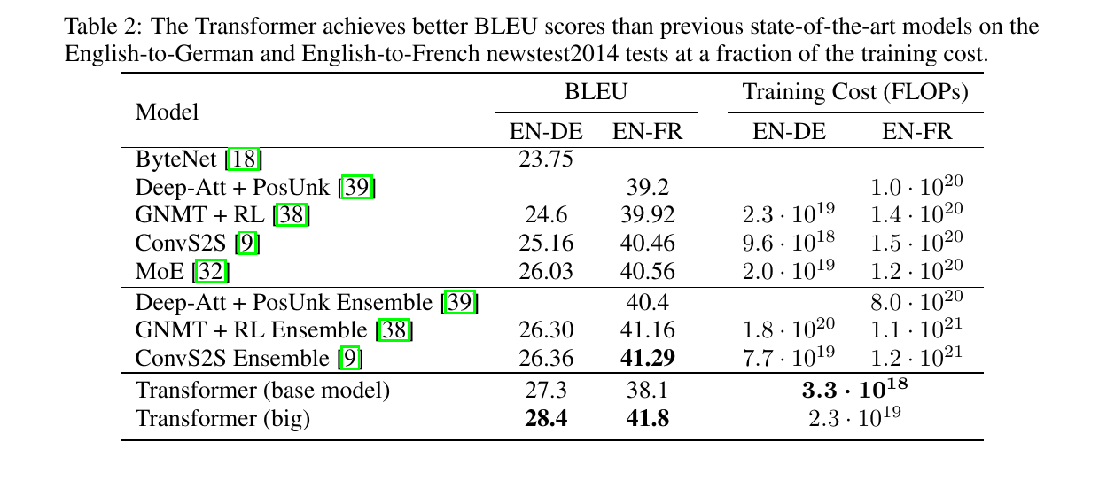
08 · RESULTS
Machine Translation: New State of the Art
28.4 BLEU
EN→DE: >2.0 above the best previously reported model, including ensembles
41.8 BLEU
EN→FR: best single model, at under 1/4 of the prior training cost
3.3×10^18
BLEU scores and training costs on WMT 2014 EN–DE / EN–FR (newstest2014). Table 2, paper p. 8.
FLOPs to train the base model — yet it already beats all prior models and ensembles
Visual: Table 2 (paper p. 8); text: §6.1 Machine Translation (paper p. 8).

Slide 10
09 · RESULTS
EN→DE BLEU: Transformer vs. Prior Art
WMT 2014 English→German newstest2014 BLEU scores — values from Table 2, paper p. 8.
The big Transformer sets a new state of the art (28.4 BLEU) — more than 2.0 BLEU above the best previously reported models, including ensembles.
Data: Table 2 (paper p. 8); discussion: §6.1 (paper p. 8).

Slide 11
10 · RESULTS
Beyond Translation: Constituency Parsing
A 4-layer Transformer was trained on English constituency parsing (Wall Street Journal portion of the Penn Treebank, ~40K training sentences).
With almost no task-specific tuning, it outperforms the BerkeleyParser — even when trained only on the WSJ training set.
In the semi-supervised setting (with a ~17M-sentence high-confidence corpus) it beats all previously reported models except the Recurrent Neural Network Grammar.
The same architecture generalizes across tasks without structural changes.
91.3 F1
WSJ-only, discriminative setting (Section 23 of WSJ)
92.7 F1
Semi-supervised setting — above every prior model except RNNG
Source: Table 4 (paper p. 10) and §6.2 / “English Constituency Parsing” (paper p. 9–10).

Slide 12
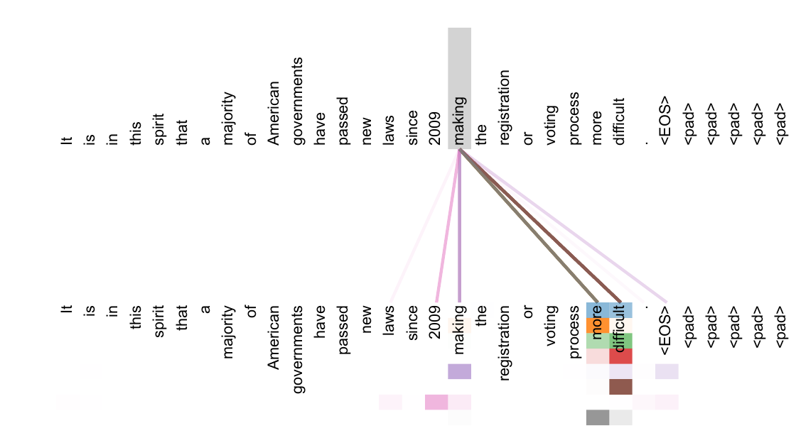
11 · RESULTS
Interpretability: What Attention Sees
Individual attention heads learn to perform different tasks; many exhibit behavior tied to the syntactic and semantic structure of sentences.
In this example (encoder self-attention, layer 5 of 6), many heads attend to a distant dependency of the verb “making”, completing the phrase “making…more difficult”.
Other heads are involved in anaphora resolution (Figure 4 of the paper).
“Not only do individual attention heads clearly learn to perform different tasks, many appear to exhibit behavior related to the syntactic and semantic structure of the sentences.” — §4, p. 7
Attention for the word “making”; colors = different heads. Figure 3, paper p. 13.
Visual: Figure 3 (paper p. 13); text: §4 (paper p. 7) and Appendix (paper p. 13).

Slide 13
12 · CONCLUSION
Conclusion & Legacy
The Transformer: the first sequence transduction model based entirely on attention — multi-headed self-attention replaces recurrent layers in encoder–decoder architectures.
Trains significantly faster than recurrent or convolutional architectures thanks to full parallelization.
New state of the art on WMT 2014 EN→DE (28.4 BLEU) and EN→FR (41.8 BLEU), at a fraction of the previous training cost.
The architecture became the foundation of modern large language models (BERT, GPT, and their successors) — attention really was all you needed.
“We are excited about the future of attention-based models and plan to apply them to other tasks.” — Vaswani et al., §7 Conclusion (paper p. 10)
Vaswani, Shazeer, Parmar, Uszkoreit, Jones, Gomez, Kaiser, Polosukhin. “Attention Is All You Need.” NeurIPS 2017 (arXiv:1706.03762). All figures/tables shown are cropped from the original paper PDF.

