Slide 1
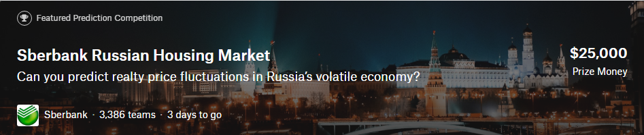
Sberbank Russian Housing Market
Kaggle Competition
Can you predict realty price fluctuations in Russia's volatile economy?
14331226 彭瑞 计应

Slide 2
Tools
Python
Python is a programming language that lets you work quickly and integrate systems more effectively.
XGBoost
eXtreme Gradient Boosting, an optimized distributed gradient boosting library designed to be highly efficient, flexible and portable.
Jupyter Notebook
The Jupyter Notebook is an open-source web application that allows you to create and share documents that contain live code, equations, visualizations and explanatory text.

Slide 3

Cross Industry Standard Process for Data Mining
Business Understanding
To learn how house prices are determined and predict house prices
Data Understanding
A Very Extensive Sberbank Exploratory Analysis
Data Preparation
Missing values imputation
Feature engineering
Modeling
XGB, LightGBM, Random Forest
Evaluation
Local CV
Feature importance
Deployment

Slide 4
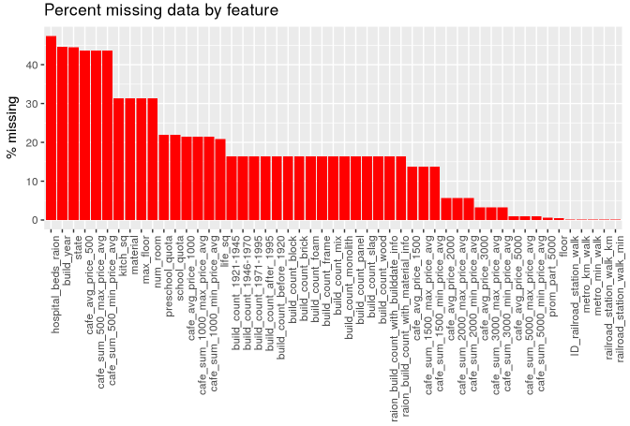
Data understanding: Excerpt from the exploratory analysis
Missing data

Slide 5
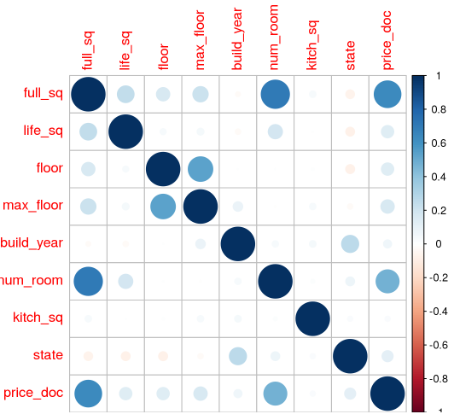
Excerpt from the exploratory analysis
Correlation

Slide 6
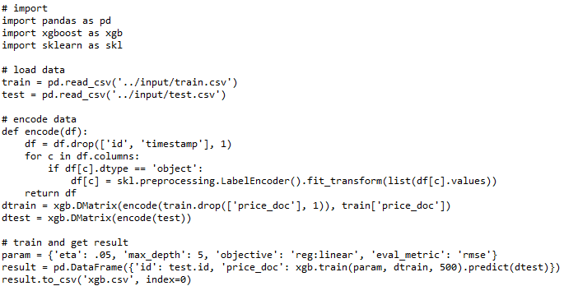
Trial: Naive XGB

Slide 7
Naive XGB
LB: about 0.316
Very simple code
Ignore macro economy and timestamp
Encode categorial data using LabelEncoder from sklearn
Train the model with arbitrary parameters
No cross validation

Slide 8
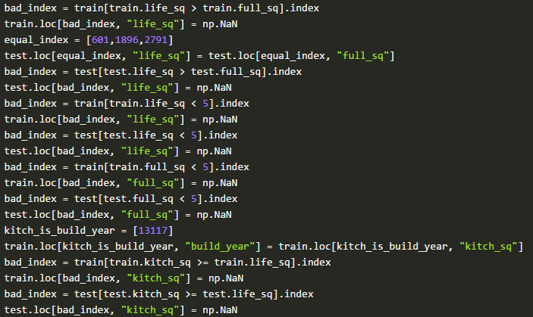
Data preparation: Excerpt from cleaning data

Slide 9
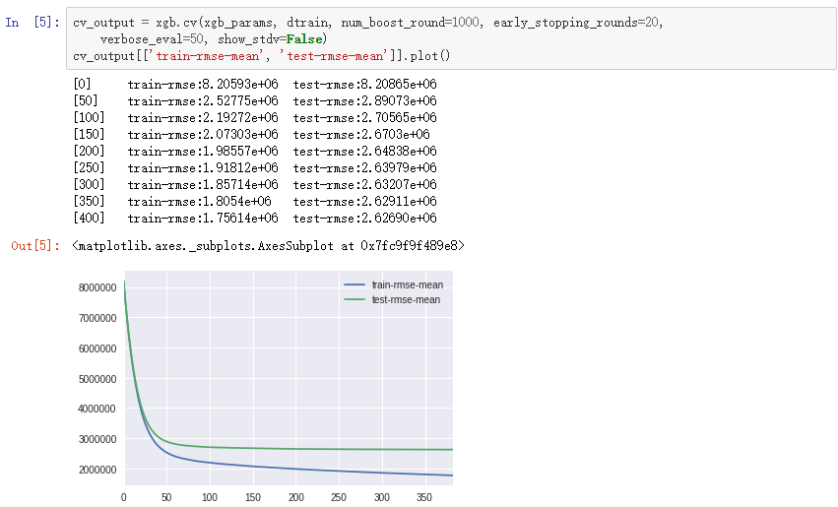
Train and evaluate XGB model

Slide 10
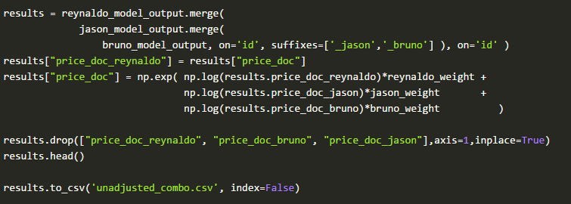
Merge results from different models

Slide 11
Ensemble Learning Exploration
Ensemble methods use multiple learning algorithms to obtain better predictive performance than could be obtained from any of the constituent learning algorithms alone.
A machine learning ensemble refers only to a concrete finite set of alternative models, but typically allows for much more flexible structure to exist among those alternatives.
Common types of ensembles
Bayes optimal classifier
Bootstrap aggregating (bagging)
Boosting
Bayesian parameter averaging
Bayesian model combination
Bucket of models
Stacking

Slide 12
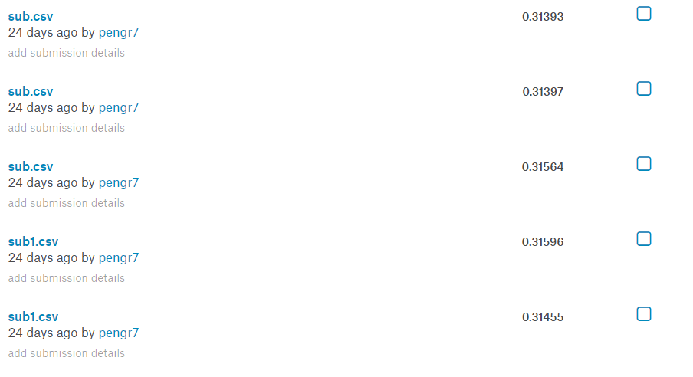
My submissions
Total: 40 submissions
Best Score: 0.31034
Date: 6/27/2017

Slide 13
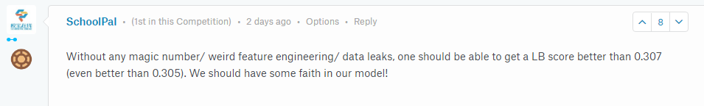
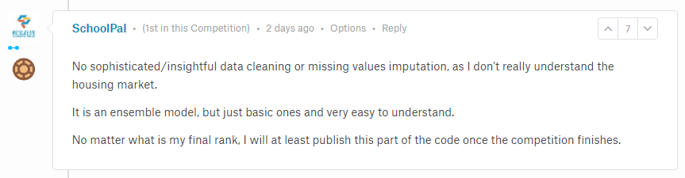
Magic number mandatory?

Slide 14
Other Kaggle competitions
Linear Regression-SYSU-2017
Large-scale classification-SYSU-2017
Titanic: Machine Learning from Disaster
House Prices: Advanced Regression Techniques
Digit Recognizer
Two Sigma Connect: Rental Listing Inquiries

