Slide 1


AI-Powered Viral Discovery from Metagenomic Data
Sihua Peng
10/31/2025

Slide 2
Background
The Challenge of Viral Discovery in Metagenomes
Hidden Viral Diversity: Metagenomic samples contain vast uncultured viral diversity
Low Abundance: Many viruses exist at low abundance, making detection challenging
Novel Viruses: Unknown viruses lack reference sequences for traditional methods
Complex Communities: Mixed DNA/RNA viruses in environmental samples
Traditional Limitations: Database-dependent methods miss novel viruses
→ Need for AI-powered, database-independent approaches

Slide 3
What We Aim to Achieve
Novel Virus Discovery: Identify previously unknown viral sequences
Low-Abundance Detection: Detect viruses at low abundance levels
Comprehensive Coverage: Support both DNA and RNA viruses
High Confidence: Dual validation using multiple AI methods
Automated Pipeline: Streamlined workflow for large-scale analysis

Slide 4
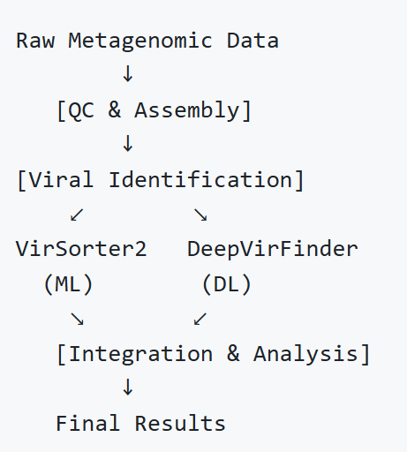
Workflow Overview
Integrated Multi-Tool Pipeline
Two AI-powered tools working in parallel for comprehensive viral identification

Slide 5
Core Technologies - VirSorter2
Machine Learning-Based Viral Identification
Method:
Supervised machine learning models
Rule-based detection system
Virus-specific feature recognition
Capabilities:
Novel virus detection (database-independent)
Multiple virus types: dsDNA, ssDNA, RNA, NCLDV
Viral hallmark gene identification
Confidence scoring (0-1 scale)
Advantage:
Identifies viruses based on sequence features, not just similarity

Slide 6
Core Technologies - DeepVirFinder
Deep Learning-Based Viral Prediction
Method:
Deep convolutional neural network
Trained on viral sequence patterns
Statistical significance testing
Capabilities:
Pattern recognition in sequences
P-value-based significance filtering
Database-independent approach
Novel virus discovery capability
Advantage:
Learns complex patterns that may indicate viral sequences

Slide 7
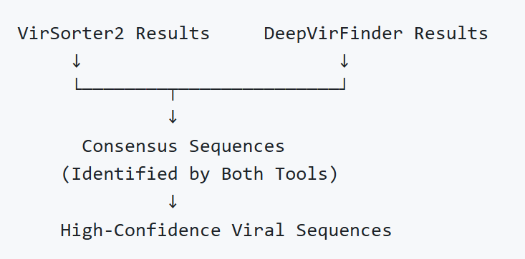
Dual Validation Strategy
Consensus-Based High-Confidence Detection
Benefits:
Reduced false positives
Increased confidence in novel virus calls
Complementary strengths of ML and DL

Slide 8
Assembly Strategy - Short Reads
Dual Assembler Approach
MEGAHIT
Fast, memory-efficient
Good for complex communities
Optimized for metagenomes
metaSPAdes
High-quality assemblies
Better for complex regions
Higher resource requirements
Advantage:
Cross-validation between assemblers increases reliability

Slide 9
Assembly Strategy - Long Reads
Long-Read Assembly for Better Resolution
metaFlye
Designed for long-read data (Nanopore/PacBio)
Better for low-abundance viruses
Resolves repetitive regions
Full-length viral genome recovery
Platform Support:
Nanopore (MinION, PromethION)
PacBio (Sequel, Sequel II)
Optional: viralFlye Refinement
Targeted reassembly of viral contigs
Improved assembly quality

Slide 10
Workflow Architecture
Complete Analysis Pipeline
Stage 1: Quality Control
fastp filtering (short-reads)
Optional long-read QC
Stage 2: Assembly
Short-read: MEGAHIT + metaSPAdes (parallel)
Long-read: metaFlye
Stage 3: Viral Identification
VirSorter2 analysis
DeepVirFinder analysis
(Optional: viralFlye refinement for long-reads)
Stage 4: Integration
Result merging
Consensus identification
Comprehensive reporting

Slide 11
Key Features
Comprehensive Viral Discovery Pipeline
Novel Virus Discovery: AI-powered, database-independent
Low-Abundance Detection: Sensitive assembly methods
DNA & RNA Support: Comprehensive virus type coverage
Dual Validation: ML + DL for high confidence
Automated Workflow: Nextflow-based, reproducible
Scalable: HPC cluster optimized (SLURM)
Flexible: Short-read and long-read support
Refinement Option: viralFlye for improved assemblies

Slide 12
Application Scenarios
Where This Workflow Shines
Environmental Metagenomics
Soil, water, ocean samples
Viral diversity exploration
Human/Animal Microbiomes
Gut virome studies
Pathogen discovery
Novel Virus Discovery
Emerging virus identification
Viral surveillance
Low-Abundance Detection
Rare virus discovery
Pathogen monitoring

Slide 13
Detection Capabilities
What Can Be Detected?
Virus Types:
dsDNA phages
ssDNA viruses
RNA viruses
NCLDV (Nucleocytoplasmic Large DNA Viruses)
Lavidaviridae (helper viruses)
Sequence Characteristics:
Novel/unknown viruses
Low-abundance viruses (assembly-dependent)
Partial genomes (fragments)
Complete viral genomes (long-reads)
Confidence Levels:
High: Consensus (both tools)
Medium: Single tool, high score
Low: Single tool, low score

Slide 14
Output Results
Comprehensive Reporting System
Generated Files:
Assembly Contigs: Assembled viral sequences
Viral Scores: VirSorter2 confidence scores
DL Predictions: DeepVirFinder scores and p-values
Merged Reports: Integrated analysis
Consensus Lists: High-confidence sequences
Report Types:
Text reports (statistics)
CSV tables (detailed data)
Consensus sequences (high-confidence list)

Slide 15
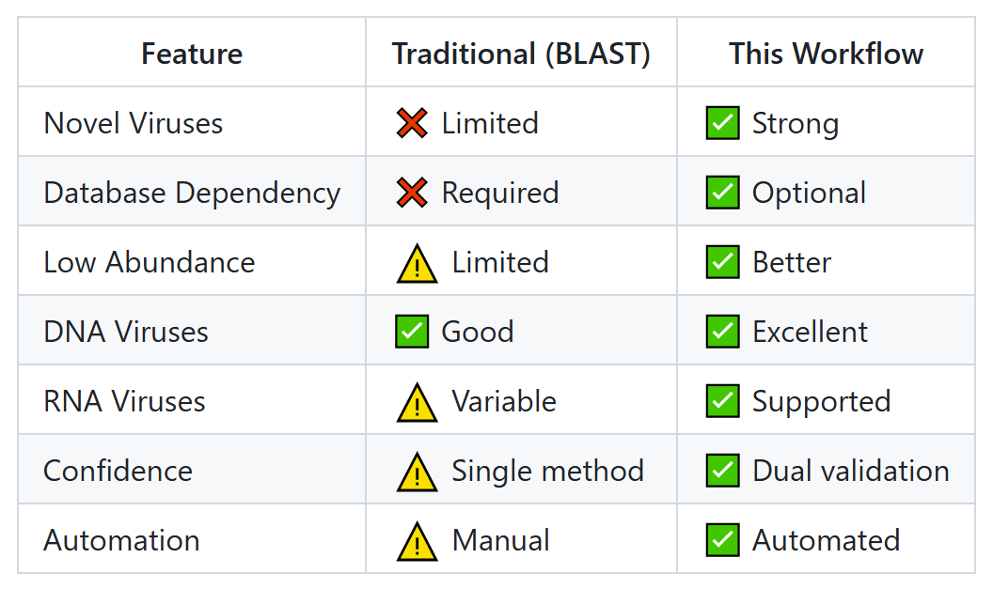
Workflow Comparison
Advantages Over Traditional Methods

Slide 16
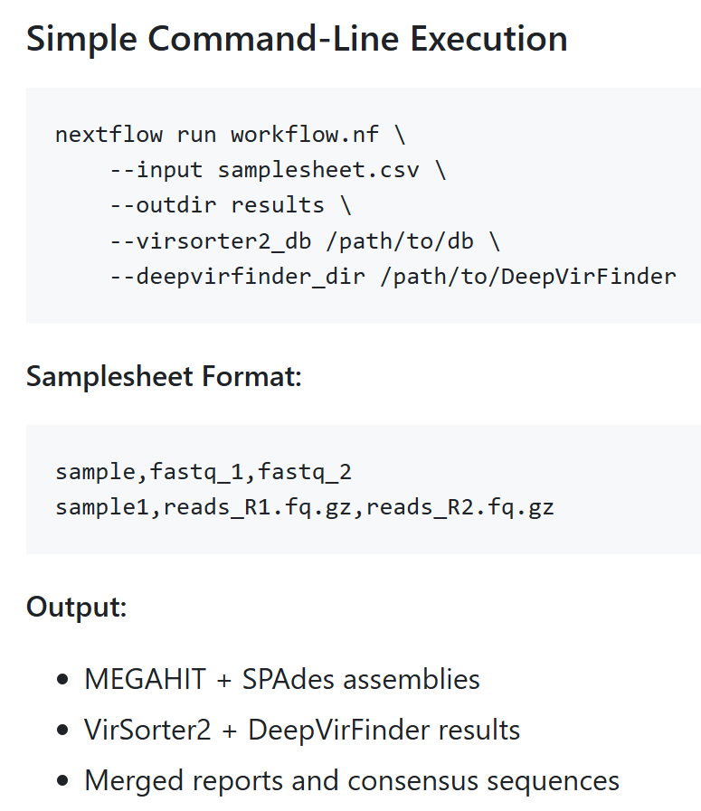
Usage Example - Short Reads

Slide 17
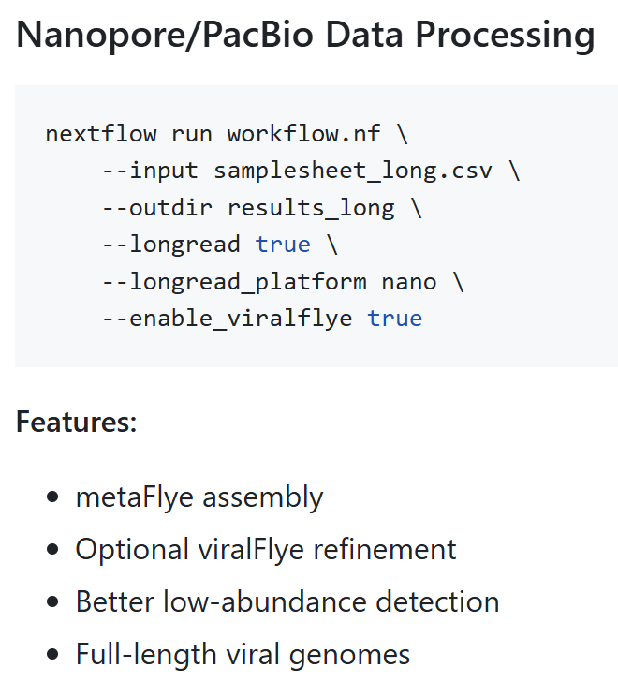
Usage Example - Long Reads

Slide 18
Performance & Scalability
HPC-Optimized for Large-Scale Analysis
Resource Efficiency:
Parallel processing
SLURM cluster support
Configurable resource allocation
Scalability:
Multiple samples simultaneously
Efficient containerization (Apptainer/Singularity)
Conda environment management
Reproducibility:
Nextflow ensures reproducible results
Version-controlled workflows
Containerized tools

Slide 19
Limitations & Consideration
Important Caveats
Assembly Dependencies:
Low-abundance detection requires sufficient coverage
Very short fragments may be missed
Assembly quality affects detection
RNA Virus Detection:
Primary reliance on VirSorter2
DeepVirFinder optimized for DNA
Computational Resources:
SPAdes requires high memory (512GB)
Long-read assembly is time-intensive
Large samples need adequate storage

Slide 20
Summary
Key Takeaways:
Comprehensive Pipeline: End-to-end viral discovery workflow
AI-Powered: ML + DL for novel virus detection
Dual Validation: High-confidence consensus results
Flexible: Short-read and long-read support
Automated: Reproducible, scalable analysis
Broad Coverage: DNA and RNA viruses
Impact: Enables systematic viral discovery in metagenomic datasets :

Slide 21
Thanks for your attention.

