Slide 1

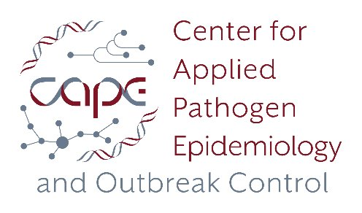
Machine Learning-Enhanced Metagenomic Viral Discovery Workflow
-- A Novel Approach for Discovering Unknown Viruses in Metagenomic Data
Sihua Peng
11/05 /2025

Slide 2
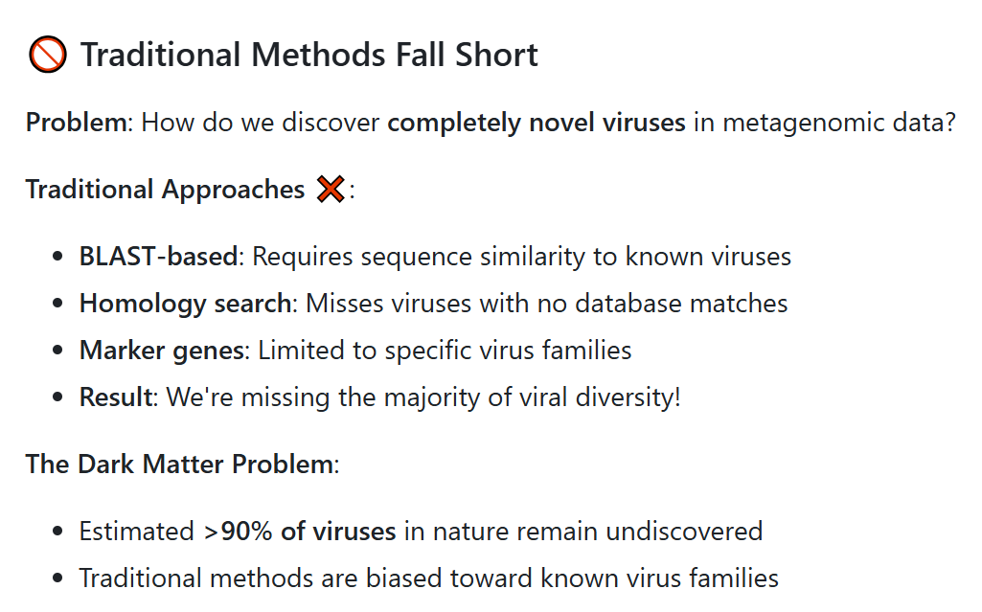
Challenge - Traditional Limitations

Slide 3
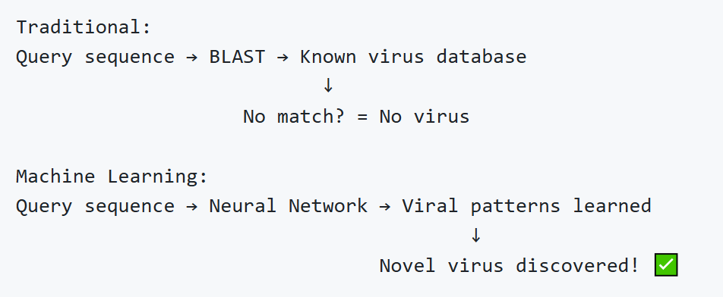
Solution - Machine Learning Revolution
Machine Learning Changes Everything
Key Innovation: Pattern Recognition, Not Similarity Search
Breakthrough: Discover viruses with 0% similarity to known sequences!

Slide 4
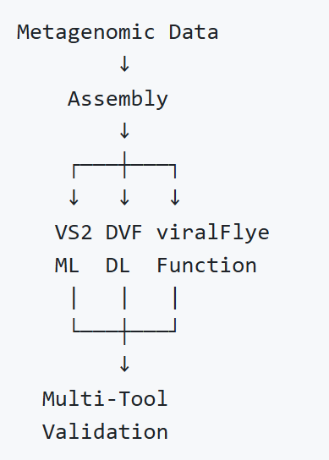
Three-Pronged ML Strategy
Three Independent Lines of Evidence:
VirSorter2 (Hybrid ML)
DeepVirFinder (Deep Learning)
viralFlye (Pfam Protein Validation)

Slide 5
Dual-Mode Design
Flexible for Different Data Types
Mode | Data Type | Tools | Key Feature
Short-read | Illumina | 2 tools (VS2 + DVF) | Dual-assembler validation
Long-read ⭐ | Nanopore/PacBio | 3 tools (VS2 + DVF + viralFlye) | Pfam protein validation
Long-read advantage: Complete viral genomes + protein validation
Recommendation: Long-read mode for novel virus discovery

Slide 6
Tool #1 - VirSorter2 (Hybrid ML)
Method: Viral features + Machine Learning classifiers
Strengths:
Identifies novel variants of known virus families
Classifies virus types (dsDNA phage, ssDNA, RNA virus)
Balanced sensitivity and specificity
Novel Virus Discovery:
Can identify viruses with divergent sequences
Uses genomic context, not just similarity
Output: ~30-50 viruses per sample (10 GB data)

Slide 7
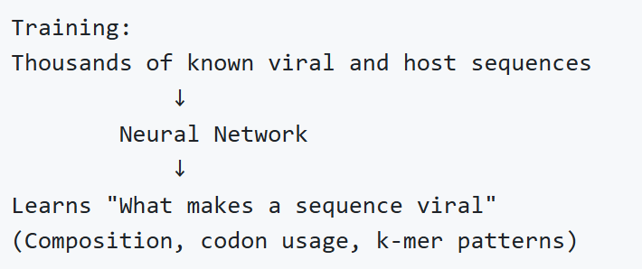
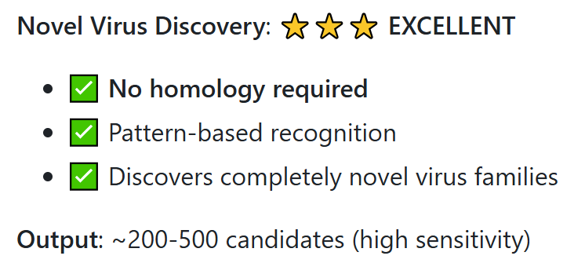
Tool #2 - DeepVirFinder (Deep Neural Network)
DeepVirFinder: The Novel Virus Hunter
Method: Deep Neural Network trained on viral vs non-viral sequences

Slide 8
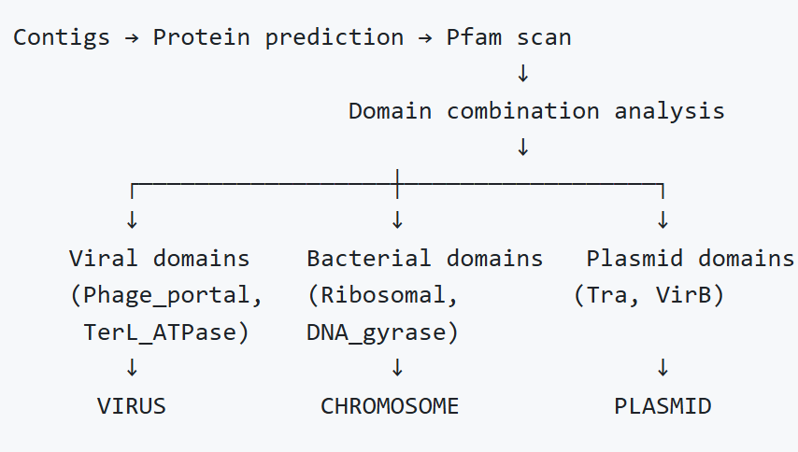
Tool #3 - viralFlye (Pfam Validation)
viralFlye: Function-Based Discovery
Method: Pfam protein domain validation (20,000 protein families)
How it Works:
Novel Virus Discovery:
Discovers viruses by FUNCTION, not sequence
Can identify completely novel viruses with known protein domains
Output: ~28 candidates (high specificity, Pfam-validated)

Slide 9
Why Three Tools?
Complementary Strengths
Tool | Discovery Method | Strength | Virus Count
VirSorter2 | Features + ML | Balanced | ~30-50
DeepVirFinder | Deep Learning | Novel Discovery | ~200-500
viralFlye | Protein Function | High Specificity | ~28

Slide 10
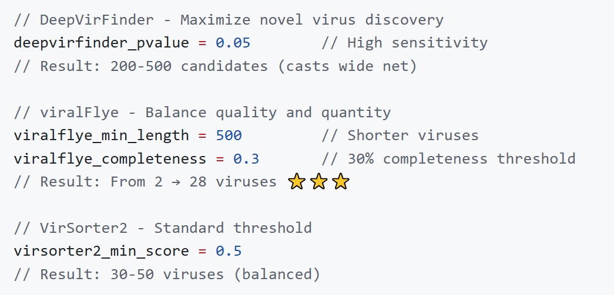
Parameter Optimization
Tuning for Novel Virus Discovery
Critical Parameters:

Slide 11
Scalable and Efficient
Resource Requirements:
Component | CPU | Memory | Time
metaFlye assembly | 32 | 128 GB | 24-48h
VirSorter2 | 16 | 64 GB | 12-24h
DeepVirFinder (ML) | 8 | 32 GB | 8-12h
viralFlye | 32 | 128 GB | 24-36h
Total | - | 256 GB | 48-72h
Parallel Execution: All three tools run simultaneously
Scalability: Tested on 1-100 GB datasets

Slide 12
Applications and Impact
Real-World Applications
1. Environmental Virology
Discover viruses in unexplored environments
Water/Wastewater, soil, extreme environments
Impact: Expand viral diversity catalog
2. Clinical Applications
Identify novel pathogens in clinical samples
Detect emerging infectious diseases
Impact: Early warning system
3. Evolutionary Biology
Understand virus-host co-evolution
Trace viral origins and diversification
Impact: Fundamental insights

Slide 13
Advantages Over Existing Methods
Feature | Traditional | Our Workflow
Novel Virus Discovery | ❌ Requires similarity | ✅ ML pattern recognition
Validation | Single tool | ✅ Three independent tools
Confidence Tiers | Binary (yes/no) | ✅ 4-level stratification
Protein Validation | ❌ Not included | ✅ Pfam domain analysis
False Positive Rate | High | ✅ Low (multi-tool filtering)
Completeness Info | ❌ Not assessed | ✅ viralComplete scores
Automation | Manual | ✅ Fully automated Nextflow

Slide 14
Conclusion
Key Takeaways
1. Machine Learning Revolution
Discovers viruses without requiring similarity to known sequences
Opens the door to viral "dark matter"
2. Multi-Tool Validation
Three independent lines of evidence
Clear confidence stratification
Minimizes false positives
High specificity through cross-validation
3. Fully automated Nextflow pipeline

Slide 15
Thanks for your attention.

