Slide 1
BLUEPRINT BIOSECURITY · PATHOGEN-AGNOSTIC BIOTHREAT DETECTION RFP
Proposal 1: NOVA-MGS
Mathematical Foundations of Metagenomic Pathogen Detection
Reference-free novelty scoring, probabilistic calibration, and evidence verification
Sihua Peng, 07/27/2026
1

Slide 2
Agenda
Σ
From k-mers to Calibrated Probabilities
01
Set-Similarity Theory
k-mers, MinHash, and FracMinHash sketching
02
Embedding-Space Geometry
Protein language model embeddings & density-based outlier detection
03
Probabilistic Calibration
NCS fusion and Isotonic regression
04
Leakage-Safe Benchmark Design
Held-out lineages, taxonomic distance, and realistic backgrounds
05
Validation & Evaluation
AUPRC, false-alert burden, and probability reliability
2

Slide 3
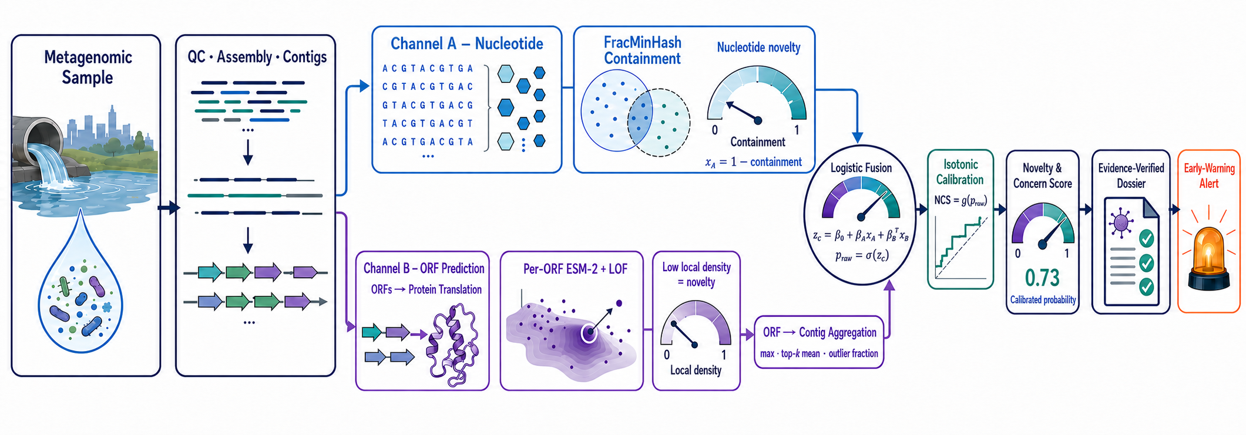
Dual-Channel Scoring, Calibration & Evidence Verification
3

Slide 4
Background
?
Why Detection Needs Reference-Free Math
Kraken2/Bracken, GOTTCHA2, and Centrifuge all rely on reference matching
A genuinely novel or highly divergent pathogen has, by construction, no reference to match
The result isn't misclassification — it's discarded into the unclassified fraction
In real wastewater metagenomes, that unclassified fraction routinely runs 60%–90%
Lower stringency → candidate surge → analyst review becomes the new bottleneck
A Formal Statement of the Problem
reads(sample) = reads(in known DB) + reads(out-of-DB)
P(detect | q) depends on sim(q, D_viral)
As sim(q, D_viral) → 0, detection rate → 0
NOVA-MGS's goal: turn the “similarity → 0” regime into a continuous, calibrated novelty probability — not a discarded read.
4

Slide 5
System Overview
⇄
Dual-Channel Scoring & Evidence Verification
Channel A · Nucleotide
Channel B · Protein
Fusion & Calibration
Evidence Verification
FracMinHash / sourmash
containment estimation
→
ESM-2 embedding +
density-based outlier detection
→
Logistic Fusion → Isotonic regression → NCS (Novelty and Concern Score)
→
Read support + coverage checks →
evidence-verified dossier
The Mathematical Objects This Talk Covers
x_A(c) = 1 − Ĉ(c, D_viral); x_B(c) = Aggregate{ LOF_κ(o) : o ∈ O(c) } → z_c = β₀ + β₁x_A(c) + β₂x_B(c) + β₃x_A(c)x_B(c) → NCS_c = g_iso(z_c)
5

Slide 6
Set-Similarity Theory
Σ
k-mer Sets & MinHash Sketching
Split a sequence of length L into every length-k substring (k-mer)
A hash function h maps each k-mer to a near-uniform integer in [0, H) — a fixed-length fingerprint of arbitrary-length input
Bottom-sketch MinHash keeps only the m smallest hash values as the sketch S(A)
The naive ratio |S(A)∩S(B)| / |S(A)∪S(B)| is biased — that denominator can reach 2m
Taking the bottom-m of the union instead yields an unbiased Ĵ, because bottom-m(A∪B) is a uniform random m-subset of the union
For fixed m, comparison cost is independent of sequence length — a guarantee FracMinHash deliberately trades away (next slide)
Definitions & Estimator
K(A) = { A[i..i+k) : i = 1..L−k+1 }
h : Σᵏ → [0, H)
S(A) = bottom-m { h(κ) : κ ∈ K(A) }
U = bottom-m( S(A) ∪ S(B) )
Ĵ(A,B) = |U ∩ S(A) ∩ S(B)| / m
Restricting to the bottom-m of the union makes Ĵ unbiased for J(A,B) = |K(A)∩K(B)| / |K(A)∪K(B)| under an idealised uniform hash; variance shrinks as m grows.
An example：
H(A)={82,15,47,31,66,24}
Sorting：15, 24, 31, 47, 66, 82
S(A) = bottom-1(H(A))={15}
S(A) = bottom-2(H(A))={15,24}
S(A) = bottom-3(H(A))={15,24,31}
6
Notes:
[Sources]
- Broder, A.Z. On the resemblance and containment of documents. SEQUENCES'97, IEEE, 1997, 21-29.
- Broder, Charikar, Frieze & Mitzenmacher. Min-wise independent permutations. STOC 1998; JCSS 60(3):630-659, 2000.
- Ondov et al. Mash: fast genome and metagenome distance estimation using MinHash. Genome Biology 17:132, 2016.
- Cohen, E. Size-estimation framework with applications to transitive closure and reachability. JCSS 55(3):441-453, 1997.
[/Sources]

Slide 7
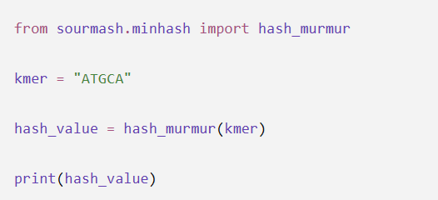
FracMinHash & Containment
∩
sourmash's Scaled Sketching Strategy
Fixed-size MinHash distorts comparisons between very differently sized sequences
FracMinHash keeps every hash below a threshold H/s (“scaled sketching”)
Sketch size scales with length: fixed-m cost is traded for cross-scale comparability
Containment suits novelty better than Jaccard: how much of a query the viral DB explains
Ĉ carries a small-sketch bias; we use the Hera et al. (2023) debiased estimator
Scaled Sketching & Containment Estimator
S(A) = { h(κ) : h(κ) < H/s }
Ĉ(A,B) = |S(A)∩S(B)| / |S(A)|
≈ C(A,B) = |K(A)∩K(B)| / |K(A)|
Var[Ĉ] ≈ C(1−C) / |S(A)| (1st-order)
Low Ĉ(query, known viral DB) → high nucleotide-level novelty. The binomial variance is a first-order approximation only: |S(A)| is itself random and Ĉ carries a small-sketch bias, so operational confidence intervals use the debiased estimator.
7
Notes:
[Sources]
- Brown, C.T. & Irber, L. sourmash: a library for MinHash sketching of DNA. JOSS 1(5):27, 2016.
- Irber et al. Lightweight compositional analysis of metagenomes with FracMinHash. bioRxiv 2022.01.11.475838.
- Hera, Pierce-Ward & Koslicki. Deriving confidence intervals for mutation rates across a wide range of evolutionary distances using FracMinHash. Genome Research 33(7):1061-1068, 2023.
- Koslicki, D. & Zabeti, H. Improving MinHash via the containment index. Applied Mathematics and Computation 354:206-215, 2019.
- Blanca, Harris, Koslicki & Medvedev. The statistics of k-mers from a sequence undergoing a simple mutation process without spurious matches. J Comput Biol 29(2):155-168, 2022.
[/Sources]

Slide 8
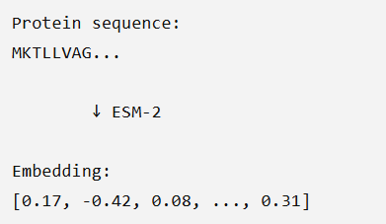
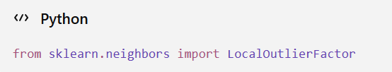
Embedding-Space Geometry
ℝ
Protein Embeddings & Outlier Detection
Six-frame ORF prediction → encode each ORF with a protein language model (ESM-2)
Nucleotide sequence can diverge past recognition, yet capsid/polymerase fold may not
We score local density on the known-viral manifold, not a classifier boundary — recovering what Channel A cannot see
At d ≈ 1280 kNN distances concentrate, so we use cosine distance on L2-normalised embeddings and PCA before LOF
Local Density & Outlier Score
ORF → e ∈ R^d (d ≈ 1280)
reach_κ(e,o) = max( κ-dist(o), d(e,o) )
lrd_κ(e) = 1 / avg_o reach_κ(e,o)
LOF_κ(e) = avg_o lrd_κ(o) / lrd_κ(e)
κ: number of nearest neighbours, e.g. 20 — distinct from the k-mer length k;
κ-dist(o): distance from o to its κ-th nearest neighbour;
reach_κ(e,o): reachability distance, floored at κ-dist(o);
lrd_κ(e): local reachability density of e;
o ranges over N_κ(e), the κ nearest neighbours of e;
d(·,·): cosine distance on L2-normalised embeddings.
LOF_κ(e) ≈ 1 means e sits at its neighbours' density; LOF_κ(e) ≫ 1 means the candidate fold is isolated within known viral space.
8
Notes:
[Sources]
- Breunig, Kriegel, Ng & Sander. LOF: Identifying Density-Based Local Outliers. SIGMOD 2000.
- Lin et al. Evolutionary-scale prediction of atomic-level protein structure with a language model (ESM-2). Science 379:1123-1130, 2023.
- Aggarwal, Hinneburg & Keim. On the surprising behavior of distance metrics in high dimensional space. ICDT 2001.
- Zimek, Schubert & Kriegel. A survey on unsupervised outlier detection in high-dimensional numerical data. Stat Anal Data Min 5(5):363-387, 2012.
[/Sources]

Slide 9
Probabilistic Calibration
Isotonic Regression
Core idea Learn a flexible score-to-probability map while preserving order.
Input: scalar model or fusion scores
Ground truth: binary labels from calibration data
Calibration data: (score, label) (1,0), (2,0), (3,1), (4,0), (5,1), (6,1) Monotonic constraint: sᵢ ≤ sⱼ ⇒ g(sᵢ) ≤ g(sⱼ) PAVA pools the violation 1 → 0: 0, 0, 1, 0, 1, 1 → 0, 0, 0.5, 0.5, 1, 1
↗
Fit: best non-decreasing step function g
↗
Algorithm: Pool-Adjacent-Violators (PAVA)
Output: empirical P(Y = 1 | score)
Caveats: isotonic regression can overfit small calibration sets, returns a coarse step function, and cannot extrapolate beyond the calibrated score range. We benchmark it against Platt scaling and beta calibration, selecting by cross-validated Brier score.
9
Notes:
[Sources]
- Barlow, Bartholomew, Bremner & Brunk. Statistical Inference under Order Restrictions. Wiley, 1972.
- scikit-learn documentation: IsotonicRegression.
[/Sources]

Slide 10
Probabilistic Calibration
↗
Aligning Channel A and B Before Fusion
Level Alignment Before Fusion
Channel A scores contigs, whereas Channel B initially scores individual ORFs.
Aggregate Channel B ORF evidence within each contig using prespecified features such as the maximum, top-q mean, and high-score proportion.
Pair the Channel A score and aggregated Channel B evidence with the same contig-level held-out-lineage label (slide 12).
These aligned features—not separately calibrated probabilities—enter the fusion model.
Output: one aligned evidence vector for each contig.
Contig-Level Feature Construction
x_A(c) = 1 − Ĉ(c, D_viral)
x_B(c) = Aggregate{ LOF_κ(o) : o ∈ O(c) }
X_c = [ x_A(c), x_B(c), length, ORF count ]
Target: y_c = predefined contig-level truth
Ĉ(c, D_viral) is the FracMinHash containment of contig c against the known viral database (slide 7); LOF_κ is the local outlier factor of slide 8. Level alignment prevents ORF-level and contig-level quantities from being pooled as if they were the same statistical unit.
10
Notes:
[Sources] - Breunig et al. LOF: Identifying Density-Based Local Outliers. SIGMOD, 2000. - Barlow et al. Statistical Inference under Order Restrictions. Wiley, 1972. - scikit-learn documentation: LogisticRegression, IsotonicRegression, calibration curves, and Brier score. [/Sources]

Slide 11
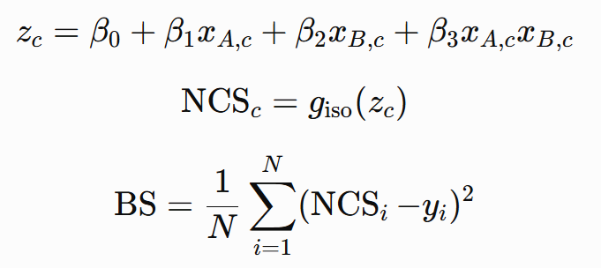
Novelty and Concern Score
σ
Fusion, Final Calibration & Reliability
Logistic regression combines aligned contig-level evidence and its interaction into a scalar fusion score z_c
The logistic output is treated as a fusion score—not automatically as a calibrated probability
Isotonic regression fitted on an independent calibration set maps z_c to the final NCS (Novelty and Concern Score) probability.
Reliability diagram: predicted-probability bins vs. observed positive rates on independent test data
The Brier score measures mean squared probabilistic error—lower is better
Fusion → Calibration → Diagnostics
BS (Brier score): The Brier score is an error metric used to evaluate the accuracy of probability predictions. A lower score indicates better performance.
Fit fusion, calibration, and final reliability evaluation on separate data splits (or by nested cross-fitting) to avoid optimistic probabilities.
11
Notes:
[Sources] - Breunig et al. LOF: Identifying Density-Based Local Outliers. SIGMOD, 2000. - Barlow et al. Statistical Inference under Order Restrictions. Wiley, 1972. - scikit-learn documentation: LogisticRegression, IsotonicRegression, calibration curves, and Brier score. [/Sources]

Slide 12
Leakage-Safe Benchmark Design
⊘
Held-Out Lineages & Honest Difficulty
In-silico spike-ins flatter any method whose reference DB still contains the spiked genome's relatives
Leave-one-clade-out: remove the entire clade of the spiked genome from every reference, sketch, and training set
Difficulty is indexed by distance to the nearest retained neighbour, not by a binary novel/known label
Time-split: fit and calibrate only on sequences deposited before date T, evaluate strictly on those after
Backgrounds are real wastewater (CASPER, NWSS, Tisza 2023, Wolfe 2026) — not simulated communities
Leakage Control & Difficulty Strata
D_train(T) = { x : deposit(x) < T }
clade(g) ∩ D_train = ∅
δ(g) = ANI( g, NN(g, D_train) )
strata: δ ≥ 90 | 80–90 | 70–80 | < 70
Performance is reported per stratum, never pooled. Pooling hides the only regime that matters: a method can look excellent on average while failing completely at δ < 80%, which is exactly where a genuinely novel agent sits.
12
Notes:
[Sources]
- Benchmark backgrounds: CASPER PRJNA1247874; NWSS PRJNA747181; Tisza et al. 2023 PRJNA966185; Wolfe et al. 2026 PRJNA1438722.
- Leave-one-clade-out and time-split protocols follow the leakage-control conventions used in CAMI benchmarking.
- Sczyrba et al. Critical Assessment of Metagenome Interpretation (CAMI). Nature Methods 14:1063-1071, 2017.
[/Sources]

Slide 13
Validation & Evaluation
✓
AUPRC, False-Alert Burden & Reliability
Positives are a vanishing fraction of contigs, so ROC-AUC is misleadingly optimistic; AUPRC is the honest summary
The operational quantity is not a rate but a workload — how many candidates per week must a human actually read?
The threshold τ is derived from an analyst budget B, not from a default 0.5 cutoff
Ranking and calibration are evaluated separately: a well-ranked score can still be badly calibrated
The Brier score decomposes into reliability, resolution, and uncertainty — we report the decomposition, not just the total
Operating Point & Reliability
AUPRC = ∫ Precision d(Recall)
N_alert(τ) = n · P( NCS > τ )
τ* = min { τ : N_alert(τ) ≤ B }
BS = reliability − resolution + uncertainty
Reporting AUPRC without the analyst workload implied at the chosen threshold makes a method look deployable when it is not. τ* ties the statistical operating point directly to the staffing constraint the programme actually faces.
13
Notes:
[Sources]
- Saito, T. & Rehmsmeier, M. The precision-recall plot is more informative than the ROC plot when evaluating binary classifiers on imbalanced datasets. PLoS ONE 10(3):e0118432, 2015.
- Brier, G.W. Verification of forecasts expressed in terms of probability. Monthly Weather Review 78(1):1-3, 1950.
- Murphy, A.H. A new vector partition of the probability score. J Applied Meteorology 12(4):595-600, 1973.
- Niculescu-Mizil, A. & Caruana, R. Predicting good probabilities with supervised learning. ICML 2005.
[/Sources]

Slide 14

Summary
How Dual-Channel Evidence Becomes a Trusted Alert
Set Similarity
Embedding Geometry
Probabilistic Calibration
Reliability Evaluation
Trusted Alert
→
→
→
→
k-mer / FracMinHash
ESM-2 + density outlier detection
Logistic fusion → isotonic → NCS
Computing BS (Brier score)
Every step produces an interpretable, auditable intermediate quantity — not a black-box score
Logistic fusion combines aligned contig-level evidence; isotonic regression calibrates the final NCS probability
Held-out-lineage and time-split benchmarks test whether the method generalizes to genuinely unseen viruses
The evidence-verified dossier converts a high NCS candidate into a reviewable, operational early-warning signal
14

