Slide 1
Pathogen-Agnostic Biosurveillance
Technical Area three(TA3):
Modeling pathogen-agnostic biosurveillance system features such as cost, sensitivity, and optimal deployment
Proposal 2: DPD (Days per Dollar)-MGS Change-Point Detection
Core Mathematical Principles
We watch thousands of microbial signals in wastewater week by week, looking for the one that has started to double — and we flag it early, with false alarms kept rare.
Thousands of sequence clusters · one beginning to grow
Sihua Peng, 07/31/2026
Notes:
Opening: reframe detection as a sequential change-point problem rather than a per-sample classification problem. The whole talk revolves around one question — what counts as having ‘begun to rise.’

Slide 2
The Whole Idea in 60 Seconds
2
Watch
Each week we sequence wastewater and sort every read into one of ~5,000 groups. We never ask what a group is — we only track how much of it shows up, week after week.
thousands of curves
Wait
Nothing in a healthy microbiome doubles steadily for weeks on end. A spreading outbreak does. So the signal is a curve that starts doubling — whatever organism it turns out to be.
for one to take off
Warn
The rest of this deck is one question made precise: how much rise is enough to call it? We alarm as early as we can while holding false alarms to about one per site per year.
early, and rarely wrong
Everything after this slide is that same idea, made rigorous enough to put a guaranteed number on the false-alarm rate.

Slide 3
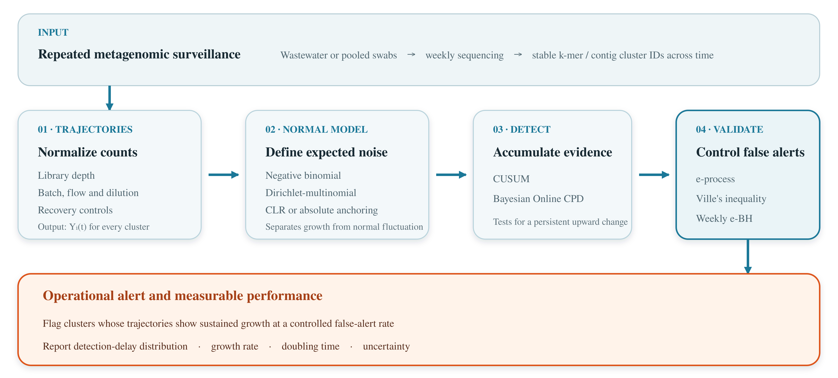
3
Aim 1 Anytime-Valid Sequential Detection on MGS Time Series
2 / 13
Notes:
The core shift: what's being detected is not identity but dynamics. r_i > 0 is the entire definition of signal.

Slide 4
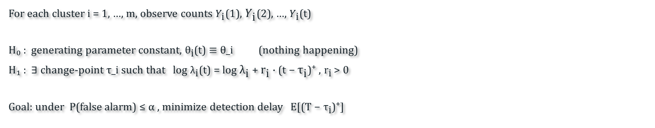
4
A Different Question: Not “What Is It?” but “Is It Taking Off?”
Instead of naming the organism, we watch whether its curve has changed
The Usual Way: Score Each Sample on Its Own
Our Way: Watch Every Curve’s Trend, All at Once
Feed in one sample, get back a score for “does this contain pathogen X?”
Each sample is judged alone — last week’s result is never used
Graded by AUC, which has no time axis and needs known answers to train on
Each cluster is a curve: how much of it we see, week after week
One question only: did this curve turn upward and keep climbing?
Asked of 1,000–10,000 curves at the same time, every single week
The Same Idea, Written Formally (skip if you like)
For each cluster i = 1, …, m, observe counts $Y_{\text{i}}$(1), $Y_{\text{i}}$(2), …, $Y_{\text{i}}$(t)
H₀ : generating parameter constant, ${\text{θ}}_{\text{i}}$(t) ≡ θ_i (nothing happening)
H₁ : ∃ change-point τ_i such that log ${\text{λ}}_{\text{i}}$(t) = log ${\text{λ}}_{\text{i}}$ + ${\text{r}}_{\text{i}}$ · (t − ${\text{τ}}_{\text{i}}$)⁺ , ${\text{r}}_{\text{i}}$ > 0
Goal: under P(false alarm) ≤ α , minimize detection delay E[(T − ${\text{τ}}_{\text{i}}$)⁺]
3 / 13
Notes:
The core shift: what's being detected is not identity but dynamics. r_i > 0 is the entire definition of signal.

Slide 5
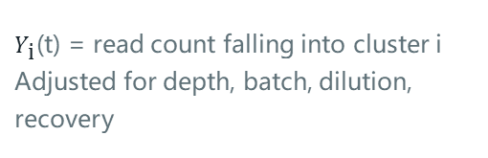
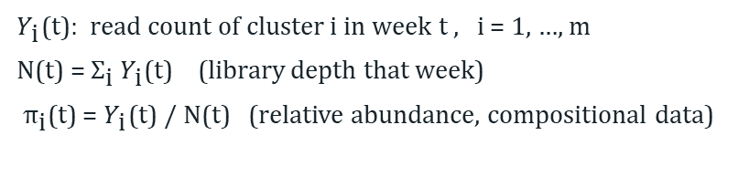
5
Step One: Turning Sewage Into Thousands of Curves
Nothing is ever matched against a pathogen database — that is what makes it pathogen-agnostic
01
02
03
Weekly Sequencing
Group the Reads
Count and Normalize
→
→
Wastewater sampling → metagenomic sequencing
About 10 million reads per run
Similar sequences get binned together (k-mer or contig based)
Each group gets an ID — no need to know what it is
$Y_{\text{i}}$(t) = read count falling into cluster i
Corrected for run depth, batch, dilution, recovery
What We Actually Measure
The One Thing That Must Hold
$Y_{\text{i}}$(t): read count of cluster i in week t , i = 1, …, m
N(t) = ${\text{Σ}}_{\text{i}} Y_{\text{i}}$(t) (library depth that week)
${\text{π}}_{\text{i}}$(t) = $Y_{\text{i}}$(t) / N(t) (relative abundance, compositional data)
Cluster IDs must be stable across time:
This week's #4417 and next week's #4417
must be the same biological entity.
Otherwise the “time series” simply doesn't exist.
4 / 13
Notes:
Cluster stability is the most underrated operational risk: reference-database updates and reassembly both cause cluster drift. Needs a fixed-clustering + anchoring strategy, plus a cold-start plan for new clusters.

Slide 6
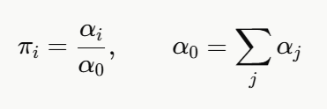



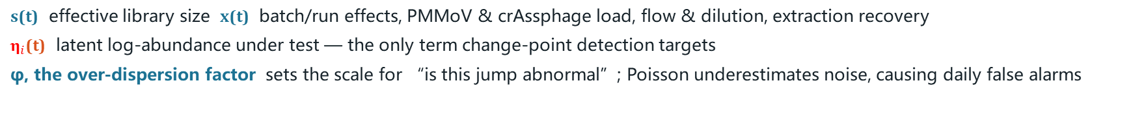

6
What Counts as Normal Week-to-Week Wobble
Before you can spot a real rise, you have to know how much noise is ordinary
One cluster at a time: counts wobble more than pure chance would give
All clusters together: they share one fixed sequencing budget
${\text{Y}}_{i}$(t) ~ NB(${\text{μ}}_{i}$(t), ${\text{φ}}_{i}$ )
E[Y] = μ , Var[Y] = μ + μ² / φ
(Y₁, …, ${\text{Y}}_{m}$)(t) ~ DM( N(t), α(t) )
What Each Symbol Is Soaking Up
s(t) effective library size x(t) batch/run effects, PMMoV & crAssphage load, flow & dilution, extraction recovery
${\text{η}}_{i}$(t) latent log-abundance under test — the only term change-point detection targets
φ, the over-dispersion factor sets how big a jump must be before it counts as abnormal; assuming pure Poisson noise underestimates the wobble and produces daily false alarms
5 / 13
Notes:
On a trajectory, a batch effect looks identical to an outbreak's onset — the number-one source of false alarms in real-world surveillance.

Slide 7
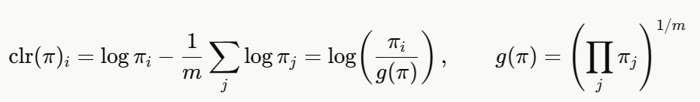
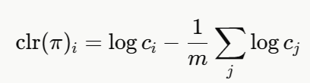
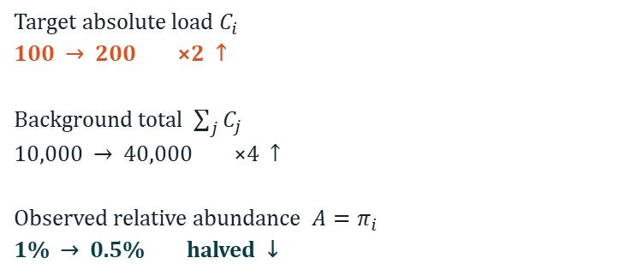
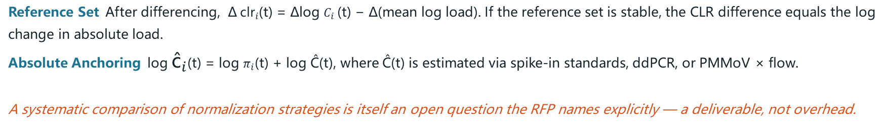
7
The Percentage Trap: A Share Can Fall While the Amount Rises
Sequencing reports shares of a fixed total, not absolute amounts
A Worked Example: the Target Doubles, Its Share Halves
The Fix: Compare Against the Average, Not the Total (CLR)
Target absolute load $C_{i}$
100 → 200 ×2 ↑
Background total $\sum_{j}{C_{j}}$
10,000 → 40,000 ×4 ↑
Observed relative abundance $A=π_{i}$
1% → 0.5% halved ↓
Scale invariance:
Two Practical Ways Out
Reference Set After differencing, Δ ${\text{clr}}_{i}$(t) = Δlog $C_{i}$(t) − Δ(mean log load). If the reference set is stable, the CLR difference equals the log change in absolute load.
Absolute Anchoring log ${\text{ĉ}}_{i}$(t) = log $π_{i}$(t) + log Ĉ(t), where Ĉ(t) is estimated via spike-in standards, ddPCR, or PMMoV × flow.
Which normalization works best is itself an open question the RFP names explicitly — so it is a deliverable, not overhead.
6 / 13
Notes:
Ignoring compositionality creates both false alarms and false reassurance. The latter is more dangerous — a missed detection doesn't announce itself.

Slide 8

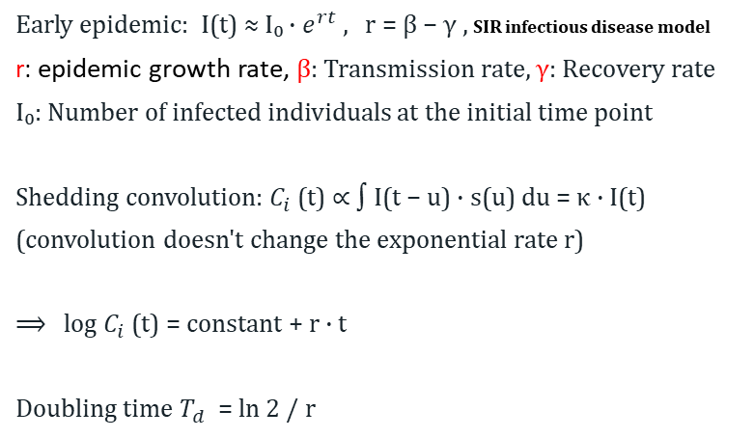
8
What an Outbreak Looks Like: Steady Doubling
We detect a behavior, not an identity
Why Real Growth Has to Be Exponential
On a log scale, the moment of change is a flat line tilting upward
Early epidemic: I(t) ≈ I₀ · $e^{rt}$ , r = β − γ , SIR infectious disease model
r: epidemic growth rate, β: Transmission rate, γ: Recovery rate
I₀: Number of infected individuals at the initial time point
Shedding convolution: $C_{i}$(t) ∝ ∫ I(t − u) · s(u) du = κ · I(t)
(convolution doesn't change the exponential rate r)
⟹ log $C_{i}$(t) = constant + r · t
Doubling time $T_{d}$ = ln 2 / r
What actually doubles steadily for weeks on end?
Microbiome noise — wobbles around baseline, no. Seasonality — rises and falls periodically, no. A single contamination event — jumps once and plateaus, no.
A spreading outbreak — yes. And almost nothing else does. That's why the detector doesn't need to know what it's looking at.
7 / 13
Notes:
Two reasons for taking logs: exponential growth becomes a line whose slope is the growth rate, and it stabilizes the variance.

Slide 9

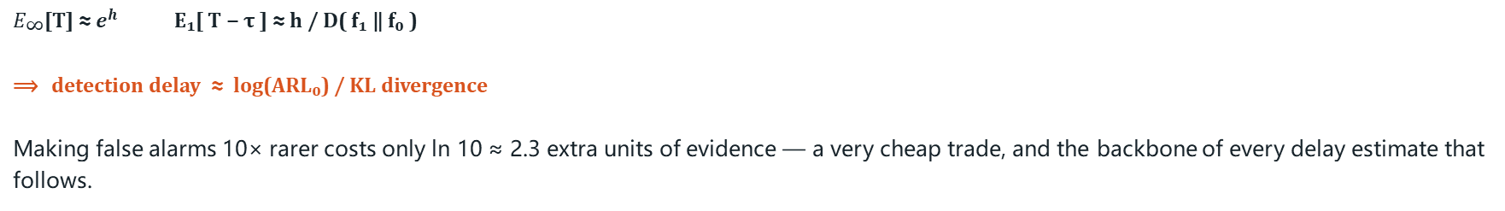

9
Detector I: CUSUM — a Running Tally of Evidence
Add up each week’s evidence; sound the alarm once the pile gets tall enough
Page’s Running Tally (1954)
Why Nothing Can Beat It (Lorden)
$S_{i}$(0) = 0
$S_{i}$(t) = max { 0 , $S_{i}$(t−1) + $Λ_{\text{i}}$(t) }
$Λ_{\text{i}}$(t) = log [ f₁($y_{i}$(t) ) / f₀($y_{i}$(t) ) ]
Alarm time T = inf { t : $S_{i}$(t) ≥ h }
Under the constraint $E_{\text{∞}}$[T] ≥ γ
minimize
$\sup_{\text{τ}}$ ess sup E[ (T − τ)⁺ | $F_{\text{τ}}$ ]
No detector can do better; CUSUM reaches this limit
The Key Trade-off: Far Fewer False Alarms Costs Very Little Delay
$E_{\text{∞}}$[T] ≈ $e^{h}$ E₁[ T − τ ] ≈ h / D( f₁ ‖ f₀ )
⟹ detection delay ≈ log(ARL₀) / KL divergence
Making false alarms 10× rarer costs only ln 10 ≈ 2.3 extra units of evidence — a very cheap trade, and the backbone of every delay estimate that follows.
8 / 13
Notes:
D(f1||f0) is exactly ‘how much evidence accumulates per observation.’ Stronger signal and lower noise mean larger KL divergence and shorter delay.

Slide 10
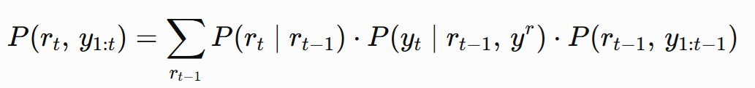
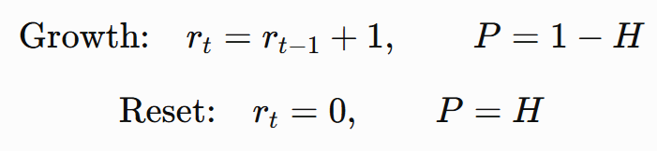

10
Detector II: BOCPD — When the Jump Size Is Unknown
The flexible option when you cannot say in advance how big the rise will be — and it also estimates when the rise began
Tracking “How Long Since the Last Change” (Adams & MacKay, 2007)
How the Two Detectors Split the Work
Run length $r_{\text{t}}$ ∈ { 0, 1, 2, … } : steps since the last change-point
Hazard rate H(r) = 1 / λ (geometric prior)
CUSUM
You must tell it how big a jump to look for. Once set, it is cheap, stable, and hard to beat.
BOCPD
Weighs all jump sizes at once, so nothing needs presetting — and it estimates when the change started.
Both update in constant time as each new week arrives.
The Detector Has Exactly One Job
Each week a detector outputs one number: how surprising this week looks if nothing had changed. That number alone is not yet a valid alarm — we look every week, across thousands of curves. Next slide.
9 / 13
Notes:
Emphasize the layering: the detector extracts signal; the next layer guarantees validity. The two combine freely.

Slide 11
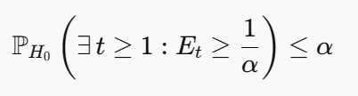
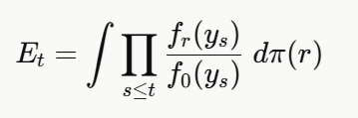
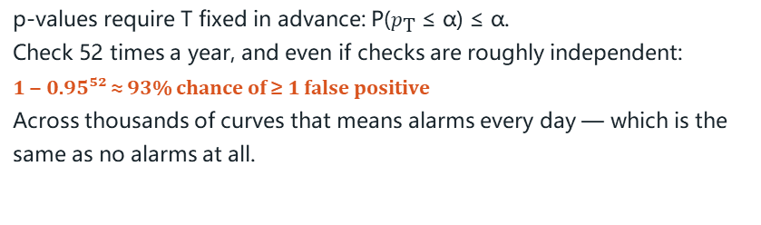
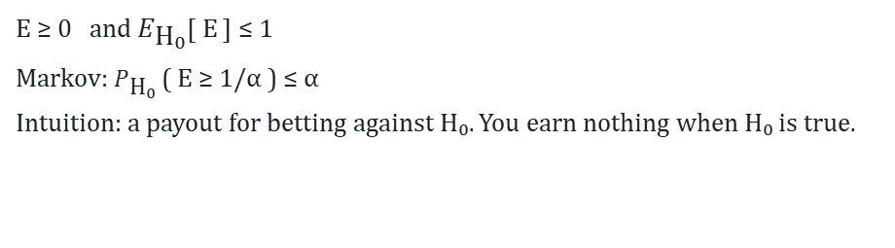
11
Why Looking Every Week Does Not Break the Statistics
The load-bearing piece: evidence you are allowed to check as often as you like
The Problem: Checking Again and Again Breaks p-Values
The e-Value: Definition and Intuition
p-values require T fixed in advance: P($p_{\text{T}}$ ≤ α) ≤ α.
Check 52 times a year, and even if checks are roughly independent:
1 − 0.95⁵² ≈ 93% chance of ≥ 1 false positive
Across thousands of curves that means alarms every day — which is the same as no alarms at all.
E ≥ 0 and $E_{\text{H}\text{₀}}$[ E ] ≤ 1
Markov: $P_{\text{H}\text{₀}}$( E ≥ 1/α ) ≤ α
Think of it as a bet against “nothing is happening.” If nothing is happening you cannot make money on average — so a large payout is real evidence.
Making It Sequential: Winnings Can Never Drift Upward on Luck Alone
Ville's inequality:
This holds at every week at once — you may look, or stop, whenever you like, even because the data looks promising. The guarantee survives.
When the growth rate is not known in advance, average over a range of rates:
10 / 13
Notes:
The cost: anytime validity is insurance, and the premium is power. Versus a fixed-sample-size test, the equivalent sample size grows by roughly 1.5–2× (from the √(2 log log t) term in the law of the iterated logarithm). We report this cost honestly.

Slide 12
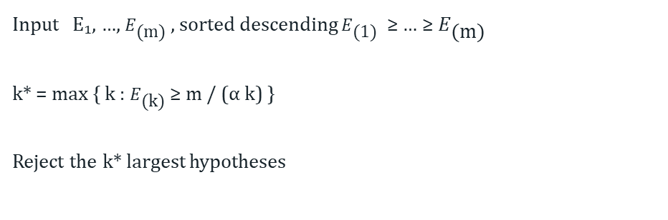
12
Watching Thousands of Curves: How High to Set the Bar
With 5,000 curves under watch, some will look unusual by pure chance
The e-BH Procedure (Wang & Ramdas, 2022)
Why It Works Here
Input E₁, …, $E_{\text{(}\text{m}\text{)}}$ , sorted descending $E_{\text{(}\text{1}\text{)}}$ ≥ … ≥ $E_{\text{(}\text{m}\text{)}}$
k* = max { k : $E_{\text{(}\text{k}\text{)}}$≥ m / (α k) }
Reject the k* largest hypotheses
Under arbitrary dependence, FDR ≤ α
It needs no assumption about how the curves are correlated. That matters here: shares of a fixed total are automatically negatively correlated, and organisms rise and fall together.
How High the Bar Actually Goes (5,000 curves, 5% error rate)
Single hypothesis
Flagging just 1
Flagging 10
E ≥ 20
E ≥ 10⁵
E ≥ 10⁴
1/α
m / α
m / (10α)
Put together: one evidence score per curve (valid at any week) → e-BH across curves each week ⟹ the error rate holds whenever you stop.
11 / 13
Notes:
A single hypothesis needs only 20; with multiplicity it takes 100,000 — that span is the cost of multiplicity, and it becomes extra detection delay. The next slide shows the cost is actually small.

Slide 13
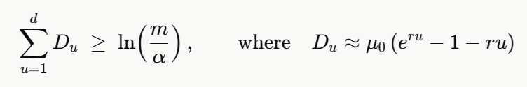
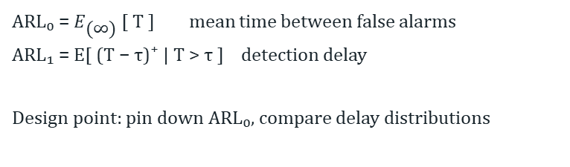
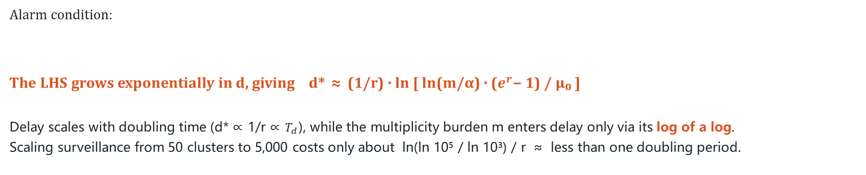
13
The Metric That Matters: How Many Days Until We Catch It
Not AUC — AUC has no time axis, and no operator can act on it
The Two Numbers That Define Performance
The One Sentence an Operator Actually Needs
ARL₀ = $E_{\text{(}\text{∞}\text{)}}$[ T ] mean time between false alarms
ARL₁ = E[ (T − τ)⁺ | T > τ ] detection delay
How we design: fix the false-alarm rate, then compare detection delays
At one false alarm per site per year, for a signal with a 3.5-day doubling time: median detection delay X days, 90th percentile Y days.
AUC cannot be stated this way.
Why Watching 5,000 Curves Costs Almost No Extra Delay
Alarm condition:
The LHS grows exponentially in d, giving d* ≈ (1/r) · ln [ ln(m/α) · ($e^{r}$− 1) / μ₀ ]
Delay scales with doubling time (d* ∝ 1/r ∝ $T_{d}$), while the multiplicity burden m enters delay only via its log of a log.
Going from 50 curves under watch to 5,000 costs less than a single doubling period of extra delay.
12 / 13
Notes:
This is the mathematical basis for the whole proposal's scalability, and the point reviewers will most likely probe — recommend giving concrete X and Y values from real data in the EOI.

Slide 14
Three Layers, One Closing Sentence
14
What’s Normal
Count models plus batch, flow and PMMoV corrections and CLR log-ratios — together they say how much week-to-week wobble is ordinary
Observation model
What’s Enough
CUSUM and BOCPD pile up the evidence; e-processes make it legitimate to look every week; e-BH keeps false discoveries in check across thousands of curves
Sequential testing
How Fast
Days of detection delay at a fixed false-alarm rate, plus growth rate and doubling time with intervals that stay valid at any time
Primary metric
The whole principle: among thousands of curves, find the one that has started to double — everything else is math answering “how much rise is enough to call it.”
Notes:
Closing: the observation model defines normal, sequential testing defines enough, and the metric measures how fast.

