Slide 1
BLUEPRINT BIOSECURITY · PATHOGEN-AGNOSTIC BIOTHREAT DETECTION RFP
Proposal 1: NOVA-MGS
Mathematical Foundations of Metagenomic Pathogen Detection
Reference-free novelty scoring, probabilistic calibration, and evidence verification
Sihua Peng, 07/27/2026
1

Slide 2
Agenda
Σ
From k-mers to Calibrated Probabilities
01
Set-Similarity Theory
k-mers, MinHash, and FracMinHash sketching
02
Embedding-Space Geometry
Protein language model embeddings & density-based outlier detection
03
Probabilistic Calibration
NCS fusion and Isotonic regression
04
Leakage-Safe Benchmark Design
Held-out lineages, taxonomic distance, and realistic backgrounds
05
Validation & Evaluation
AUPRC, false-alert burden, and probability reliability
2

Slide 3
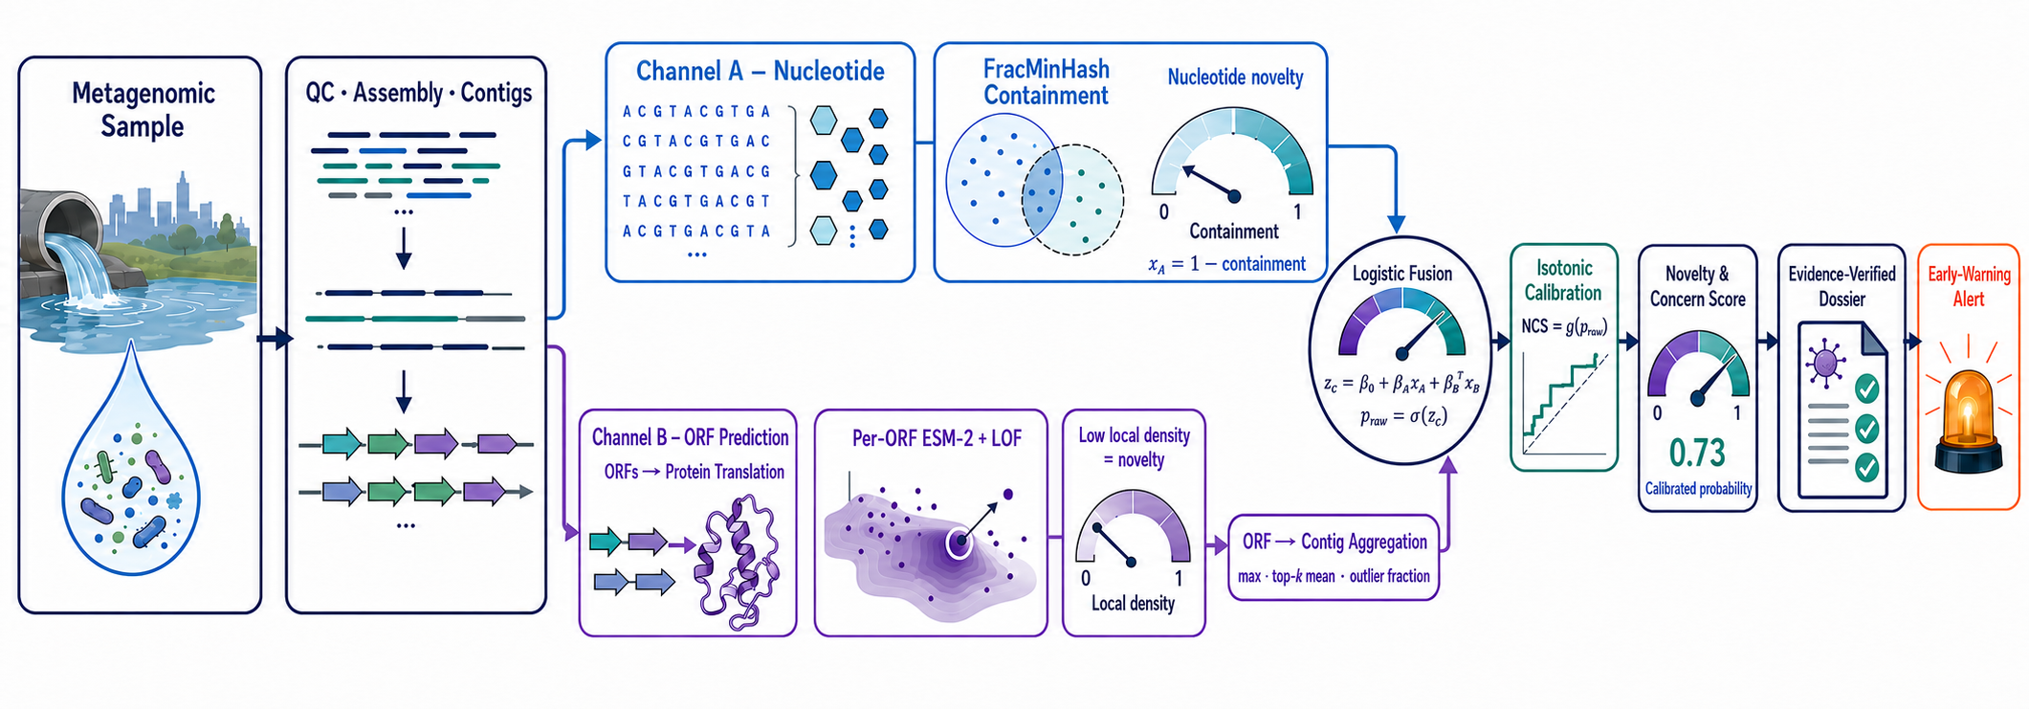
Dual-Channel Scoring, Calibration & Evidence Verification
3

Slide 4
Background
?
Why Detection Needs Reference-Free Math
Kraken2/Bracken, GOTTCHA2, and Centrifuge all rely on reference matching
A genuinely novel or highly divergent pathogen has, by construction, no reference to match
The result isn't misclassification — it's discarded into the unclassified fraction
In real wastewater metagenomes, that unclassified fraction routinely runs 60%–90%
Lower stringency → candidate surge → analyst review becomes the new bottleneck
A Formal Statement of the Problem
reads(sample) = reads(in known DB) + reads(out-of-DB)
P(detect | s) depends on sim(s, D)
As sim(s, D) → 0, detection rate → 0
NOVA-MGS's goal: turn the “similarity → 0” regime into a continuous, calibrated novelty probability — not a discarded read.
4

Slide 5
System Overview
⇄
Dual-Channel Scoring & Evidence Verification
Channel A · Nucleotide
Channel B · Protein
Fusion & Calibration
Evidence Verification
FracMinHash / sourmash
containment estimation
→
ESM-2 embedding +
density-based outlier detection
→
Logistic Fusion → Isotonic regression → NCS (Novelty & Concern Score)
→
Read support + coverage checks →
evidence-verified dossier
The Mathematical Objects This Talk Covers
x_A = 1−containment; x_B = aggregated ORF evidence → z_c = β₀+β_Ax_A+β_Bᵀx_B → NCS_c = g_iso(σ(z_c))
5

Slide 6
Set-Similarity Theory
Σ
k-mer Sets & MinHash Sketching
Split a sequence of length L into every length-k substring (k-mer)
A hash function can be understood as a "digital fingerprint generator": it converts data of arbitrary length into an integer of fixed length.
A hash function h maps each k-mer to a near-uniform integer in [0, H)
Bottom-sketch MinHash keeps only the m smallest hash values as a “fingerprint”
The intersection-over-union of two fingerprints unbiasedly estimates Jaccard similarity
Benefit: no alignment needed — comparison cost is independent of sequence length
DNA sequence → k-mer set → hash value set → retain the m smallest values
Definitions & Estimator
K(A) = { A[i..i+k) : i = 1..L−k+1 }
h : Σᵏ → [0, H)
S(A) = bottom-m { h(κ) : κ ∈ K(A) }
Ĵ(A,B) = |S(A)∩S(B)| / |S(A)∪S(B)|
Ĵ(A,B) is an unbiased estimator of the true Jaccard similarity J(A,B) = |K(A)∩K(B)| / |K(A)∪K(B)|; its variance shrinks as |S| grows.
An example：
H(A)={82,15,47,31,66,24}
Sorting：15, 24, 31, 47, 66, 82
S(A) = bottom-1(H(A))={15}
S(A) = bottom-2(H(A))={15,24}
S(A) = bottom-3(H(A))={15,24,31}
6

Slide 7
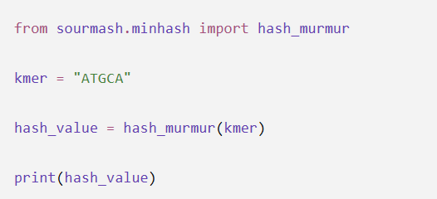
FracMinHash & Containment
∩
sourmash's Scaled Sketching Strategy
Fixed-size MinHash distorts comparisons between very differently sized sequences
FracMinHash instead keeps every hash below a threshold H/s (“scaled sketching”)
The scale factor s (e.g., 1000) is fixed, so sketch size scales naturally with length
Containment fits “novelty” better than Jaccard:
It measures how much of a query's k-mer content the known viral DB explains
Scaled Sketching & Containment Estimator
S(A) = { h(κ) : h(κ) < H/s }
Ĉ(A,B) = |S(A)∩S(B)| / |S(A)|
≈ C(A,B) = |K(A)∩K(B)| / |K(A)|
Var[Ĉ] ≈ C(1−C) / |S(A)|
Low Ĉ(query, known viral DB) → high nucleotide-level novelty; the variance formula grounds confidence intervals and alert thresholds.
7

Slide 8
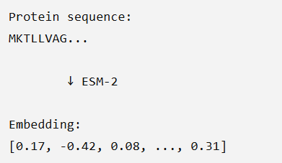
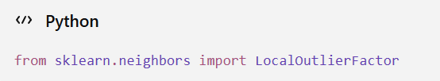
Embedding-Space Geometry
ℝ
Protein Embeddings & Outlier Detection
Six-frame ORF prediction → encode each ORF with a protein language model (ESM-2)
Nucleotide sequence can diverge past recognition, yet capsid/polymerase fold may not
We estimate local density on the known-viral protein manifold, not a classifier boundary
Candidates in low-density regions signal structural / functional novelty
Complements Channel A's blind spot: what nucleotides can't see, structure can
Local Density & Outlier Score
ORF → e ∈ R^d (d ≈ 1280)
ρ_k(e) = k / ( n · V_k(e) )
# Local density near point e.
LOF_k(e) = ( Σ lrd_k(o)/lrd_k(e) ) / k # o∈N_k(e)
V_k(e)：The volume of the high-dimensional region centered at e that just encompasses the k-th nearest neighbor;
e: embedding vector of the protein to be detected;
n: known total number of viral proteins;
k: the number of nearest neighbors selected, e.g., 20;
lrd_k(o): The local reachable density of neighbor o.
lrd_k(e): local reachable density of e;
Higher LOF(e) means e sits in a sparser neighborhood than its peers — the candidate protein fold is more “isolated” within known viral space.
8

Slide 9
Probabilistic Calibration
Isotonic Regression
Core idea Learn a flexible score-to-probability map while preserving order.
Input: scalar model or fusion scores
Ground truth: binary labels from calibration data
Calibration data: (score, label) (1,0), (2,0), (3,1), (4,0), (5,1), (6,1) Monotonic constraint: sᵢ ≤ sⱼ ⇒ g(sᵢ) ≤ g(sⱼ) PAVA pools the violation 1 → 0: 0, 0, 1, 0, 1, 1 → 0, 0, 0.5, 0.5, 1, 1
↗
Fit: best non-decreasing step function g
↗
Algorithm: Pool-Adjacent-Violators (PAVA)
Output: empirical P(Y = 1 | score)
9
Notes:
[Sources]
- Barlow, Bartholomew, Bremner & Brunk. Statistical Inference under Order Restrictions. Wiley, 1972.
- scikit-learn documentation: IsotonicRegression.
[/Sources]

Slide 10
Probabilistic Calibration
↗
Aligning Channel A and B Before Fusion
Level Alignment Before Fusion
Channel A scores contigs, whereas Channel B initially scores individual ORFs.
Aggregate Channel B ORF evidence within each contig using prespecified features such as the maximum, top-q mean, and high-score proportion.
Pair the Channel A score and aggregated Channel B evidence with the same contig-level Aim 3 label.
These aligned features—not separately calibrated probabilities—enter the fusion model.
Output: one aligned evidence vector for each contig.
Contig-Level Feature Construction
x_A(c) = Channel A contig score
x_B(c) = Aggregate{ LOF(o) : o ∈ O(c) }
X_c = [ x_A(c), x_B(c), length, ORF count ]
Target: y_c = predefined contig-level truth
Level alignment prevents ORF-level and contig-level quantities from being pooled as if they were the same statistical unit.
10
Notes:
[Sources] - Breunig et al. LOF: Identifying Density-Based Local Outliers. SIGMOD, 2000. - Barlow et al. Statistical Inference under Order Restrictions. Wiley, 1972. - scikit-learn documentation: LogisticRegression, IsotonicRegression, calibration curves, and Brier score. [/Sources]

Slide 11
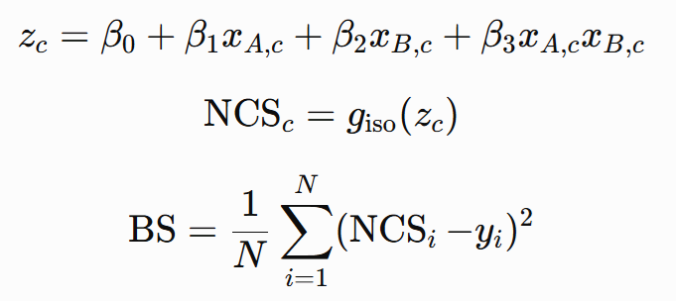
σ
Novelty and Concern Score
Fusion, Final Calibration & Reliability
Logistic regression combines aligned contig-level evidence and its interaction into a scalar fusion score z_c
The logistic output is treated as a fusion score—not automatically as a calibrated probability
Isotonic regression fitted on an independent calibration set maps z_c to the final NCS (Novelty and Concern Score) probability.
Reliability diagram: predicted-probability bins vs. observed positive rates on independent test data
The Brier score measures mean squared probabilistic error—lower is better
Fusion → Calibration → Diagnostics
BS (Brier score): The Brier score is an error metric used to evaluate the accuracy of probability predictions. A lower score indicates better performance.
Fit fusion, calibration, and final reliability evaluation on separate data splits (or by nested cross-fitting) to avoid optimistic probabilities.
11
Notes:
[Sources] - Breunig et al. LOF: Identifying Density-Based Local Outliers. SIGMOD, 2000. - Barlow et al. Statistical Inference under Order Restrictions. Wiley, 1972. - scikit-learn documentation: LogisticRegression, IsotonicRegression, calibration curves, and Brier score. [/Sources]

Slide 12

Summary
How Dual-Channel Evidence Becomes a Trusted Alert
Set Similarity
Embedding Geometry
Probabilistic Calibration
reliability evaluation
Trusted Alert
→
→
→
→
k-mer / FracMinHash
ESM-2 + density outlier detection
Logistic fusion → isotonic → NCS
Computing BS (Brier score)
Every step produces an interpretable, auditable intermediate quantity — not a black-box score
Logistic fusion combines aligned contig-level evidence; isotonic regression calibrates the final NCS probability
Held-out-lineage and time-split benchmarks test whether the method generalizes to genuinely unseen viruses
The evidence-verified dossier converts a high NCS candidate into a reviewable, operational early-warning signal
17

