Slide 1


Unsupervised fine-tuning model of influenza virus A protein based on ESM-2 protein language model
Sihua Peng
04/21/2025

Slide 2
Fine-tune ESM-2 protein language model
I fine-tuned the ESM-2 protein language model using influenza A virus protein sequence data from the NCBI Virus Database.
The original downloaded dataset contains 1,737,586 protein sequences (11 types of influenza A proteins from different species).
A total of 388,385 sequences were obtained after removing duplicates and those with 100% identity.

Slide 3
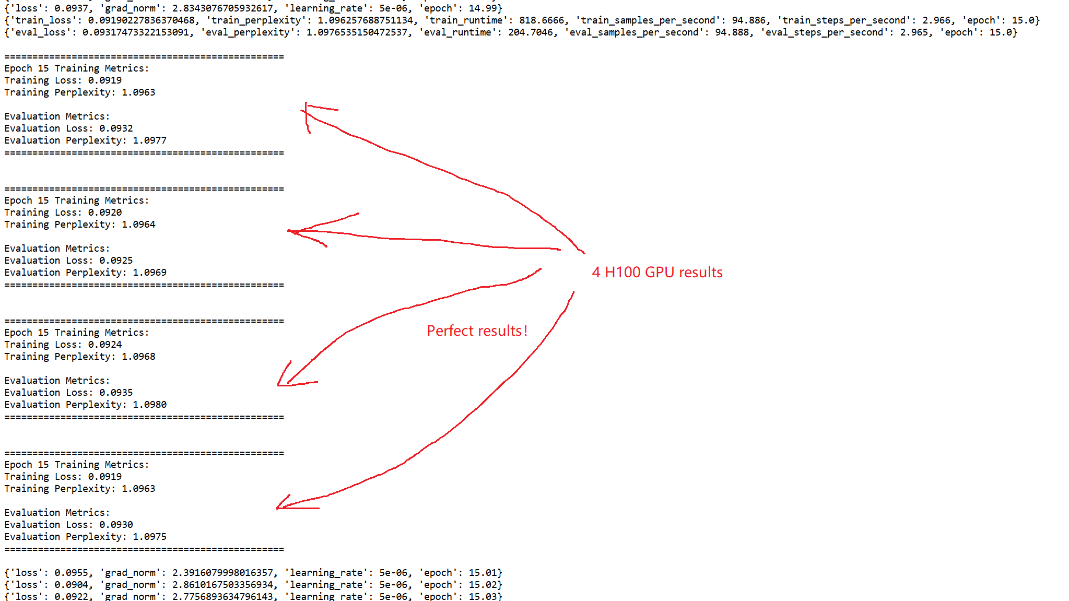
Model training

Slide 4
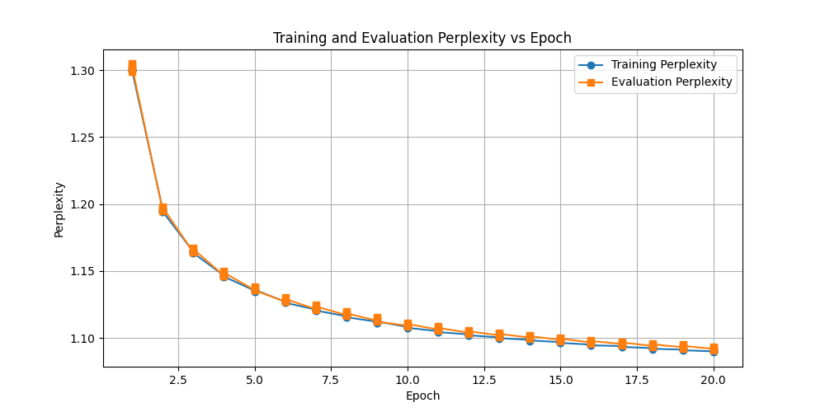
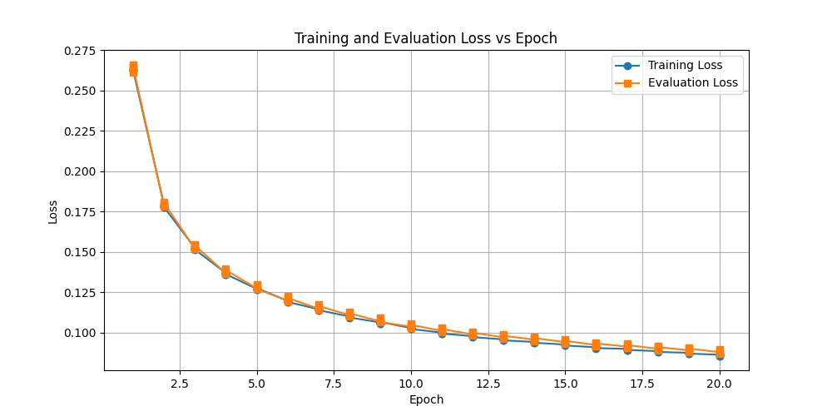
Results for 20 Epochs
Training Metrics:
Training Loss: 0.0856
Training Perplexity: 1.0894
Evaluation Metrics:
Evaluation Loss: 0.0888
Evaluation Perplexity: 1.0929

Slide 5
Conclusion
Unsupervised fine-tuning of the ESM-2 model appears to be highly successful.
Perplexity measures how well the model predicts the next token in a sequence (lower is better). A perplexity close to 1 means the model is highly confident in its predictions.
Both training and evaluation perplexity are very close to 1, which is excellent for a language model. This indicates the model has learned meaningful representations of protein sequences.
The small difference between training and evaluation perplexity (1.0929 - 1.0894 = 0.0035) further confirms minimal overfitting.

Slide 6
One of the downstream studies
HPAI H5N1 Cross-species comparison and generalization research
Aim: Study the conservation and variability of influenza virus A proteins in different hosts (e.g., humans and poultry).
Method: Use ESM-2 embedding to compare H5N1 protein sequences from different species and analyze evolutionary pressure and functional differences.
Application: Study the mechanism of cross-species transmission of viruses and predict potential animal-borne influenza epidemics.

Slide 7
Thanks!

