Slide 1
Machine Learning based Heart Blood Vessel Pressure Prediction from 3D CT Image Using a Graph-Like Model
Peng Sun
Guanglei Xiong

Slide 2
Heart Blood Vessel Disease: Health Killer
Heart blood vessel disease (Coronary Artery Disease, CAD) is the leading cause of death globally
USA has the no. 1 CAD patient population
320K people die of this disease annually
China has the no. 2 CAD patient population
10M patients in 2011
1M increase annually after 2011

Slide 3
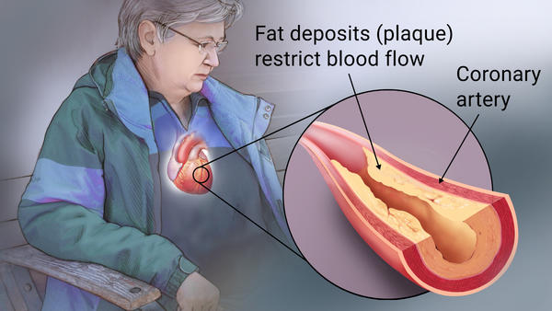
The Cause: Blood Vessel Narrowness
Blood vessel gets narrowed due to fat deposits
Restrict/Block the blood flow
May need surgery (stent, bypassing)

Slide 4

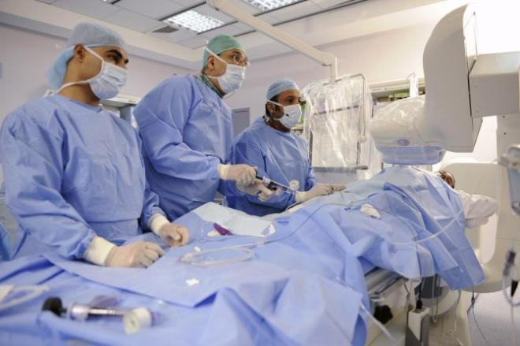
Quantitative Metric
Cautious when making the diagnosis
Need a quantitative metric in clinical practice, so that
  > threshold: healthy (go home and observe)
  < threshold: unhealthy (surgery)

Slide 5
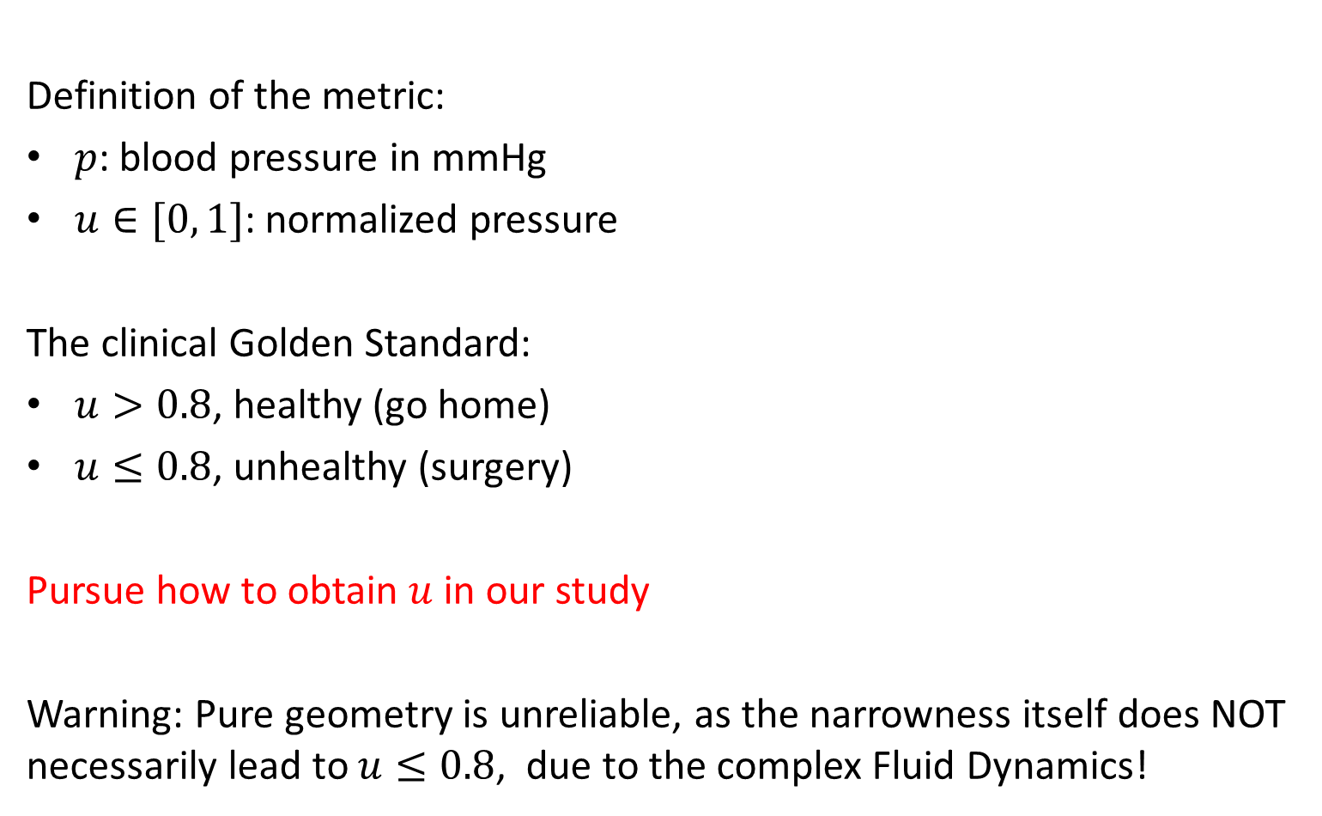

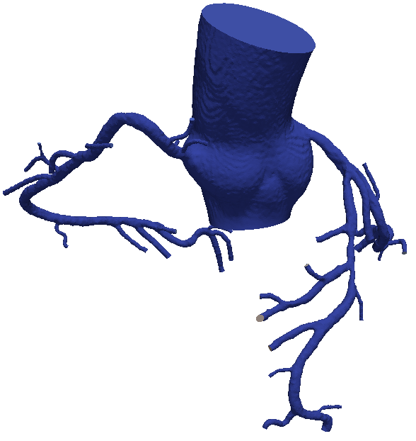
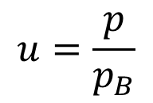

Quantitative Metric (Cont. 1)
Definition of the metric:
: blood pressure in mmHg
: normalized pressure
The clinical Golden Standard:
, healthy (go home)
, unhealthy (surgery)
Pursue how to obtain in our study
Warning: Pure geometry is unreliable, as the narrowness itself does NOT necessarily lead to , due to the complex Fluid Dynamics!

Slide 6
Outline
Technology Evolution
Review of Previous Machine Learning Approaches
  A Graph-like Model: Motivation and Overview
  A Graph-like Model: Inference and Parameter Learning
Empirical Results

Slide 7
The Outline
Technology Evolution
Review of Previous Machine Learning Approaches
  A Graph-like Model: Motivation and Overview
  A Graph-like Model: Inference and Parameter Learning
Empirical Results

Slide 8
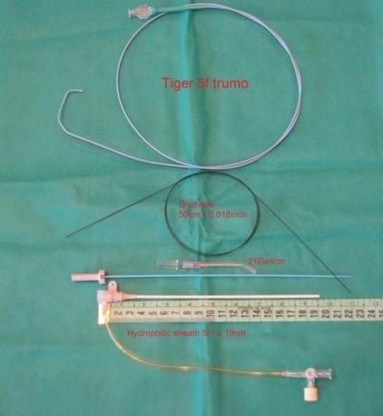
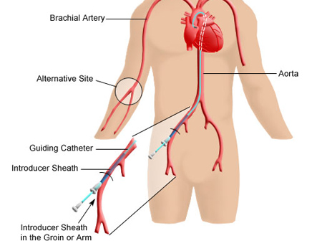
The 1st Generation Technology
Inject and measure
Invasive
Costly (~1,500 China Yuans)
~50% turns out to be healthy

Slide 9
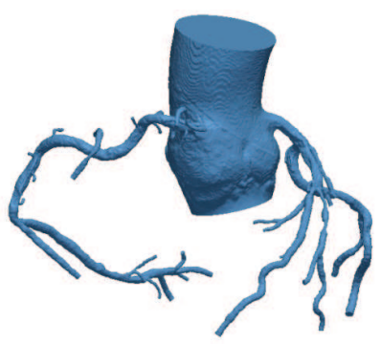
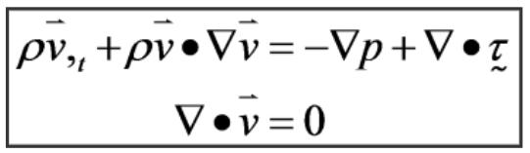
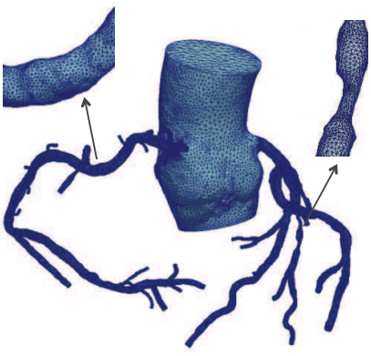

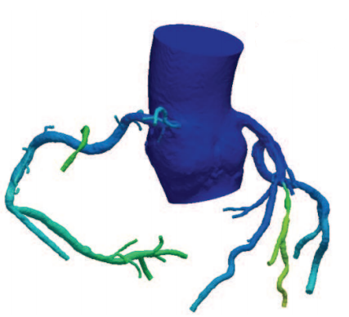
The 2nd Generation Technology
Computational Fluid Dynamic Simulation by Finite Element Method over the mesh grids (patented by Heartflow Inc., FDA approval in Nov. 2014)

Slide 10
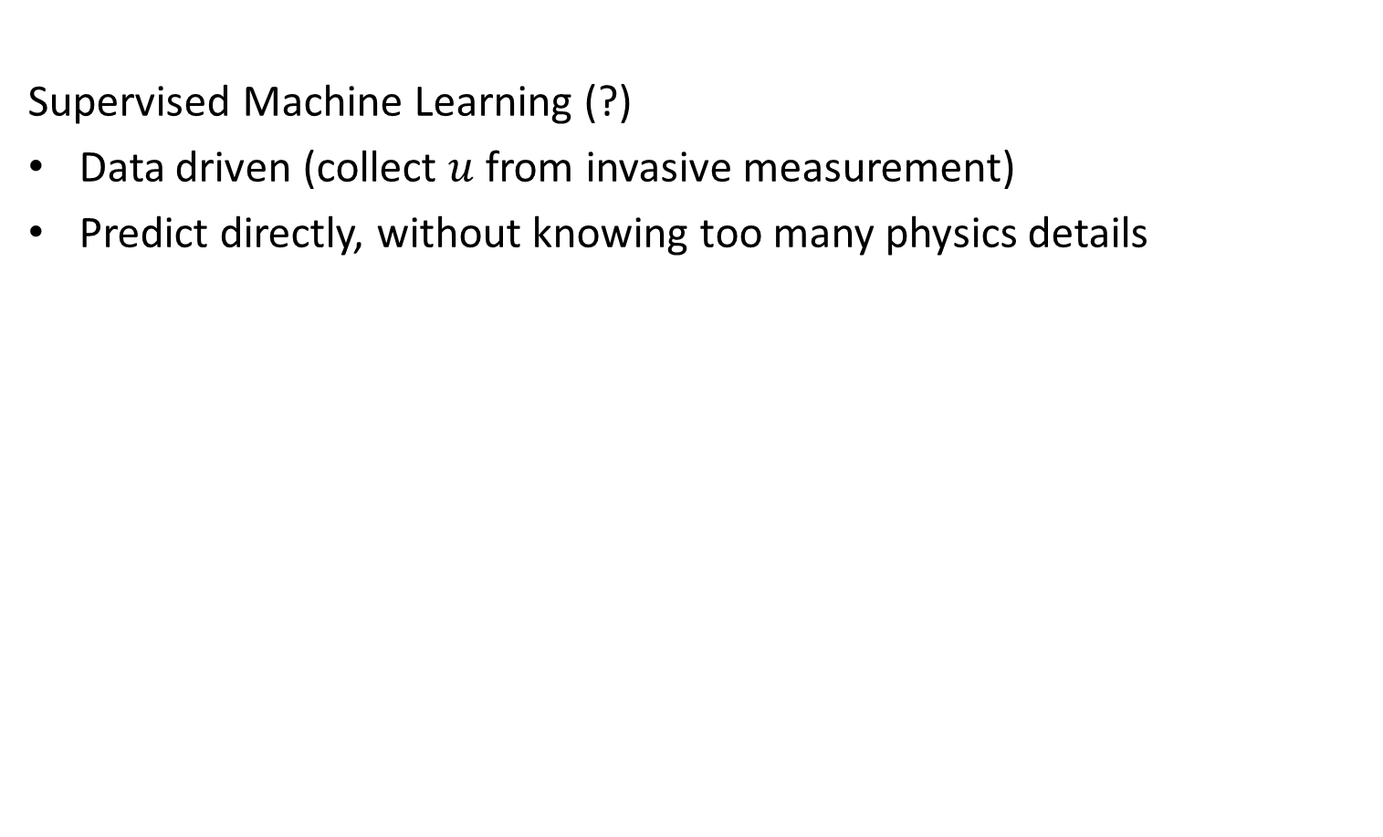
The 3rd Generation Technology (?)
Supervised Machine Learning (?)
Data driven (collect from invasive measurement)
Predict directly, without knowing too many physics details

Slide 11
Outline
Technology Evolution
Review of Previous Machine Learning Approaches
  A Graph-like Model: Motivation and Overview
  A Graph-like Model: Inference and Parameter Learning
Empirical Results

Slide 12
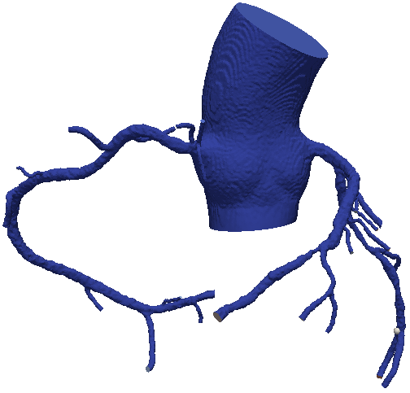
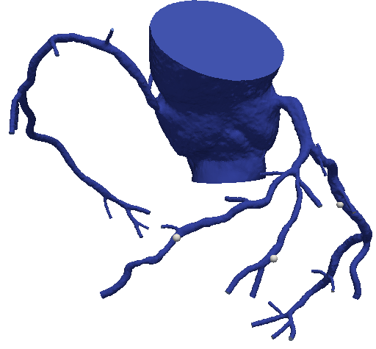
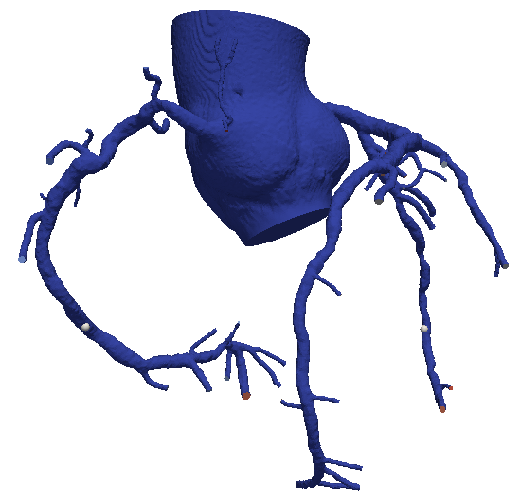
Dataset
Our proprietary dataset. Totally 252 patients, each has
3D image for the heart blood vessels, raw and binarized (data)
1 to 4 measure points (label/ground truth)

Slide 13
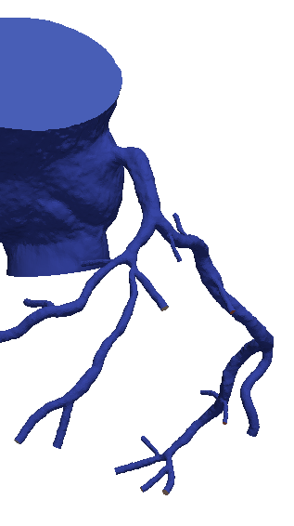
The Flat-Learning Solution
1. For each interested point, extract hand crafted features:
# of branches upstream/downstream
The min/max/mean/variance/ histogram/… of the diameters for current vessel segment
The length of current segment/to the root/to the end/…
etc…
2. Train a classifier (e.g., MLP) on top
Sankaran, S. et al. "Fast computation of hemodynamic sensitivity to lumen segmentation uncertainty." IEEE Trans. on Medical Imaging 34.12 (2015): 2562-2571.
Lucian, L. et al. "A Machine Learning Approach for Computation of Fractional Flow Reserve from Coronary Computed Tomography." Journal of Applied Physiology (2016): jap-00752.

Slide 14
The Flat-Learning Solution: Drawbacks
For each interested point,
hand crafted features + classifier
Drawbacks:
Poor modeling of the dependencies among points (absorb it in features)
Inconvenient when generating the heat-map (duplicate calculations)
Sankaran, S. et al. "Fast computation of hemodynamic sensitivity to lumen segmentation uncertainty." IEEE Trans. on Medical Imaging 34.12 (2015): 2562-2571.
Lucian, L. et al. "A Machine Learning Approach for Computation of Fractional Flow Reserve from Coronary Computed Tomography." Journal of Applied Physiology (2016): jap-00752.

Slide 15
The Outline
Technology Evolution
Review of Previous Machine Learning Approaches
  A Graph-like Model: Motivation and Overview
  A Graph-like Model: Inference and Parameter Learning
Empirical Results

Slide 16
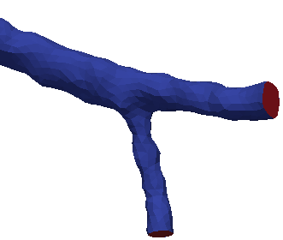
The Graph (-Like) Model Solution
Motivation: explicitly models the dependencies among points with graph model. Leverage the local and the global, a division of labor:
Local model: a regressor, seeing only a small vessel segment
Global model: constrain the local predictions for ALL points
Connections : the constraint
vessel segment

Slide 17
The Graph (-Like) Model Solution (Cont.)
What’s the proper graph model?
Conditional Random Fields?
  Branching?
  Probabilistic inference?
Proposed in this study: the Circuit Model
Connections : the constraint
vessel segment

Slide 18
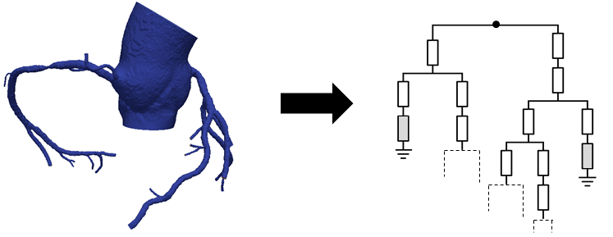
Build the Circuit
Input: the binary blood vessels 3D image (accurate segmentation)
Blood vessels cut into small segments, each viewed as a resistor
Resistors connected in series and in parallel
At the end of each vessel, add a “pseudo” resistor to mimic the unseen vessel

Slide 19
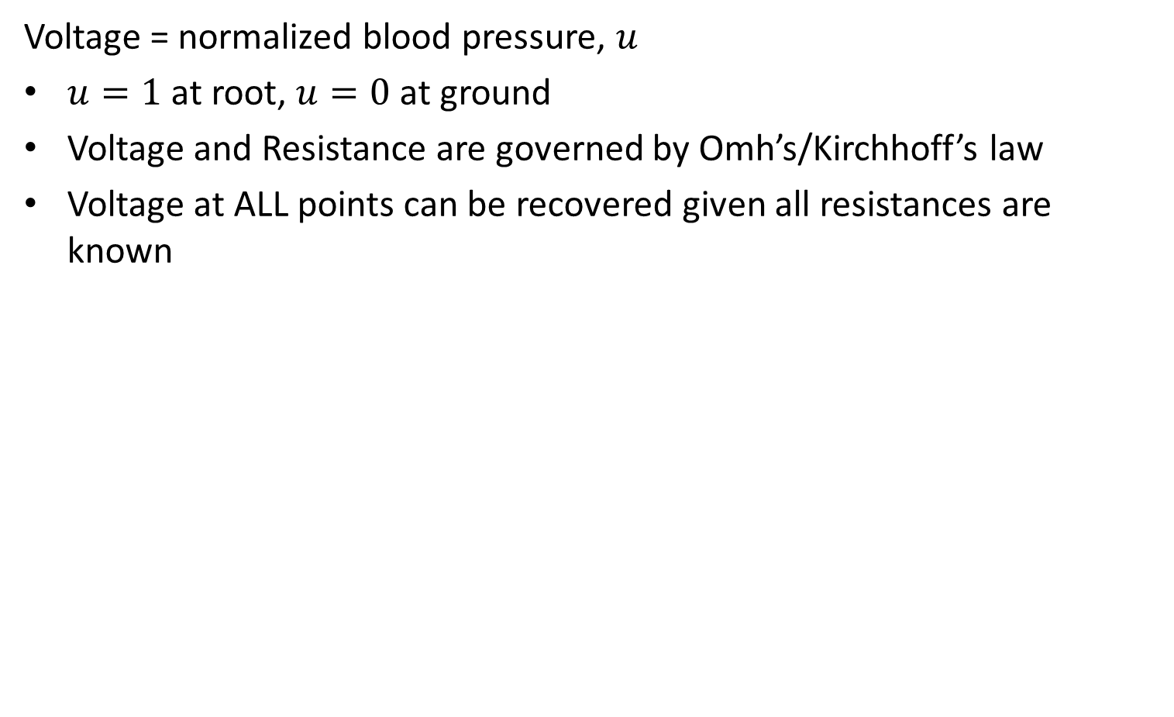
The Circuit Model: Global
Voltage = normalized blood pressure,
at root, at ground
Voltage and Resistance are governed by Omh’s/Kirchhoff’s law
Voltage at ALL points can be recovered given all resistances are known

Slide 20
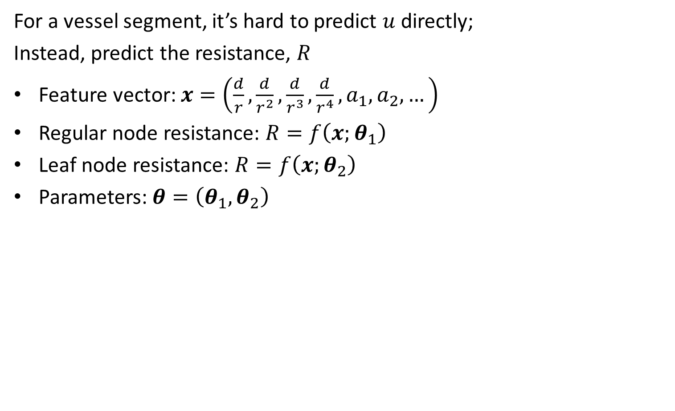
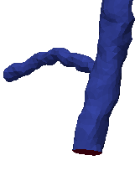
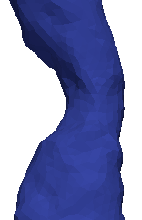


The Circuit Model: Local
For a vessel segment, it’s hard to predict directly;
Instead, predict the resistance,
Feature vector:
Regular node resistance:
Leaf node resistance:
Parameters:

Slide 21
Outline
Technology Evolution
Review of Previous Machine Learning Approaches
  A Graph-like Model: Motivation and Overview
  A Graph-like Model: Inference and Parameter Learning
Empirical Results

Slide 22
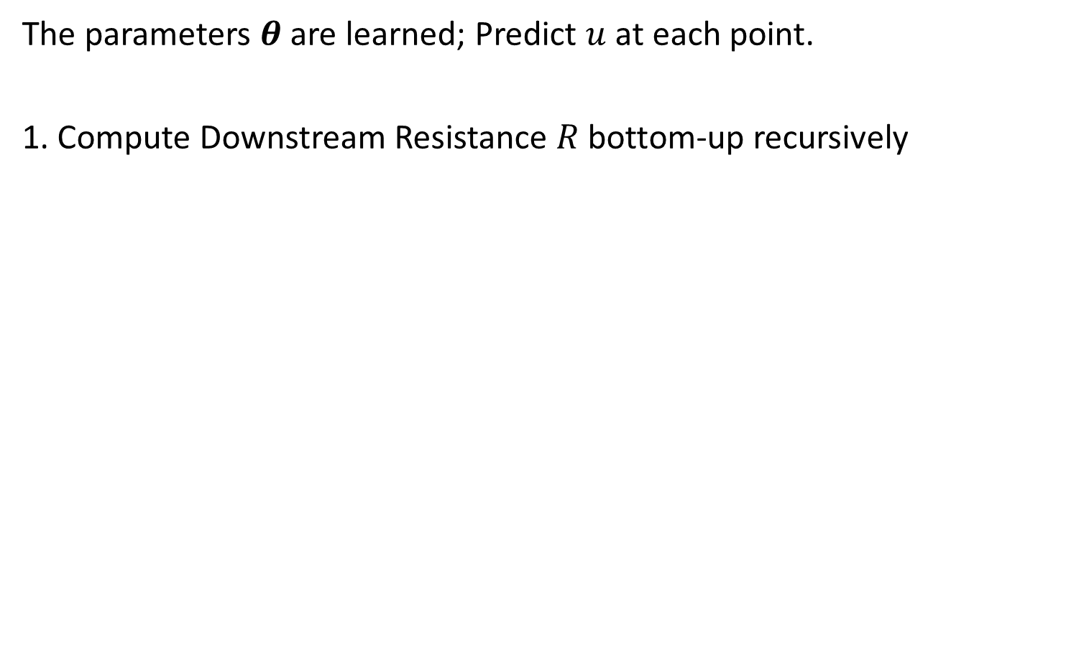



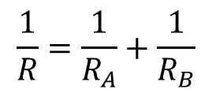
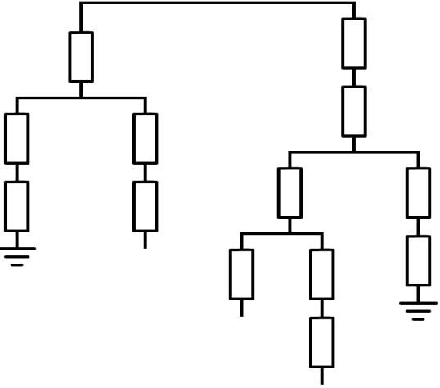







Inference
The parameters are learned; Predict at each point.
1. Compute Downstream Resistance bottom-up recursively
Parallel:
Series:
Leaf node:

Slide 23
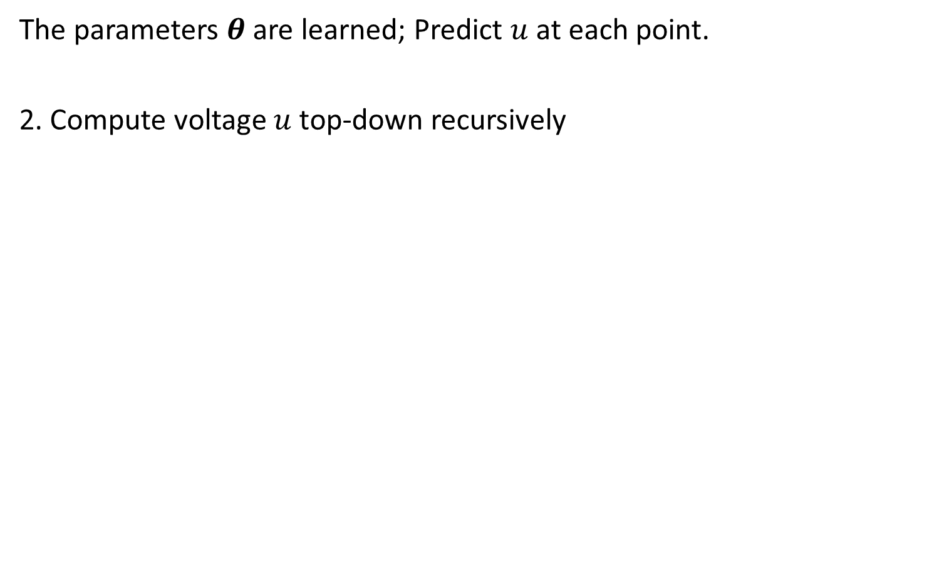




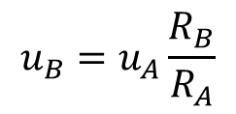


Inference (Cont.)
The parameters are learned; Predict at each point.
2. Compute voltage top-down recursively
Regular node:
Root node:

Slide 24
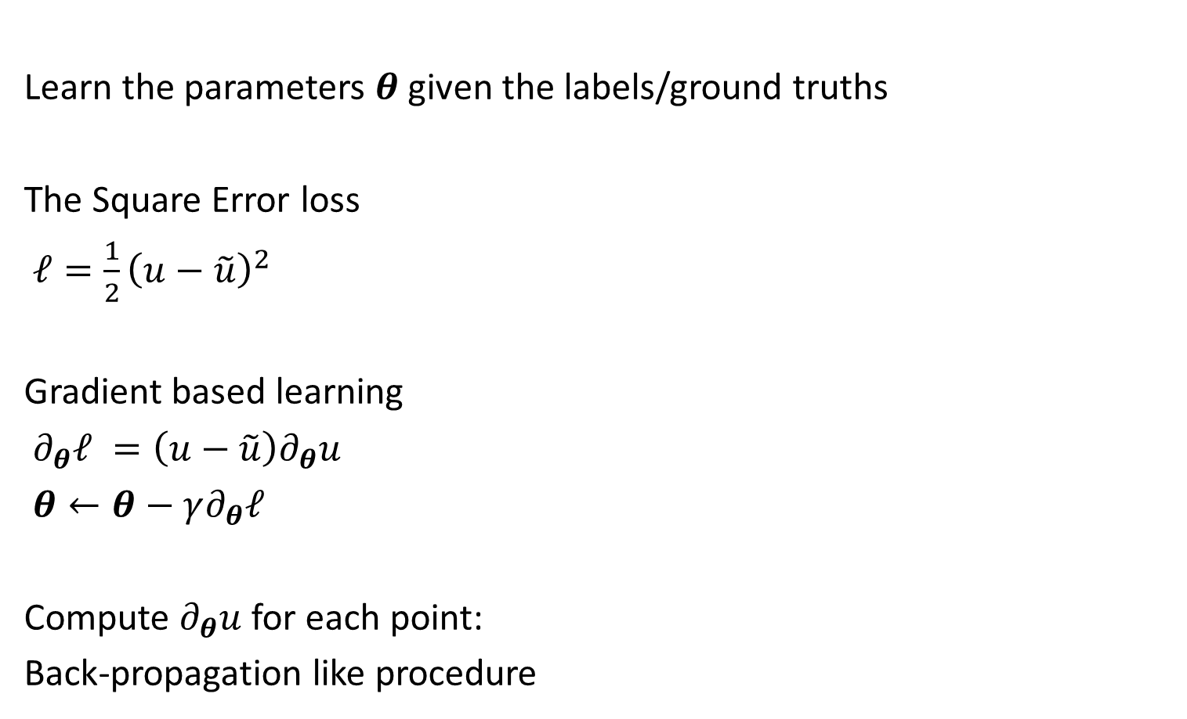
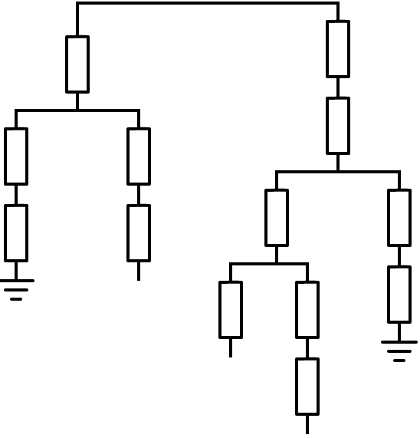


Training
Learn the parameters given the labels/ground truths
The Square Error loss
Gradient based learning
Compute for each point:
Back-propagation like procedure

Slide 25
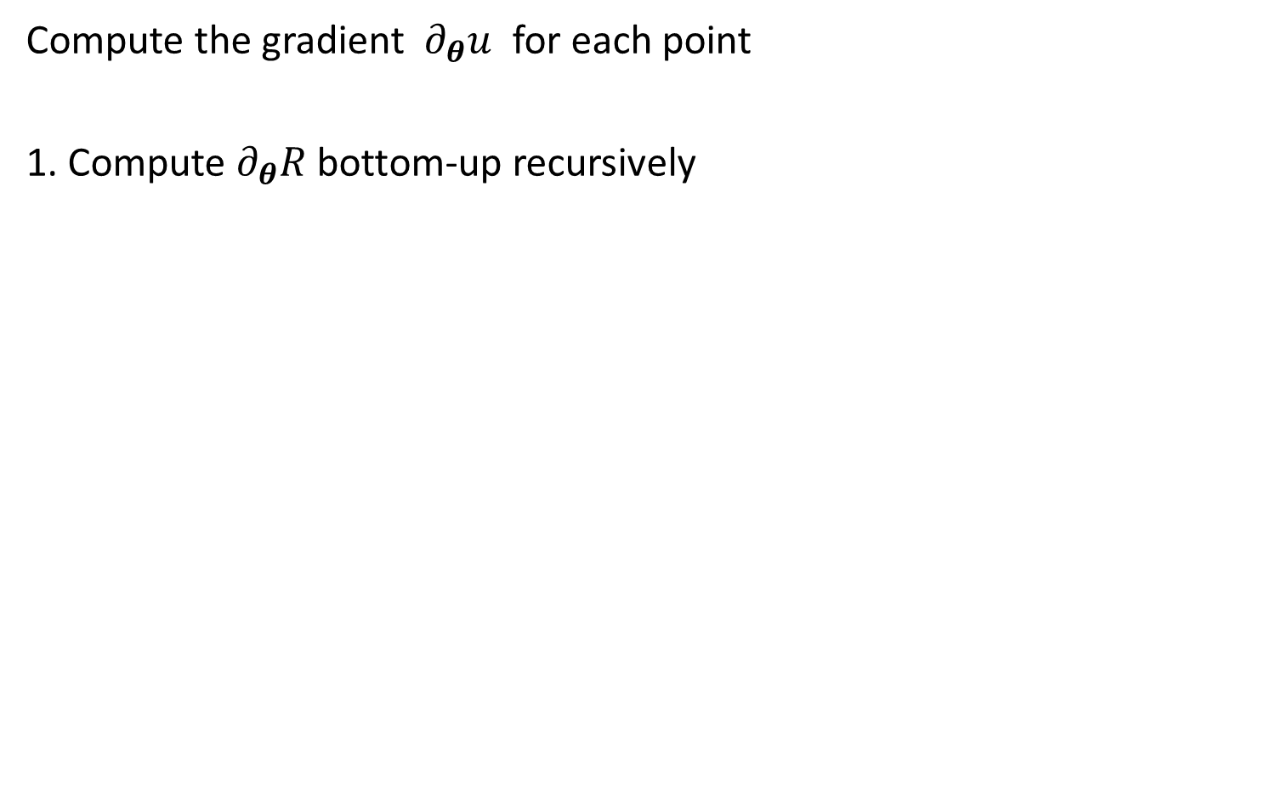
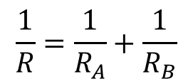





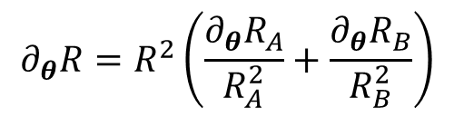





Training (Cont. 1)
Compute the gradient for each point
1. Compute bottom-up recursively
Parallel
Series
Leaf node

Slide 26
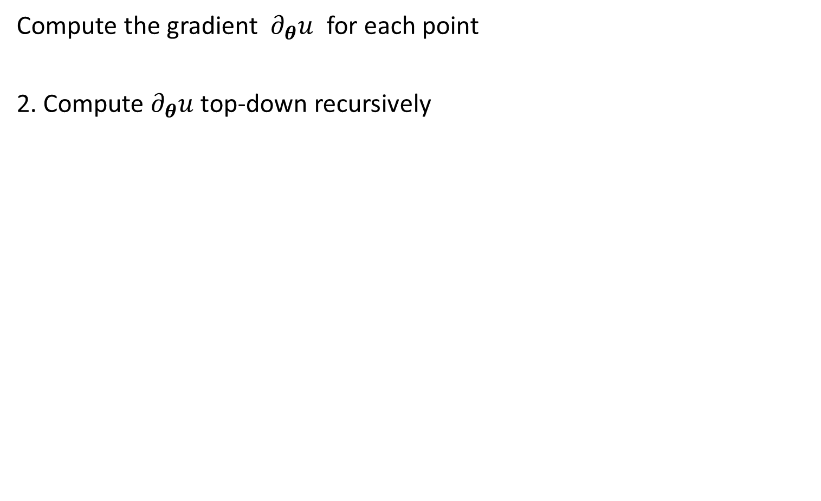
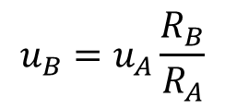



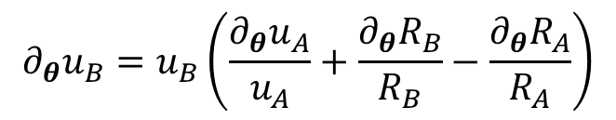




Training (Cont. 2)
Compute the gradient for each point
2. Compute top-down recursively
Regular node:
Root node:

Slide 27
Outline
Technology Evolution
Review of Previous Machine Learning Approaches
  A Graph-like Model: Motivation and Overview
  A Graph-like Model: Inference and Parameter Learning
Empirical Results

Slide 28
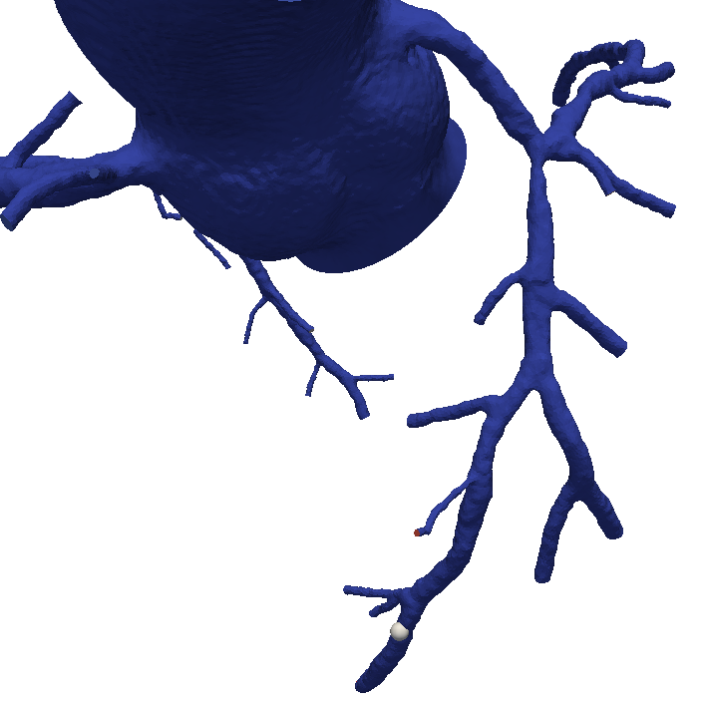
Comparison (1 Measure Point)
 | CM | CFD | GT
A | 0.7931 | 0.57 | 0.77
A

Slide 29
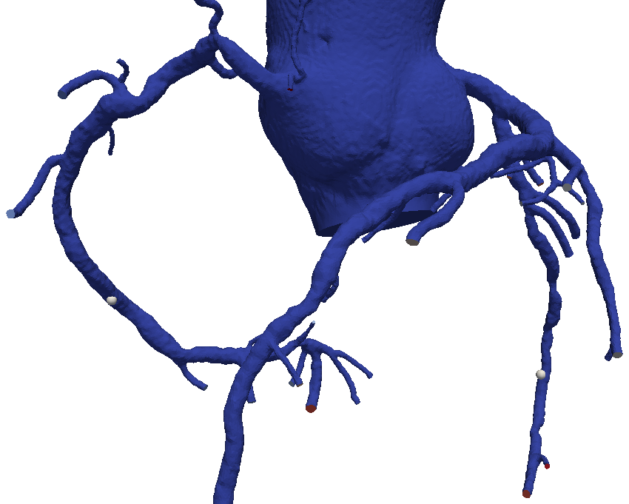
Comparison (2 Measure Points)
A
 | CM | CFD | GT
A | 0.9594 | 0.83 | 0.86
B | 0.9180 | 0.89 | 0.88
B

Slide 30
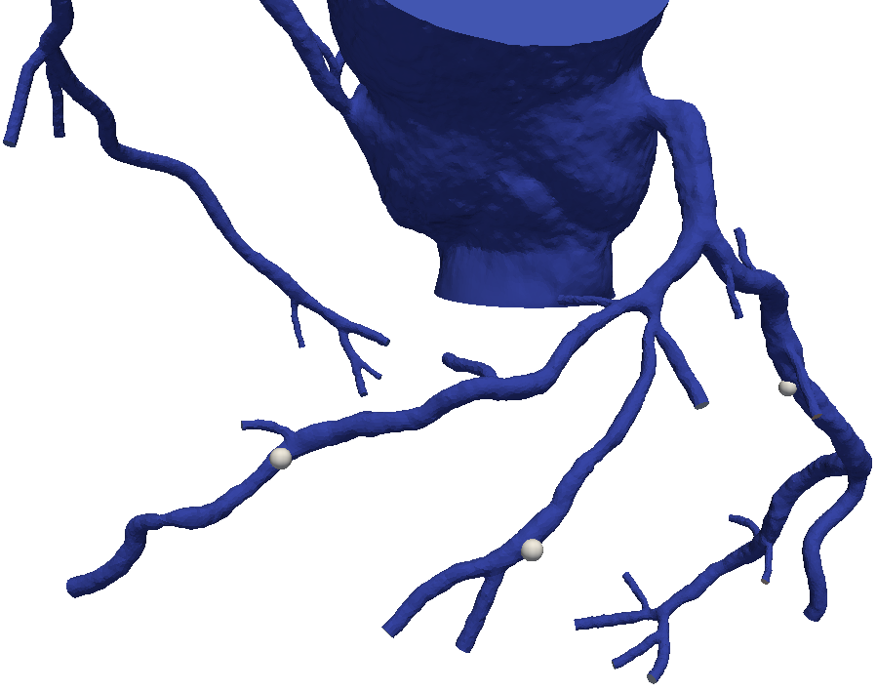
Comparison (3 Measure Points)
A
C
B
 | CM | CFD | GT
A | 0.9116 | 0.83 | 0.77
B | 0.7746 | 0.79 | 0.84
C | 0.9872 | 0.90 | 0.94

Slide 31
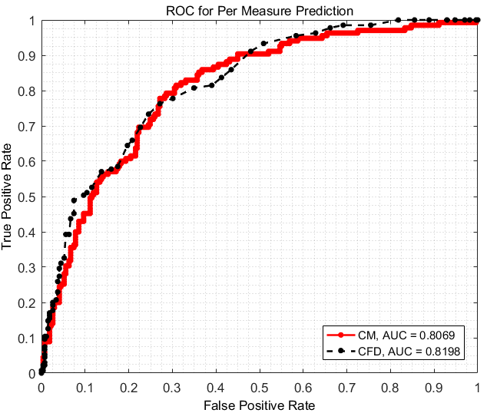
ROC per Measure

Slide 32
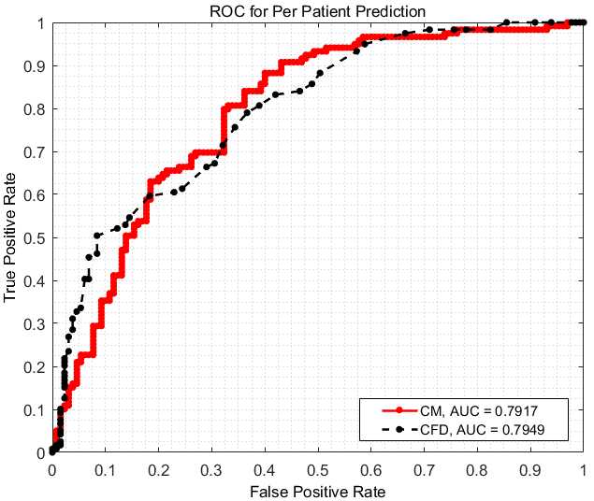
ROC per Patient

Slide 33
Conclusion & Acknowledgement
Developed a machine learning based method to predict normalized blood pressure for the diagnosis of heart blood vessel disease
Comparable to CFD based method
Work-around of the patented technology by Heartflow Inc.
Work-around of “physical model”

