Slide 1
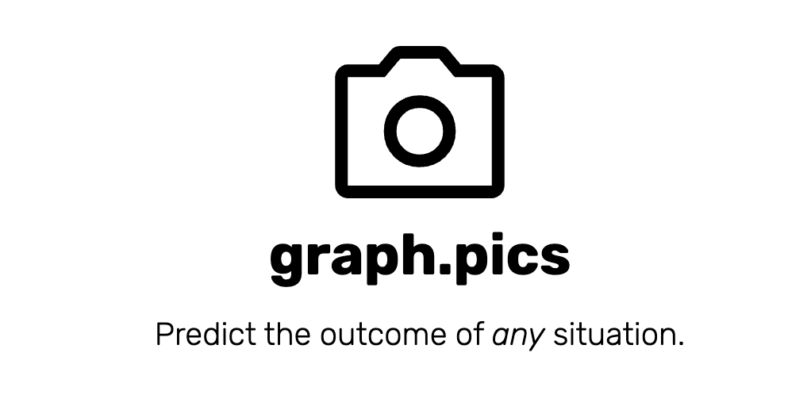
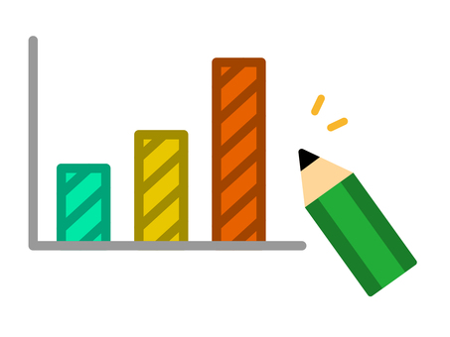
graph.pics
Caden Milne and Aidan Dougherty

Slide 2
What is it?
Novel Statistical Analysis Tool
Social Media
Fortune Teller
Financial Advisor

Slide 3
Purpose?
Revolutionize statistical analysis by leveraging large language models
Connect people through shared statistical predictions

Slide 4
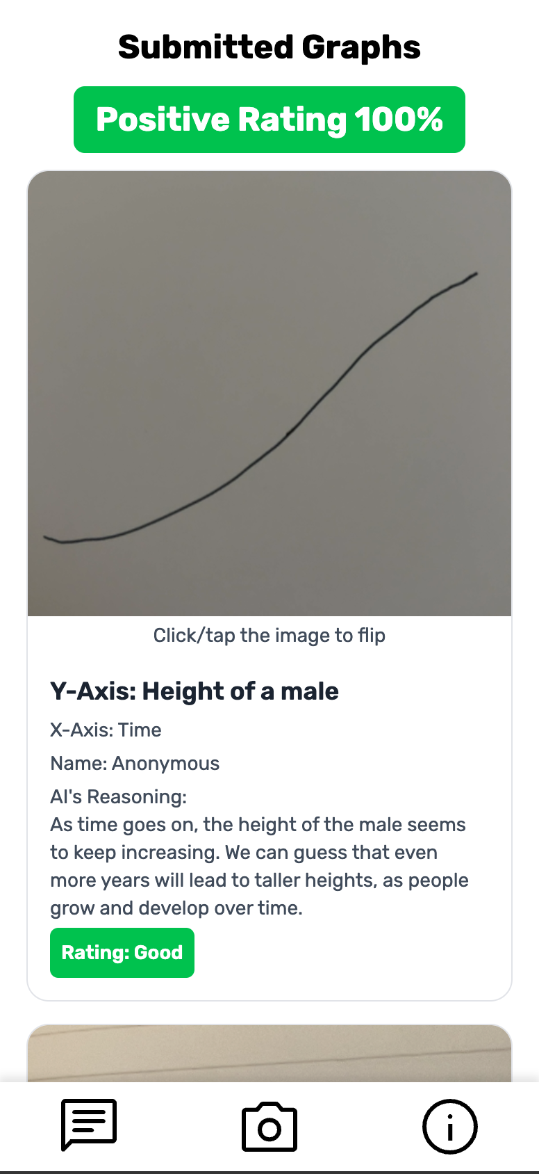
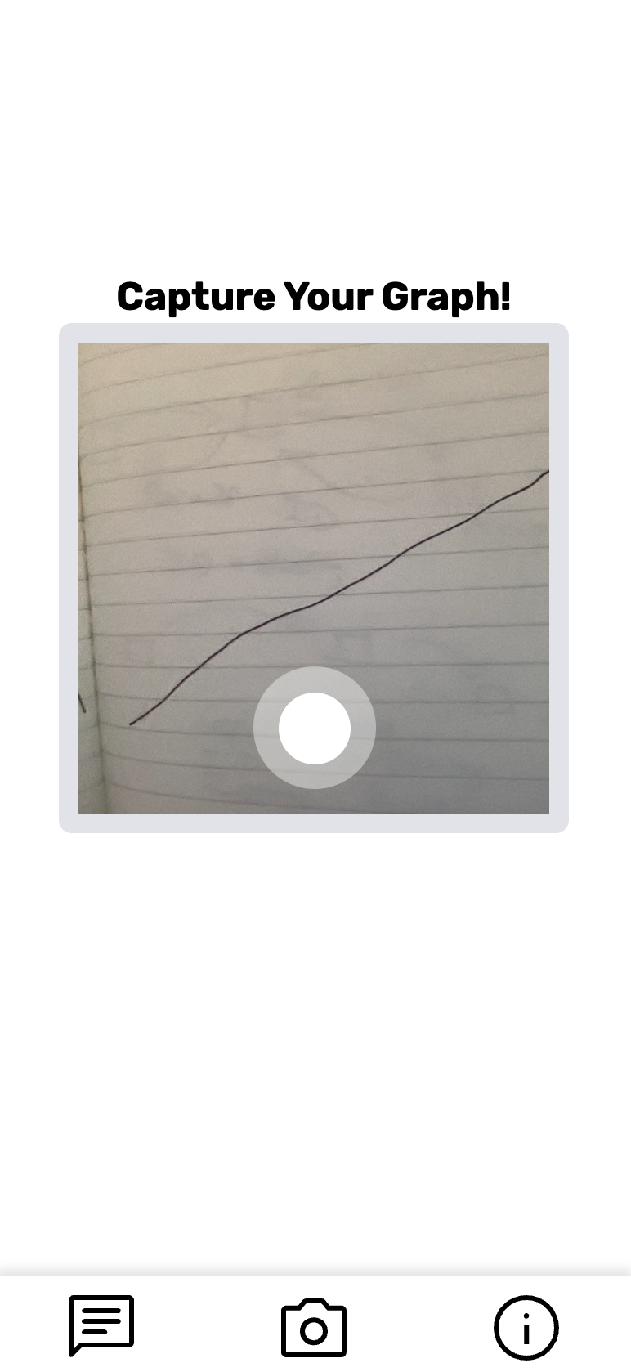
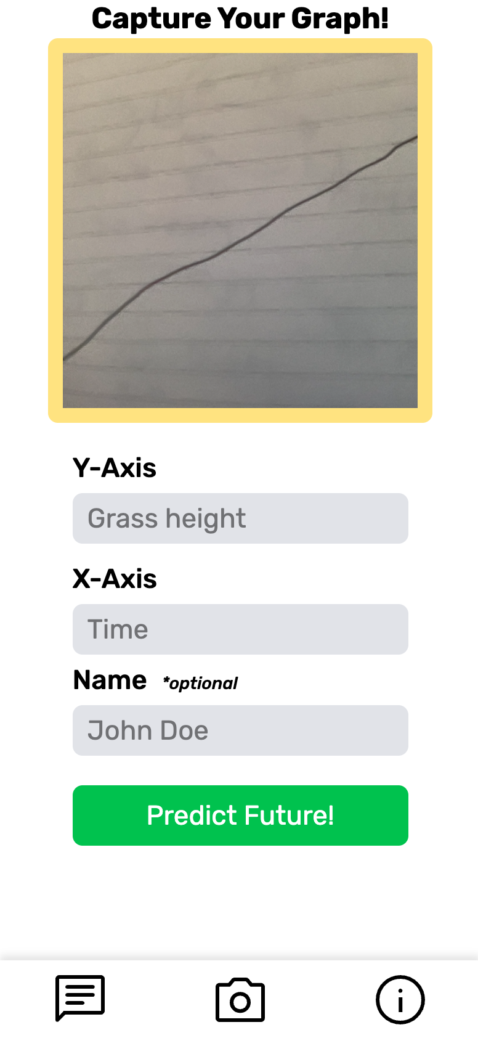
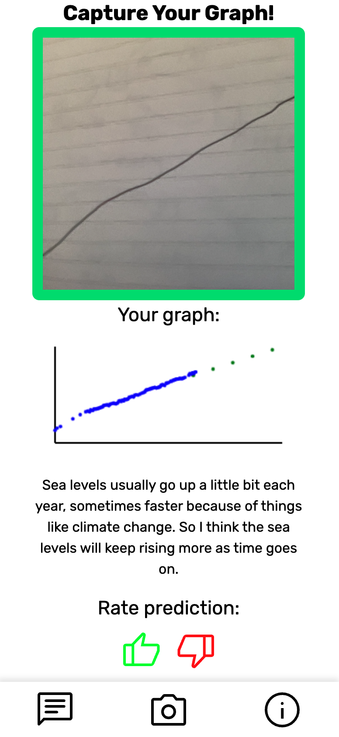
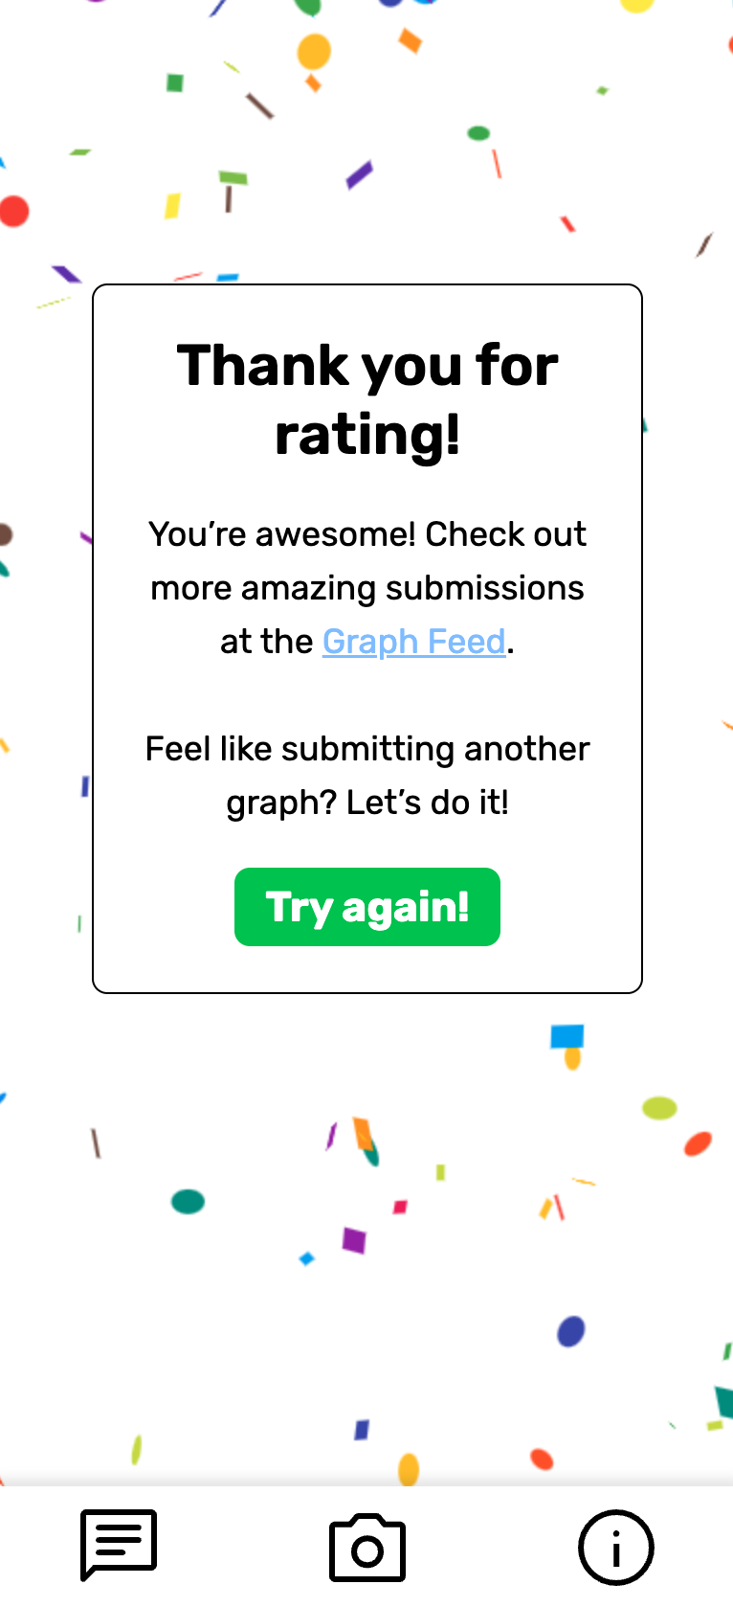
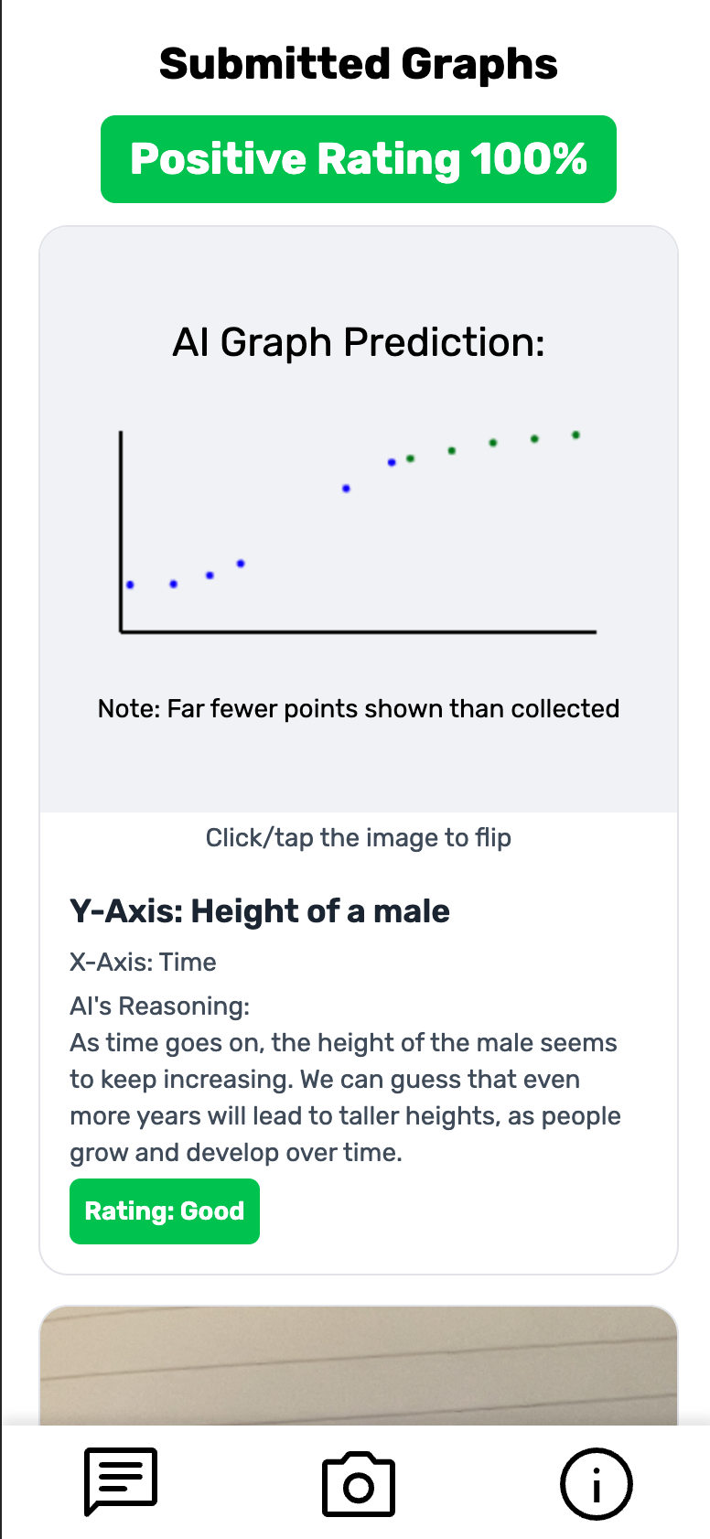
How it works?

Slide 5
Dive deeper
The LLM will extend you’re drawn line with its prediction.

Slide 6

Live Demo
It is fully functional and live at https://graph.pics

Slide 7




Tech Stack
React + TailwindCSS
Go
MongoDB Atlas Cloud

Slide 8


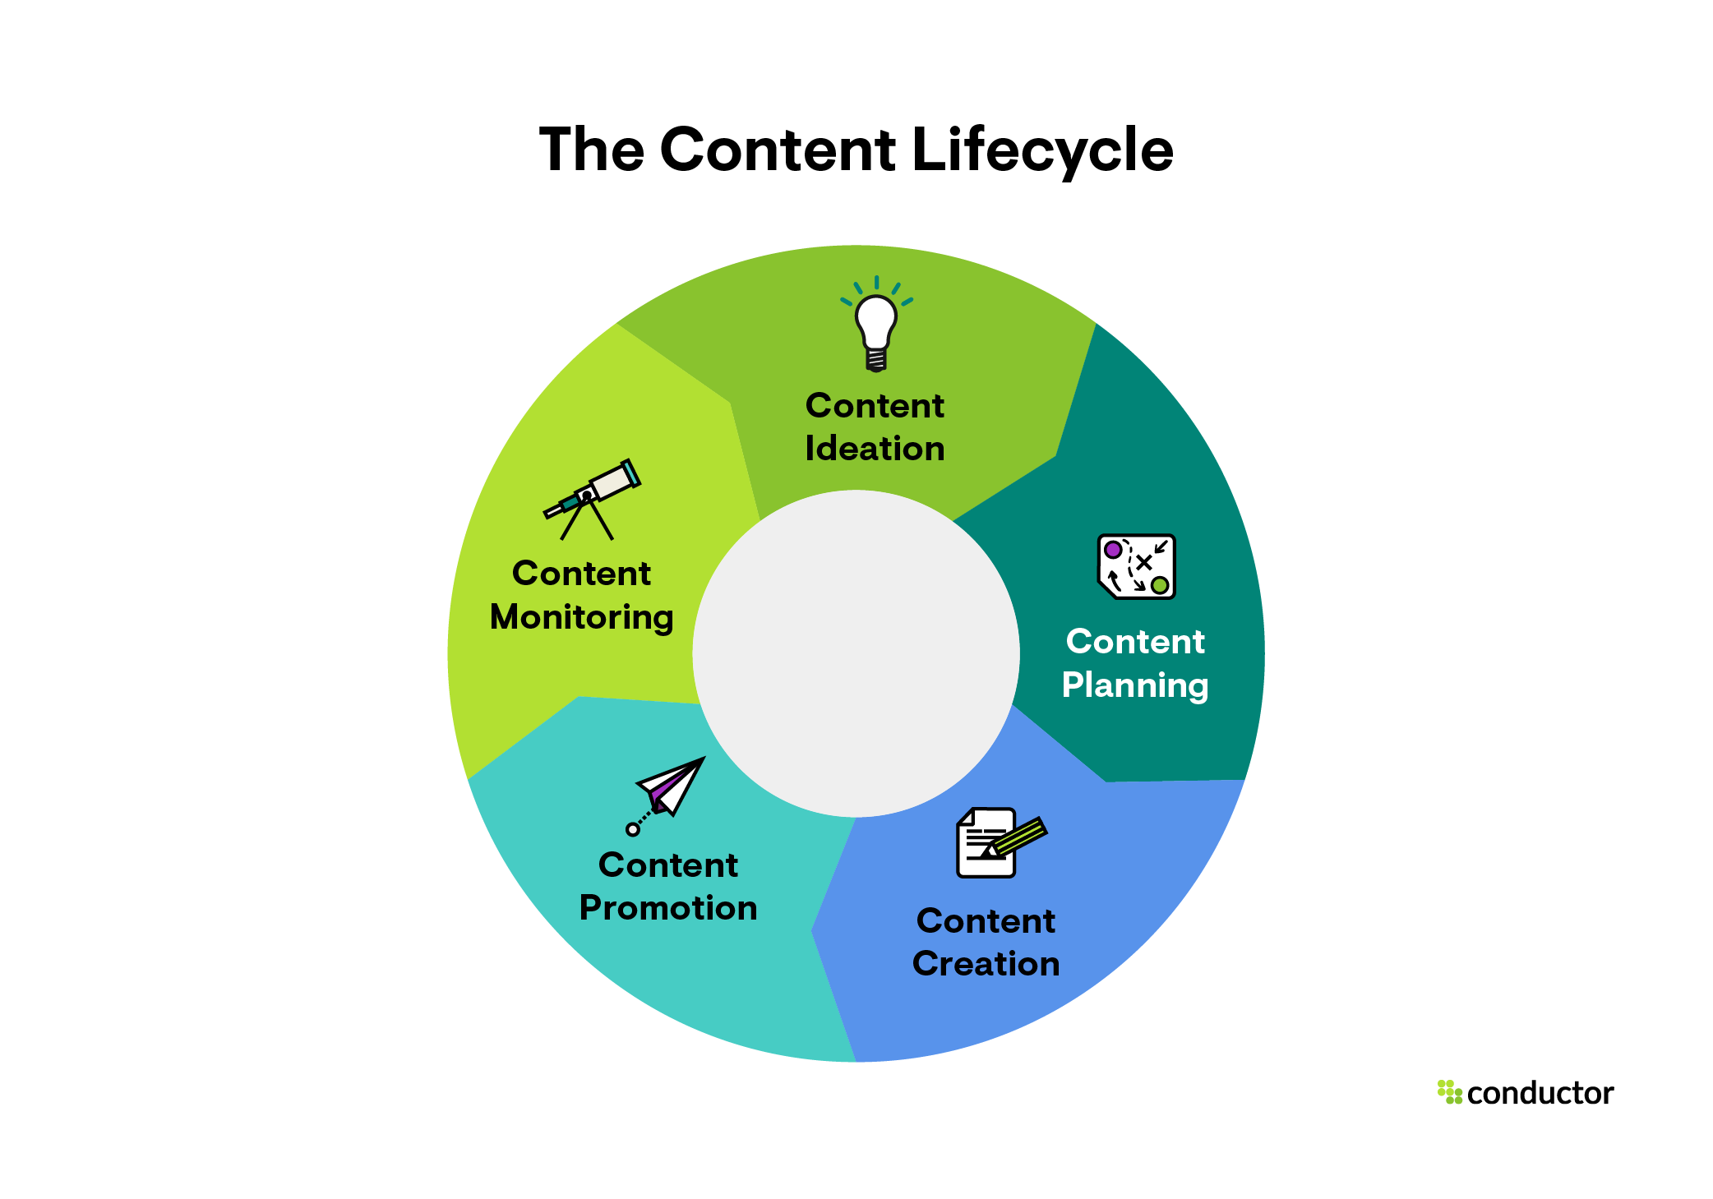

Hackathon Tracks
Best Use of Computer Vision
Best Content Creation Hack
Best Domain Name from GoDaddy
Best use of AI

Slide 9
What is it again?
Novel Statistical Analysis Tool
Social Media
Fortune Teller
Financial Advisor
Anything you want it to be ☺

