Slide 1
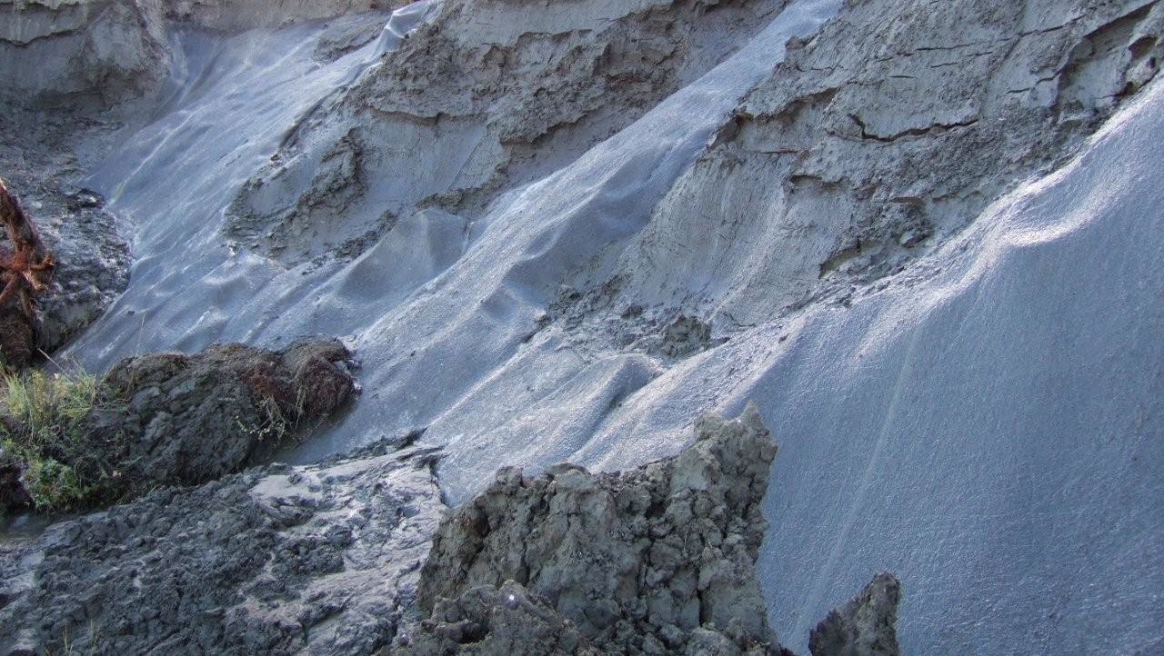


Heat Flux through Permafrost By Penny Rowe and Steven Neshyba Polar ENgagement through GUided INquiry (PENGUIN)
Permafrost (photo courtesy of the National Snow and Ice Data Center, University of Colorado, Boulder)
Notes:
The image at left shows Ice core researchers from AWI drilling at the EastGRIP ice core site Greenland

Slide 2
Learning Objectives
In this module we will learn about heat flux by examining how heat moves through permafrost.

Slide 3
Learning Objectives
Part I
What is permafrost?
Where does it occur?
How is climate change affecting it?
What are the consequences?

Slide 4
What is Permafrost?
Permafrost is permanently frozen ground
At or below 0 C for at least two years
Occurs in polar regions
Read about permafrost in the Arctic here: https://nsidc.org/cryosphere/sotc/permafrost.html.

Slide 5
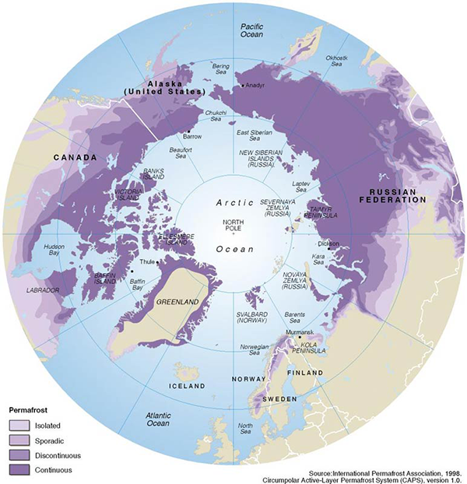
Where does permafrost occur?
Notes:
The purple is permafrost

Slide 6
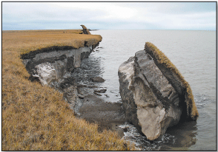
How is climate change affecting permafrost?
Scientific consensus: humans are causing dangerous climate change.
Permafrost is thawing, with serious consequences.
Watch a video by the Alfred Wegener Institute to learn more: Permafrost – what is it? (https://youtu.be/lxixy1u8GjY)
Collapsing permafrost (From “Measuring and Forecasting the Response of Alaska’s Terrestrial Ecosystem to a Warming Climate,” By Pearce et al, 2012. )

Slide 7
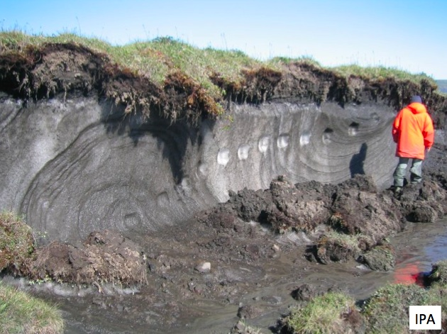
Learning Objectives
Part II
Temperature profile of permafrost
Over a year
Over multiple years
Slicing through permafrost (Image from the International Permafrost Association courtesy of the Global Cryosphere Watch
Notes:
The image shows a slice through permafrost. Imagine measuring temperature down through the ground from the top to the bottom.

Slide 8
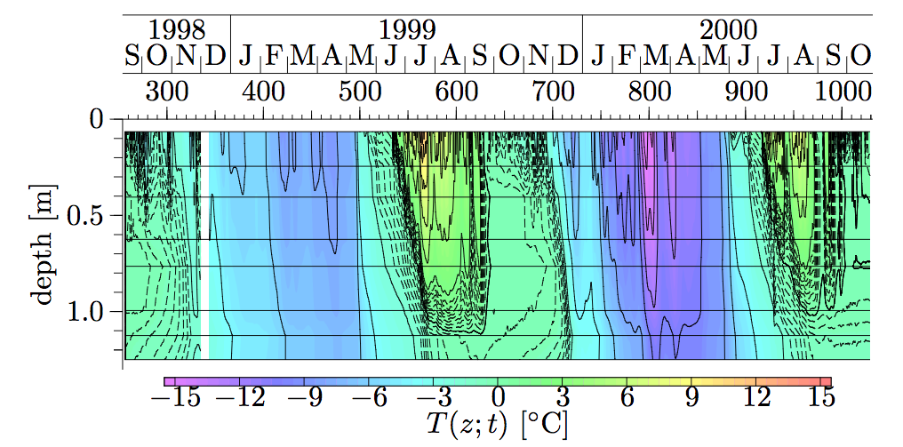
Temperature profile of permafrost
Notes:
Discuss the image. Depth on left. Years and months at top, so left to right indicates time passing. Colors indicate temperature. Examine change in temperature with depth and with time. We will examine changes over multiple years in the activity next.

Slide 9
Learning Objectives
Part III
What is heat flux?
Calculating heat flow through permafrost.
Examining changing heat flux in permafrost over multiple years.

Slide 10
What is heat flux?
Imagine you are standing at the top look down at a square of ground, say a 1 m x 1 m square.
You want to understand how energy is flowing down into the ground through that square, or up out of that square.
The energy has units of Watts (think of a 60 Watt light bulb).
The heat flux is giving in Watts per square meter, or W/m².
Slicing through permafrost (Image from the International Permafrost Association courtesy of the Global Cryosphere Watch

Slide 11
Heat flux
1 m
1 m
Surface
T(z₁=0)
z = 0
T(z₂)
depth
z
T(z₃)
T(z₄)

Slide 12
Heat flux
1 m
Heat flux:
1 m
Surface
T(z₁=0)
𝑗_{ℎ} = −𝐾_{ℎ} 𝑑T/𝑑𝑧
z = 0
T(z₂)
depth
z
T(z₃)
thermal conductivity
Change in T with z
T(z₄)
Postive 𝑗_{ℎ} => heat moving down

Slide 13
Model of temperature profile through permafrost
1 m
1 m
Surface
T(z₁=0)
Which way do you think heat would flow in this example?
z = 0
warmer
T(z₂)
depth
z
T(z₃)
Is j_{h} positive or negative?
T(z₄)
cooler

Slide 14
Heat flux
1 m
Heat flux:
1 m
Surface
T(z₁=0)
𝑗_{ℎ} = −𝐾_{ℎ} 𝑑T/𝑑𝑧
z = 0
T(z₂)
depth
z
T(z₃)
thermal conductivity
Change in T with z
T(z₄)
Postive 𝑗_{ℎ} => heat moving down

Slide 15
Thermal conductivity
𝐾_{ℎ}: Thermal conductivity
Quantifies how well permafrost can transfer heat.
Specifically, how energy (J) moves through the permafrost (m) with time (s), based on the temperature (K).
K_{h} = C_{h} D_{h}

Slide 16
Thermal conductivity
𝐾_{ℎ}: Thermal conductivity
Quantifies how well permafrost can transfer heat.
Specifically, how energy (J) moves through the permafrost (m) with time (s), based on the temperature (K).
K_{h} = C_{h} D_{h}
C_{h:} Volume heat capacity
Energy to increase temperature of 1 m of ground 1 K.
Units: J m⁻¹ K⁻¹
C_{h} = ρ c_{h}
ρ = density of material in kg m⁻¹
c_{h} = Specific heat capacity in J kg⁻¹ K⁻¹

Slide 17
Thermal conductivity
𝐾_{ℎ}: Thermal conductivity
Quantifies how well permafrost can transfer heat.
Specifically, how energy (J) moves through the permafrost (m) with time (s), based on the temperature (K).
K_{h} = C_{h} D_{h}
C_{h:} Volume heat capacity
Energy to increase temperature of 1 m of ground 1 K.
Units: J m⁻¹ K⁻¹
C_{h} = ρ c_{h}
D_{h}: Thermal diffusivity
Rate of heat transfer from hot to cold.
Units: m² s⁻¹

Slide 18
Heat flux
1 m
Heat flux:
1 m
Surface
T(z₁=0)
𝑗_{ℎ} = −𝐾_{ℎ} 𝑑T/𝑑𝑧
z = 0
T(z₂)
depth
z
T(z₃)
thermal conductivity
Change in T with z
T(z₄)
Postive 𝑗_{ℎ} => heat moving down

Slide 19
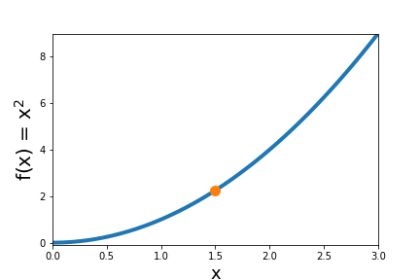
Math: the analytic derivative
Analytic Derivative: df/dx
Example:
f(x) = x²
df/dx = 2x
df/dx is
2*1.5 = 3

Slide 20
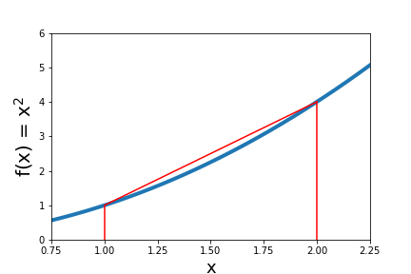
Math: the numerical derivative
Numerical Derivative: Δf/Δx
Δf
Δx
4-1
2-1
=
= 3
Why do it numerically?
Because the computer can do it for you.

Slide 21
Permafrost module
Next you will apply these ideas to real-world permafrost data by working through a Jupyter Notebook in Python:
https://www.kaggle.com/pennyrowe/permafrost

Slide 22
Permafrost module
Next you will apply these ideas to real-world permafrost data by working through a Jupyter Notebook in Python:
https://www.kaggle.com/pennyrowe/permafrost

Slide 23

Acknowledgements
This Polar ENgagement through GUided INquiry (PENGUIN) module was created with funding from the National Science Foundation. Creative Commons Copyright.
You may freely use and share with attribution to the PENGUIN project as follows:
Rowe, P.M. et al (2020): Integrating polar research into undergraduate curricula using computational guided inquiry, Journal of Geoscience Education, https://doi.org/10.1080/10899995.2020.1768004.

Slide 24
Check out other PENGUIN modules
Processing Images of Arctic Ice: Explore image processing of polar satellite images.
Ice Cores and Climate Change: Work with data from ice cores from the East Antarctic Ice Sheet and Greenland, to explore earth's past climate and glacial cycles.
Heat flux through Permafrost: Learn what permafrost is and how it is impacted by climate change, and calculate heat flux through permafrost.
Polar spectra and Quantum Mechanics: Learn about the greenhouse effect by examining infrared emission spectra of the polar atmosphere.
Thermodynamics of Arctic Ice melt: Explore Arctic sea ice extent and calculate the amount of heat required to melt Arctic sea ice

Slide 25
Extra slides
End of presentation
Extra slides follow

Slide 26
Learning Objectives
Part I
What is permafrost?
How is climate change affecting it?
What are the consequences?
Part II
Temperature profile of permafrost
Over a year
Over multiple years
Part III
Determining heat flow through permafrost.
Examining changing heat flow in permafrost over multiple years.

Slide 27
Model of temperature profile through permafrost
1 m
1 m
Surface
T(z₁=0)
z = 0
T(z₂)
depth
z
T(z₃)
T(z₄)

