Slide 1
Dynamic Programming

Slide 2
Maximal Square

Slide 3
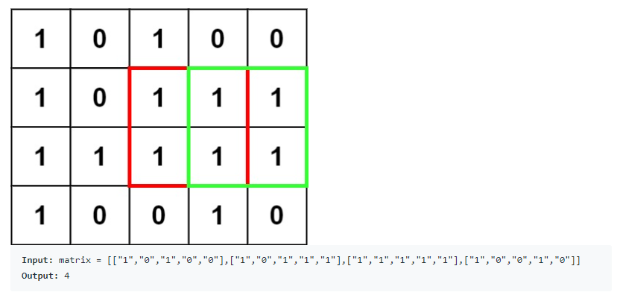
Problem Description
Given a binary matrix filled with 0 and 1, find the largest square containing only 1 and return its area.
For example :

Slide 4


Slide 5
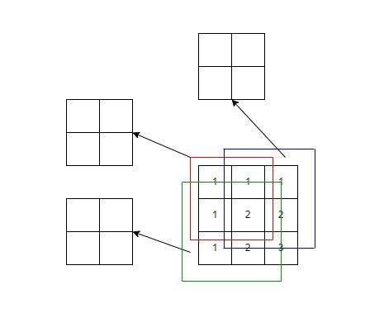
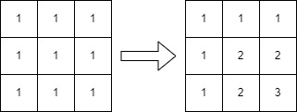
Solution
dp[ i ][ j ] = min (dp[i - 1][ j ], dp[ i ][j - 1], dp[i - 1][j – 1])

Slide 6
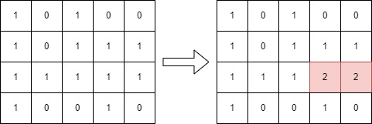
Solution

Slide 7
Longest Increasing Subsequence(LIS)

Slide 8
Problem Description
Given an array, return the length of the longest strictly increasing subsequence.
Input : [10, 9, 2, 5, 3, 7, 101, 4]
Output : 4
Explanation : [2, 3, 7, 101]

Slide 9


Slide 10
Solution - Dynamic Programming
 | 10 | 9 | 2 | 5 | 3 | 7 | 101 | 4 | sum
dp[0] | 10 |  |  |  |  |  |  |  | 1
dp[1] |  | 9 |  |  |  |  |  |  | 1
dp[2] |  |  | 2 |  |  |  |  |  | 1
dp[3] |  |  | 2 | 5 |  |  |  |  | 2
dp[4] |  |  | 2 |  | 3 |  |  |  | 2
dp[5] |  |  | 2 |  | 3 | 7 |  |  | 3
dp[6] |  |  | 2 |  | 3 | 7 | 101 |  | 4
dp[7] |  |  | 2 |  | 3 |  |  | 4 | 3

Slide 11
Solution – Greedy & binary search
 | 10 | 9 | 2 | 5 | 3 | 7 | 101 | 4
0 | 1
1 |  | 1
2 |  |  | 1
3 |  |  | 1 | 2
4 |  |  | 1 |  | 2
5 |  |  | 1 |  | 2 | 3
6 |  |  | 1 |  | 2 | 3 | 4
7 |  |  | 1 |  | 2 |  | 4 | 3

Slide 12
Two Set II

Slide 13
Problem Description
Given a number n, return the number of ways numbers 1 to n can be divided into two set of equal sum.
Input : 7
Output : 4
Explanation : {1,3,4,6} + {2,5,7}, {1,2,5,6}+{3,4,7}, {1,2,4,7}+{3,5,6}, {1,6,7}+{2,3,4,5}

Slide 14


Slide 15
Solution
dp[ i ][ j ] = dp[i - 1][ j ] + dp[i - 1][j – i]
Ans = dp[n - 1][ target ]
 | 0 | 1 | 2 | 3 | 4 | 5 | 6 | 7 | 8 | 9 | 10 | 11 | 12 | 13 | 14
0 | 1 | 0 | 0 | 0 | 0 | 0 | 0 | 0 | 0 | 0 | 0 | 0 | 0 | 0 | 0
1 | 1 | 1 | 0 | 0 | 0 | 0 | 0 | 0 | 0 | 0 | 0 | 0 | 0 | 0 | 0
2 | 1 | 1 | 1 | 1 | 0 | 0 | 0 | 0 | 0 | 0 | 0 | 0 | 0 | 0 | 0
3 | 1 | 1 | 1 | 2 | 1 | 1 | 1 | 0 | 0 | 0 | 0 | 0 | 0 | 0 | 0
4 | 1 | 1 | 1 | 2 | 2 | 2 | 2 | 2 | 1 | 1 | 1 | 0 | 0 | 0 | 0
5 | 1 | 1 | 1 | 2 | 2 | 3 | 3 | 3 | 3 | 3 | 3 | 2 | 2 | 1 | 1
6 | 1 | 1 | 1 | 2 | 2 | 3 | 4 | 4 | 4 | 5 | 5 | 5 | 5 | 4 | 4
7 | 1 | 1 | 1 | 2 | 2 | 3 | 4 | 5 | 5 | 6 | 7 | 7 | 8 | 8 | 8

Slide 16
Thanks for your attention

