Slide 1
Victims Data Analysis
Group8 Member:
Anju Sambasivan()
Fan Yu()
Mengyue Yang(19899833)
Sean Gao()
Weizheng Jiang()

Slide 2
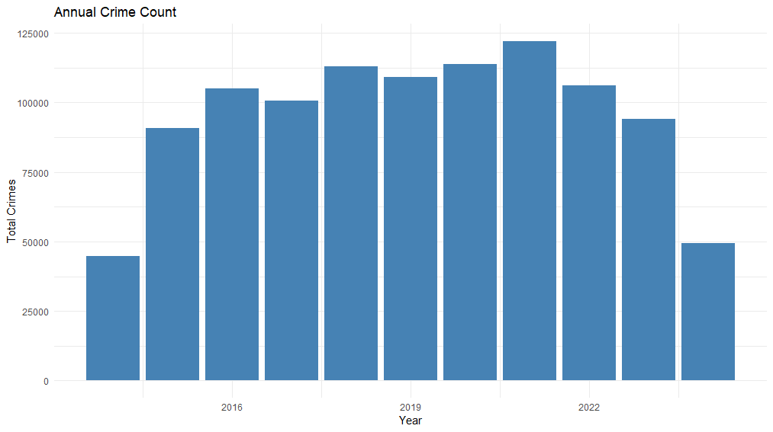
Introduction of the project
- Background

Slide 3
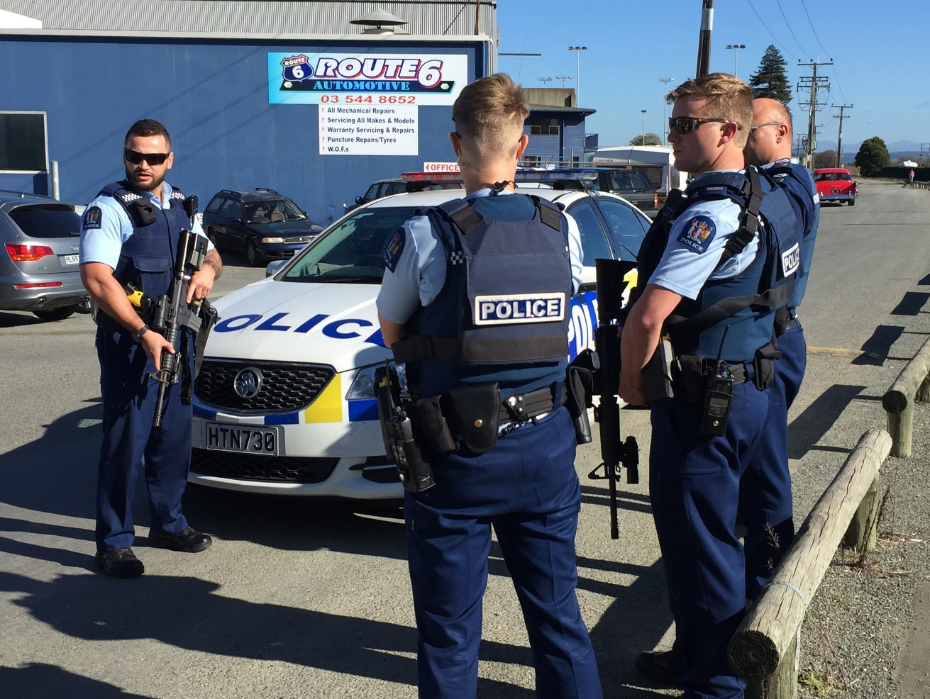
Introduction of the project
- The importance of the project

Slide 4
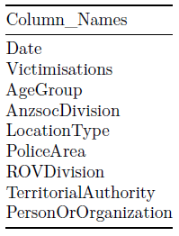
Introduction of the project
- About the data we use
Total data: 1048575 from 2014 to 2024, 5 age groups, 6 AnzsocDivisions,
36 LocationTypes, 39 PoliceAreas, 5 ROVDivisions,
68 TerritorialAuthorities, and 2 Organizational Types.

Slide 5
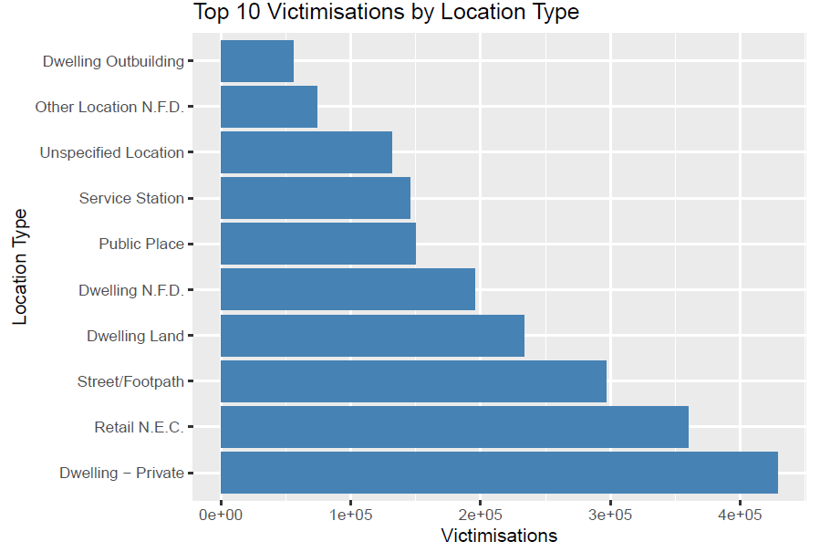
Introduction of the project

Slide 6
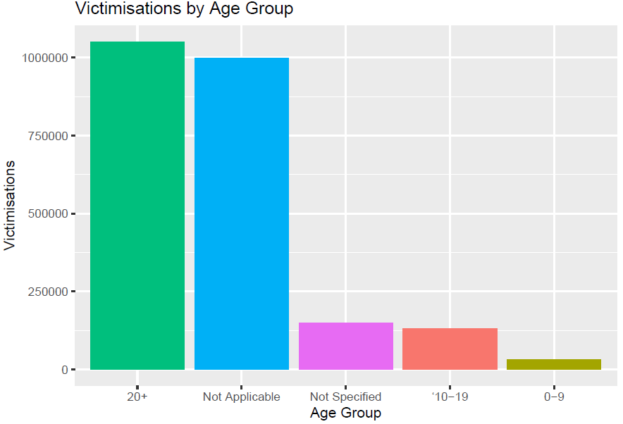
Introduction of the project

Slide 7
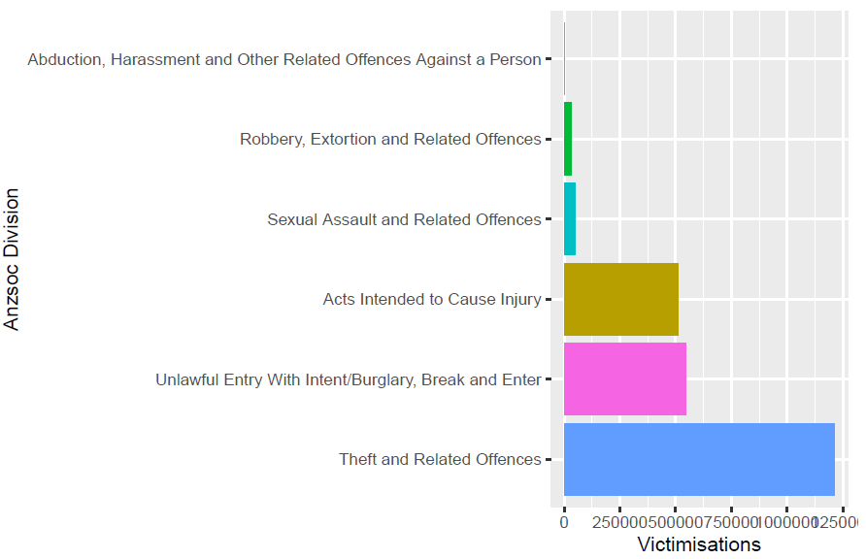
Introduction of the project

Slide 8
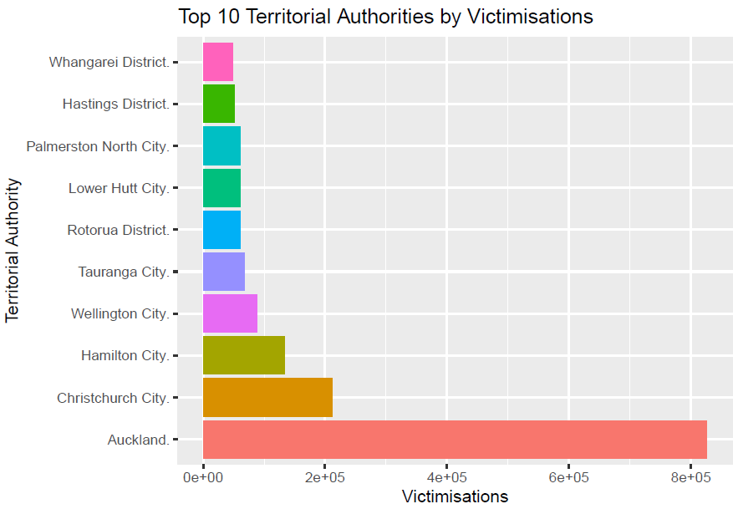
Introduction of the project

Slide 9
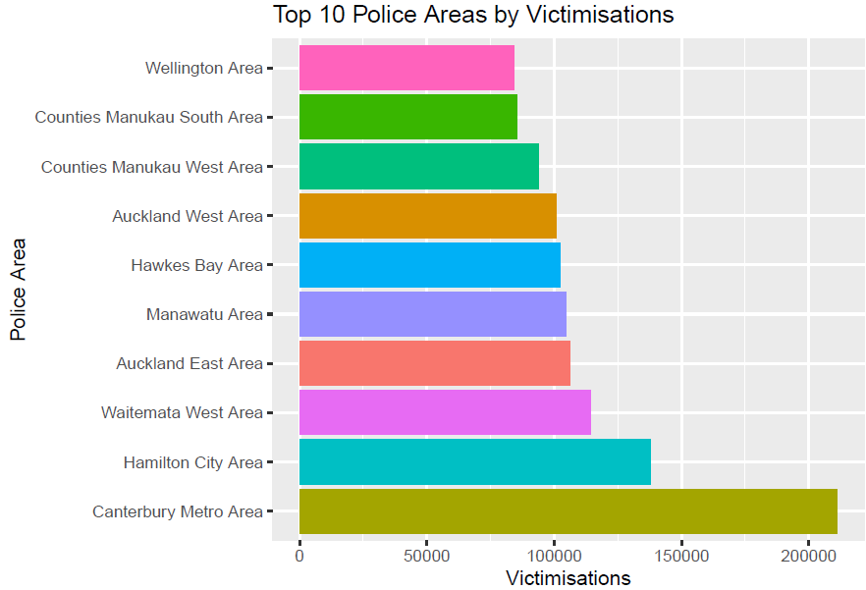
Introduction of the project

Slide 10
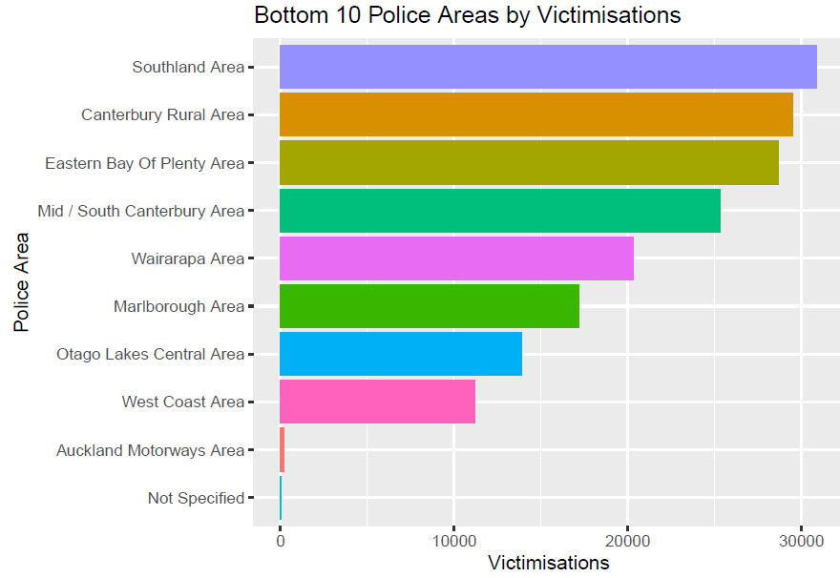
Introduction of the project

Slide 11
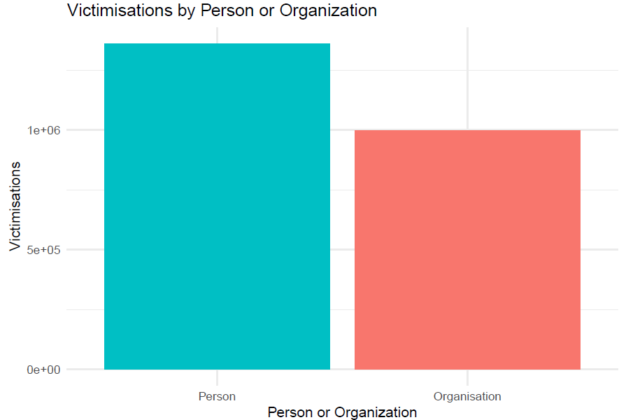
Introduction of the project

Slide 12
Technical Methods and Result Interpretation
Data summary, data pre-processing/processing
- The methods in use and the justifications for using those
methods.
- The results generated by those methods.
- Narrative developed based on the results (storytelling).
- Visualisations developed and aid the analysis results
- Possible comparisons if multiple methods are used to
generate the same solutions.
- Possible performance analysis, e.g. Confusion matrix,
residual analysis...

Slide 13
Conclusions
how well the method(s) solved the problems. Possible 15 enhancement.

