Slide 1
What’s the Problem we are Working on?
How does different pricing models and different user strategies affect the aggregate power of a community?
Power companies have different pricing models such as:
Fixed-pricing
Time of use
Real-time
Users have different energy scheduling strategies such as leveraging external battery and scheduling electrical appliances.
Nagihan Cay
Carolyn P. Forney
Ece Tug
Tokumaru Yahashi

Slide 2
Why is this an Important Problem?
At a certain point, different models and user strategies may affect the peak load.
Could affect price of power at different times.
Peak consumption costs the power company by having more generators to handle the demand.
The users may need to pay more during peak consumption time.
Try to find a balance between the models so that peak load is reduced.

Slide 3
What are Other People’s Approach?
B. Daryanian, R. Bohn, and R. Tobors
Used linear programming formation, but ignored battery inefficacy.
P. Van de ven, N. Hegde, L. Massoulie, and T. Salonidis
Claimed there is a threshold-based stationary cost minimizing policy.
I. Koutspopoulos, V. Hatzi, and L. Tassiulas
Explored the problem from a utility operator’s perspective controlling when the battery may charge.
R. Urgaonkar, B. Urgaonkar, M. Neely, and A. Sivasubramainiam
Looked at using energy storage with market-based electricity prices to lower electricity costs in data center.
Problem: Assumed that future prices and power consumption is not known or predictable.
S. Barker, A. Mishra, D. Irwin, P. Shenoy, and J. Albrecht
SmartCap: Flattening peak electricity demand in smart homes.
A. Mishra, D. Irwin, P. Shenoy, J. Kurose, and T. Zhu
SmartCharge: Cutting electricity bill in smart homes with energy storage.

Slide 4
What is our Proposed Approach?
Explore what will bring to the power line in community where users have different pricing models.
In another words, if users use different pricing model, how will it affect the total consumption of the power line from the community perspective.

Slide 5
What are the Steps to Achieve Our Approach?
Summarize different pricing models/user energy scheduling strategies
Decide what kinds of metrics we want to use in our experiments
Different community size
Different user strategies
Different pricing models:
Fixed Pricing
Time of Use
Real Time Pricing
Decide what kind of technology we want to use to implement our experiment using C++.
Parsing Raw input CSV files
Implement pricing models/user scheduling
Preliminary analysis of experiment results

Slide 6
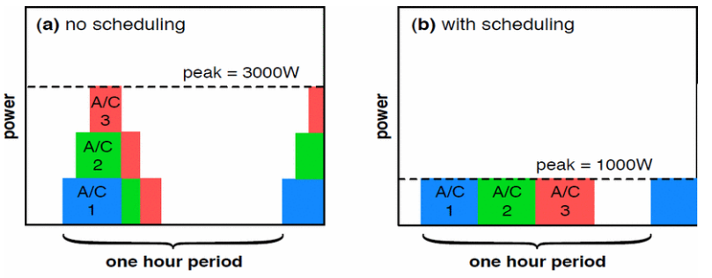
What Have We Done? (Appliance)
Appliances
Based on SmartCap
Pseudo code
Scheduling but not fully completed

Slide 7
What Have We Done? (Battery)
Scaling Distributed Energy Storage for Grid Peak Reduction
Aditya Mishra, David Irwin, Prashant Shenoy, and Ting Zhu
Variable rate pricing provides only a week incentive for distributed energy storage at scale – introduce a surcharge on user’s peak demand so users don’t all shift the demand to lowest-price periods – reversing peak demand times/possibly increasing it.
Also cut down on needed storage space batteries – save money on buying large expensive batteries – previous work (SmartCharge) show that a battery capacity at the average US homes electricity usage costs so much there is not really pricing ROI advantage.
Approach would shift aggregate grid demand such that it was the same or equal to average demand or all the time.
Pseudo Code for Battery Charging
Metrics of the code.
Notes:
show that a battery capacity at the avg US homes electricity usage costs so much there is not really a pricing ROI advantage

Slide 8
What Have We Done? (Battery Continue)
To behave greedily or peak-centric
Consider the inequality below, which compares the benefit of greedily taking advantage of variable rates versus the cost of raising peak demand.
Xmax * Eloss * Chigh * T-Xmx * Clow > XmaxP
In this case, we consider only two rate periods: high and low.
Chigh is the cost per kWh during the high rate period.
Clow is the cost per kWh during the low rate periods.
T is the length of the low-price period.
P is the cost per kWh of usage during the peak hour each day.
Eloss is the energy conversion loss as a percentage stored energy (typically 80% in our test).
Xmax is the maximum charging rate of the battery.
Notes:
Left side is the maximum monetary cost of greedily charging the battery during its low price period and discharging during the high price period and the
Right side is the peak demand surcharge while maximally charging the battery

Slide 9
What Have We Done? (Battery Continue)
Charging and Discharging logic
If the electricity rate is low and demand is below average, then greedily charge at the maximum rate is (1) holds, else charge at a rate to sustain the target average demand.
If the electricity rate is low and demand is above average, then greedily charge at the maximum rate is (1) holds, else discharge at a rate to sustain the target average demand.
If the electricity rate is high and demand is below average, then greedily discharge at the full rate (bounded by the building’s demand) if (1) holds , else do nothing.
If the electricity rate is high and demand is above average, then greedily discharge at the full rate (bounded by the building’s demand) if (1) holds, else discharge at a rate to sustain the target average demand.
Notes:
Toggle between Greedy and Peak-centric, it balances the objective of the greedy algorithm, i.e., to
discharge, and the peak-centric algorithm, i.e., to charge,
by doing nothing.

Slide 10
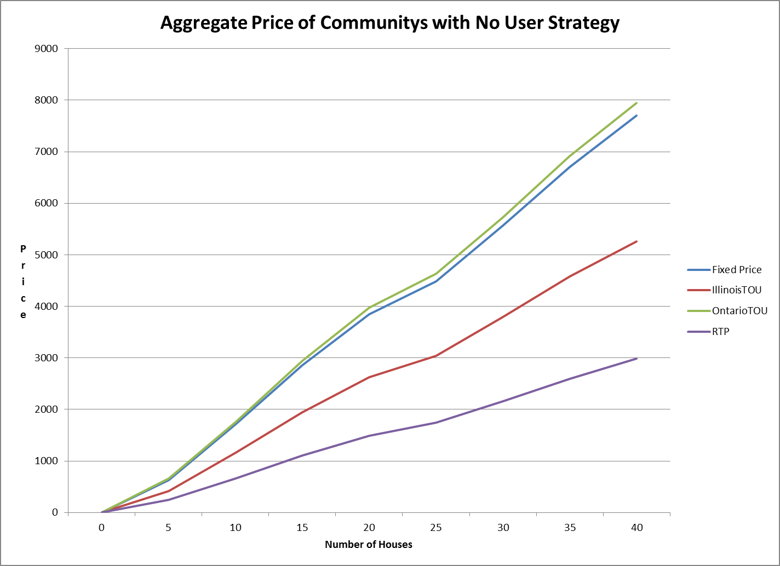
Data Results

Slide 11
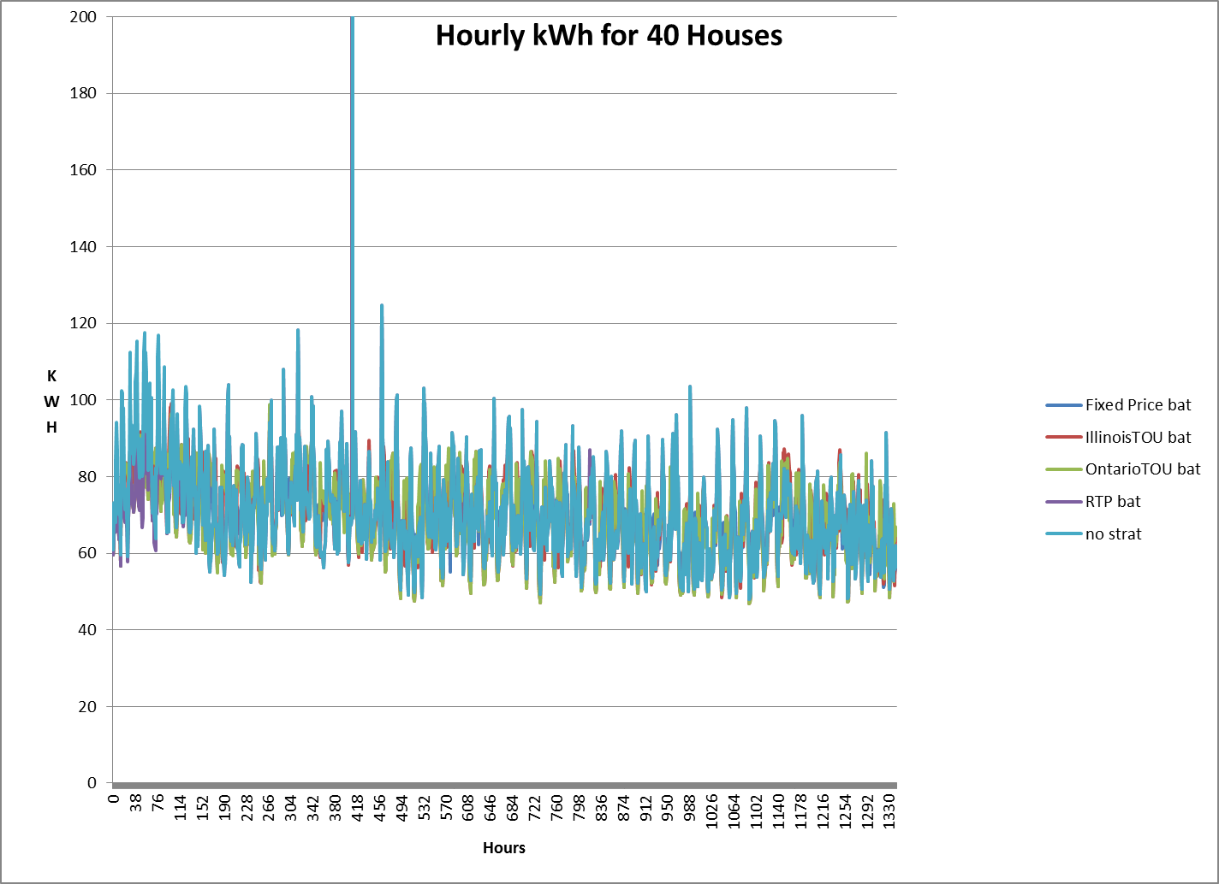
Data Results

Slide 12
Data Results
 | fixed Price | illinois | ontario | RTP
price bat | 7691.11 | 5108.33 | 7745.91 | 2949.05
price at 40 no strategy | 7695.96 | 5253.69 | 7947.06 | 2989.41
number of houses | Aggregate energy cost No Strategy kWh
0 | 0
5 | 7924.44
10 | 21455.1
15 | 35681.1
20 | 48099.8
25 | 56024.2
30 | 69554.9
35 | 83780.8
40 | 96199.5
 | Fixed Price bat | Fixed Price bat | Fixed Price bat | Fixed Price bat | Fixed Price bat
0 | 59.6407 | 60.6407 | 61.6407 | 62.6407 | 63.6407
1 | 63.8432 | 64.8432 | 65.8432 | 66.8432 | 67.8432
2 | 68.2531 | 69.2531 | 70.2531 | 71.2531 | 72.2531
3 | 67.8333 | 68.8333 | 69.8333 | 70.8333 | 71.8333
4 | 67.7867 | 68.7867 | 69.7867 | 70.7867 | 71.7867
5 | 79.1342 | 80.1342 | 81.1342 | 82.1342 | 83.1342
6 | 80.2169 | 81.2169 | 82.2169 | 83.2169 | 84.2169
7 | 78.3094 | 79.3094 | 80.3094 | 81.3094 | 82.3094
8 | 68.7432 | 69.7432 | 70.7432 | 71.7432 | 72.7432
9 | 72.2635 | 73.2635 | 74.2635 | 75.2635 | 76.2635
10 | 69.8599 | 70.8599 | 71.8599 | 72.8599 | 73.8599
 | fixed Price | illinois | ontario | RTP | no strategy
agg energy cost | 96138.9 | 95998.6 | 96039.8 | 95204.3 | 96199.5

Slide 13
What are Our Future Works?
Adjust the SmartCap
Controller for low pricing hours
Combine battery charging and appliances
Compare the predicted real time pricing model with actual pricing
Compare the battery charging and appliances strategies
More thoroughly test the simulation

Slide 14
Demo

Slide 15
Team Members’ Roles
Summarizing Different Pricing Models
Leveraging External Battery
Carolyn P. Forney
Tokumaru Yahashi
Scheduling Electrical Appliances
Nagihan Cay
Ece Tug
Writing Pseudo Code
Leveraging External Battery
Carolyn P. Forney
Tokumaru Yahashi
Scheduling Electrical Appliances
Nagihan Cay
Ece Tug
Implementation and Generating Graphs of the Codes
David Skoada
Simulation
Carolyn P. Forney
Tokumaru Yahashi

Slide 16
References
SmartCap: Flattening Peak Electricity Demand in Smart Homes
S. Barker, A. Mishra, D. Irwin, P. Shenoy, and J. Albrecht
SmartCharge: Cutting the Electricity Bill in Smart Homes with Energy Storage
A. Mishra, D. Irwin, P. Shenoy, J. Kurose, and T. Zhu
Scaling Distributed Energy Storage for Grid Peak Reduction
A. Mishra, D. Irwin, P. Shenoy, J. Kurose, and T. Zhu

Slide 17
Thank You
Any Questions?

