Slide 1
Flights: ON Time? NO Time?
NYC Flights Punctuality Analysis with Tableau Desktop
By Peng Wang
Instructor Mr. Hamid Rajaee
Metro College of Technology
8 July 2021

Slide 2
Project Scope
Year
Source Dataset
Problem statement
2013
330K Records of Flights Details
19 Features (Original)
Business needs to know which Airline carrier has the best punctual performance and which one is the worst.

Slide 3
Project Procedure
CSV Source Data
Tableau Prep
Tableau Desktop
Flights.csv
Review and Understand Raw Data
Flow_Flights.tfl
Remove, Clear and Add New Features
Desktop_Flights.twb
Analysis and Visualization

Slide 4
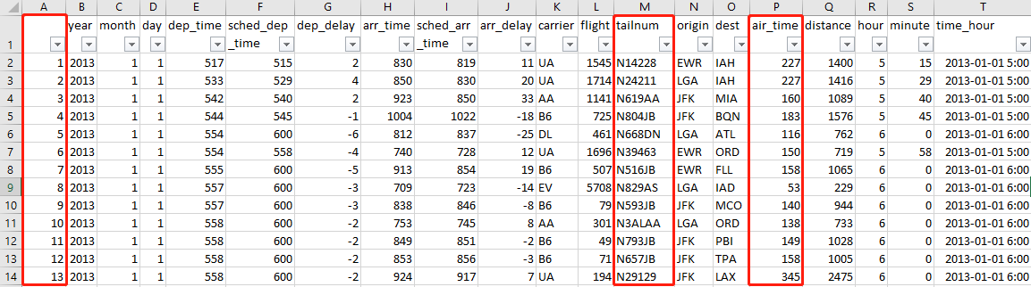
Raw Data

Slide 5
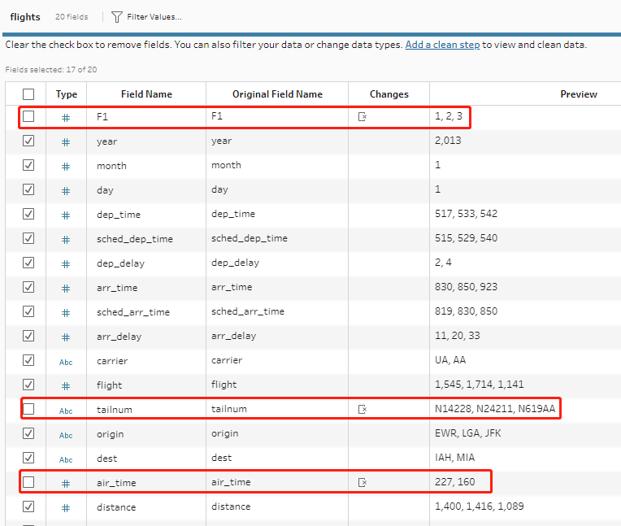
Tableau Prep: Remove Fields

Slide 6
Add New Features
Weekday
Departure Status
Arrival Status
Make Current Data Meaningful

Slide 7
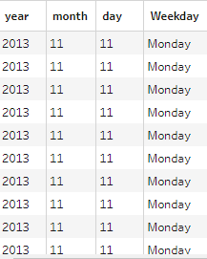
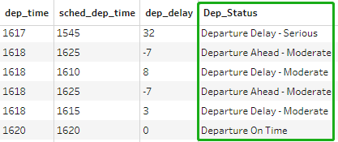
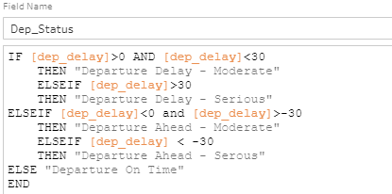

Create Calculated Fields

Slide 8
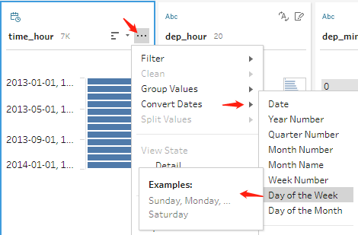
Another Way to Add Weekday

Slide 9
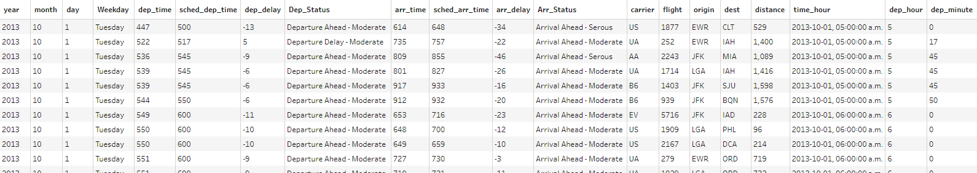
Dataset with Additional Features

