Slide 1
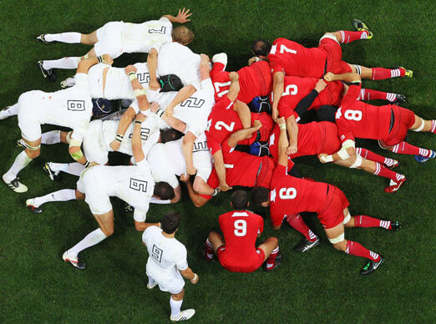
Scrum
Jacob Greenland

Slide 2
What is Scrum?
An agile framework for completing software development projects.
“A flexible development strategy where a development team works together to achieve a common goal.”
One of it’s key principle is to allow the customer to change their mind during the development process.

Slide 3
Origins
Conceived by Jeff Sutherland and Ken Schwaber in the early 90s.
The name refers to a rugby scrum, and the essence of teamwork required in both Rugby and Development.
Teams require autonomy to achieve excellence

Slide 4
What roles are there?
One Product Owner
One Scrum Manager
Development Team

Slide 5
Product Owner
Represents the customer.
Handles the business side of the project, and liaises with the stakeholders.
Doesn’t interfere with the technical side of the project.
The ability to convey priorities between the stakeholders and the scrum team is vital.

Slide 6
Scrum Manager
Is the buffer between the development team and any distracting influences.
Ensures that the usual Scrum processes are followed.
Ensures that the team are all working towards the same end goal.

Slide 7
Development Team
Responsible for delivering potentially shippable increments within each Sprint.
They handle design, development and testing of a Sprint.
They are self-organised, and have the final say on how the Sprint is implemented.

Slide 8
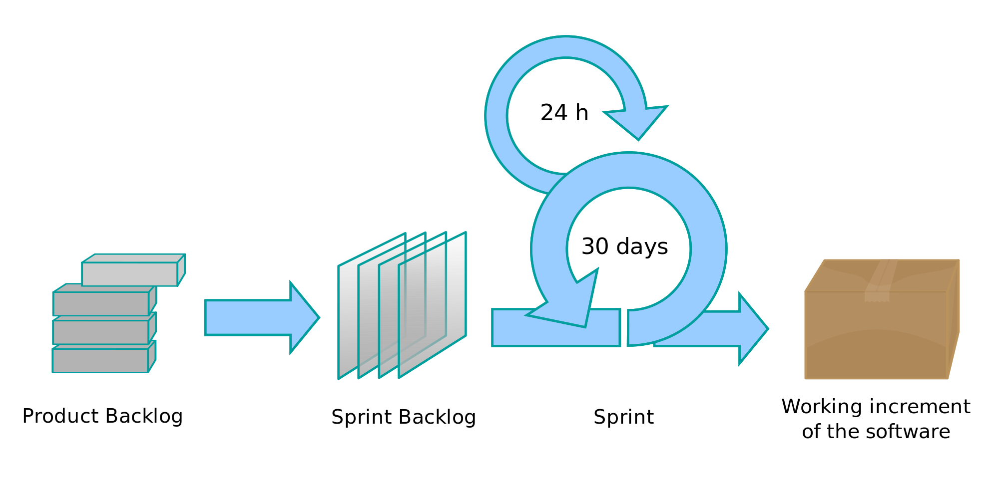
The Scrum Model

Slide 9
Product Backlog
The product backlog is a list of requirements that the team must complete for the project to be considered a success.
This list contains features, bug fixes and other requirements
The list is ordered in terms of risk, or value to the overall product.

Slide 10
Sprint Backlog
List of features that are taken from the Product Backlog, that can be achieved in the sprint.
These features are determined during a Sprint Meeting at the start of each Sprint.

Slide 11
Sprints
Projects progress via a series of ‘Sprints’.
A sprint is a short development period (usually two to four weeks) where a team works on the Sprint Backlog.
The short length is designed to make sure the goals are achievable and realistic.
Once a Sprint finishes, the next one begins immediately.

Slide 12
Stand-ups
Progress is tracked by daily or stand-ups.
These stand ups include the Scrum Master and Development Team.
Usually last 15 minutes in total, and are scheduled for the same time, and place each day.
Keeps the team synchronised with the progress of others.

Slide 13
Stand-ups Cont.
Each member of the development team stands up, and informs the group:
What they did yesterday.
What they’ll do today.
What obstacles are affecting progress.
These stand-ups are beneficial for not only the Scrum Master, but the rest of the team too.

Slide 14
Advantages
The incremental nature of Scrum means that a product is deliverable while the project is still ongoing.
Testing is performed with each iteration, and not in bulk at the end of the project.
Changes can be made to the requirements at any point, without causing problems.

Slide 15
Disadvantages
Not easy to maintain if the development team is spread across a country or continent.
If communication or planning isn’t concise, the whole project can be jeopardised.
‘Feature Creep’

Slide 16
Any Questions?

